Slide 1
An In-depth Response to Security at Community Centers
Threat Reduction Best Practices
Jeremy Wade, TCRMF Risk Services Manager
Richard Wigzell, TCRMF Risk Management and Program Analyst
Notes:
Presenter Notes:
Notes pages will have content information for consistency, but this should also be your time to add to the content.
Share stories and experience to make the introduction your own.
Facilitation instruction is italicized.
Content information:
Content information will be provided with NO italics.

Slide 2
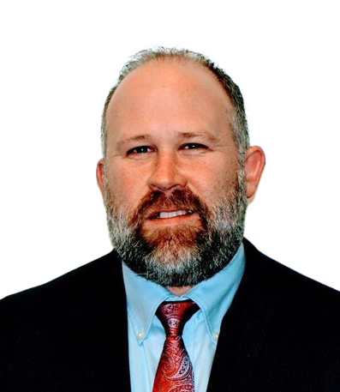
Today’s Presenters
Jeremy Wade
TCRMF Risk Services Manager
Richard Wigzell
TCRMF Risk Management and Program Analyst

Slide 3
Participants and Program
Panelists
Mike Davis, Executive Director, Nueces Center for Mental Health and Intellectual Disabilities,
Pam Gutierrez, Executive Director, Denton County MHMR Center,
Eunice Davis, Director of Risk Management, The Harris Center
Panel Discussion
Moderator - Catherine “Cat” Hood, Training Consultant, TCRMF, welcomes audience questions and comments.
Presentation
Available by download at Conference website

Slide 4
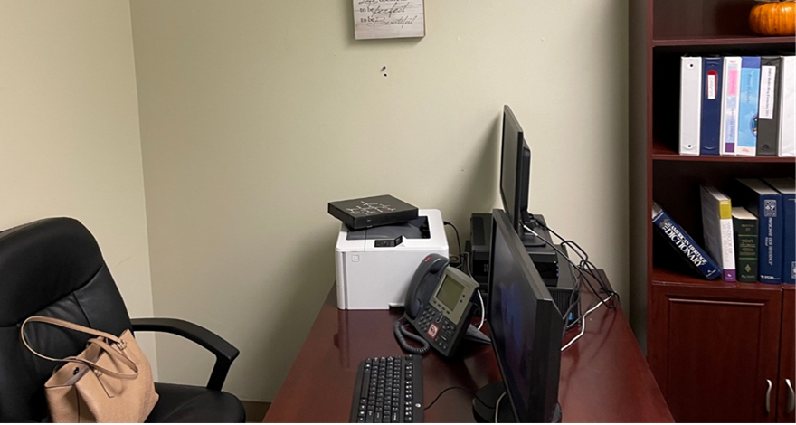

Slide 5
Agenda
Presentation
Warning Signs
Social media and Community Awareness
What Can Centers Do?
Active Assailant Training Drills
History of Violence
Panel
Share their experiences from Workplace Violence incidents
Answer questions from the moderator
Answer questions from the audience
Notes:
Here is a list of what we will discuss today followed up by a panel discussion Q&A
As we go through this presentation, please know that resources are available to you through:
TCRMF Loss Control with their Active Shooter Response Training and Active Shooter Drill assistance
TCRMF Risk Management Consulting’s Security Assessments
Assistance from local Law Enforcement agencies
FBI publications
And experiences that other Community Centers’ experiences some of which you will hear about today with our panel

Slide 6
Warning Signs

Slide 7
Warning Signs of Potential Violence
Changes in behavior
Threatening behavior
Uncooperative or noncompliant
Personal hygiene
Withdrawn/depressed
“You’re safe”
Empathy for previous active shooters
Talks of “putting things in order”
Notes:
Changes in Behavior
Key indicator
Threatening Behavior
History of violence should not be ignored
Bullying or threats of committing violence
Uncooperative with supervisors; noncompliant with policy
Decrease in personal hygiene
Withdrawn/depressed; begins avoiding co-workers
Talks of “putting things in order”
Odd comments like “You’re safe.”
Empathy for previous active shooters

Slide 8
School Violence
is known ahead of time!
US Secret Service
Notes:
75% of school violence is known ahead of time US Secret Service
“Most people who are likely to commit violence rarely act without signals.” Crisis Leadership Now – L. Barton
Majority of incidents at medical facilities are targeted
The incident is not random
Pay attention to threats and aggressive behavior
Know what to watch for
Warning signs
Develop a critical eye
Identify Run and Hide locations
Identify “weapons” to fight with

Slide 9
Warning Signs of Potential Violence
“Most people who are likely to commit violence rarely act without signals.”
Crisis Leadership Now – L. Barton
Notes:
“Most people who are likely to commit violence rarely act without signals.” Crisis Leadership Now – L. Barton
Majority of incidents at medical facilities are targeted
The incident is not random
Pay attention to threats and aggressive behavior
Know what to watch for
Warning signs
Develop a critical eye
Identify Run and Hide locations
Identify “weapons” to fight with

Slide 10
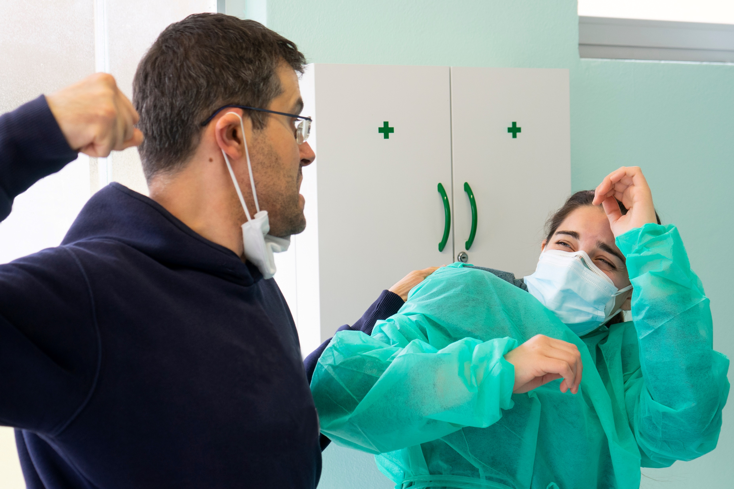
Warning Signs of Potential Violence
Majority of incidents at medical facilities are targeted
Not random
Pay attention to threats and aggressive behavior
Notes:
Majority of incidents at medical facilities are targeted
The incident is not random
Pay attention to threats and aggressive behavior

Slide 11
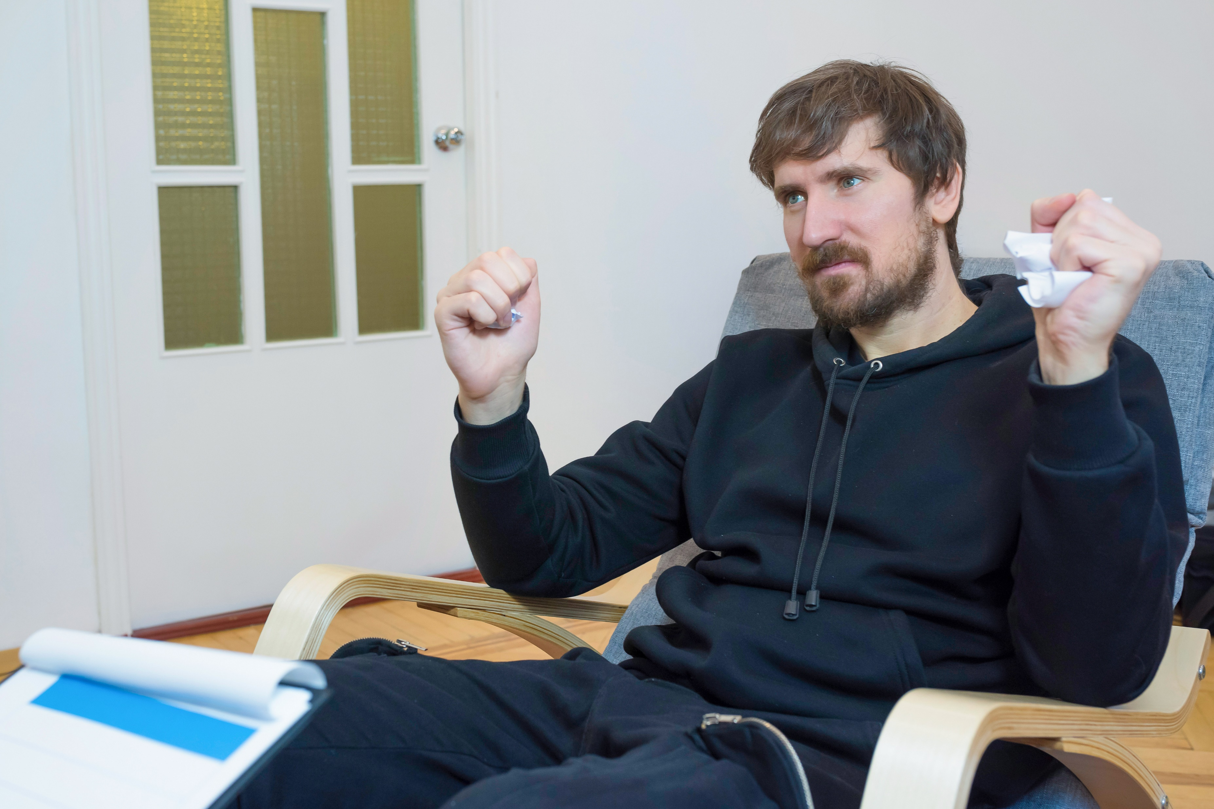
Know What Signs to Watch For
Warning Signs
Notes:
Know what to watch for
Warning signs

Slide 12
Develop a Critical Eye
Identify Run and Hide locations
Identify “weapons” to fight with
Notes:
Develop a critical eye
Identify Run and Hide locations
Identify “weapons” to fight with

Slide 13
Security at Community Centers
Building Access
Police Response
Point of Contact - Lobby
Don’t Underestimate Threat
History of Violence
Monitor Social Media
Notes:
Learn from previous incidents
Access into the building
Ensure locked and secured doors are functioning as designed
Employees creating an unexpected breach
Create an ability to restrict access throughout the building
Police response
Protect your first points of contact - Lobbies
Do not underestimate threats
Consumers
Terminated employees
The public
Do not overlook a history of violence
Social media monitoring

Slide 14
Social Media Monitoring

Slide 15
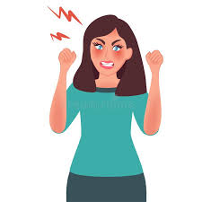
Why monitor?
People rarely act without signals
Threats can come from anyone
Identify threats and elevate to:
HR
Executive Team
Police
Notes:
“Most people who are likely to commit violence rarely act without signals.” Crisis Leadership Now – L. Barton
Do not underestimate threats
Consumers
Terminated employees
The public
Monitor threats made by anyone and elevate
HR
Executive Team
Police, when necessary

Slide 16
Five Phases of an Active Shooter
Fantasy or Obsession
Plan
Prepare
Practice
Implement
They will set off “signals” in the first four phases that might appear in social media:
Talk about causing harm to someone
Brag or show pictures of guns they have
Brag about a “kill list”
Take video while target practicing

Slide 17
What to Monitor
Facebook, Twitter, Instagram, Linked in, Nextdoor, Snapchat, Tiktok, YouTube
Discord (chat with members, topical, document release – Jack Teixeira)
Twitch- content creation platform, others old people don’t know about (me)
Enlist volunteers to monitor local indicators, warning signs, rumors, etc.
Handle with care
Notes:
Facebook, Twitter, Instagram, Linked in, Nextdoor, Snapchat, Tiktok, YouTube
Discord (chat with members, topical, document release – Jack Teixeira)
Twitch- content creation platform, others old people don’t know about (me)
Enlist volunteers to monitor local indicators, warning signs, rumors, etc.
Handle with care

Slide 18
History of Violence

Slide 19
History of Violence
Review your files
Document incidents of violence, aggression or bullying in your client files
Flag the file prominently so new clinicians or case managers are aware of the history
Train new staff about history of violence
Review clients with history and behavior annually with case manager and senior mental health staff

Slide 20
History of Violence
Immediately review available records when
Released from jail
Released from state hospital or other mental health hospital
Your own client files that may have incidents buried in the past, (not flagged)
Parole and probation officers’ records or memories
Public records or press reports

Slide 21
Security Checklist

Slide 22
Key Elements
All doors with card access
Lobby management system in place
Camera coverage of lobby, approaches to entrance, areas around the building and parking lots
Ability to see and respond to camera feeds in real time

Slide 23
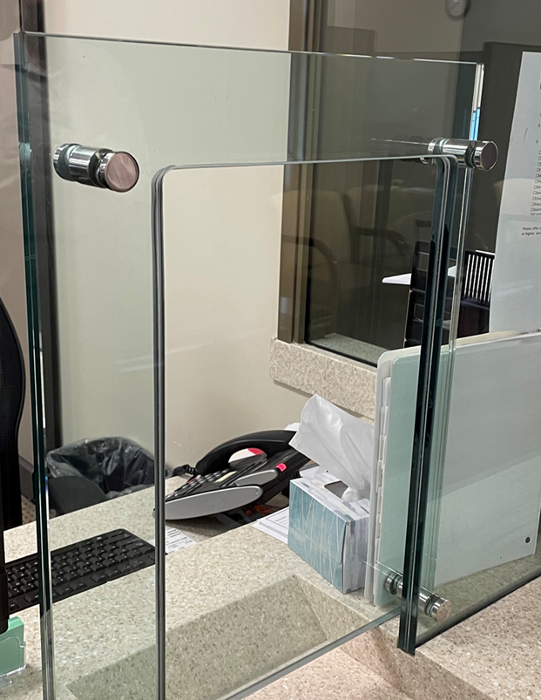
In the Lobby
Measures to increase lobby comfort and reduce frustration
Lobby oversight by mental health professional
Panic buttons
Security guards or off duty law enforcement
Lobby Ambassador
Effective barriers to protect lobby staff

Slide 24
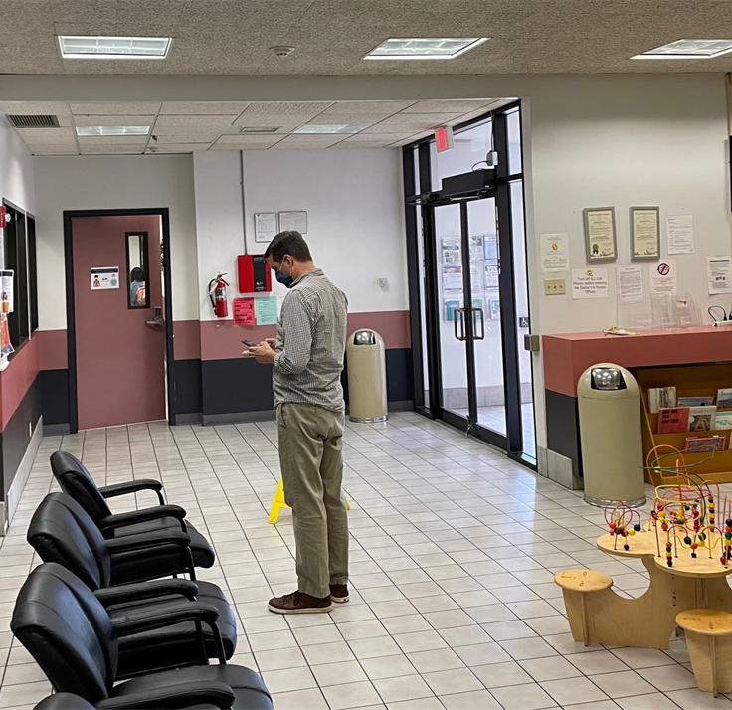
A More Comfortable Lobby
Comfortable chairs
Amusements for the kids
TV
Vending machines
Access to restrooms
Free water
Lobby ambassador to help answer questions, check on appointment times, observe for signs of frustration or anger
Response plan for lobby disturbances

Slide 25
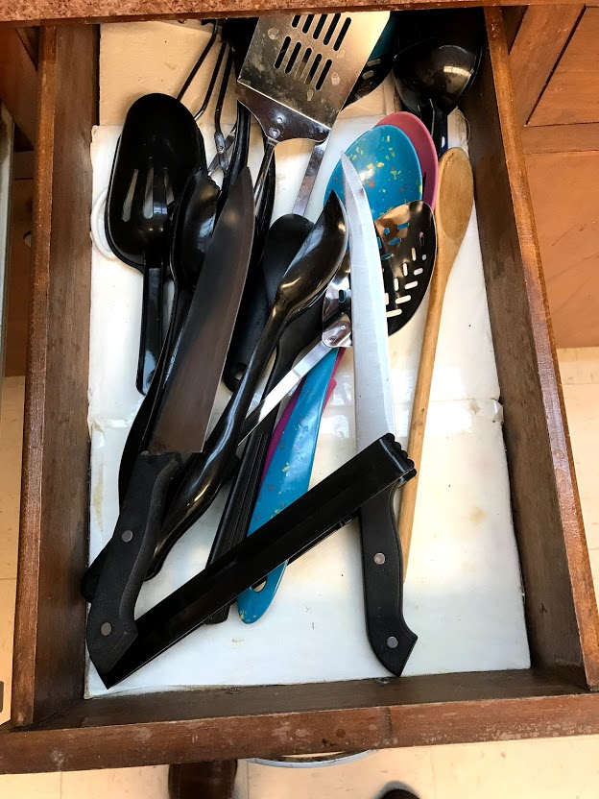
Past the Lobby
Client escort to appointment and back to the lobby afterwards
Visitor sign-in with some kind of visitor identification
Entrapment risks in offices
Janitor and utility closet doors locked
Office doors lockable and office windows have blinds
No sharp knives in break rooms
Severe weather shelters identified
Evacuation diagrams simple, easy to read and not posted on the wall too high up
Notes:
Client escort to appointment and back to the lobby afterwards
Visitor sign-in with some kind of visitor identification
Potential for entrapment in offices
Janitor and utility closet doors locked
Office doors lockable and office windows have blinds
No sharp knives in break room
Social media monitoring by designated staff member(s)

Slide 26
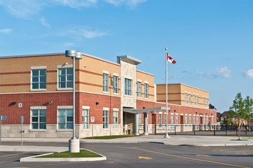
Community Outreach
Hotline and 888
Speakers for community groups like Rotary, Lions, Chamber of Commerce, churches
Collaborations with schools, veterans’ groups, other social service organizations
More and closer interaction with law enforcement
Annual fundraising/center awareness event
5k race, chili cook-off, presence at other community events like arts & crafts fairs, etc.

Slide 27
What Can Centers Do?

Slide 28
Emergency Action Plan
Implement an Emergency Action Plan for Workplace Violence
Notes:
Implement an Emergency Action Plan for Workplace Violence
Conduct your own vulnerability assessments
Part of the EAP
Assistance from TCRMF Risk Management Consulting
Identify your weak points regarding security
Access points in and out of your facilities
Discourage propping open of doors
Emergency code delivery system(s)
Points of egress
Mass text alerts

Slide 29
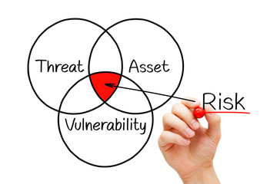
Vulnerability Assessment
Conduct vulnerability assessments
Part of the EAP
Assistance from TCRMF Risk Management Consulting
Identify your weak points regarding security
Emergency code delivery system(s)
Mass text alerts
Active shooter shelters identified
Lockable with blinds
Points of egress
Notes:
Implement an Emergency Action Plan for Workplace Violence
Conduct your own vulnerability assessments
Part of the EAP
Assistance from TCRMF Risk Management Consulting
Identify your weak points regarding security
Access points in and out of your facilities
Discourage propping open of doors
Emergency code delivery system(s)
Points of egress
Mass text alerts

Slide 30
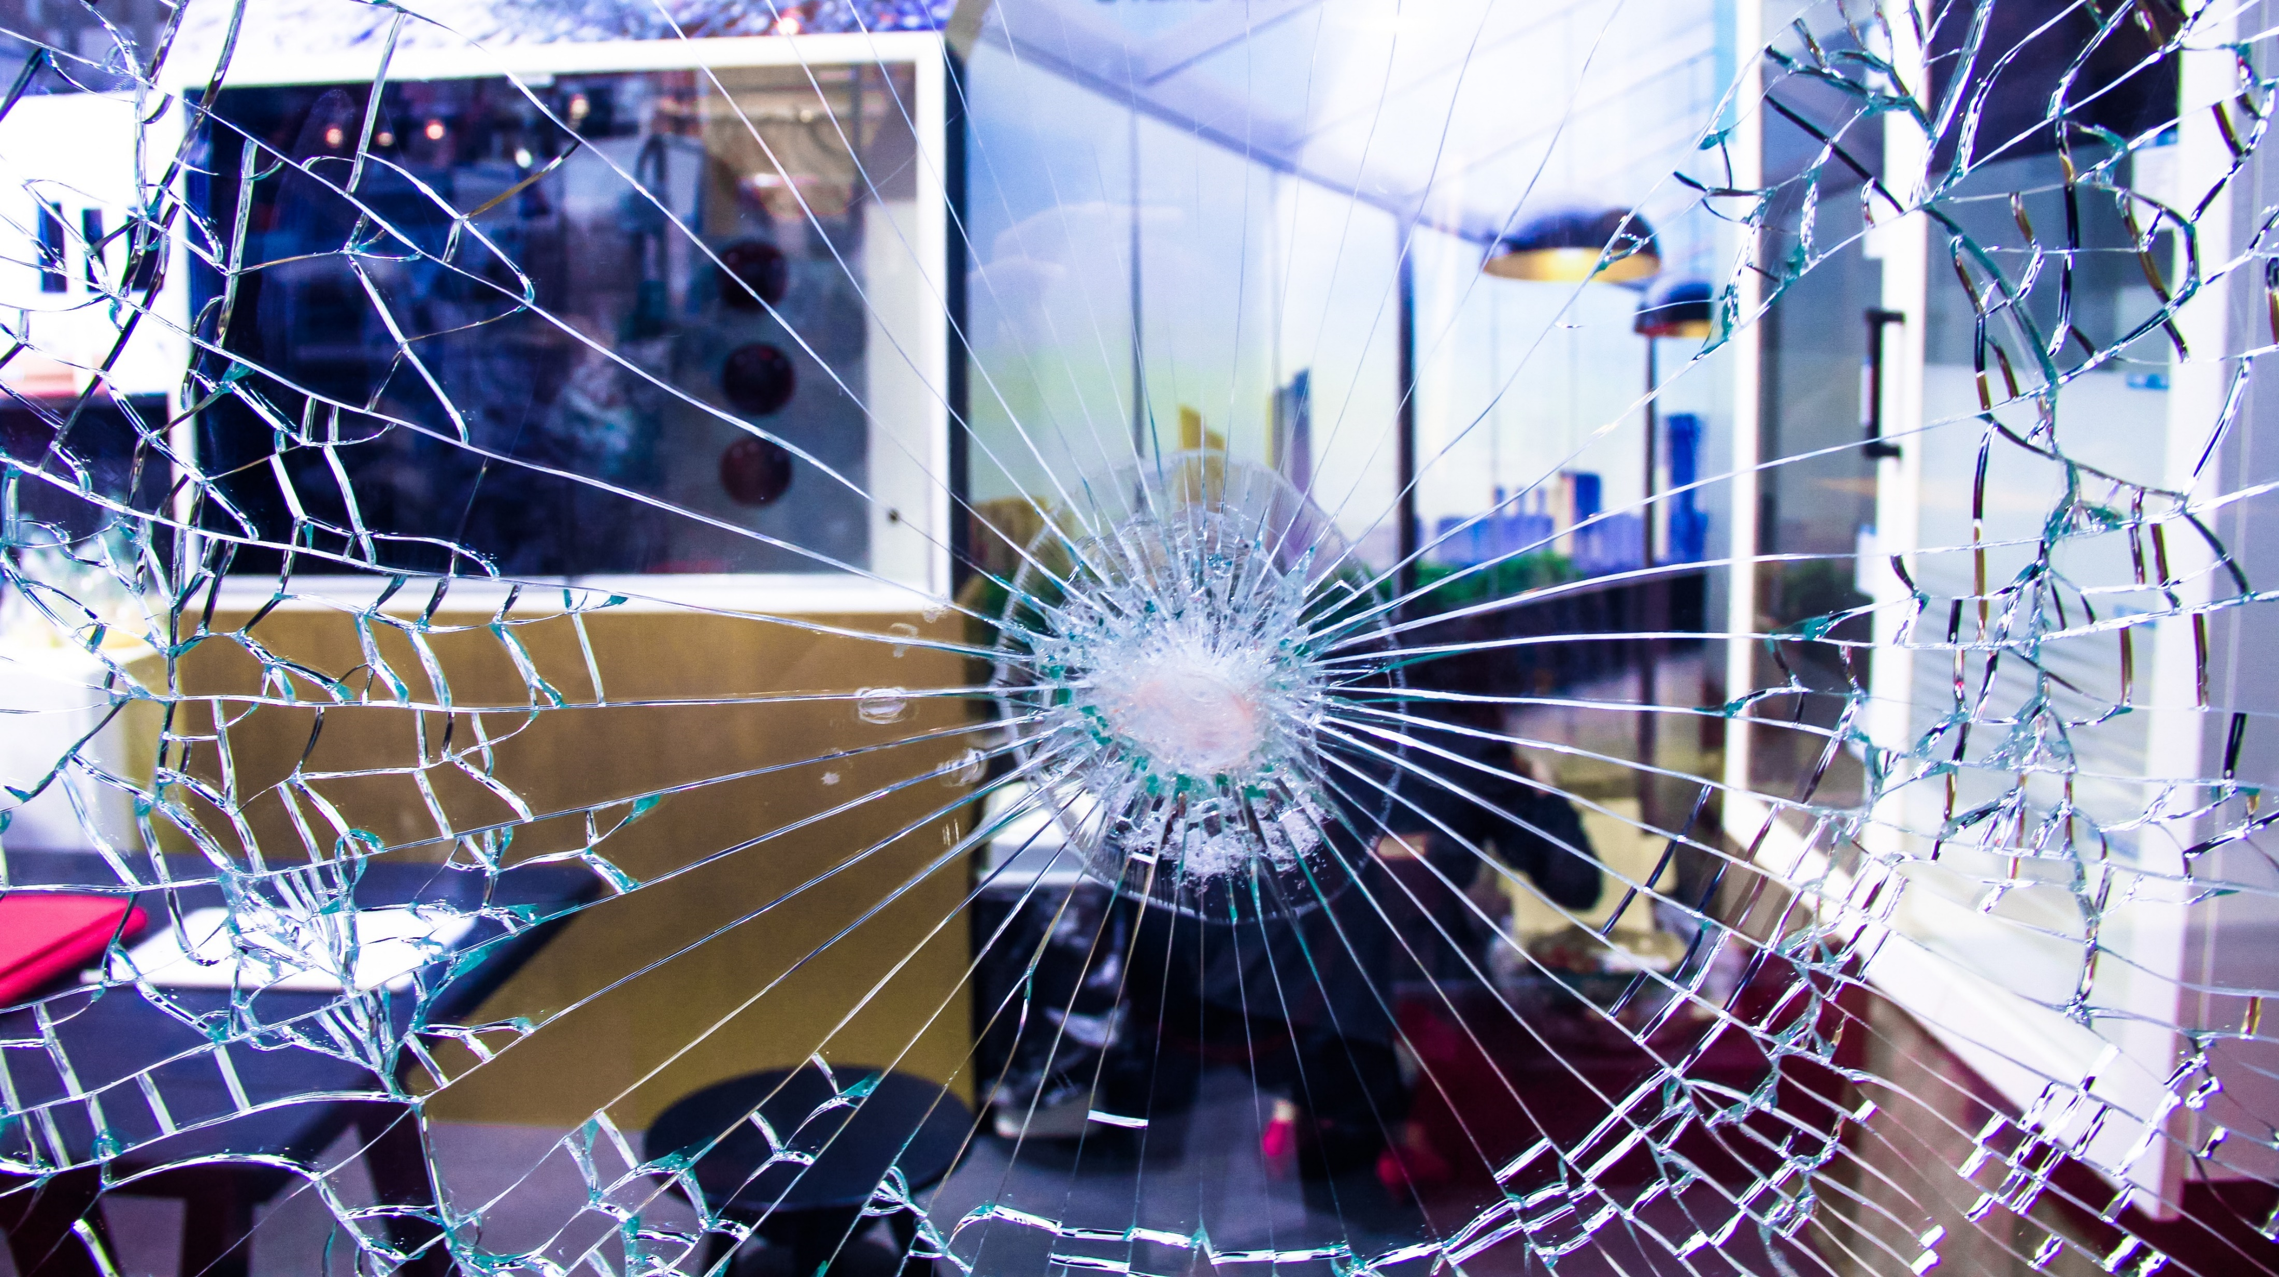
First Point of Contact
Protect it!
Glass
Escape door
Ability to Restrict Access
Notes:
First point of contact
Find a way to protect
Glass
Escape door
Ability to restrict access

Slide 31
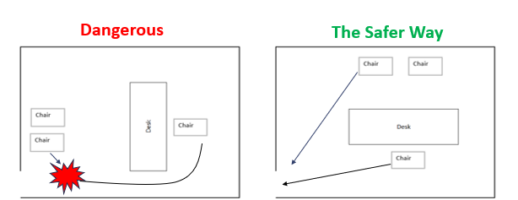
Change Your Office Layout
Give yourself first access to the door
Consider meetings in another office
Your safety > IT and wiring
HR and Supervisor offices
Notes:
With the doctor shooting incident, his office was set up like “Dangerous” above
He had to get around his desk and run past the attacker just to get out of his office
This layout traps the employee in the office, whereas the attacker only has to take one step to block the door
Completely flipping the “Dangerous” layout and putting the client inside the office can also have a negative effect because it can cause the client’s anxiety to escalate due to the feeling of being trapped
The session will not be productive
The “Safer Way” layout
Gives the employee the quickest route to the door (think Hide in an active shooter incident, too)
Keeps the client from feeling trapped and helps maintain anxiety at a low level
Should also be used by supervisors and HR personnel (in any work environment) who conduct evaluations, coachings and terminations in their office.
If you cannot set up your office the “Safer Way”, conduct meetings in another office that can be set up in that manner
Arrange your office to give yourself first access to the door
If the office can’t be changed, see your clients in another office or conference room where you have first access to the door
IT and wiring requirements should not take priority over your safety
Offices where disciplinary or termination activities happen should also be arranged to prevent entrapment

Slide 32
Review and Assess
Talk to Police Department
Social Media Monitoring
Schedule review on consumers with history of violence
Notes:
Talk to your local police department
Vulnerability assessments
Assist with drills and training
Social Media Monitoring
Consumers with a history of violence
Scheduled review

Slide 33
Active Shooter Training Drills

Slide 34
Plan Ahead
Plan ahead
Schedule a day and time window
Inform everyone
Staff
Consumers
Keep appointment as planned
Offer teleconference or reschedule
Notes:
Plan ahead
Schedule a day and time window
Inform everyone that the drill is going to happen
Staff
Consumers
Keep appointment as planned
Offer teleconference or reschedule
Use the Run or Hide techniques learned in TCRMF Active Shooter Defense Training
Can set up for Fight but do not physically harm the “shooter”

Slide 35
Run. Hide. Fight.
Use the Run or Hide techniques learned in “TCRMF Active Shooter Response Training”
Can set up for Fight but do not physically harm the “shooter”
Notes:
Use the Run or Hide techniques learned in TCRMF Active Shooter Defense Training
Can set up for Fight but do not physically harm the “shooter”

Slide 36
Everyone Participates!
Keep consumers seated in the lobby
Take down “In Session” signs five minutes before start
During drill
Place sign or hang tag
Simulates Hide
ECI and IDD evacuation
Is it possible?
Better to fortify
Notes:
Have everyone participate
Keep consumers seated in the lobby
Take down “In Session” signs five minutes before start
During drill
Place sign or hang tag
Simulates Hide
ECI and IDD evacuation
Is it possible?
Best practice to fortify that room or area, if we cannot…Run

Slide 37
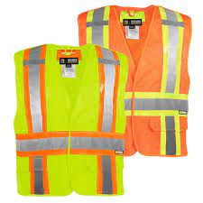
Identify Shooter
Person playing the role of the “shooter”
Wear a high visibility vest or something clearly signifying an Active Shooter drill
Check all doors
If locked, move on
If sign or hang tag on door, move on
If unlocked, open and count the number of occupants out loud
Notes:
The person playing the role of the “shooter”
The employee playing the role of the active shooter should wear a high visibility vest or something signifying his/her role.
Check doors
If locked, move on
If sign or hang tag, move on
If unlocked, open and count out casualties

Slide 38
Assistant One – Make Noise
Assistant 2 – Track Casualties
Two metal trashcan lids
Shout out as loud as you can
Use a bullhorn
Do not use any gunshot sounds
Loud enough for others to hear at a distance
Track “casualties”
Note anything that was done correctly but went wrong
Confirmed locked office door that was opened by the “shooter”
Secured access door that was opened without a keycard/code/key
Could not hear the alert in certain areas of the building
1
2
Notes:
Additional persons walking with the “shooter”
Use something that will make a very loud noise (not gun shot sounds)
Two metal trashcan lids slammed together
Taking a stick/bat to a metal trashcan
It must be loud enough for people to hear
Track the number of “casualties”
Anyone you see
The number the first few drills might alarm you
Note anything that was done correctly but went wrong
Locked door not functioning properly
Could not hear the alert in certain areas or rooms/offices
Track the duration of the drill
Track non-participants

Slide 39
Training Drill Best Practices
Do!
Change starting point with each drill
Conduct formal review upon completion
Do Not!
DO NOT COME IN WITH GUNS! Even fake!
Don’t conduct unannounced
Don’t wear a mask or any other threatening clothing
Don’t use fireworks or smoke bombs
Notes:
DO NOT!!!!!!
Don’t come in with guns. Fake or not, I do not care!
It’s not worth the trauma it may cause
This includes paintball or air soft guns
Visitor in the lobby may be openly carrying a firearm and not ask questions
Now we have a fatality because of a drill
Don’t conduct the drill unannounced
Don’t wear masks or tactical gear
Don’t use fireworks or smoke bombs (the firework kind)

Slide 40
Our Panel

Slide 41
Our Panel
Mike Davis
Executive Director, Nueces Center for Metal Health and Intellectual Disabilities
Pam Gutierrez
Executive Director, Denton County MHMR Center
Eunice Davis
Director of Risk Management Services, The Harris Center
Catherine Hood
Training and Development Consultant, TCRMF

Slide 42
Panel Questions & Answers
Questions from the Moderator

Slide 43
Panel Questions & Answers
Questions from the Audience

Slide 44
Thank you!
Jeremy Wade
Risk Services Manager
jeremy.wade@sedgwick.com
Richard Wigzell
Risk Management Consultant
richard.wigzell@sedgwick.com

