Slide 1

EMPLOYEE ENGAGEMENT
2.0 sustaining employee morale during challenging times
CRESLYN R. FOSTER ,ABD,MBA,HRPM
CHIEF HR OFFICER

Slide 2
SPINDLETOP CENTER
FORMED ON SEPT. 1, 2000
LOCAL MENTAL HEALTH AUTHORITY
SERVES GOLDEN TRIANGLE
WIDE SERVICE ARRAY
MENTAL HEALTH DEPUTY PROGRAM

Slide 3


HOW WAS YOUR WEEKEND?

Slide 4

INITIAL RESPONSE

Slide 5
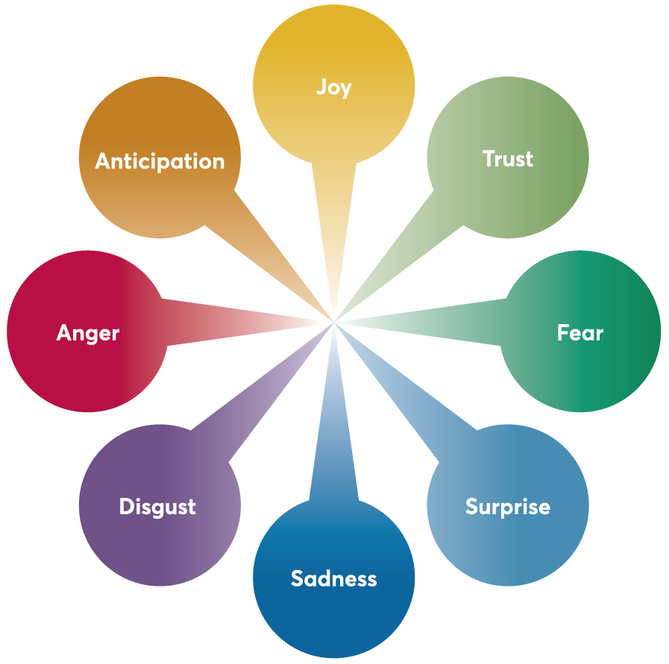
RANGE OF EMOTIONS

Slide 6
“Decentralization vs. Centralization…which Leadeship Model will sustain our organizational culture during challenging times? ”
-

Slide 7

ASSESSMENT PROCESS
Review existing HR processes
Are there processes that need to be transformed?
Who will be impacted?
Can technology support the need?

Slide 8

DISCOVERY PROCESS
Why are employees leaving the organization?
What can we do better?
What did we implement to sustain optimal employee morale?

Slide 9
paradigm shift
Tropical Storm Imelda 2019
Winter Storm Uri 2021
NEW NORMAL 2021 AND BEYOND
COVID Pandemic 2020
Hurricane Harvey 2017

Slide 10
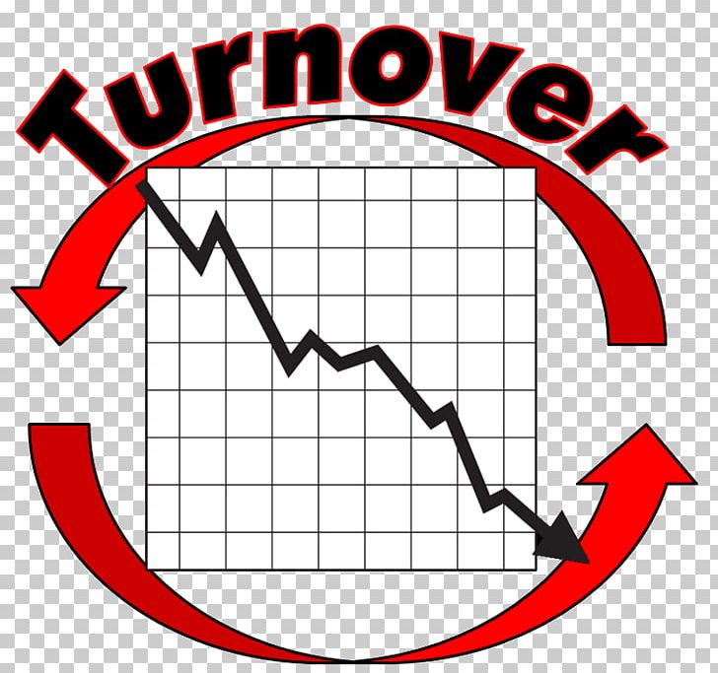
TURNOVER TRENDS
WHY ARE EMPLOYEES LEAVING?

Slide 11



MOST COMMON RESPONSES

Slide 12
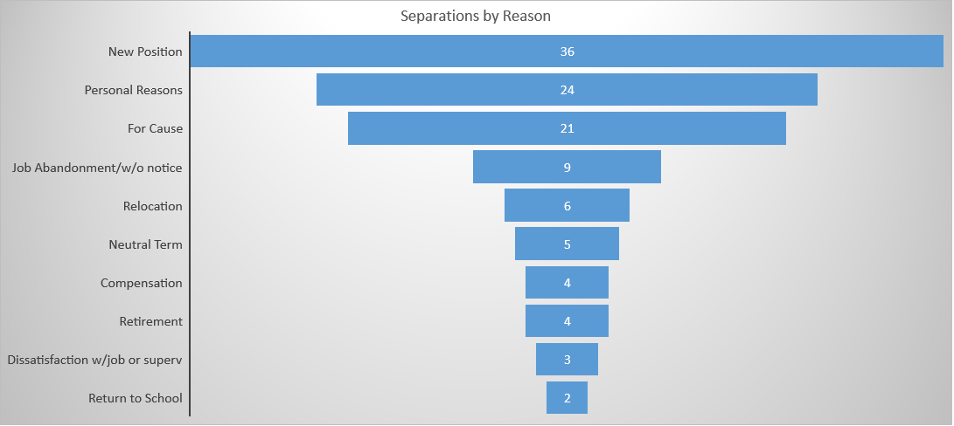
SEPARATION BY REASON

Slide 13
SEPARATION BY POSITION TYPE

Slide 14



INFORMAL FEEDBACK

Slide 15

WATERCOOLER DATA

Slide 16

WHAT CAN WE DO BETTER?

Slide 17
What is our leadership model?
Centralization
Decentralization

Slide 18
LET’S EXPLORE
DECENTRALIZED
CENTRALIZED
SEGMENTED PROCESSES
NONCOMPLIANCE WITH POLICIES
UNKNOWN EMPLOYEE EXPERIENCE
HIGHER OPERATING COSTS
STREAMLINED PROCESSES
CONSISTENCY WITH POLICIES
ENHANCED EMPLOYEE EXPERIENCE
LOWER OPERATING COSTS

Slide 19
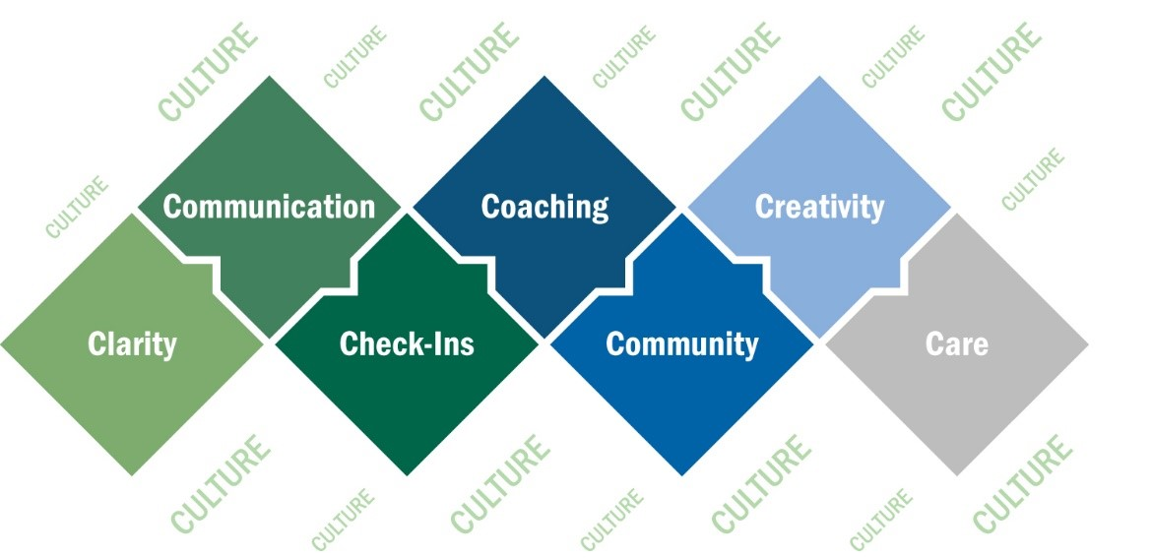
Pivot time – HYBRID MODEL

Slide 20

EMPLOYEE
ENGAGEMENT
WHAT DID WE IMPLEMENT?

Slide 21

Employee engagement
NATIONAL ADMIN DAY
NATIONAL HOUSEKEEPING DAY
NATIONAL NURSE DAY
FLU SHOTS OFFERED TO ALL EMPLOYEES
COFFEE TALKS
CREATIVE MASK DESIGN CONTEST

Slide 22

EMPLOYEE ENGAGEMENT
COVID VACCINES INCENTIVE
WELLNESS WEBINARS
APPRECIATION LUNCHEON
EMPLOYEE EVENTS AT 5 UNDER
FOOD TRUCKS
MR. SNOWIE & ICE CREAM DAYS
TOWN HALL MEETINGS BY CEO

Slide 23
Employee Training Summary

Slide 24

TRAINING & DEVELOPMENT
ACTIVE SHOOTER IN THE WORKPLACE
ASK & ASSIST TRAININGS
IDD POSITIVE INTERVENTIONS TRAINING
MENTAL HEALTH FIRST AID TRAINING
TRAUMA INFORMED CARE
ONGOING TCRMF TRAININGS

Slide 25

LEADERSHIP DEVELOPMENT
ROUNDTABLE ROADSHOW
LEADERSHIP EMPOWERMENT SERIES
MIDDLE MANAGEMENT COMMITTEE
AMPLIFY MENTORING PROGRAM
LEAD ACADEMY
FRONTLINE MANAGERS PROGRAM

Slide 26

RESET BUTTON
TRANSACTIONAL
TRANSFORMATIONAL
SHORT-TERM FOCUS
MAINTAIN STATUS QUO
CONSTRAINED THINKING
RESISTANT TO CHANGE
COMPLIANCE
SUCCESSION PLANNING
CURIOUSITY
VISIONARY
AGILE
COMMITMENT

Slide 27

CHANGE MANAGMENT
PLANNED CHANGE
INCREMENTAL CHANGE
STRATEGIC CHANGE
COMMUNICATION!!!

Slide 28

PARTICIPATIVE LEADERSHIP
EMPLOYEE SURVEYS
WEEKLY HUDDLES
WORKGROUPS
COMMITTEES
CONSISTENT COMMUNICATION

Slide 29

KEY-TAKE-AWAYS
ONGOING ASSESSMENT PROCESS
AGILITY IS PARAMOUNT
RESET BUTTON
RELATIONSHIPS MATTER
COMMUNICATION IS KEY

Slide 30

KEY –TAKE -AWAYS
ACKNOWLEDGE
ENGAGE
DEVELOP

Slide 31

Final thoughts….
“ Leadership is not about being in charge. Leadership is about taking care of those in your charge.”
- Simon Sinek

Slide 32
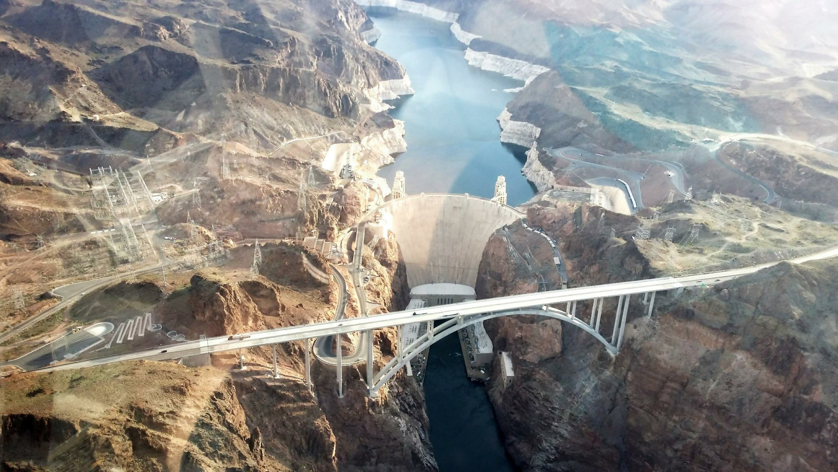
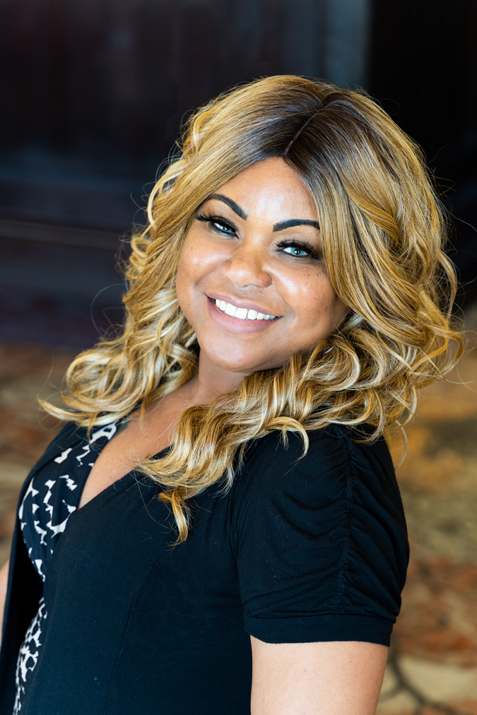
Thank You!!
Creslyn.Davis@stctr.org
(409)784-5592

