Slide 1
FEDERAL UPDATE: RACING TOWARDS NOVEMBER
JONAH C. CUNNINGHAM, PRESIDENT AND CEO

Slide 2
Goals for Presentation
Provide an Update on NACBHDD Work
Understand the Role, Structures, And Tensions of The Federal Government
Provide an Overview of Recent Actions
Share Possible Post-Election Items

Slide 3
About NACBHDD
Founded in 1989
Represents Local Authorities
Dual Focus on I/DD and Behavioral Health
Affiliate of NACo

Slide 4
NACBHDD Updates

Slide 5
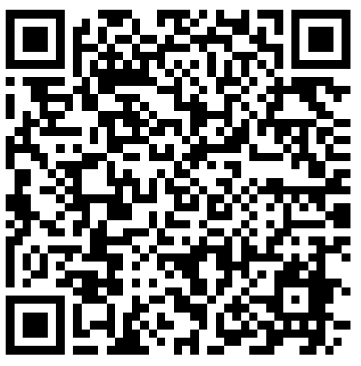
Crisis Messaging
Designed for Local Leaders
Includes County Examples
Next Report Focused on Rural Leaders

Slide 6
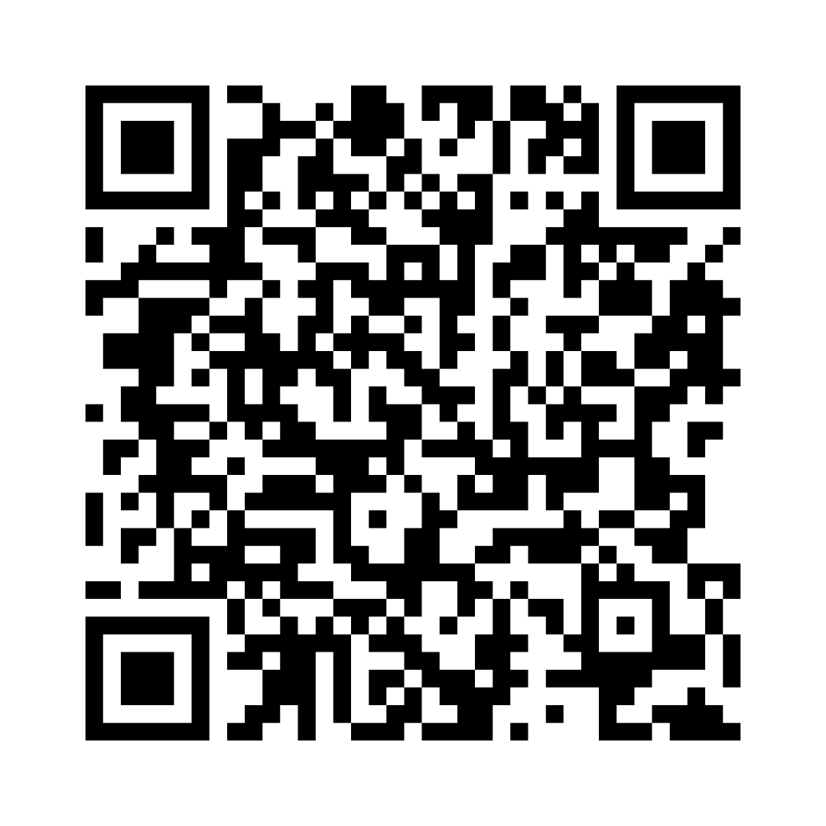
NACo Mental Health Commission
Launched February 2023
Strategic Policy Advisor
Partnered on Policy Brief Series

Slide 7
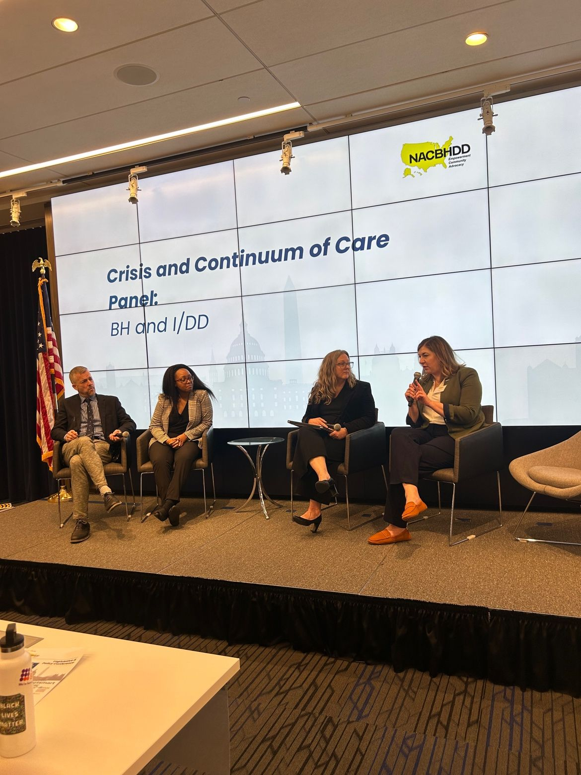
Legislative and Policy Conference
Candid Discussions with Policymakers
“Best Little Meeting in America”
March 2025 in Washington, DC

Slide 8
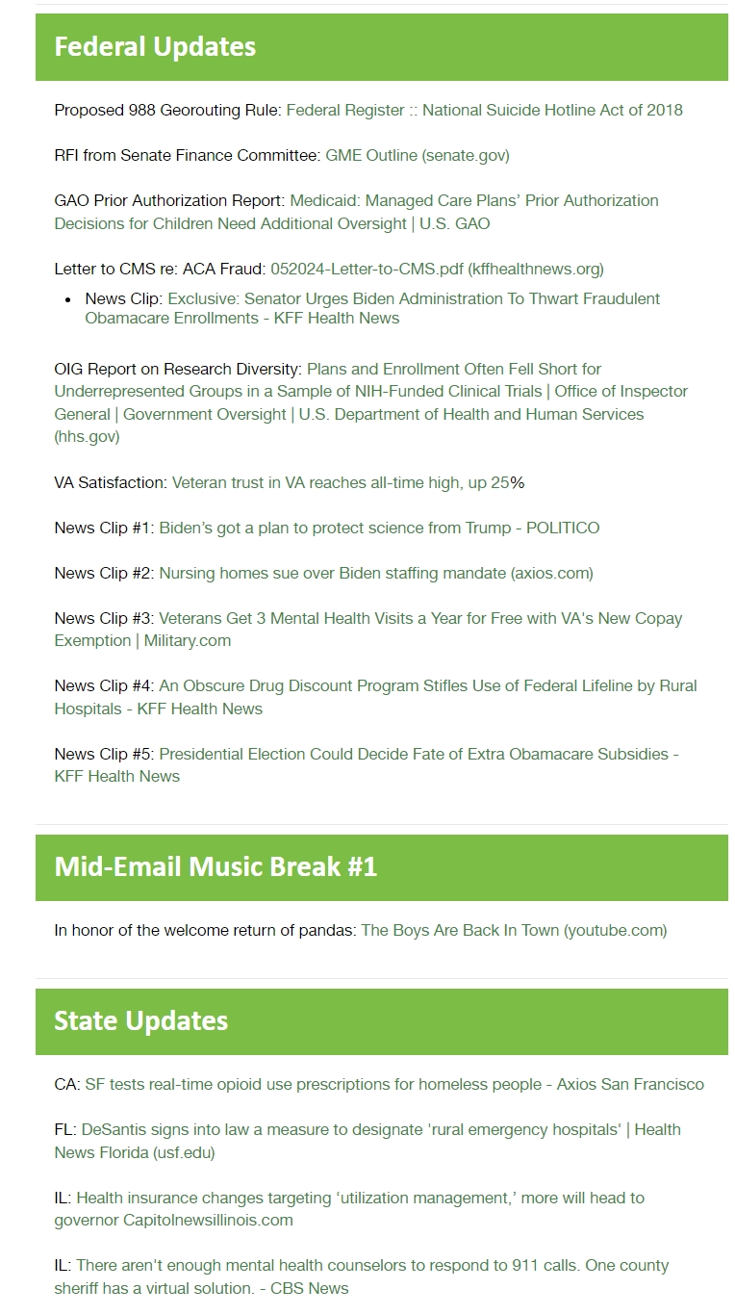
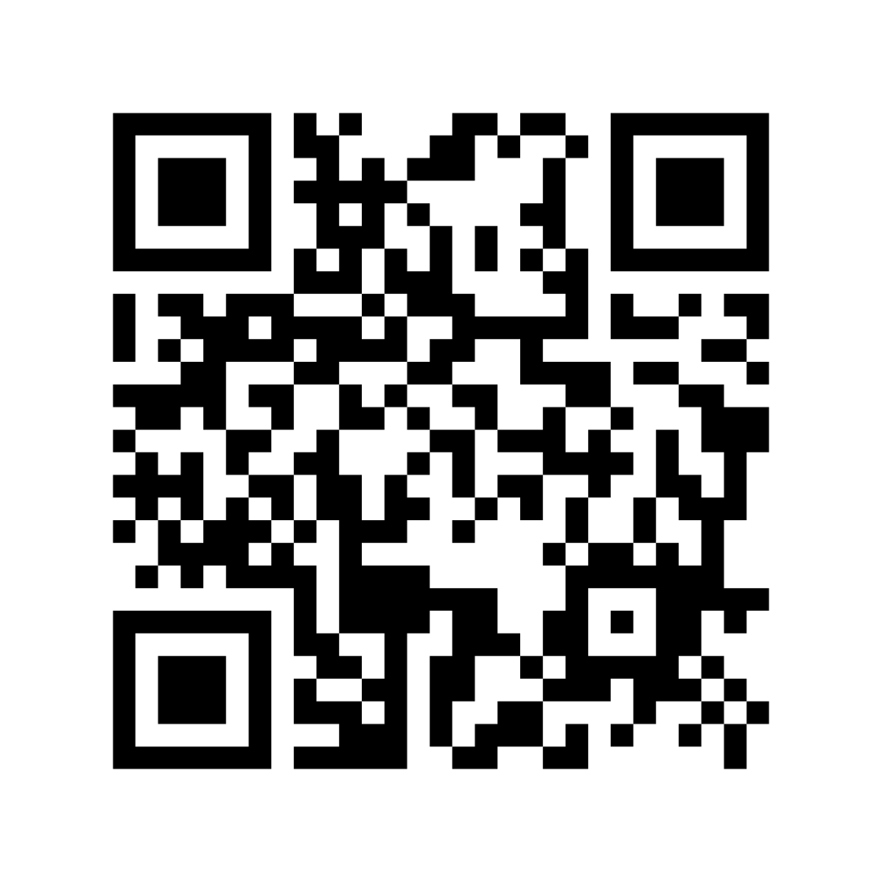
NACBHDD Newsletters
Week in Review
NACBHDD News
Periodic Announcements

Slide 9
Review of Federal Roles

Slide 10
Role of Federal Government
in Health
Research
Funding
Technical Assistance
Regulation & Oversight
Surveillance
Provision Of Services

Slide 11
Branches of Government
Legislative
Executive
Judicial

Slide 12
Processes for Policy Change
Legislation (Congress)
Administrative Law (Executive Branch)
Court Ruling (Judiciary)

Slide 14
Administrative Law
Agency With Proper Authority Develops Draft Rule
OIRA Reviews Draft
Agency Publishes Proposed Rule
Agency Receives Comments And Makes Changes To Proposed Rule
OIRA Reviews Draft Final Rule
Agency Publishes Final Rule

Slide 15
Policy Landscape

Slide 16
118th Congress
Split Congress
Small Majorities
Tensions Between Branches, Chambers

Slide 17
Power of the Purse
Congress Must Pass 12 Appropriations Bills
Can Pass Bills to Keep Funding Flat (CR)
Can Combine Some Bills Together (Omnibus/Mini-Bus)
No Bills Passed=Government Shutdown

Slide 18
FY2025 Year Funding
Traditionally Avoid Shutdowns During Election Years
Proposed Cut of 10-11%
Mark Up for L-HHS Funding June 24-28th

Slide 19
Executive Branch
Encompasses Various Agencies, Departments, Commissions
Issue and/or Enforce
Regulations, Rules, Directives
Power Derived From Establishing Law

Slide 20
Administrative Law
Number of Regulations Issued
988 Geo-routing
Nursing Home Staffing
Disability Protections in Health Care

Slide 21
Congressional Review Act
Allows Congress to Veto Regulations
Review Recent Rules
Passed By Simple Majority

Slide 22
SCOTUS Cases of Note
Funding for Tribal Health Overhead
Becerra v. Northen Arapaho Tribe
Administrative Law (Chevron Deference)
Relentless v. Dept. of Commerce
Criminalization of Homelessness
City of Grants Pass, OR v. Johnson

Slide 23
Post-Election Projections

Slide 24
119th Congress
Senate/House Makeup
Leadership Elections
Fiscal Fights (Debt Ceiling, Appropriations, Reconciliation)

Slide 25
Executive Branch
Personnel is Policy
Shift in Policy Regarding Entitlements
Medicaid
Medicare

Slide 26
Resources for Federal Policy
Congress.Gov
Regulations.Gov
Crsreports.Congress.Gov

Slide 27
THANK YOU
jcunningham@nacbhd.org
NACBHDD.org

