Slide 1
CEU Code: 1002

Slide 2
COMMUNITY LEADERSHIP IN ACTION:
CHARTING A NEW PATH FOR YOUTH CRISIS RESPONSE

Slide 3
Youth Crisis Outreach Teams (YCOTs)
Susan Garnett, MHMR of Tarrant County
  Susannah.Garnett@mhmrtc.org
Jessica Jimenez, Heart of Texas Behavioral Health Network
  Jessica.Jimenez@hotbhn.org
Kelli Guerrero, Heart of Texas Behavioral Health Network
  Kelli.Guerrero@hotbhn.org
Katie Mitten, Meadows Mental Health Policy Institute
  kmitten@mmhpi.org
Veronica Martinez, Texas HHSC
  Veronica.Martinez1@hhs.texas.gov

Slide 4
Paving the Way
Susan Garnett
88th Session, Rider 52, (d)(3) Youth Mobile Crisis Outreach Teams.
  $7M per year to establish youth mobile crisis outreach teams to reduce risk of hospitalization and transition youth into care, including three mobile crisis outreach teams for children served by the Department of Family and Protective Services.
Pilot → Early Implementation
Community leadership in children’s services, partnering with juvenile justice, DFPS, schools, hospitals, other providers

Slide 5
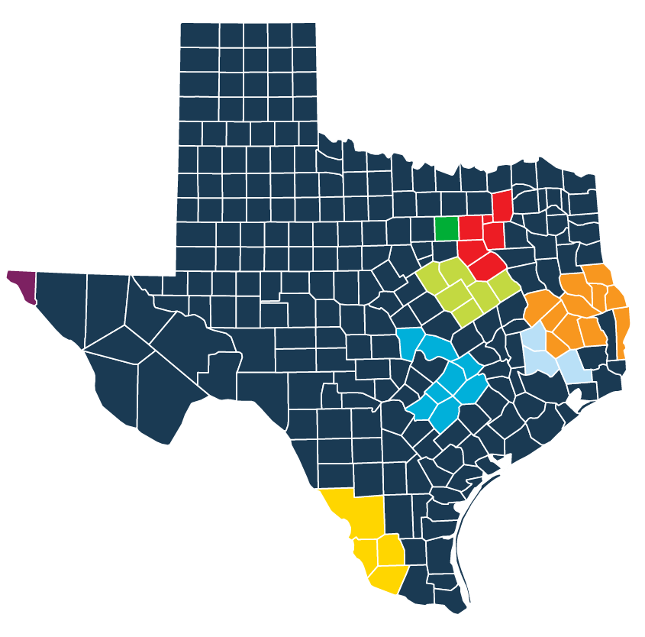
Current YCOT Sites
Bluebonnet Trails Community Services
Border Region Behavioral Health Center
Burke
Emergence Health Network
Heart of Texas Behavioral Health Network
North Texas Behavioral Health Authority
MHMR of Tarrant County
Tri-County Behavioral Healthcare

Slide 6
From Pilot to Practice
Jessica Jimenez & Kelli Guerrero
YCOT provides trauma-informed assessments and evaluations addressing immediate crisis intervention needs for children (ages 3-17) experiencing mental health crises.
YCOT provides services in residential areas, businesses, emergency departments, other health care and community settings, etc.
YCOT offers:
  active de-escalation and crisis stabilization in the least restrictive environment
  diversion from inpatient hospitalization and law enforcement interventions
  intensive short-term services for up to 90 days following crisis resolutions to help prevent future crises and connect individuals with community resources

Slide 7
From Pilot to Practice
Jessica Jimenez & Kelli Guerrero
Staffing: Program Director (LPHA), Program Manager (LMSW), Counselor (LHPA or LMSW in supervision w/ approved exemption), 2 Case Managers (QHMP), Family Partner, Peer Specialist, rotating on-call QMHPs (handle crisis calls after business hours, on weekends and holidays)
Populations targeted:
  Youth experiencing immediate mental health crises.
  Youth experiencing family issues, exposure to violence and trauma, and suspected mental health concerns.
  Youth with multiple or extended stay inpatient psychiatric hospitalizations.
  Youth with high acuity (e.g., serious emotional disturbance, intellectual/developmental disability; physical aggression, trafficking history; substance use)

Slide 8
From Pilot to Practice
Jessica Jimenez & Kelli Guerrero

Slide 9
Special Populations:
Individuals with IDD
Katie Mitten
Estimated 1/3 of people with IDD also have mental health needs.
Generally, people with IDD experience traumatic events at higher rates than the general population and may cope with and process these in different ways.
Youth with IDD are more likely to interact with law enforcement, which can be dangerous and may result in further criminal justice involvement.
Resources:
  LIDDA
    Crisis Intervention Specialists
  Outpatient Biopsychosocial Approach for IDD Services (OBI)
    Additional funding for the next biennium
    Resource to coordinate with YCOT involvement
    Part of post-crisis follow-up care

Slide 10
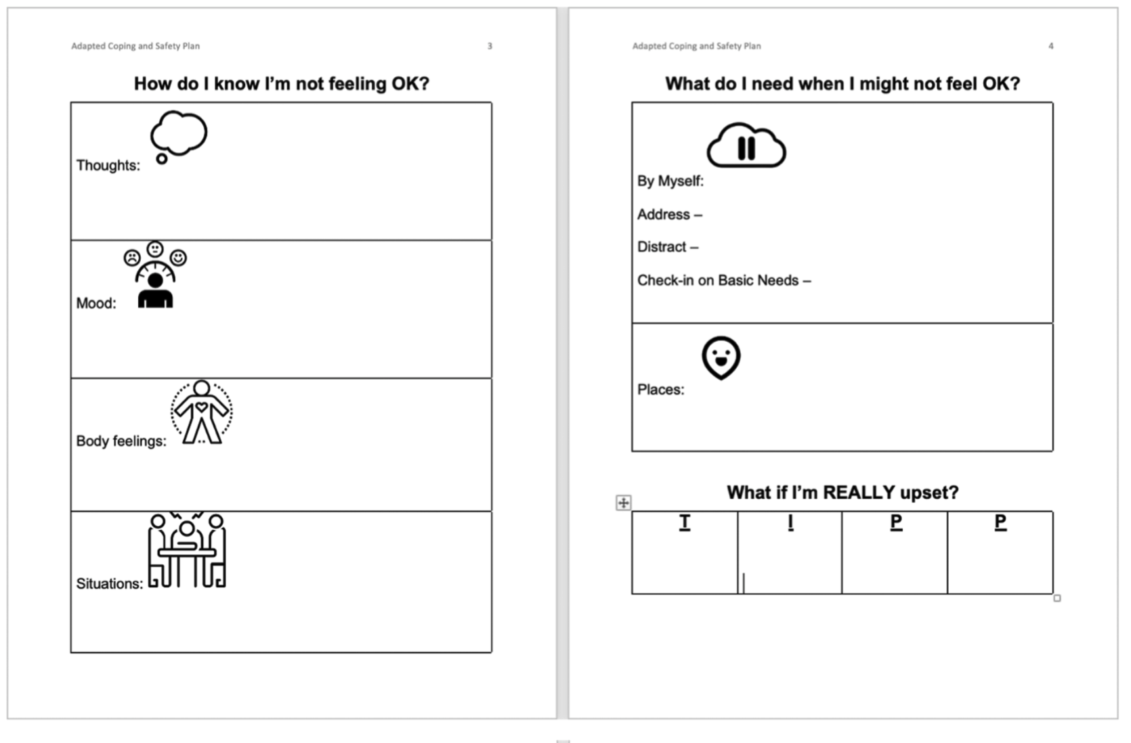
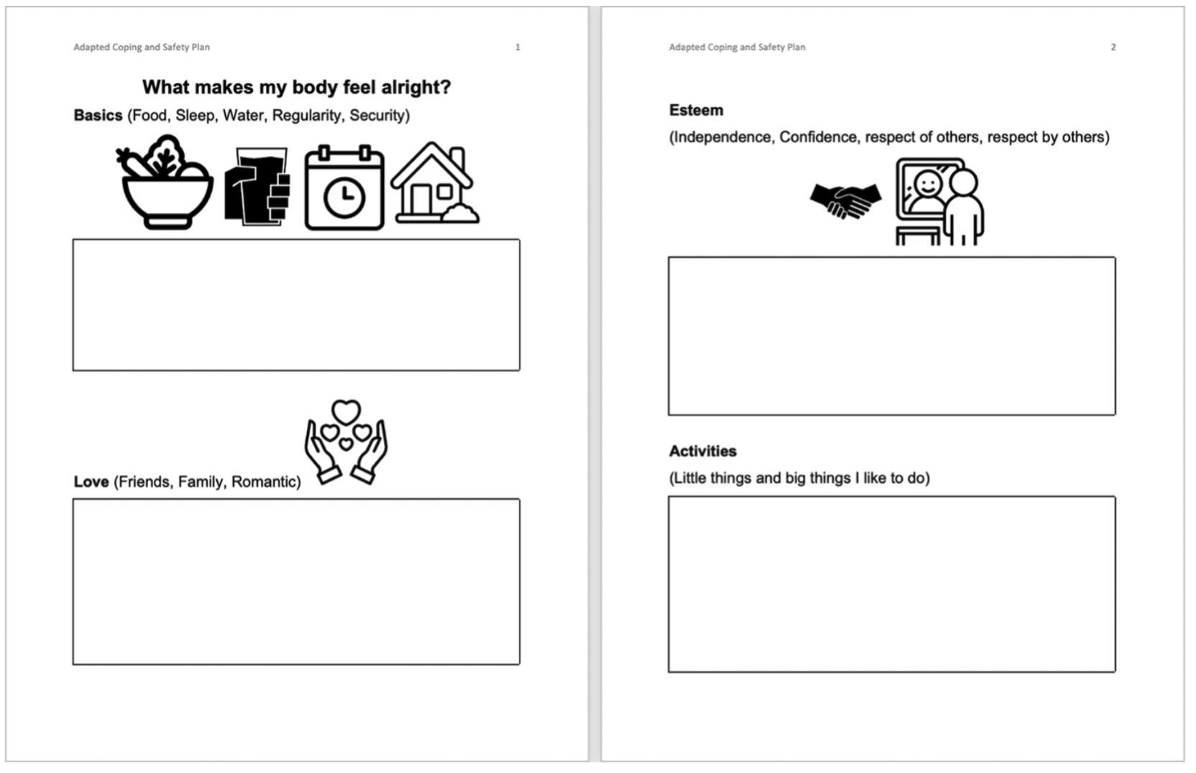
YCOT & IDD
Modify existing tools to be less reliant on verbal cues and integrate other communication and learning approaches.
Adapted Safety Plan

Slide 11

The Future of YCOT
Veronica Martinez
89th Session, Rider 54. Youth Mobile Crisis Outreach Teams.
  $27M per year for YCOTs, including funding to establish at least eight new teams.
  HHSC is directed to prioritize establishment of new YCOTs in urban areas.
Looking Forward

Slide 12

Questions
Questions

