Slide 1
Aligning Zero Suicide with CCBHC
PRESENTED BY:
Integral Care
Tropical Texas Behavioral Health
The Harris Center
HHSC Prevention and Behavioral Health Promotion Office

Slide 2
Why suicide Care matters for Texans
According to the Texas Health and Human Services Commission (HHSC) and the American Foundation for Suicide Prevention (AFSP),
On average, one Texan dies every two hours by suicide
Suicide is the second leading cause of death for Texans aged 15-34
Notes:
Teresa
Changing the way we work with every client

Slide 3
Suicide Care Impact
Deaths by suicide are preventable
Notes:
Teresa
Changing the way we work with every client
This Photo by Unknown Author is licensed under CC BY-ND

Slide 4
Meet the Panel
Teresa Williams, Director of Clinical Services at Integral Care
Juan Rios, Zero Suicide Program Manager at The Harris Center
Leivy Resendiz, Quality Manager & Zero Suicide Project Director at Tropical Texas Behavioral Health
Jessica Pedrick, Special Projects Administrator at Integral Care
Notes:
Jessica

Slide 5
Introduction
Zero Suicide is a framework comprised of seven elements to improve safe suicide care in health and behavioral healthcare settings
Certified Community Behavioral Health Clinics (CCBHCs) improve community behavioral health services by treating the whole person through access to integrated care
The Connection: Zero Suicide strengthens and accelerates CCBHC impact
Notes:
Jessica Implementing Zero Suicide serves as a catalyst that accelerates progress in other areas of CCBHC certification by embedding a culture of safety, accountability, and data-driven care. It strengthens clinical workflows, staff training, and risk assessment protocols—core components of the CCBHC model. As organizations adopt these rigorous standards, they naturally elevate overall service quality, coordination, and outcomes across the board.

Slide 6
Effective delivery techniques
Notes:
Teresa
Lead – System-wide leadership and policy commitment
Train – Competent, confident, caring workforce
Identify – Systematic risk screening & assessment
Engage – Collaborative safety planning & follow-up
Treat – Evidence-based treatment of suicidality
Transition – Safe care transitions & warm handoffs
Improve – Data-driven quality improvement

Slide 7
LEAD
Zero Suicide: Foster leadership-driven, safety-oriented culture
CCBHC Standards:
Crisis care policies & procedures
Inclusion of individuals with lived experience
Notes:
Teresa – Introduce element

Slide 8
LEAD
Notes:
Teresa – Story Slide

Slide 9
TRAIN
Zero Suicide: Ensure staff are trained in suicide prevention
CCBHC Standards:
Training on suicide prevention at hire & annually
Staff attitudes & cultural competence
Notes:
Juan Rios
T-CCBHC 1.c.1 Regarding training “…Training plans require the T-CCBHC to provide training on preliminary triage/risk assessment, suicide and overdose prevention and response at orientation and at reasonable intervals thereafter.”
T-CCBHC 4.b.1 Regarding employee attitudes “…services are trauma-informed, and recovery oriented, being respectful of the needs of each person receiving services, their preferences and values…”
T-CCBHC1.c.1
Making sure staff have the tools they need to take care of the clients they care for (role specific, relevant training)
Originally, had a four-hour gatekeeper training that was not always as impactful as we may want due to length and level of content
Mandatory for all staff entering the agency during orientation period
Made changes to provide a shorter, yet equally educational gatekeeper training to make room for more targeted clinical trainings without taking people away from their client facing obligations
1 hour virtual ask
Created a suicide skills enhancement bundle that was easily assigned to QMHP level staff for purposeful, targeted training on suicide screenings, risk assessments and interventions that would be required in their daily job
Easily assigned on hire and done during orientation
Repurposed a previous, slightly outdated training within our LMS to act as a yearly refresher for staff to meet the need of both Zero Suicide and CCBHC for refresher training
Includes refresher sections on CSSRS, suicide risk assessment, safety planning and CALM
T-CCBHC4.b.1
Incorporating care statement into job descriptions
“Every employee plays a role in suicide care and prevention by embracing our values and applying a trauma-informed approach rooted in safety, trust, choice, collaboration, and empowerment”.

Slide 10
TRAIN
Notes:
Juan Rios T-CCBHC1.c.1
Making sure staff have the tools they need to take care of the clients they care for (role specific, relevant training)
Originally, had a four-hour gatekeeper training that was not always as impactful as we may want due to length and level of content
Mandatory for all staff entering the agency during orientation period
Made changes to provide a shorter, yet equally educational gatekeeper training to make room for more targeted clinical trainings without taking people away from their client facing obligations
1 hour virtual ask
Created a suicide skills enhancement bundle that was easily assigned to QMHP level staff for purposeful, targeted training on suicide screenings, risk assessments and interventions that would be required in their daily job
Easily assigned on hire and done during orientation
Repurposed a previous, slightly outdated training within our LMS to act as a yearly refresher for staff to meet the need of both Zero Suicide and CCBHC for refresher training
Includes refresher sections on CSSRS, suicide risk assessment, safety planning and CALM
T-CCBHC4.b.1
Incorporating care statement into job descriptions
“Every employee plays a role in suicide care and prevention by embracing our values and applying a trauma-informed approach rooted in safety, trust, choice, collaboration, and empowerment”.

Slide 11
IDENTIFY
Zero Suicide: Screen and assess all individuals for suicide risk
CCBHC Standards:
Risk screening at intake
Suicide risk assessment in diagnostics
Use of validated tools
Crisis services include suicide response
Notes:
Juan Rios
T-CCBHC 2.b.1 Regarding screening “…all people new to receiving services…will, at the time of first contact, receive an immediate preliminary triage/risk assessment to determine acuity of needs.”
T-CCBHC 4.c.1 Regarding crisis response services “The T-CCBHC delivers emergency crisis intervention services directly…the services must, at minimum, include suicide prevention and intervention.”
T-CCBHC 4.d.3 Regarding intake “The initial evaluation of people receiving services includes an assessment of whether the person is a risk to self or others, including suicidal/homicidal risk factors.”
T-CCBHC 4.d.4 Regarding comprehensive evaluation “The comprehensive evaluation shall include an assessment of imminent risk, including suicide risk…danger to self or others…”
T-CCBHC 4.d.7 Regarding screening “The T-CCBHC uses culturally and linguistically appropriate screening tools…”

Slide 12
IDENTIFY
Notes:
Juan Rios

Slide 13
ENGAGE
Zero Suicide: Collaborative safety planning and follow-up
CCBHC Standards:
Crisis plans following emergencies
Follow-up care and safety planning
Support for high-risk individuals
Notes:
Engage (description slide): “Engage all individuals at risk of suicide using a suicide care management plan.”
Summary points: Pathway to Care, Lethal Means Safety, Collaborative Safety Plan, Next Steps
A pathway to care that instills hope and is recovery focused
Collaborative safety planning
Counseling on access to lethal means
The steps taken by providers to maintain the patient's engagement in, and commitment to, their care while working collaboratively with the individual
Maintaining communication with the individual between appointments and during transitions
The pathway is embedded and documented in an electronic health record
Supporting healthcare workers who provide the care for individuals at risk of suicide

Slide 14
ENGAGE
Notes:
Engage (example slide): success story #1 (TTBH- Suicide Safe Care Navigators engaging at risk individual that had opted to close case as part of their suicide plan-firearms and/or engagement data).
Suicide Safer Care Pathway
Caring Contacts
Lethal Means Safety
Safety Planning Interventions

Slide 15
TREAT
Zero Suicide: Directly treat suicidality with evidence-based methods
CCBHC Standards:
Provide or refer to EBPs like CBT and DBT
Notes:
Treat (description slide): “Treat suicidal thoughts and behaviors directly using evidence-based treatments.”
Summary Points: treat, least restrictive care, Direct care, Indirect Care, Next Steps
Provide interventions and treatments that directly address suicidal thoughts and behaviors
Collaboratively engaged and offered treatment in the least restricve setting possible
Find/adapt interventions and treatments to be culturally appropriate

Slide 16
TREAT
Notes:
Treat (example slide): success story #2 (PC and MH Prescribers (CRSES) and treatment care team integration or CoC/Diversion Center engagement.). Treatment and resulting outcome data available.
Evidence-Based Practices: Safety Planning, CAMS, CBT-SP, CASE
Least Restrictive Care
Stepped-Care Model
Crisis Support and Follow Up
Brief Interventions and Follow Up
Respite Care/Diversion Centers

Slide 17
TRANSITION
Zero Suicide: Ensure continuity of care across settings
CCBHC Standards:
Protocols for ED & inpatient transitions
Follow-up within 24 hours post-discharge
Notes:
Transition (description slide): “Transition individuals through care with warm hand-offs and supportive contacts”
Summary points: Transition, Best Practices, Roles of Crisis Services
Transitions of individuals at risk between providers of care
Inpatient to outpatient care
Outpatient care to community providers or residential settings
Following crisis care services
Caring Contacts

Slide 18
TRANSITION
Notes:
Transition (example slide): Success Story #3 (Suicide Safe Care Navigators at Residential and Inpatient Facilities.)
Warm Hand-Off
Rapid Referral and Follow-Up
Caring Contacts
Other Bridging Strategies: Peer support, support system engagement, support between episodes of care

Slide 19
IMPROVE
Zero Suicide: Use data for continuous quality improvement
CCBHC Standards:
Collect and analyze suicide-related outcomes
Maintain a CQI plan addressing suicide event
Notes:
Teresa Williams

Slide 20
IMPROVE
Notes:
Teresa

Slide 21
Suicide Care Initiative (SCI)
SCI focuses on enhancing suicide care in the public mental health system through assisting centers with implementing the Zero Suicide Framework
SCI funds four centers to serve as regional support and technical assistance hubs
Integral Care, Tropical Texas Behavioral Health, The Harris Center, and MHMR Tarrant County
Notes:
Teresa

Slide 22
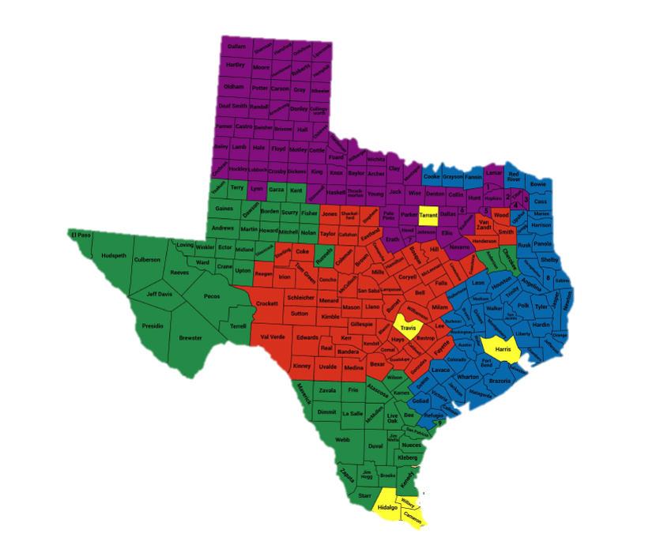
Regional Suicide Care Support Centers (RSCSCs)
My Health My Resources (MHMR) of Tarrant County: Mike Olson michael.olson@mhmrtc.org
Integral Care: Giselle Aguirre giselle.aguirre@integralcare.org
The Harris Center for Mental Health and IDD: Juan Rios juan.rios@theharriscenter.org
Tropical Texas Behavioral Health: Nichole Boetger-Hernandez nboetger@ttbh.org
State Suicide Care Coordinator: Samm Zachary Samantha.Zachary@hhs.texas.gov
Notes:
Teresa

Slide 23
Strengthening Suicide Prevention Through SCI
Zero Suicide fidelity reviews at no cost
Free suicide prevention trainings, including Train-the-Trainer opportunities
Ongoing technical assistance and implementation support
Regular Community of Practice calls to share knowledge
Complimentary suicide prevention materials and supplies
Notes:
Teresa

Slide 24
Zero Suicide and CCBHCs are stronger together
Approximately 35% of T-CCBHC elements are related to suicide
Integration leads to better outcomes, safer transitions, and reduced suicide risk
Together, we build a system where no one falls through the cracks
Notes:
Teresa

Slide 25
Ask us anything
Notes:
Jessica (moderator) Extended Panel Q&A / Additional Prepared Questions (10–15 minutes)
Facilitated discussion to deepen insight. Possible questions include:
How has the integration of Zero Suicide changed clinical outcomes or client experience?
What resistance did you encounter during implementation, and how was it addressed?
What advice would you give to agencies just beginning this process?
How do you sustain momentum and staff engagement post-launch?

