Slide 1
Building Connections in Peer Support: Expanding the Impact of Peer Workers
Check-in Code: 3002
Miracle Akortha, PSS, CFP, MHPS
Behavioral Health Services
Texas Health and Human Services
June 25, 2025

Slide 2
Learning Objectives
To Strengthen collaborative relationships
To Enhance Peer worker visibility and Voice.
To Expand knowledge and skillsets
To Increase system integration and influence

Slide 3
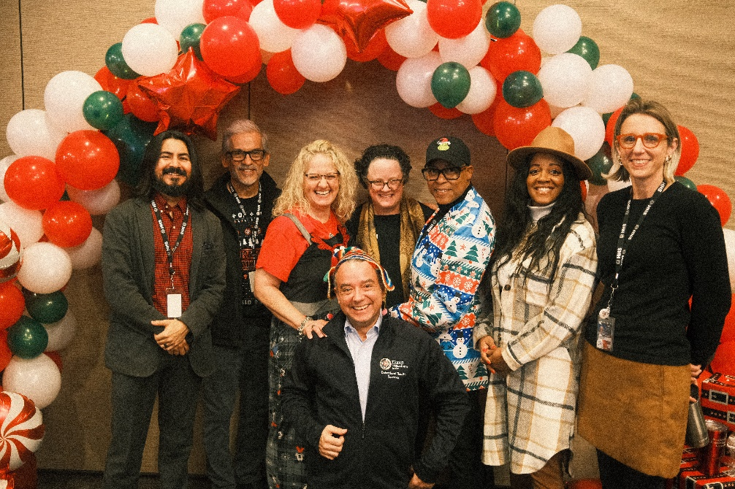
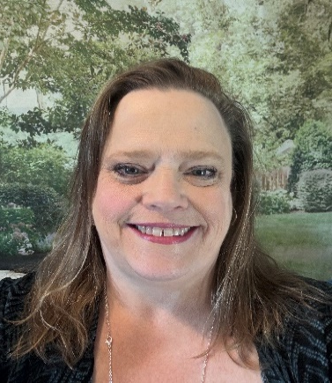
Peer Support and Recovery Team
*Miracle Akortha PSS,CFP,MHPS
*Carole Blackmon MS,CFP, QMHP

Slide 4
Peer Support and Recovery
Vision​
A Texas where everyone can access peer and recovery support to achieve their ideal quality of life.​
Mission ​
To enhance the peer support workforce, strengthen and expand the capacity of peer and recovery services, and align data and research efforts.​
Goals​
Workforce development​
Services capacity expansion​
Data and research alignment

Slide 5
The Peer Professional (1 of 2)
Mental Health Peer Specialist (MHPS
Recovery Support Peer Specialists (RSPS)
Re-Entry Peer Specialist (JI-RPS)
Certified Family Partner (CFP)
Peer Support Supervisor (PSS)

Slide 6
The Peer Professional (2 of 2)
Peer Support Specialists:
Have a state-regulated training and certification process.
Must maintain ongoing supervision.
Are governed by a professional code of ethics and are subject to disciplinary action for violation of the code of ethics.
Maintain certification through ongoing continuing education credits.

Slide 7
Peer Specialist Eligibility Requirements
A Peer Specialist (MHPS, RSPS, JI-RPS) must:
Be at least 18 years of age;
Have lived experience with mental health, substance use or justice involvement;
Have a high school diploma or complete the General Education Development (GED) test;
Be willing to appropriately share your recovery story with recipients;
Be able to demonstrate current self-directed recovery; and
Pass criminal history and registry checks.

Slide 8
Family Partner Eligibility Requirements
A Family Partner must:
Be a parent (birth, adoptive, or foster), legally authorized representative (LAR), or primary caregiver with lived experience parenting or raising a child or youth with a serious emotional disturbance (SED) or mental or substance use condition;
Be at least 18 years or older;
Have a high school diploma or high school equivalency certificate issued in accordance with the law of the issuing state;
Have lived experience navigating a child-service system, such as a mental health, juvenile justice, social security, or special education system, as a parent, LAR, or primary caregiver of a child or youth with an SED or mental health or substance use condition;
Be willing to appropriately share their own recovery story with recipients of CFP services; and
Have successfully completed and passed the Texas Health and Human Services (HHSC) approved certification process.

Slide 9
Certification Process
Peer Process:
Complete the Texas Peer Specialist Orientation and Self-Attestation;
Complete the CORE training;
Complete Supplemental Training (MHPS,RSPS,JI-RPS);
Apply for certification with the Texas Certification Board;
Pass a criminal background check; and
Complete 250 Supervised Work Experience Hours.
Family Partner Process:
Complete Basic Certification training through Centralized Training Infrastructure;
Pass exam; and
Complete initial application on the Texas Certification Board website.

Slide 10
Certification Numbers

Slide 11
Certification Numbers
MHPS-1016
RSPS-971
JI-RPS-56
CFP-161
PSS-352

Slide 12
Peers Are Part of the Integrated Care Team

Slide 13
What does support look like?
Setting expectations from the first session
Defining what support is:
Do with, not for.
Resource support.
Information sharing.
See one, practice one, do one
Encouraging change through Motivational Interviewing
Skill practice.

Slide 14
Peers on Recovery Plans: Enhancing Services
Mentoring- A Peer using their lived experience to mentor the individual through the recovery journey.
Advocacy- A Peer uses their advocacy skill to help teach and encourage advocacy in recovery.
Linkage- A peer links people to resources in the community to be able to support themselves.
Mentoring
Linkage
Advocacy

Slide 15
Why Voice Is Important
Person-Directed Services
Independence
Strength-based
Sustainability
Learned skills
“When we speak, we are afraid our words will not be heard or welcomed. But when we are silent, we are still afraid. So, it is better to speak”. - Audre Lorde

Slide 16
Peers Moving into Action
Identifying Barriers:
Help establish and support the family through challenges while in care.
Developing small and obtainable steps:
Creates the opportunity to celebrate small wins withing their wellness journe.

Slide 17
Peers Use of Empowerment and Self-Advocacy
Empowerment:
The process of becoming stronger and more confident especially in controlling ones like and claiming ones rights.
Self-Advocacy:
The action of representing oneself or ones views or interest.
Knowing when to empower our consumer(s) and encourage them to use their self-advocacy skills is essential to creating independence within the wellness journey.

Slide 18
What are Peer Services? (1 of 2)
Peer Services include:
Individual sessions – Peers can meet individually with people to assist them in developing practical coping skills and instill hope as they work through their recovery journey.
Group sessions – Peers provide groups that people can attend to learn new coping skills and share their skills with others.
Support and advocacy – Peers can assist when an individual is overwhelmed and needs someone to talk to who might understand their situation.

Slide 19
What are Peer Services? (2 of 2)
A Peer Specialist:
Offers hope and encouragement;
Models recovery, resiliency, and shared decision-making;
Advocates for individuals and teaches them effective self-advocacy;
Helps people individuals achieve their life and recovery goals;
Teaches skills learned by first-hand experience;
Helps people individuals navigate through the many recovery systems; and
Peers Facilitates contact with internal and external resources.

Slide 20
Increase Your Touch Points
Have Peer Specialists do the following:
Introduce the services.
Be present in the lobby and waiting room and transitional spaces.
Be seen. The more Peers are seen; their role is more understood and established.
*Pro Tip: Have a Peer Specialist do warm handoffs.

Slide 21
Peer Benefit
How to Bill for Peer Support
Peer support will be payable through the current established procedure code H0038 (15 Minute time coded)
Peer Support may be delivered one-on-one or in group settings.
Fee for Service (FFS) Medicaid: Members will be eligible for 104 units in a rolling 6 month period without authorization.
Medicaid Management Care: Health Plans will authorize the benefit but must still follow the same amount, duration, and scope as FFS.
Reimbursement Rates:
$11.25 per 15 minute unit for individual.
$1.82 per 15 minute unit per person for group settings.

Slide 22
Family Partner Benefit
CFP services became a covered benefit under Texas Medicaid on March 1, 2025.
These services are designed to support parents, LARs, and primary caregivers of Medicaid-eligible children or youth who meet the following criteria:
20 years of age and younger
Diagnosed with an SED or a mental health or substance use condition
Have CFP services included as a component in their person-centered and trauma-informed recovery plan (also known as the plan of care)
Reimbursement Rates:
$12.73 per 15-minute increment for individual setting
$1.82 per 15-minute increment per person for group setting

Slide 23
Documentation
Documentation of services must indicate:
The date, time and place of service;
Means of delivery; and
A summary of the purpose and content of the services, along with specific strategies and activities utilized, as related to the goal(s) and objective(s) in the plan of care of the Medicaid-eligible child or youth.
Supervisors must document all supervisory sessions and maintain records in the employee personnel file.
Record keeping and documentation activities are not a benefit of Medicaid.

Slide 24
Think Tank
Let’s talk about it…

Slide 25
Thank you
Miracle.Akortha@hhs.texas.gov

