Slide 2
COLLABORATIVE CARE IN
FORENSIC PSYCHIATRY:
A proposal for the innovative collaboration between academic psychiatry and the local justice system
Notes:
PO

Slide 3
INTRODUCTIONS
PATRICIA ORTIZ
MD
DANIELA CHISOLM
JD
KRISTI TAYLOR
JD
Notes:
PO

Slide 4
DISCLOSURES
No disclosures to report.
Notes:
PO

Slide 5
LEARNING OBJECTIVES
Identify key recommendations made by the National Judicial Task Force to Examine State Courts’ Response to Mental Illness in their 2022 report
Identify benefits of involving general psychiatry residents and forensic psychiatry fellows in the judicial community as viewed by various psychiatric, legal, and community stakeholders
Understand potential obstacles to involving psychiatric trainees in the local judicial system
Notes:
PO

Slide 6
Background & Context
Notes:
PO/KT

Slide 7
National Initiative:Improving the Justice System Response to Mental Illness
Develop resources and best practices,
Improve caseflow management,
Build capacity of state and national court leaders to implement reforms, and
Promote education for national and state court leaders.
Notes:
KT

Slide 8
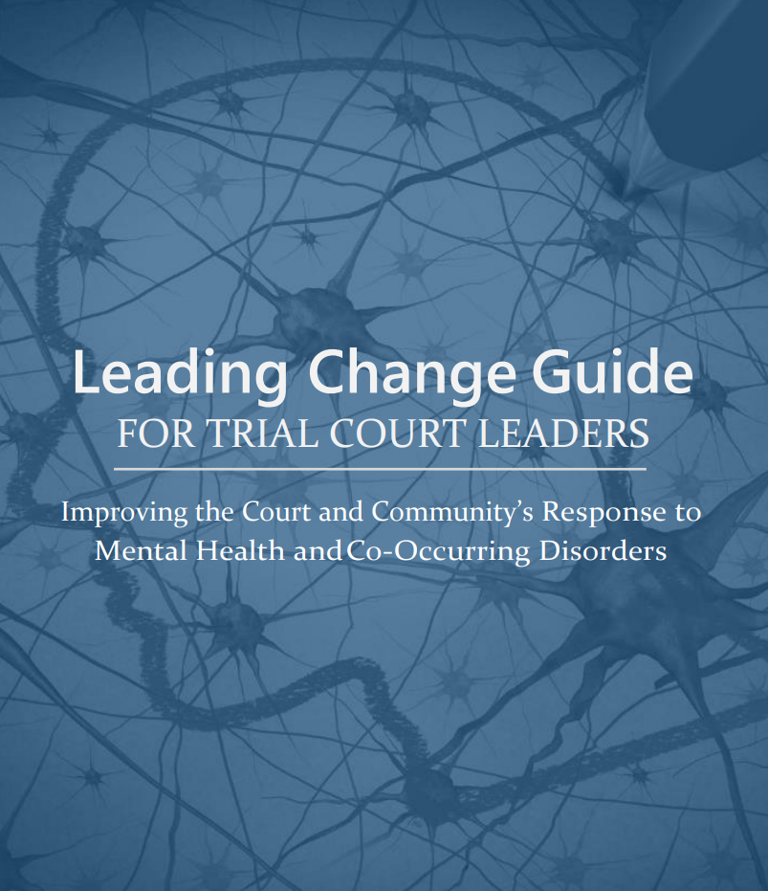
The Leading Change Guide 2022
The Leading Change Guide provides a national perspective for mental health responses at the local as well as the state court level by providing judges across the country with a guide to develop mental health plans for their local jurisdictions.
Notes:
KT

Slide 9
Judges & Psychiatrists Leadership Initiative
Creating a community of judges and psychiatrists through web-based and in-person trainings and the development and distribution of a newsletter to judges and psychiatrists;
Increasing the reach of trainings to build the non-clinical skills of court professionals, which will help improve individual and public safety outcomes; and
Developing educational resources to increase judges’ and psychiatrists’ understanding of the latest research and best practices for people with mental illnesses involved in the justice system.
Notes:
KT
The Judges and Psychiatrists Leadership Initiative (JPLI) aims to stimulate, support, and enhance efforts by judges and psychiatrists to improve judicial, community, and systemic responses to people with behavioral health needs who are involved in the justice system by

Slide 10
Initial Legal Exposure in Residency
PGY-1s rotate at forensic state hospital
El Paso Psychiatric Center
Legal training for PGY-1s at orientation
Led by Assistant County Attorney in the Mental Health Litigation Unit
Traditional Forensic Didactics
Notes:
PO

Slide 11
Silos
Psychiatric Side
Legal Side
Learning new jurisdiction
Full time general psychiatrist
Clerkship director
Expand forensic education in general residency
Forensic fellowship one day?
Civil Commitment Process
EDOs, CMEs, Resident Testimony
Assisted Outpatient Treatment Program
Grant funded
Wrap around services…
Until money runs out
Notes:
PO, DC

Slide 12
A lawyer and a psychiatrist walk into a bar…
Notes:
PO

Slide 13
INNOVATIVE COLLABORATION!
Notes:
Fireworks animation?
PO/DC

Slide 14
Texas Tech Health El Paso and
EP County Attorney Partnership
PGY-1 training expanded to ~9 hour training
Civil Commitment Process
PGY-4 Elective at Assisted Outpatient Treatment (AOT)
Goal: Bidirectional Collaboration
Notes:
The Texas Tech University Health Sciences Center (TTUHSC) El Paso Department of Psychiatry and the El Paso County Attorney's Office are proposing a mutually beneficial partnership that will create expansion, sustainability, and innovation for the El Paso community. Embedding general psychiatry residents and forensic psychiatry fellows in the judiciary and legal system will increase interest among trainees in working with forensic populations after graduation and in pursuing additional fellowship training in forensic psychiatry, as well as cultivate more positive attitudes toward, and less avoidance of, forensic patients (Frierson, 2020). It would also create an innovative curriculum and diverse training experiences for forensic psychiatry fellows. On the legal side, psychiatry trainees would provide clinical expertise to both criminal and civil judges, enhancing the ability of the judicial system to better serve the individual needs of each person that encounters the legal system. Additionally, the legal requirements for criminal and civil diversion processes will be met, in turn creating expansion for mental health programs and sustainability for the overall court systems. The collaborative efforts will further the model of therapeutic jurisprudence, which facilitates the healing of an individual in the legal system, rather than continuing a punitive judicial experience. This collaboration will assist El Paso in becoming a model that can be implemented nationally.
DC

Slide 15
The stars align…
Texas Higher Education Coordinating Board (THECB) Grant
Starting a forensic psychiatry fellowship
Recruiting now for July 2025
Notes:
The stars aligned
PO

Slide 16
CHALLENGES & SOLUTIONS
Initial challenges faced in establishing the collaboration
Ongoing challenges
Resident prior patients in AOT
Strategies
Notes:
DC/PO
Finding Training Sites
Other stakeholders
Fear of starting something new
Resistance from jails and prisons to allow outside entity into their space/Litigation concerns
Criticism of AOT from civil liberties groups

Slide 17
FUTURE STEPS
Training sites for fellowship
Case studies or examples illustrating the effectiveness of the collaboration
Key metrics and outcomes observed
Detailed analysis of cost savings for El Paso County through the use of medical school residents
Comparison of costs before and after the implementation of the program
Notes:
DC/PO
AOT- LARA
Feedback from a PGY-1 on the didactics?
Email from defense attorney complimenting the changes in testimony

Slide 18
BENEFITS & SUCCESSES
OF CO-TRAINING
Notes:
PO

Slide 19
BENEFITS AND LONG TERM GOALS
Access for justice-involved individuals
Resident/Fellow Educational Outcomes
Benefits to Legal side
Study financial implications
Cost savings for El Paso County before and after the implementation of the program
Notes:
DC

Slide 20
OPERATIONAL SUCCESSES
Greater forensic interest among residents
Civil commitment process
Improved testimony
Improved efficiency
AOT successes
Notes:
PO/DC

Slide 21
EXPANDING
INNOVATION

Slide 22
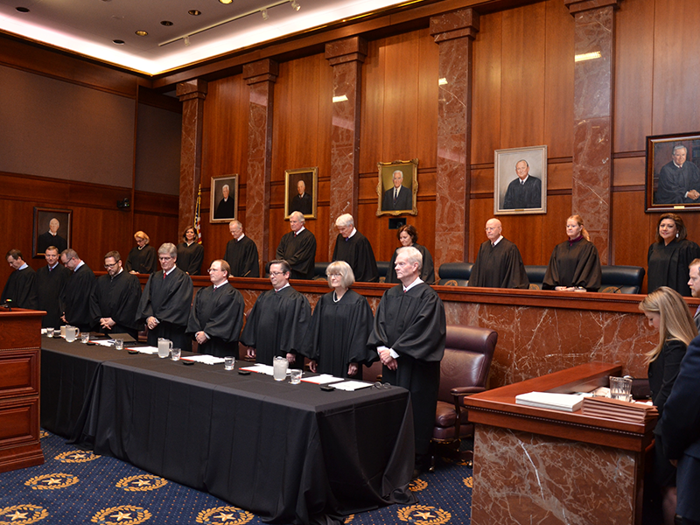
THE ROLE OF JCMH IN THIS PROJECT
The mission of the Judicial Commission on Mental Health is to engage and empower court systems through collaboration, education, and leadership, thereby improving the lives of individuals with mental health needs, substance use disorders, or intellectual and developmental disabilities (IDD).
The Supreme Court of Texas and Texas Court of Criminal Appeals jointly formed the JCMH to address problems at the intersection of complex human service systems and the judicial system.
Overcrowded dockets leaving courts inadequate time | A lack of communication, coordination, and collaboration
A need for specialized, multidisciplinary legal training | A lack of technology to efficiently manage dockets and to track cases
A need for the children and adults involved in the justice system to have a voice in decisions that affect them | A lack of community resources to provide adequate services

Slide 23
STATEWIDE EXPANSION PLANS
JCMH will share this model with other regions of Texas
Reimagining Justice Podcast highlighted this innovation
JCMH plans to create an online class sharing the innovation including a curriculum, guidebook, and forms to be rolled out with the Judges and Psychiatrist Leadership Initiative

Slide 24
FUTURE DIRECTION
Plans for future enhancements and potential national expansion through partnerships with National Center for State Courts

Slide 25
QUESTIONS?

Slide 26
THANK YOU &
ACKNOWLEDGEMENTS

