Slide 1


Driving Agency Growth through Training
Andrew Ahles, LMFT-S
Clinical Training Manager
Jennifer Torres, MSW
Director of Intensive Services
Check in Code: 4001
Notes:
Inroduction- Andrew and JT

Slide 2

Learning Objectives
Collaborate with participants to identify state-wide barriers to training clinical staff and possibilities for future innovation
Discuss how to leverage data to strategically match training initiatives with Agency KPI
Identify training strategies to increase utilization and quality of evidence-based and trauma-informed practices including Seeking Safety, Nurturing Parenting, ASIST, Illness Management Recovery, and Counseling on Access to Lethal Means.
Notes:
Andrew

Slide 3

Starting the Conversation
Notes:
Questions for consideration:
What are the biggest challenges you face regarding training new clinical staff?
What are you most proud of in your training process?
What do you most wish to change or improve regarding your training process?

Slide 4

Training is your organization’s first impression
Notes:
Andrew

Slide 5

Training sets and reinforces organizational culture and values
Notes:
Jennifer

Slide 6

Clinical Training Infrastructure

Slide 7
History
Developed in 2021 as a way to address training gaps for new clinical hires and better support the learning of clinical specific workflows. Began with 1 trainer and 1 peer support specialist trainer, expanded to the current team of 6 by the end of 2022. The team reports directly to the Operations Directors and Chief Clinical Officer of the MH Division at Metrocare and provides support to all direct clinical staff within the division’s reporting structure, including: QMHPs and Care Coordinators LPHAs Peer Support Specialists LCDCs Intensive Program Clinical Staff (ACT, TCOOMI, Wraparound, etc.)
Notes:
JT

Slide 8
The Basics
Dedicated Team of 6 Trainers, all with direct clinical experience 4-week period of Clinical Training and Mentorship for new hires following Employee Orientation Weekly refresher trainings available to all clinicians as well as one on one coaching as needed Up to date manuals and guides for documentation and procedures Annual curriculum competency for Seeking Safety Annual Training initiative chosen each FY to highlight a particular area of clinical focus (eg, Counseling on Access to Lethal Means, Advanced Applications of IMR, etc.) Collaboration with Operations Directors, Clinical Managers, and other departments to identify pain points, improve workflows, and assist with internal and external audits
Notes:
Andrew

Slide 9
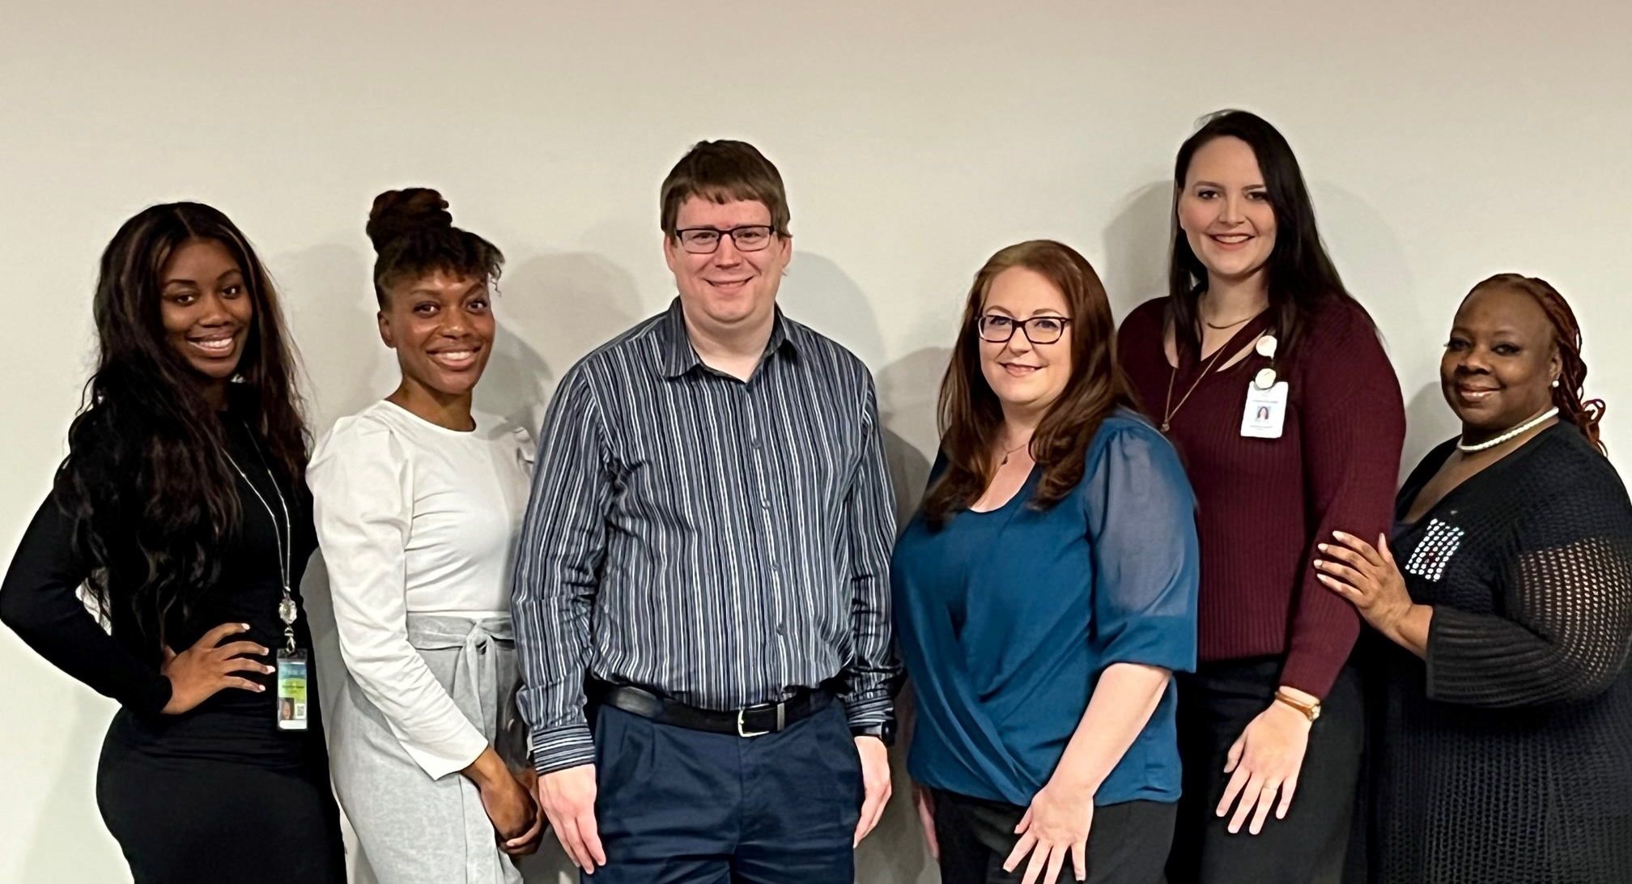
Notes:
Andrew

Slide 10

Peer Focused Training
One member of the training team is a Mental Health Peer Specialist and a Peer Support Supervisor She provides peer specific training to any new peers who are onboarded as well as provide a peer perspective when developing training initiatives. Serves peer group by providing monthly recurrent meetings for all peer staff
Notes:
JT

Slide 11
Onboarding and Clinical Training
Week 1 | Week 2 | Week 3 | Week 4
Employee Onboarding | Clinical Training | Shadowing and Mentorship | Shadowing and Mentorship
Week 5 | Week 6 | Week 7 | Week 8
Clinical Training and Learning Review | Shadowing and Practice | Shadowing and Practice | Beginning of Formal Ramp up
Notes:
Andrew

Slide 12
How We Train
Interactive, Engaging, Purposeful, more than just “view the video” or “follow the slides”. Training materials stem from an established list of learning objectives for each day of training. ANSA/CANS- review and practice scoring and principles in person as well as assigning online certification course Recovery Planning- teach both payor standards and Metrocare’s process Progress Notes and Safety Plans- Examples and Practice Curricula- What can be used and how it can be used Learning Review- A final check at the end of the training period for new hires to practice documentation and demonstrate what they’ve learned. Feedback is collected by a trainer and provided to the hiring manager.
Notes:
Andrew

Slide 13
The Collaborative Role of Clinical Training
Clinical Directors
Quality Management
Clinical Training
Program Managers
Clinical Staff

Slide 14

Collaboration
Quality Management identifies an issue with progress note documentation for a particular staff or program, and communicates this issue to the direct manager Manager addresses the issue with staff, and connects them with Clinical Training for additional follow up and support Clinical Training provides coaching to supplement Manager supervision and with context can identify any broader trends or gaps. Clinical Training addresses any gaps in training process and communicates back to QM and Operations Directors regarding opportunities to improve processes or workflows.

Slide 15



Special Projects
AvatarNX Implementation- technical assistance and training material development Recovery Planning Training- retraining all clinical staff and providing input to recovery plan form revisions Eleos Implementation- technical assistance and how to guide development Safety Plan form revision to align with ASIST and CALM best practices
Notes:
JT

Slide 16

Questions So Far?
Notes:
Both

Slide 17

Data Driven Initiatives and Outcomes

Slide 18
Clinical Skillsets
Policies, Procedures, and Workflows
Organizational Mission, Values, and Established Culture
Notes:
Andrew

Slide 19
Strategic Alignment
Agency Mission and Values
KPIs
Training Initiatives
Training Team Benchmarks
Clinical Workflows
Learning Objectives
Training Materials and Schedule
Learning Review
Notes:
Andrew

Slide 20
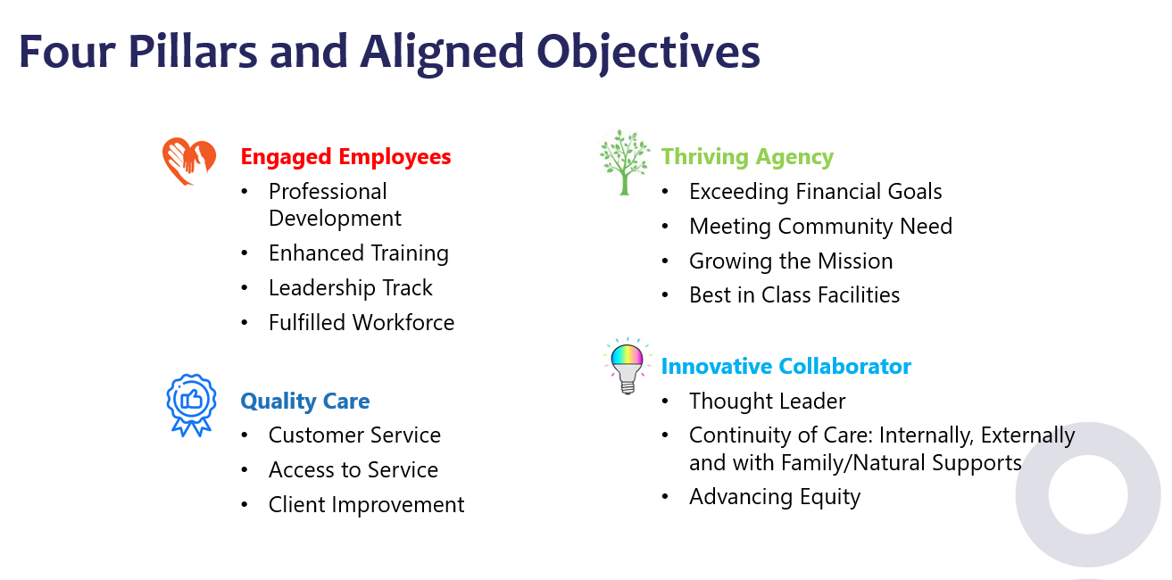
Notes:
Jennifer

Slide 21
Clinical Staff Turnover
Agency Value: Engaged Employees Target: Decrease clinical staff turnover in their first 6 months and 1 year of employment Key Indicator: Decrease clinical staff turnover to less than 10% in the first 6 months of employment. Includes all staff who attend Clinical Academy Does not include staff who resign during HR Orientation period and do not begin Clinical Academy
Notes:
Andrew

Slide 22
57 Staff
27 Staff
27 Staff
Notes:
Andrew

Slide 23
23 Staff
13 Staff
11 Staff
Notes:
Andrew

Slide 24
Notes:
Andrew

Slide 25
Clinical Staff Turnover- Outcomes
6 month staff turnover has decreased since its initial value in 2022. We continue to look for methods and programs to create more stability in the workforce in the first 6 months of hiring. 90 day turnover has been reduced by half since 2022, making it easier to keep staff for more than 6 months.
Notes:
Andrew

Slide 26
Seeking Safety Initiative
Agency Value: Quality Care, Trauma Informed Care Target: Increasing utilization of Seeking Safety curriculum across Metrocare’s MH Programs. Key Indicator: Increase Seeking Safety Utilization by at least 30% across Metrocare Programs. Measured by count of curriculum indicated on Progress Note Baseline in September 2022 was 852 sessions in that month Began Mental Health Division wide training/retraining in Seeking Safety in Fall 2022. Utilized series of 4 training videos as required by HHSC. Integrated additional conversations around trauma and substance use to increase engagement with the material and reinforce population specific messages. Purchased several hundred physical Seeking Safety manuals to ensure access to material Training Team began Competency Observations utilizing Seeking Safety fidelity form in Fall 2023 to ensure quality of sessions.
Notes:
JT

Slide 27
Notes:
JT

Slide 28
Seeking Safety Initiative- Outcomes
Monthly Seeking Safety Utilization increased over 300% from September 2022 to August 2023 Utilization increased further over the next 12 months and has remained stable Ongoing Seeking Safety Competencies indicate that staff are well engaged with the material and deliver it to fidelity
Notes:
JT

Slide 29
Nurturing Parenting Initiative
Agency Value: Quality Care Target: Increasing utilization of Nurturing Parenting curriculum across Metrocare’s Children and Adolescent Programs Key Indicator: No specific target due to specialized nature of Nurturing Parenting training. Measured by count of curriculum indicated on Progress Note Baseline in January 2023 was 112 sessions in that month Began offering in house Nurturing Parenting Facilitator Training in February 2023. One member of the training team became an approved organizational trainer. Purchased several hundred physical copies of NP curriculum. Include budget line items each FY for sufficient NP materials and AAPI access/reporting.
Notes:
Andrew

Slide 30
Notes:
Andrew

Slide 31
Nurturing Parenting Initiative- Outcomes
Monthly Nurturing Parenting Utilization increased nearly 400% from January 2023 to December 2023. Utilization has fluctuated from month to month but overall gains have been retained. We would like to see further gains. Our next target is increasing AAPI administration and follow up scoring.
Notes:
Andrew

Slide 32
Safety Planning Compliance and Quality- Ongoing
Agency Value: Quality Care Safety Plan form was revised in Summer 2024 to better reflect crisis intervention and risk assessment best practices and to mirror language and best practices from ASIST and CALM trainings. Report was developed with IT department to indicate the presence of an ANSA/CANS risk factor (suicide risk, harm to others, etc.) and whether or not a safety plan was completed following that assessment. Data collection is ongoing. Monthly feedback is provided to managers identifying high risk clients who may need follow up. This initiative has also revealed gaps in understanding of the scoring of certain ANSA/CANS items.

Slide 33
Other Training Outcomes
Applied Suicide Intervention and Skills Training (ASIST)- Multiple staff registered ASIST trainers. Over 300 clinicians trained since 2022. Counseling on Access to Lethal Means (CALM) produced by HHSC. Multiple staff are approved presenters. 134 trained this Fiscal Year. Advanced Applications of Illness Management Recovery (IMR)- In house training developed by the training team discussing effective use of IMR with high acuity clients. Meant to complement the annual recertification course on Centralized Training. 190 staff attended during FY 2024. Technical Assistance for LPHAs going through the training process to become approved providers for TF-CBT and CPT. Grant Applications for additional funds for training resources. Received a grant from NTBHA to increase access to EBPs for FY 2025

Slide 34
Other Data We Track
Feedback surveys from Clinical Academy and any other trainings throughout the FY Utilization of CPT and TF-CBT by trained LPHAs Specific department/program turnover within 6 months and 1 year Late charting percentage

Slide 35
Some Lesson’s We’ve Learned
Good clinicians are not always good trainers, but clinical trainers need to be good clinicians. Trainers must be tech savvy and able to assist staff who struggle with technology. Collaboration between trainers and managers is essential. If you want something to change, hold yourself and your staff accountable with objective data.

Slide 36
Questions?

Slide 37
Continuing the Conversation
Notes:
Questions for consideration:
What is the data your organization tracks to indicate effective training/clinical service delivery?
What do you need to get started or add to what you already have?
What is your next step?

Slide 38
Final Questions?

Slide 39
Thanks for Coming!
Don’t forget your evaluation!

