Slide 1

All About Access
How Gulf Coast Center is Implementing Same Day Access and Just-In-Time Prescriber Scheduling
Felicia Jeffery, LPC, Chief Executive Officer
Dr. M. Renee Valdez, MD, PhD, Chief Medical Officer
Jessica Gentry, LPC-S, Senior Director of BH Services
Check-in Code: 1001

Slide 2

Culture: Strengthening values, collaboration, and innovation
People: Enhancing staff efficiency, reducing burnout, and improving care
Numbers: Increasing productivity, optimizing financial outcomes, and ensuring compliance
What is a CEO responsible for?
Culture, People and Numbers

Slide 3
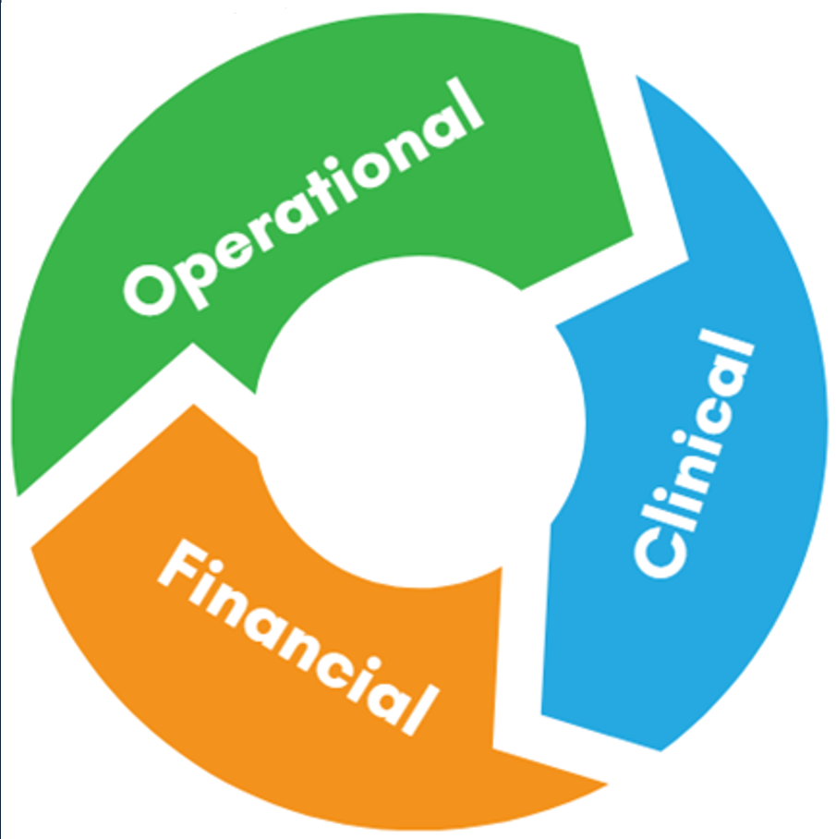
Our why: Excellence
Improving Population Health
Risk management pooling
Preventive Care
Scio-economically impactful
Reducing Cost of Care
Productivity
Sustainability
Cost effective
Comparatively effective
Quadruple
Aim
Patient Experience
Patient Satisfaction
Outcomes
Quality
Safety
Provider Experience
Provider Satisfaction
Work/Life Balance
Workflow optimization

Slide 4
Model for Change Management
https://www.kotterinc.com/methodology/8-steps/

Slide 5
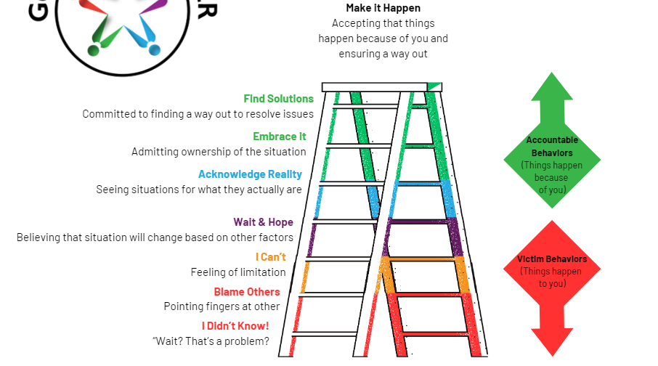
Ladder of Accountability

Slide 6
Our Golden Thread
A Golden Thread is a unifying element or connection. In clinical work, a "golden thread" refers to the consistent and logical connection that ties together all elements of a client's care. It ensures that every part of the client’s record aligns and supports the overarching treatment goals.
For All About Access (AAA), GCC’s Golden Thread is the Change Management Model.

Slide 7
Turning Insight into Urgency

Slide 8

Chaos
Distress
Powerlessness
FEAR

Slide 9

TEXAS has the HIGHEST number of DEATHS by SUICIDE
57 people in Brazoria County every year
59 people in Galveston County every year
hdpulse.nimhd.nih.gov

Slide 10
In 2021, there were a total of 5.8 million visits to the ER with primary diagnoses of mental, behavioral, and neurodevelopmental disorders.
In 2022, mental health visits to the ER rose 24% for children ages 5-11 and 31% for children ages 12-17 as compared to 2019.
cdc.gov

Slide 11

CARE SHOULDN’T START IN THE EMERGENCY ROOM
It should happen in a Community Health Center.
ALL ABOUT ACCESS IS THE BEGINNING OF HOPE.

Slide 12
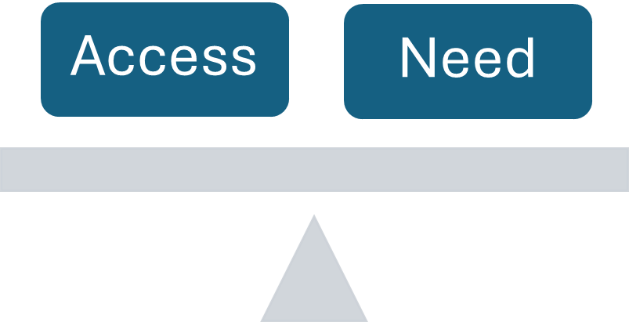
MENTAL HEALTH: Balancing ACCESS and NEED
ACCESS
  Funding
  Providers
  Services
NEED
  Prevalence
  Barriers

Slide 13
Our Experience Tells a Story of Want
How much change can I make in my role? I don’t know where to start.
The resources exist but we are not using them efficiently.
Community Partners tell me that services are difficult to access.
Will we ever catch up with the need?
Do we need to change all the processes, or just a few?
How can I defend a system that doesn’t seem to be serving our communities?
THE SYSTEM ISN’T WORKING.
Individuals come for help, and we are creating barriers to their care.

Slide 14
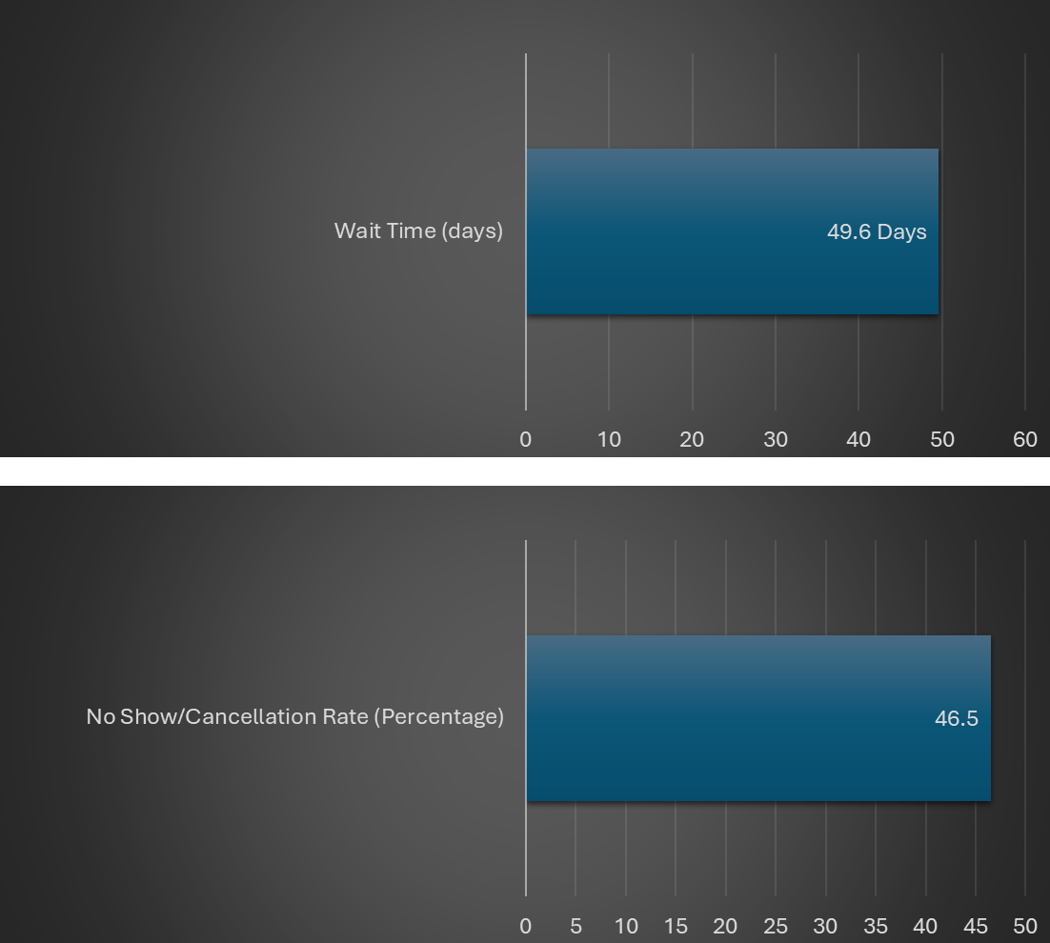
OUR DATA TELLS A STORY OF MISSED OPPORTUNITIES
Average Wait Time for Initial Assessments is 49.6dd with a No-Show of 46.5%.
In 2024, on average, only about 20% of our patients received their initial Mental Health assessment within the goal of 10 days of initial contact.
Individuals seek care when they have symptoms that they are unable to effectively manage on their own.
They are ready to engage, but our system is not always ready to receive them when they need the support.
Individuals may go elsewhere for treatment, or they may give up and stop asking for help.

Slide 15
“ASK FOR HELP. NOT BECAUSE YOU ARE WEAK. BUT BECAUSE YOU WANT TO REMAIN STRONG.”
~Lee Brown

Slide 16

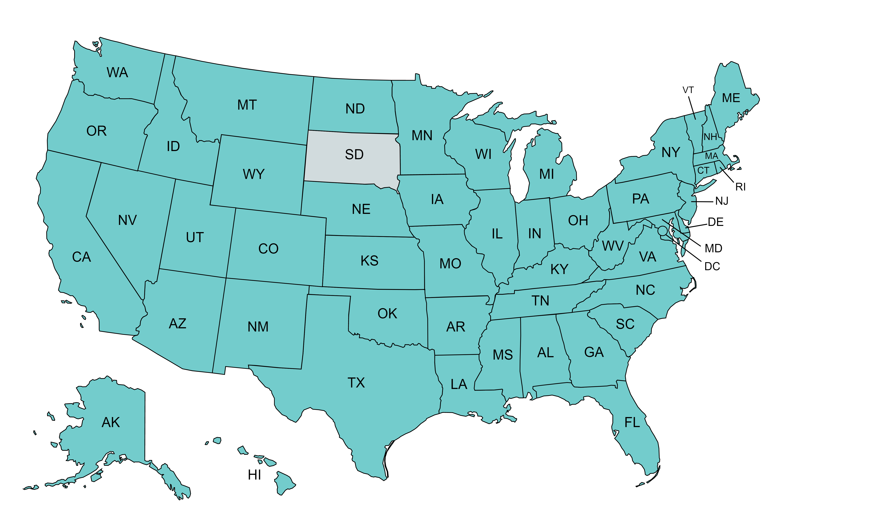
“Working to help organizations deliver the highest quality care possible, while improving the quality of life for those delivering the care!”
MTM Services has delivered consultation to over 1,000 providers (MH/SA/DD/Residential) in 49 states, Washington, DC, and 2 foreign countries since 1995.
MTM Services’ Access Redesign Experience (Excluding individual clients):
  5 National Council Funded Access Redesign grants with 200 organizations
  across 25 states.
  12 Statewide efforts with over 300 organizations.
  Over 30,000 individualized flow charts created.
Led CCBHC implementation and TA efforts in 5 states.
16

Slide 17
Same Day Access Consultation Results
Average Reduction in Wait Days = 47%
Average Increase in Intake Volume = 12%
Average Savings per Center = $128,416
Average Return on Investment = 6 to 1
WWW.MTMSERVICES.ORG

Slide 18
Building the Coalition: Vision Meets Action

Slide 19
“Coming together is a beginning. Keeping together is progress. Working together is success.”
~Henry Ford
The AAA implementation team started with many leaders throughout the organization to review the results of the gap analysis performed by MTM services.
As the months passed, the implementation got smaller, identifying key team players to assist with the development of the actual AAA process.

Slide 20

Same-day Mental Health Assessment. New diagnostic evaluations are available on an unscheduled basis via walk-in clinics at every site. No more scheduling of intakes.
We serve who we see.
Next-day Flexibility. Sometimes we need a contingency plan, to fit in a person in crisis, or maybe someone can’t wait today but they can come back tomorrow. No more no-shows or cancellations.
No one is turned away.
Use the people resources we have in place
To meet the needs of the patient in front of us
Without stressing the system

Slide 21

We welcome any individual who walks into our clinic.
We ask how we can help.
We listen to their story.
As a team we determine the best way to meet the individual’s needs right now.
We place the individual at the center of their care and create a plan.
No One Is Turned Away does not mean that we can meet all of an individual’s needs right now.
It DOES mean that we COME TO CARE.
Coming To Care means that we each believe in our ability to do just that – to care for those that seek help from us.

Slide 22
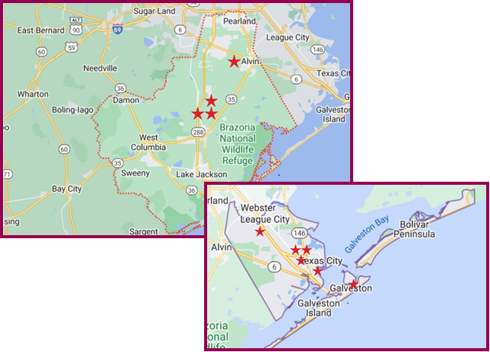

ALL ABOUT ACCESS
Walk-in
MH Assessments
EVERY Clinic
EVERY Day

Slide 23
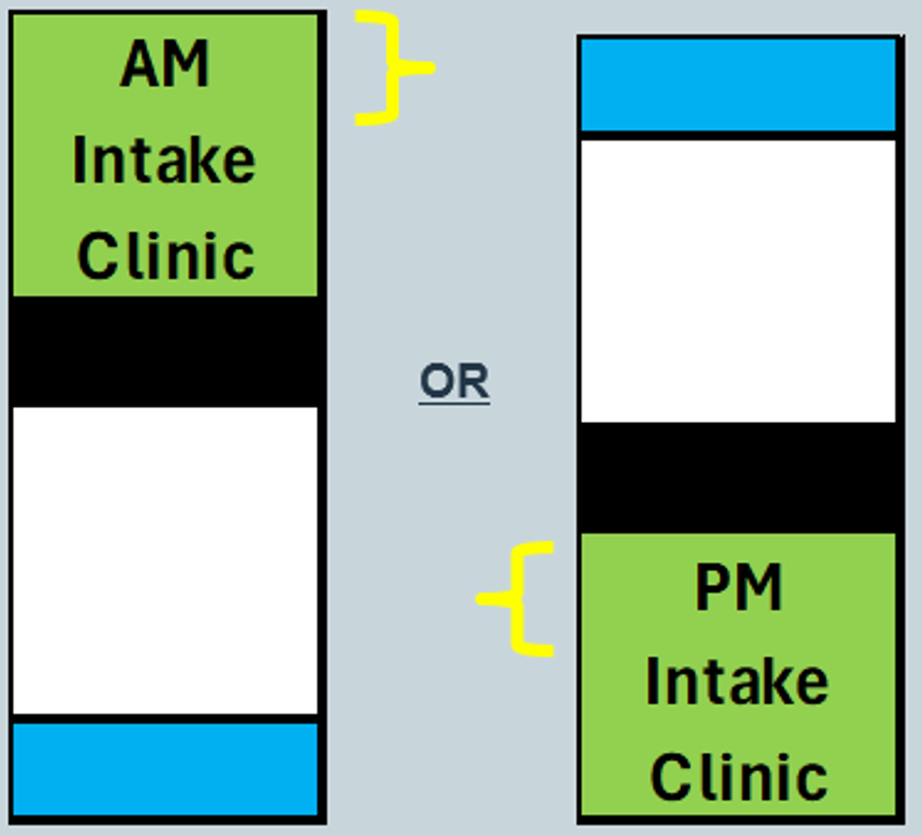
Initial Mental Health Assessment Clinics
Youth and Adults
No appointment needed
Half-day, every day, at all clinics
Arrival Time first part of clinic
Resourced throughout GCC
Optimize provider and staff schedules

Slide 24
Initial Mental Health Assessment Process
Person checks-in
(PSS)
Financial Assessment, Insurance Verification
(EA)
Mental Health Assessment
(QMHP + LPHA)
Level of Care Assessment and Treatment Planning
(QMHP)
Person checks-out
(PSS)
Total duration: 135 min (adults) - 165 min (youth).

Slide 25
Contingency Planning
Scenario Requires Contingency Plan
Clinic Program Manager Notified
Clinic PM Employs Appropriate Contingency Plan
Clinic PM Reaches out to BH Director(s), Access Coordinator +/- ‘Situation Room’ for Additional Help
If all options ruled-out: FAST PASS
Sample Scenarios:
Wait > 30 min after completing paperwork
Exceed on-site Q/L staffing resources
Individual impatient RE: wait time
Individual unable to wait, has not completed paperwork
Individual arrives after arrival window
Individual reports recent hospital discharge
Individual presents in Crisis
Request for services not provided by intake clinic, or GCC

Slide 26

CONTINGENCY PLAN STEPS: Initiate in order
1) Program Manager looks for an onsite Clinician (QMHP) who is available due to no-show or late cancellation. ​
2) Program Manager determines if an onsite Program Manager/Team Lead is available to complete the assessment.​
3) Program Manager confirms that there are no onsite clinicians available and will need a telehealth clinician (Remote QMHP or LPHA) to support the need.​
4) Program Manager requests support from the Access Coordinator on SDND Clinic Teams Channel.​
5) Access Coordinator looks for a center QMHP/LPHA who is available complete the assessment via televideo.​
6) All above options are ruled out, PSS offers a Fast Pass for the next day. ​
7.) When providing individual with the Fast Pass, hand them an appointment card and write “Fast Pass.” A card with a Fast Pass QR code will be used in the future.​
8.) Make sure to add the Fast Pass “flag” in individual’s chart in SmartCare. ​
​
For individuals who present in crisis, please remember to follow the desk procedure: https://gulfcoastcenter2.sharepoint.com/:w:/s/ZeroSuicide/EXAlT6mA019Au1b6VrFl9wkBth23LhIidXBQQEUAT00FVw?e=zTa9Pl​

Slide 27
Fast Pass Script
Program Support Staff – “I’m sorry the wait time is taking longer than we anticipated (or: “I’m sorry, but we are no longer seeing walk-ins today.”) but we have all of your initial paperwork done so I can offer you a Fast Pass for tomorrow. When you come in, you will be the next person to see our clinician. Is there a time between _____ and ____ tomorrow that would be convenient for you?
Script:
“Good. Be sure to be here by _____ tomorrow. If you are late, I won’t be able to hold the fast pass for you. Thank you for your understanding and I’ll see you tomorrow.
Client Agrees
Script:
“I’m very sorry we couldn’t accommodate you today. We will keep your paperwork on file for one month, so you won’t have to complete it again when you return. Here is a list of our intake hours and locations. We hope to see you again.
Client Says No

Slide 28
Transforming Message into Mobilization

Slide 29


Staff Buy-In Is Priceless
Staff buy-in is crucial when implementing change because it directly influences the success, sustainability, and impact of any new initiative.
Increases Engagement and Commitment
Reduces Resistance
Improves Implementation Quality
Builds Trust and Morale
Taps into Expertise
Drives Culture Change
Leads to Better Outcomes

Slide 30
Two presentations regarding AAA on two consecutive All Center Calls. The first presentation focused on the Why, focusing on what the Data is showing us, what the Community is telling us, and the process of Change Management.
The second presentation was more detail oriented and focused on how AAA will look in the clinics, and how specific roles will impact its implementation.
The AAA leadership team also attended smaller team meetings prior to implementation to answer questions and address concerns.
How We Did It

Slide 31

What we asked for:
What we meant:
A Commitment to hearing the message
An Open Mind regarding the why, the vision, the reasons behind the changes to come, and the changes that will take place
Insight into how these changes affect roles at GCC
Ideas and questions which can be brough additional upcoming smaller team meetings

Slide 32
Empowering Clinical Staff for Change
QMHPs did not complete MH Intake Assessments prior to AAA. All affected staff required documentation training and practice.
QMHP-----LPHA Warm Hand-Off: A process was created and reviewed with the QMHP and LPHA teams prior to beginning AAA.
Daily Huddle is a brief, recurring meeting where the team checks in to discuss goals, challenges, and priorities at the beginning or middle of the day. It should last no longer than 15 minutes.
Microsoft Teams Situation Room: Means of virtual communication for all Clinical Administrative Staff allowing close monitoring of Assessment Clinics and real-time implementation of solutions to urgent issues.

Slide 33
QMHPs did not complete MH Intake Assessments prior to AAA. All affected staff required documentation training and practice.
QMHP-----LPHA Warm Hand-Off: A process was created and reviewed with the QMHP and LPHA teams prior to beginning AAA.
Daily Huddle is a brief, recurring meeting where the team checks in to discuss goals, challenges, and priorities at the beginning or middle of the day. It should last no longer than 15 minutes.

Slide 34
Daily Huddle
A Daily Huddle is a brief, recurring meeting where a team check-ins in to discuss goals, challenges, and priorities. This is to be led by the Clinic Program Manager or other appointed staff. This is a daily teams call and should last no more than 15 minutes.
Welcome and Appreciations (name an event/person that stands out from yesterday)
AAA Staff Updates: Absences and coverage for today
Contingency Plan: Discuss if used the day before and why
Hospital Discharges: Review those who have been referred for today
Challenges: Does staff need additional support today?
Gratitude Moment: This can be a request to the team

Slide 35

The Situation Room
This group lives in TEAMS and is the primary way staff communicate urgent needs to one another.
For example: “My QMHP 2 went home sick, and we have 2 individuals waiting. Can anyone assist remotely?”
This channel also allows leadership to see how staff are communicating with one another and if they are overcoming barriers in a solution-focused way. Are clinic managers and team leads responding? If not, why?

Slide 36

The Difference We Made

Slide 37
Uniting Small Wins into Sustained Momentum

Slide 38
Short Term Wins: In September 2024, AAA data was shared on the All-Center Call to show staff how their commitment to the process was positively impacting those seeking services. Additional data updates are shared every few months in a variety of different meetings.
Don’t Let Up: Reminding the team of the WHY and how to reach out for help. Leaders ask how the process is going when meeting individually with staff and during team meetings.

Slide 39
WHAT AAA DATA IS SHOWING US
Average time between Intake and Initial Psychiatric Appointment: 3-5 business days
Initial Psychiatric Appointment No-Show Rate stands at 32%. Prior to beginning AAA services, the no-show rate for the first psychiatric appointment was 46.5%. This is a decrease of 14.5%.
Between 9/1/24 - 6/1/25, GCC completed a total of 2,100 intakes!
CLINIC | ALLOTTED # OF SLOTS | TOTAL NUMBER OF INTAKES COMPLETED BETWEEN 9/1/24-6/1/25 | TURN AWAY EVENTS (FAST PASS GIVEN) 9/1/24-6/1/25 | WALK OUT EVENTS (AN INDIVIDUAL LEAVES WITHOUT A SERVICE OR FAST PASS) 9/1/24-6/1/25
Texas City: Adult | 6-8 | 621 | 207 | 71
Southern Brazoria: Adult | 3 | 418 | 40 | 6
Northern Brazoria: Adult | 3 | 229 | 31 | 11
Galveston Island: Adult | 4 | 427 | 68 | 51
Southern Brazoria: Youth and Family | 3 | 200 | 24 | 9
Galveston: Youth and Family | 3 | 205 | 8 | 9

Slide 40
A FEW LESSONS LEARNED….
AAA is not a first-come, first serve service.
1
We get too comfortable and fail to maintain fidelity to the process
2
Plan for coverage!!!
3

Slide 41

Moving Away From First Come, First Serve Mentality
AAA is not a service that requires an individual to get to the clinic first.
This is different than other social services in the community, or the traditional way we think about social services.
If we continue to think about AAA as a first come, first serve service, it will not function as it’s intended.

Slide 42

DON’T FORGET THE CONTINGENCY PLAN
A Fast Pass is given only when the clinic cannot accommodate an individual during the same day process due to being at capacity for that day, or if the wait time exceeds 30 minutes.
If the clinic can see the individual and the wait time is 30 minutes or less and the individual cannot wait, no Fast Pass would be provided.
A Fast Pass is only given when all resources have been exhausted.

Slide 43
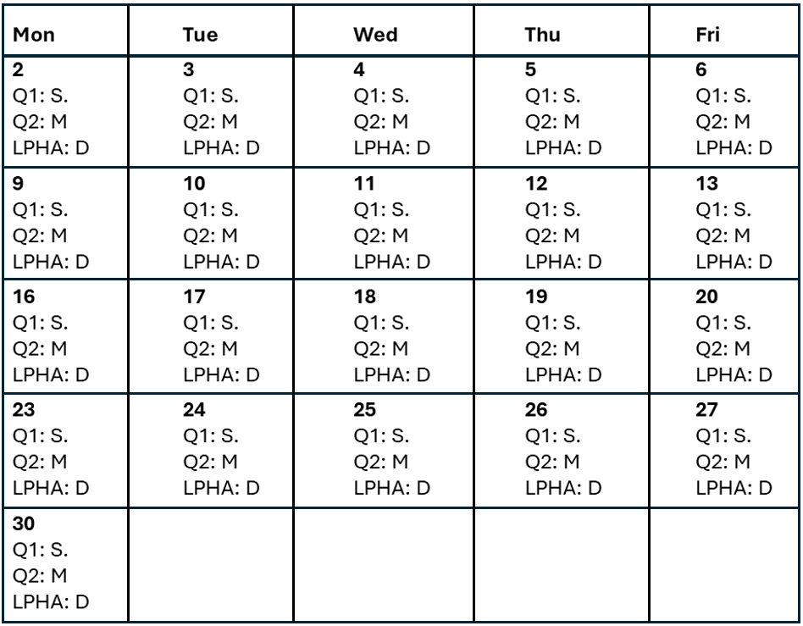
AAA Monthly Clinic Calendar: Looking ahead for the month. Do we have enough coverage?
AAA QMHP Time Off Requests: Clinic Managers must think ahead when approving QMHP and LPHA time off

Slide 44
Making Positive Change the Cultural Norm

Slide 45

Now, more than 90% of persons seeking care from GCC achieve their Initial Mental Health Evaluation in <10 days
Now, on average, individuals are scheduled for a psychiatry intake within 3-5 days after their initial mental health appointment

Slide 46

Seeing the Path Forward:
“Accessibility is a culture to be built.”
- Sheri Byrne-Haber
Follow-up psychiatry appointments are booked 2 weeks to 3 months out on average
Work-in appointments are utilized on a regular basis to address clinical concerns
Schedules are booked to a fullness of 115% or more
20% or more of scheduled appointments are a ‘no-show’
Just under 20% of appointments are cancelled last minute
By the end of day of service, psychiatry schedules are almost ½ empty
… so right now, someone has to wait, even though we have room.

Slide 47
Deepening our Culture of Access
Just-In-Time Prescriber Scheduling, MTMServices.org
Key features:
  Appointments scheduled no more than 3-5 days out
  Refills following missed appointment needs prescriber visit
  Expected drastic increase in Show rate
    Leads to more predictable schedule, including less inter-appointment refills for prescribers to manage
Maintaining fidelity to the JIT model while tailoring to organizational context
Continued Change Management Approach

Slide 48

Easy Psychiatry Scheduling
WHO: | Individuals receiving psychiatric care at GCC
WHEN: | For return psychiatry appointments needed on or after July 28, 2025
WHAT: | We will schedule appointment within 3 to 5 days of being contacted
WHERE: | All GCC psychiatry clinics - youth and adults
HOW: | After visit, the front desk staff will provide a reminder card The card will say when to call to make the next appointment When we are called, we will schedule the return appointment within 3 to 5 days

Slide 49
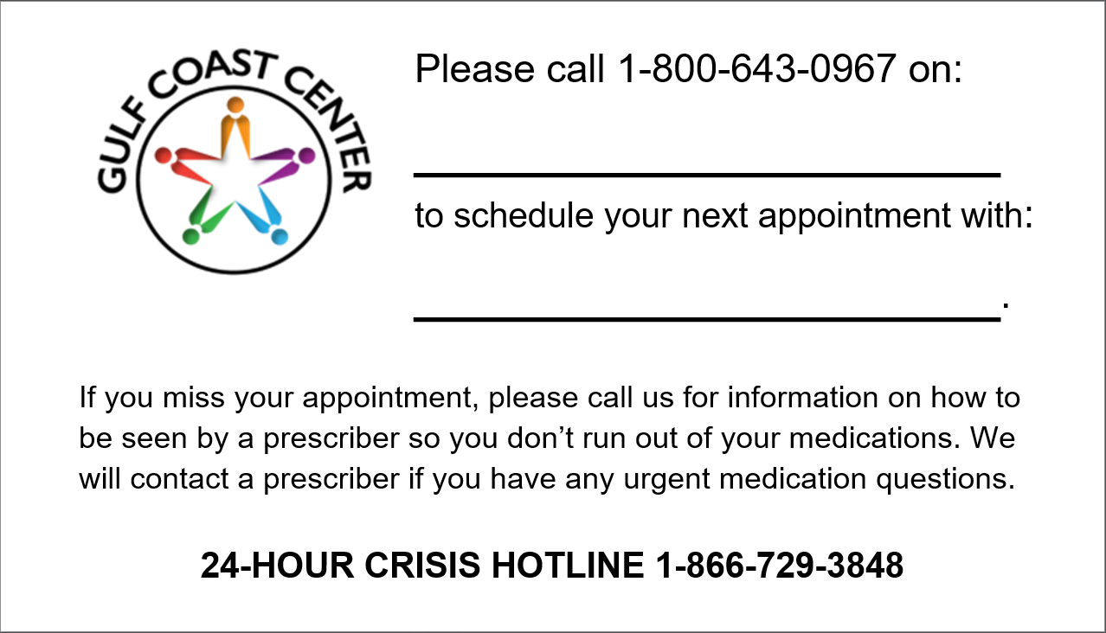
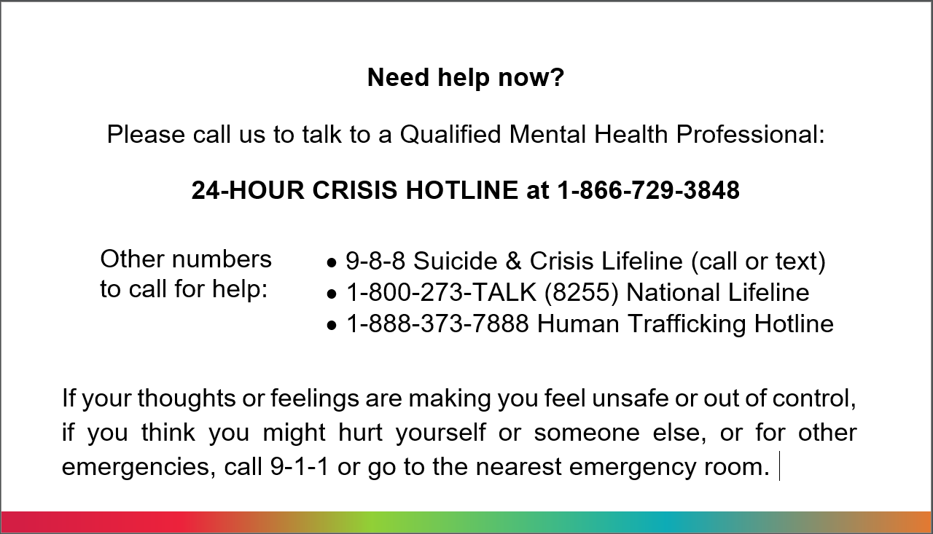
Keeping People Connected:
Patient Letter
Appointment Card
Scripting for Staff
Documentation in Patient Record
Automated Reminder Text Messages
Automated Reminder Calls
Case Management
Outreach for Missed Appointments

Slide 50
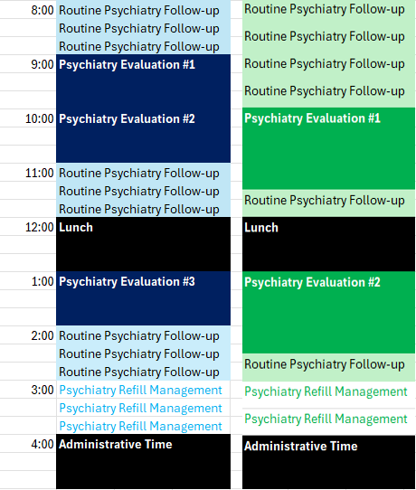
Missed Appointments
Individuals instructed to call us so they can be seen by a prescriber for a Psychiatry Refill Management visit
These will be short visits, same-day; Walk-in vs. Work-in
Individuals may have to wait and may not see their usual prescriber
Enhances SAFETY
  Avoids ‘blind’ refills
  Increased engagement of individuals in care
  Prescribers continue to be contacted for any urgent clinical or medication issues

Slide 51

When ACCESS to Quality Mental Health Care meets or exceeds NEED, Mental Health SOARS

Slide 52

Calm
Comfort
Capability
HOPE
Academic Medicine 95(5):p 682-685, May 2020.

Slide 53
“Culture does not change because we desire to change it. Culture changes when the organization is transformed; the culture reflects the realities of people working together every day.”
~ Frances Hesselbein

Slide 54

Thank
You

