Slide 1
Innovative Techniques &
Tools for Comprehensive Grant Management
Dr. Twanda Wadlington Senior Director of Development
Executive Director of MHMR Foundation

Slide 2
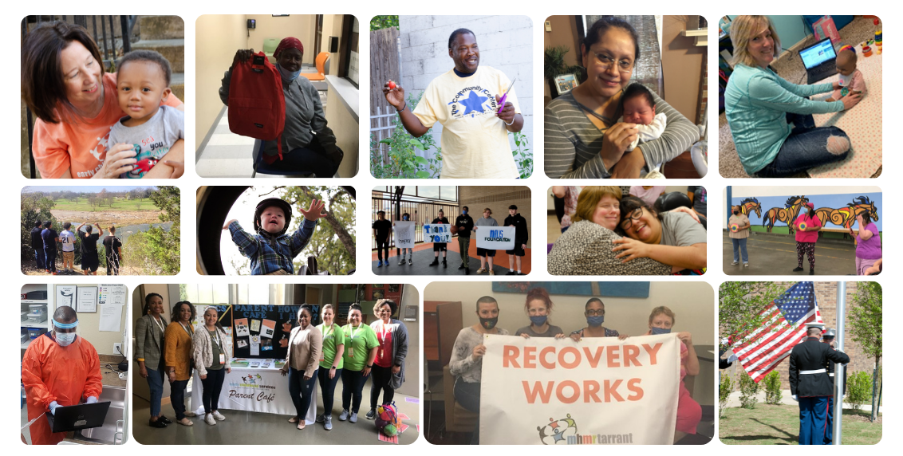
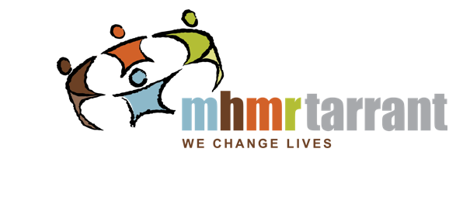
About My Health My Resources of Tarrant County
For more than 50 years, MHMR has provided community-based services for youth and adults with intellectual and developmental disabilities (IDD), mental health conditions, and substance use disorders, as well as babies and young children with developmental delays.
MHMR employees use a person-centered approach to fulfill the mission: We Change Lives! Using innovative approaches,
MHMR partners with community organizations to provide services and a hopeful future.

Slide 3
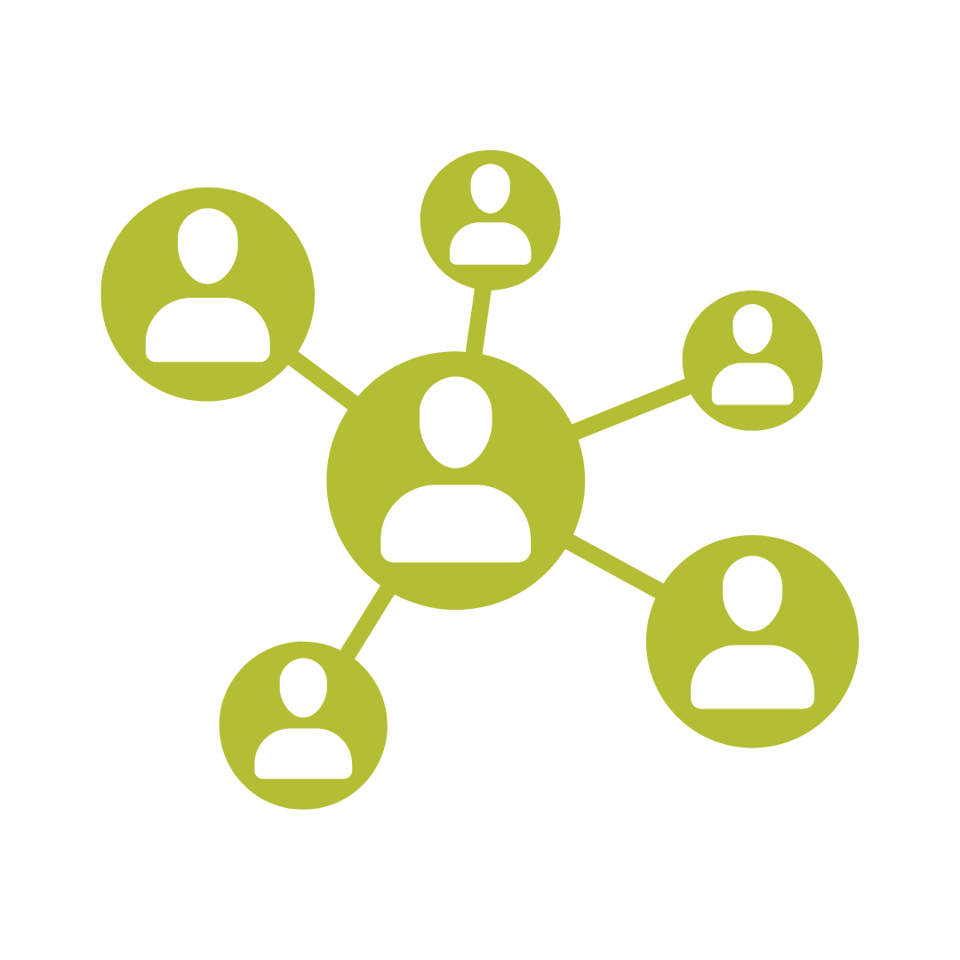
2024 Recap - Grants & Development Tips, Tools, and Lessons Learned
Balancing Funding Priorities
Enhancing Collaboration Internally & Externally
Challenges
Technology & AI

Slide 4
Balancing Funding Priorities: Performance Contracts vs. Grants
Accountability & Deliverables:
Performance contracts emphasize measurable outcomes and strict accountability.
Grants often allow more flexibility in deliverables and timelines.
Complementary Roles:
Grants can fund innovation and capacity-building.
Performance contracts can drive long-term success and accountability.
Management Challenges:
Navigating differing compliance requirements.
Balancing short-term deliverables with long-term strategic goals.

Slide 5
Enhancing Collaboration Internally & Externally
Adapting Structures:
Foster cross-functional teams and shared leadership models.
Implement systems that support transparency and joint planning.
Benefits of Collaboration:
Shared resources, broader impact, and innovation.
Cross-sector partnerships can address complex social issues.
Overcoming Barriers:
Build trust by communicating clearly and aligning on shared goals and milestones.
Use a collaborative to mediate conflicting priorities.

Slide 6
Challenges
Institutional Resistance:
Use change champions and phased implementation.
Communicate clear benefits and align with mission.
Building Buy-In Internally & Externally:
Engage stakeholders early and often.
Highlight shared goals and past successes.
Securing Matching Funds:
Leverage in-kind contributions and public-private partnerships.
Explore crowdfunding or community investment models.

Slide 7
Examples of Matching Funds – Cash
Existing cash reserves set aside to address match requirements.
Cash contributions from individuals, businesses, and other organization.
Portion of the organization's unrestricted cash-on-hand or general support funds towards project expenses.
Partners who can contribute matching funds.
Funds from other grants to meet the matching requirement, if allowed by the grantor

Slide 8
Examples of Matching Funds – In Kind
Volunteer services dedicated to the project activities.
Staff time and effort dedicated to the grant-funded project as an in-kind contribution.
Donated items like office supplies, equipment, facilities, or professional services (e.g., legal or accounting).
Office space, meeting rooms, or utilities specifically used for the grant-funded activities.

Slide 9
Technology & AI
Transformative Impact:
AI streamlines application reviews and identifies funding trends.
Tech platforms improve transparency and efficiency.
Databases
Excel
Shared documents
Ethical Considerations:
Ensure fairness, transparency, and data privacy.
Avoid bias in AI-driven decision-making processes.
AI results requires review, edits, and approval.

Slide 10
2025 Learning Objectives
Understand the full lifecycle of grant management and the critical touchpoints from pre-award to post-award.
Gain insights into the practical application of tools and techniques that can enhance grant management efficiency.
Learn from the real-world experiences of MHMR of Tarrant County, including best practices and lessons learned.
Notes:
This presentation will explore innovative strategies and tools that can revolutionize your approach to grant management, from prospecting to post-award tracking and reporting.

Slide 11
Defining Grant Management
….refers to the comprehensive oversight of a grant throughout its entire lifecycle, which includes the pre-award, award, and post-award phases. This process helps organizations ensure that funds are used responsibly, enhances the efficiency of tracking and financial reporting, builds a strong performance history for securing future grants, and strengthens relationships with funding agencies.
Key components of grant management include:
Research and gathering information.
Seeking new grant opportunities.
Applying for relevant grants.
Utilizing funds to further organizational goals.
Preserving pertinent information in a shared accessible space.
Notes:
Grant Management Life Cycle FAQs
What are critical steps in the grant management process?
There are three phases to the grant management life cycle process: pre-award, award and post-award. Each of these phases contains multiple steps, beginning with a nonprofit’s examining its needs and researching funding opportunities, and ending with closing out a grant once the funded project is complete or the money has been spent.
What are the key components of grant management?
The seven key components of effective grant life cycle management are identifying and assessing grant opportunities, developing a proposal, performing contract management, managing and reporting on finances, implementing and monitoring program operations, ensuring compliance, and managing relationships.
How can technology help with the grant management life cycle?
By leveraging technology, nonprofit organizations can streamline and automate administrative processes, enhance collaboration and communication, improve financial management and compliance and optimize their grant management efforts.
Why is it important to understand the grant management life cycle?
Understanding the grant management life cycle enables nonprofits to effectively navigate the entire grant process, from identifying opportunities to closeout. By understanding each phase, nonprofits can identify suitable opportunities, develop strong proposals, implement projects in alignment with grant requirements and ensure compliance and accountability. This knowledge enables nonprofits to maximize their chances of securing funding, efficiently manage grant money and demonstrate impact to grantors.
What are four tips for responsible grant management?
First, establish clear communication channels with the grantor and maintain regular contact throughout the grant period to ensure alignment, address concerns and provide timely updates. Next, develop a robust system for financial tracking and reporting to ensure accurate and transparent use of grant funds, timely submission of financial reports and adherence to budgetary guidelines. Then, maintain meticulous documentation of all grant-related activities, including project milestones, expenses and outcomes, to support compliance, auditing and future reporting requirements. And finally, foster a culture of continuous learning and improvement by regularly evaluating the grant management process, identifying lessons learned and implementing necessary adjustments to enhance future grant seeking and management efforts.

Slide 12
The Grants Lifecycle
Pre-Award
Award
Post-Award/ Closeout
Research
Proposal & Budget Development
Application Submission
Application Review
Negotiation
Acceptance
Implementation & Management
Monitoring & Reporting
Evaluations & Closeout
Audit

Slide 13
Traditional Versus Modern Grant Management
Traditional Grant Management
Modern Grant Management
Manual processes and spreadsheets
Inefficiency and potential for errors
Decentralized processes
Mounds of paperwork!
Data-driven and technology-enabled systems
Increased efficiency and accuracy
Centralized systems
Data analytics and insights
Transparency and accountability

Slide 14
Our Challenges
Increasing competition
Evolving funder requirements (match, MOUs, Letters of Support)
Need for greater transparency and accountability (reporting)
Data security and privacy
Technology integration and adaptation

Slide 15
Innovative Techniques for Improved Grant Management
Strategically prioritize funding needs
Centralize grant information
Make data-driven decisions
Build a culture of transparency and accountability
Invest in capacity building
Prioritize sustainability
Foster collaboration
Implement risk management strategies
Implement continuous improvement strategies (e.g., outline roles)

Slide 16
Innovative Tools for Efficient Grant Management
Integrated Grant Management Software (CRM): Use CRM systems specifically designed for nonprofits or customized for grant management to centralize data, streamline workflows, and enhance communication.
AI-Powered Tools: AI can assist in various aspects of grant management.
Automated Reporting Tools: Generate automated reports for financial tracking, project performance, and compliance, saving time and ensuring accuracy.

Slide 17
Innovative Tools for Efficient Grant Management Cont.
Real-Time Expense Tracking: Utilize financial management systems to track and monitor expenditures in real-time, ensuring adherence to budget allocations and grant requirements.
Cloud-Based Storage Solutions: Store all grant-related documents in a secure, centralized location, ensuring easy access and facilitating audits.
Project Management Software: Utilize project management tools to create timelines, track milestones, and manage tasks throughout the grant lifecycle.

Slide 18
SharePoint – Development Team (Public)

Slide 19
SharePoint – Development Team (Private)

Slide 20
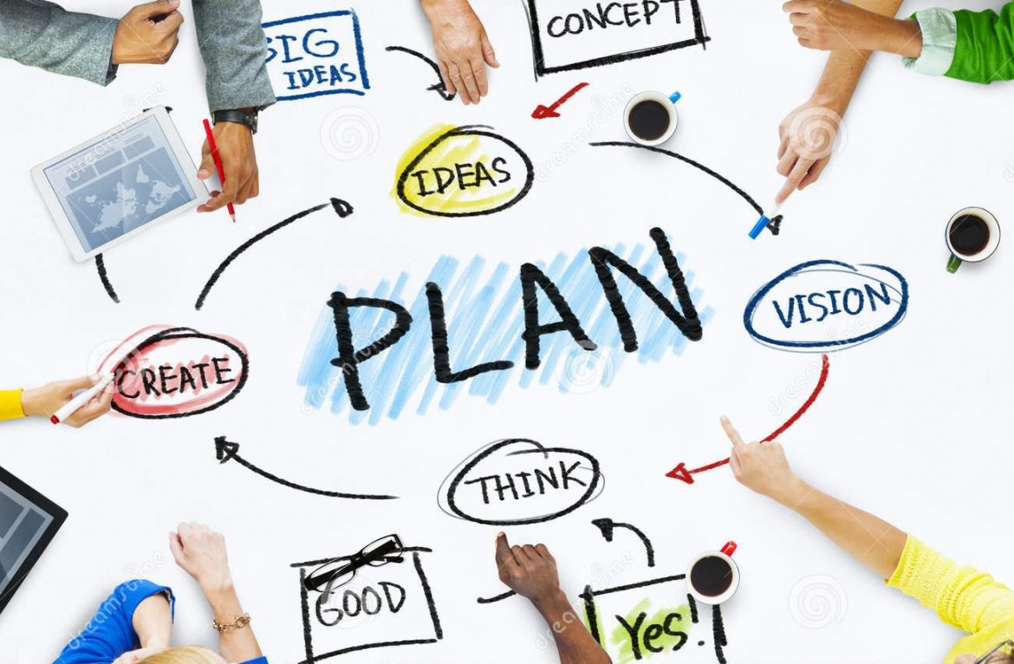
Key Components of a Comprehensive Grant Management Plan
Develop clear project goals and objectives that are SMART (Specific, Measurable, Achievable, Relevant, and Time-bound).
Implement robust systems for tracking and reporting expenses.
Understand and adhere to all grant requirements and regulations.
Develop a plan for evaluating project impact and submitting regular progress reports.
Establish clear communication channels for internal and external stakeholders.

Slide 21
Implementing Innovative Techniques and Tools
Choose the right tools!
Invest in training staff to effectively utilize new tools and techniques.
Regularly evaluate the effectiveness of implemented innovations and adapt strategies as needed.

Slide 22
MHMR in Action…
Grant Team Roles
Master Grant Submission Calendar
Weekly Grant Management Meetings
Grany Management Tasks vis Planner
Shared Grant Application Repository
Weekly Email Grant Updates
Agency versus Foundation

Slide 23
Grant Team Roles

Slide 24
Master Grant Submission Tracker
Awarded

Slide 25
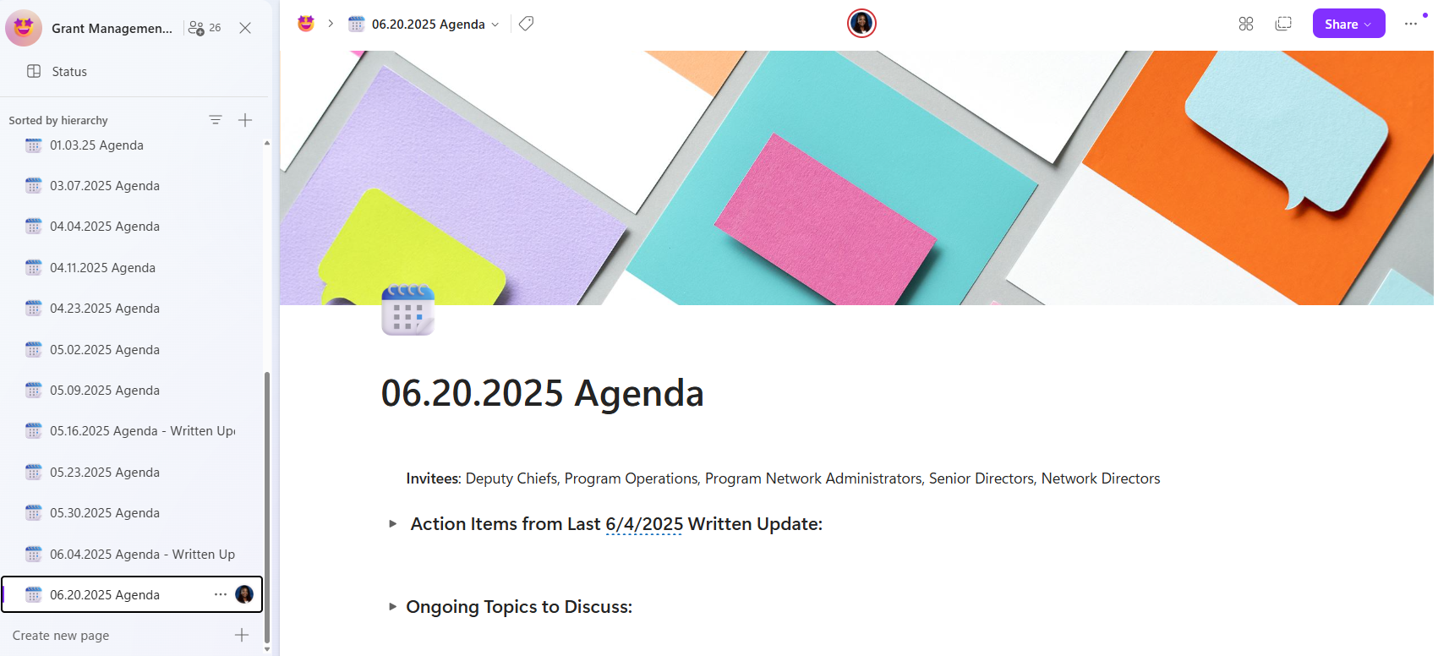
Weekly Grant Management Meetings

Slide 26
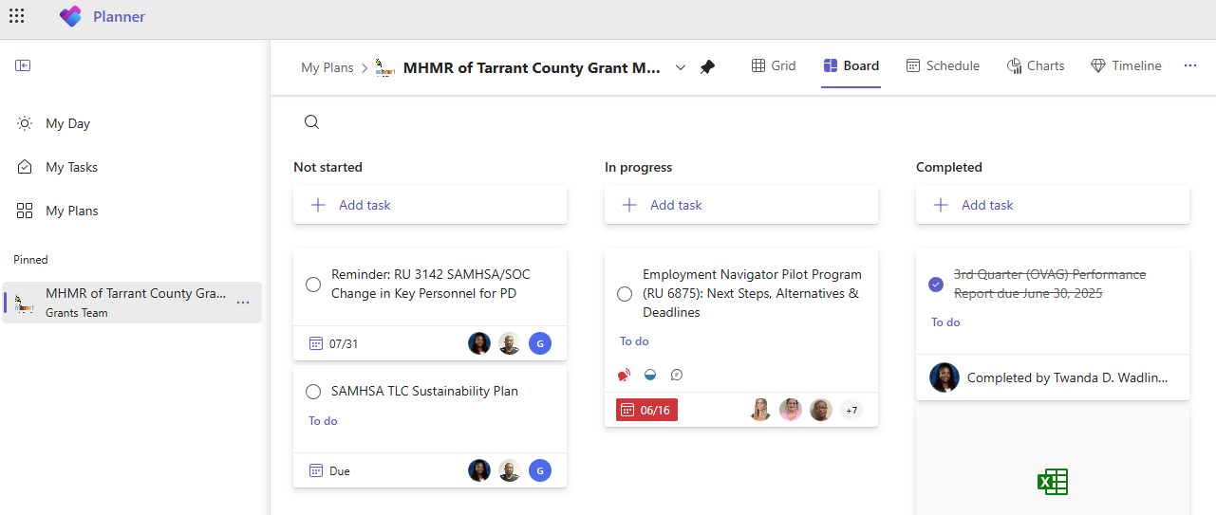
Grant Management Tasks via Planner

Slide 27
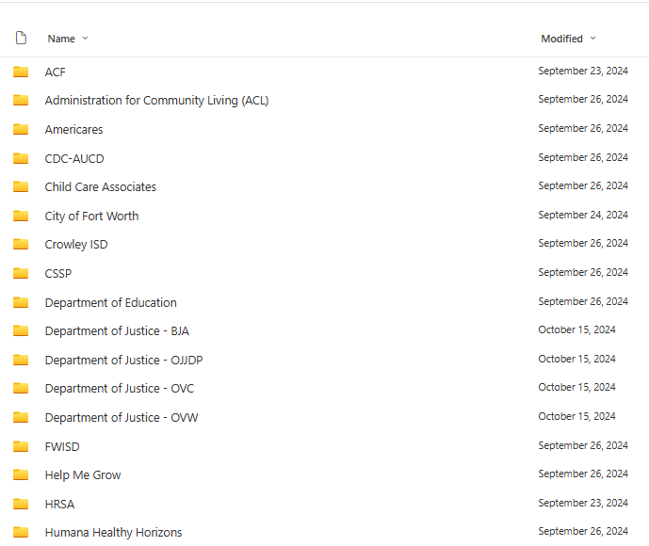
Shared Grant Application Repository

Slide 28
Weekly Email Grant Updates

Slide 29
Agency Organizational Chart

Slide 30
Development Team Organizational Chart
MHMR
Chief of Staff
Senior Director of Development /
MHMR Foundation Executive Director
Grant Specialist
Grant Coordinator
Board Liaison /
Communication Coordinator
Communication Specialist
Communication Intern

Slide 31
Recent Grant Success (2022 to present)
MHHR of Tarrant County
State
Rider 52 (MST & YCOT)
Peer-Run Youth Crisis Respite Program (PRYCRP)
Mental Health Grant for Justice-Involved Individuals
PEI Texas Home Visiting
General Victims Assistance Grant Program
Community-Based Services for Commercially Sexually Exploited Youth
Construction Grant Program for Mental Health Facilities
Supporting Mental Health and Resiliency in Texans Innovation (SMART)
State Crisis Intervention Grant Program

Slide 32
Recent Grant Success (2022 to present)
Federal
DOJ BJA FY 2023 Adult Treatment Court Discretionary Grant Program
DOJ OJP FY 2023 Comprehensive Opioid, Stimulant, and Substance Use Site-based Program (COSSUP)
VA Homeless Providers Grant and Per Diem (GPD) Program Per Diem Only (PDO)
SAMHSA Community Mental Health Centers
SAMHSA System of Care
SAMHSA Treatment Drug Courts
SAMHSA Healthy Transitions
HRSA Pediatric Mental Care Access

Slide 33
Recent Grant Success (2022 to present)
MHMR Foundation
The Meadows Foundation
The Morris Foundation
The Pritzker Foundation
The Rainwater Foundation
The Rees Jones Foundation
United Way of Tarrant County
United Way of Wise County

Slide 34
Trends at MHMR
State Grants
Increase funding for community-based services
Integrating Mental Health and IDD Services
Whole-person care approach
Cross-training of staff
Challenges with IDD
Workforce shortages
Funding gap

Slide 35
Thank you! Questions?
Twanda.Wadlington@mhmrtc.org
www.linkedin.com/in/drtwandadrph
Communication@mhmrtc.org

Slide 36
We Want Your Feedback
Take a few moments to complete this anonymous survey to help us improve.

