Slide 1

Check in code 3003

Slide 2

Jailhouse Docs:
Psychiatric Care in the county jail setting

Slide 3

    Jonathan Artz, MD, MS
      Assistant Medical Director, Bluebonnet Trails Community Services
    Courtney Bearden, PMHNP-BC
      Director of Medical Services Administration, Bluebonnet Trails Community Services

Slide 4
Disclosure to Learners
38th Annual Texas Council Conference
June 25-27, 2025

Slide 5
Successful Completion
Successful completion of this continuing education activity includes:
Missing no more than 15 minutes of the activity or each session.
Completion and submission of participant evaluation.
Notes:
Summarize: “Here are the instructions to successfully earn CE credit”

Slide 6
Continuing Education
Continuing Medical Education:
This activity has been planned and implemented in accordance with the accreditation requirements and policies of the Texas Medical Association (TMA) through the joint providership of The Texas Department of State Health Services Continuing Education Program and Texas Council of Community Centers.
The Texas Department of State Health Services Continuing Education Program is accredited by the Texas Medical Association to provide continuing medical education for physicians.
The Texas Department of State Health Services Continuing Education Program designates this live activity for a maximum of 6.00 AMA PRA Category 1 Credits™. Physicians should claim only the credit commensurate with the extent of their participation in the activity.
This activity has been designated by the Texas Department of State Health Services Continuing Education Program for 1.50 credits of education in medical ethics and/or professional responsibility.
Notes:
Summarize slides 3-4: “Here are the accreditation statements for continuing medical education, nursing continuing professional development, and licensed psychologists.”

Slide 7
Continuing Education
Nursing Continuing Professional Development:
The Texas Department of State Health Services Continuing Education Program is accredited as a provider of nursing continuing professional development by the American Nurses Credentialing Center’s Commission on Accreditation.
The Texas Department of State Health Services Continuing Education Program has designated a maximum of 6.00 contact hours of Nursing Continuing Professional Development.
Licensed Psychologists:
The Texas Department of State Health Services Continuing Education Program has designated a maximum of 6.00 contact hours for Licensed Psychologists.
This activity has been designated by The Texas Department of State Health Services Continuing Education Program for 1.50 hours in professional ethics.
Notes:
Summarize slides 3-4: “Here are the accreditation statements for continuing medical education, nursing continuing professional development, and licensed psychologists.”

Slide 8
Commercial Support &
Disclosure of Conflict of Interest
This event received no commercial support.
The speakers and Planning Committee for this event have disclosed no financial interests.
Notes:
Summarize: “There are no disclosed financial interests or commercial support.”

Slide 9
Non-Endorsement Statement &
Off Label Use
Accredited status does not imply endorsement of any commercial products or services by the Texas Department of State Health Services, Texas Medical Association, or American Nurse Credentialing Center.
The speakers did not disclose the use of products for a purpose other than what it had been approved for by the Food and Drug Administration.
Notes:
Summarize: “These are statements for non-endorsement and off label use.”

Slide 10
Objectives
Objectives
1. Describe the logistical challenges of implementing a jail psychiatric clinic.
2. Identify unique challenges of treating patients in a county jail setting.
3. Describe the process for completing forced medicine applications and competency evaluations.

Slide 11
Objectives
Objectives
1. Describe the logistical challenges of implementing a jail psychiatric clinic.
2. Identify unique challenges of treating patients in a county jail setting.
3. Describe the process for completing forced medicine applications and competency evaluations.

Slide 12

Meet Jake
  24yo WM
  Diagnoses of Schizophrenia, Alcohol Use Disorder and Cannabis Use Disorder
  First seen in BTCS crisis respite center

Slide 13

Meet Jake
  Arrested by local police for making verbal threats to strangers in the parking lot at HEB

Slide 14

Meet Jake
  Scenario A:
  Jake is detained and remains in county jail pending hearing.
  He is not taking medication and continues to deteriorate, experiencing worsening command AVH and paranoia.
  Jake assaults a correctional officer and is subsequently charged with felony assault on a public servant.

Slide 15
Psychiatric needs in the county-based jail system
  Estimated 34% of adult inmates have a mental health disorder; approx. 70% in youth detention facilities
  County jails remain the largest mental health facilities in the state
  Some 1,753 inmates in Texas county jails are awaiting transfer to state hospital beds.
  The average wait time for transfer to a maximum-security unit (MSU) is 233 days, while the average wait for non-MSU beds is 189 days.

Slide 16
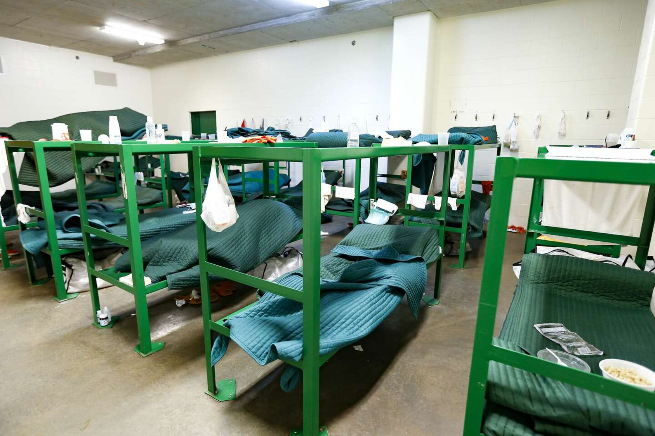

Slide 17
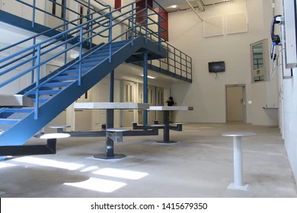

Slide 18


Slide 19
Meet Jake
  Scenario B:
  Jake is detained and remains in county jail pending hearing.
  He is seen by a psychiatric prescriber and restarted on Invega Sustenna.
  Jake’s symptoms improve and he can engage in legal process and release planning.

Slide 20
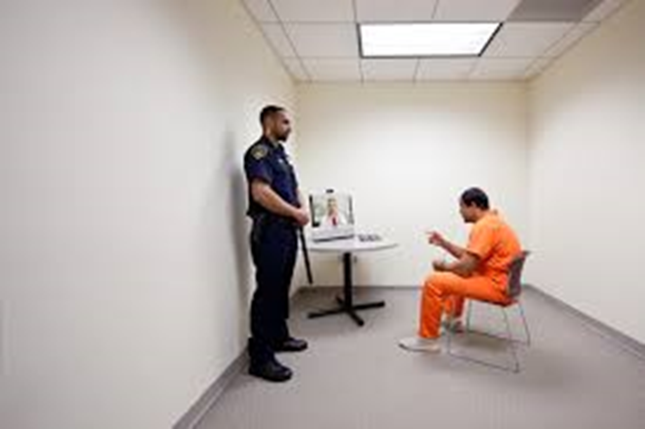
Contracting Process
Benefits of telehealth vs in-person clinics
Costs to consider in contracted rate
  Provider time
  Collaborating physician
  Liability coverage
  Administrative overhead
Role of NPs/PAs with physician collaboration
Notes:
Telehealth- more time and cost effective,
In-person- able to see patients unwilling or unsafe to bring down to medical
NPs/PAs- less expensive, easier to fill position
MD/DOs- able to complete forced med applications and CMEs
BTCS hourly rates:

Slide 21
Logistical Challenges
Limited technology in the jail
  BTCS provides our own equipment and IT support
Jail staffing limitations
  Schedule clinic around count and mealtimes
  Avoid scheduling clinic on court days if possible
Coordination with jail primary care
  Strongly encourage psych provider gain read-only access to the jail’s medical record

Slide 22
Objectives
Objectives
1. Describe the logistical challenges of implementing a jail psychiatric clinic.
2. Identify unique challenges of treating patients in a county jail setting.
3. Describe the process for completing forced medicine applications and competency evaluations.

Slide 23
Formulary Limitations
  Consideration of dosing times (most jails avoid TID+)
  Drugs with risk of abuse or diversion
  High-cost medications
  The most important thing here is communication. We share our BTCS formulary with the jail before beginning to provide services and agree upon a shared formulary.

Slide 24

Formulary Limitations
  Medications commonly limited in correctional setting:
  Any controlled substance
  Wellbutrin
  Seroquel (“quell” or “baby heroin”)
  Hypnotics
  Effexor IR
  ADHD treatment (including non-stimulants)
  Tegretol
  Gabapentin

Slide 25

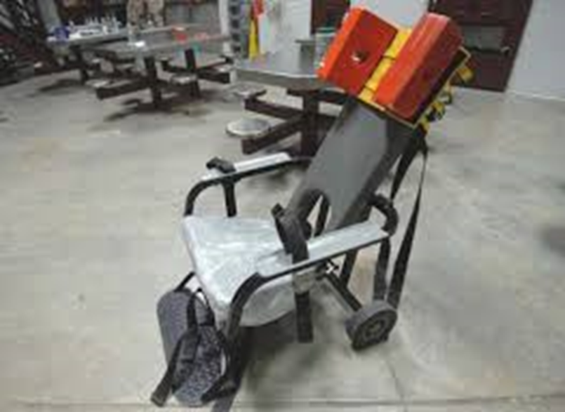
Safety Precautions

Slide 26
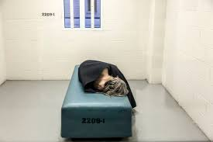
Safety Precautions

Slide 27
Benefits
Continuity of care for our patients seen at Bluebonnet and in/out jail system
Flexibility with provider- can move providers in and out of jail clinic as needed to meet agency needs
Reliable income stream

Slide 28
Meet Jake
  Released on PR bond with a prescription for Invega Sustenna and naltrexone. Warm handoff to Bluebonnet outpatient clinic.

Slide 29
“My free world doctor prescribed me to take my Wellbutrin crushed and snorted.”
“This will get my charges dropped, right?”
“Can you order the judge to let me out?”
“I was diagnosed with Amphetamine Deficiency Disorder as a child.”
“Well it was worth a try.” (after asking for medicinal cannabis)

Slide 30
Objectives
Objectives
1. Describe the logistical challenges of implementing a jail psychiatric clinic.
2. Identify unique challenges of treating patients in a county jail setting.
3. Describe the process for competency evaluations and completing forced medicine applications.

Slide 31
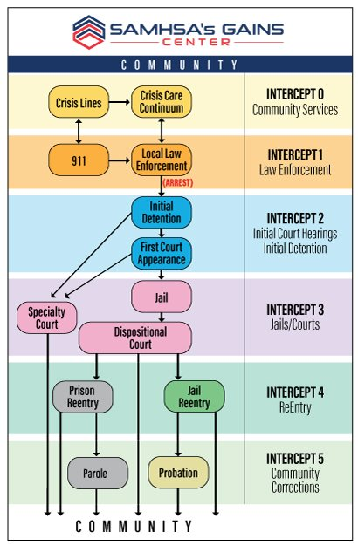
Jail Diversion Services
Jail Medical/Psychiatric Care
Jail Based Competency Restoration

Slide 32
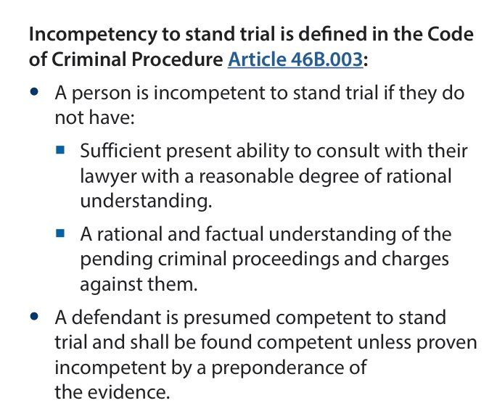
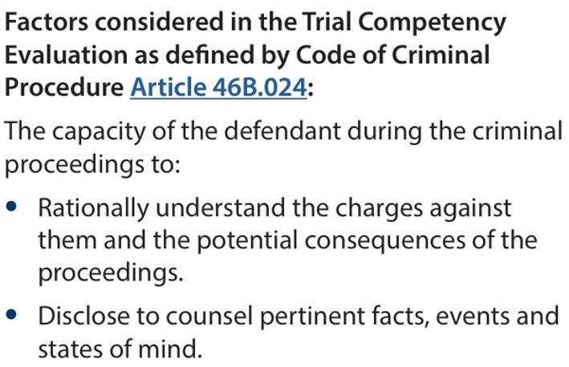
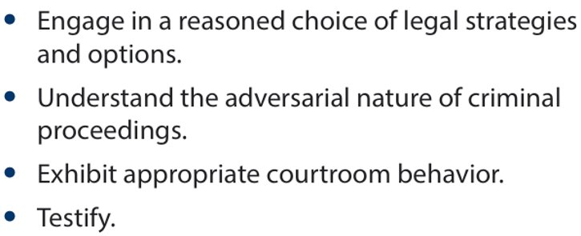
What Makes Someone Incompetent to Stand Trial (IST)?
Notes:
https://txbhjustice.org/assets/main/downloads/trial-competency-and-forensic-commitments-101.pdf

Slide 33
Qualifications for Competency Evaluations
Art. 46B.022. EXPERTS: QUALIFICATIONS. (a) To qualify for appointment under this subchapter as an expert, a psychiatrist or psychologist must:
(1) as appropriate, be a physician licensed in this state or be a psychologist licensed in this state who has a doctoral degree in psychology; and
(2) have the following certification or training:
(A) as appropriate, certification by:
(i) the American Board of Psychiatry and Neurology with added or special qualifications in forensic psychiatry; or
(ii) the American Board of Professional Psychology in forensic psychology; or
(B) training consisting of:
(i) at least 24 hours of specialized forensic training relating to incompetency or insanity evaluations; and
(ii) at least eight hours of continuing education relating to forensic evaluations, completed in the 12 months preceding the appointment.
(b) In addition to meeting qualifications required by Subsection (a), to be appointed as an expert a psychiatrist or psychologist must have completed six hours of required continuing education in courses in forensic psychiatry or psychology, as appropriate, in either of the reporting periods in the 24 months preceding the appointment.
(c) A court may appoint as an expert a psychiatrist or psychologist who does not meet the requirements of Subsections (a) and (b) only if exigent circumstances require the court to base the appointment on professional training or experience of the expert that directly provides the expert with a specialized expertise to examine the defendant that would not ordinarily be possessed by a psychiatrist or psychologist who meets the requirements of Subsections (a) and (b).

Slide 34
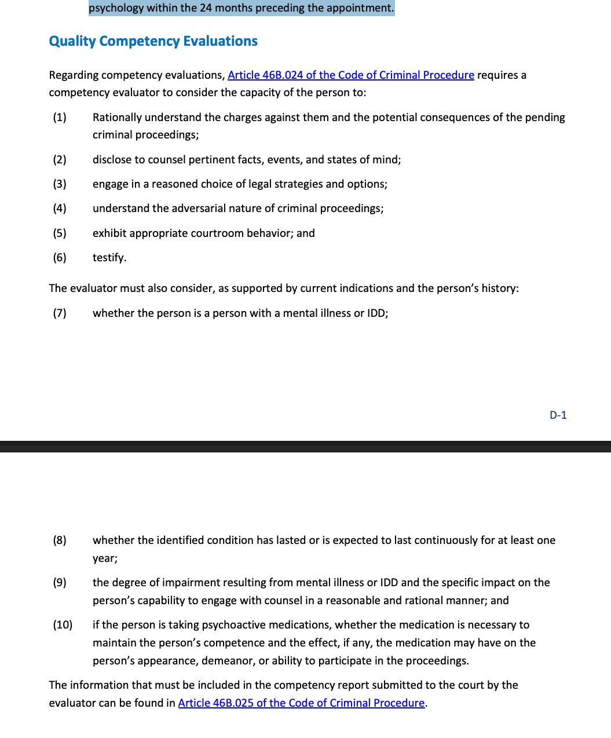
Competency Evaluations
Validated Competency Eval Tools
MacArthur Competence Assessment Tool–Criminal Adjudication
North Texas State Hospital (NTSH) Vernon Competency Assessment
Reports are typically written with template.
Notes:
Question from Macarthur
Do you think that your lawyer will help you more, less, or about the same as lawyers usually help people who are in trouble with the law?
Answers: More, Less, About the same; What are your reasons for thinking that?

Slide 35
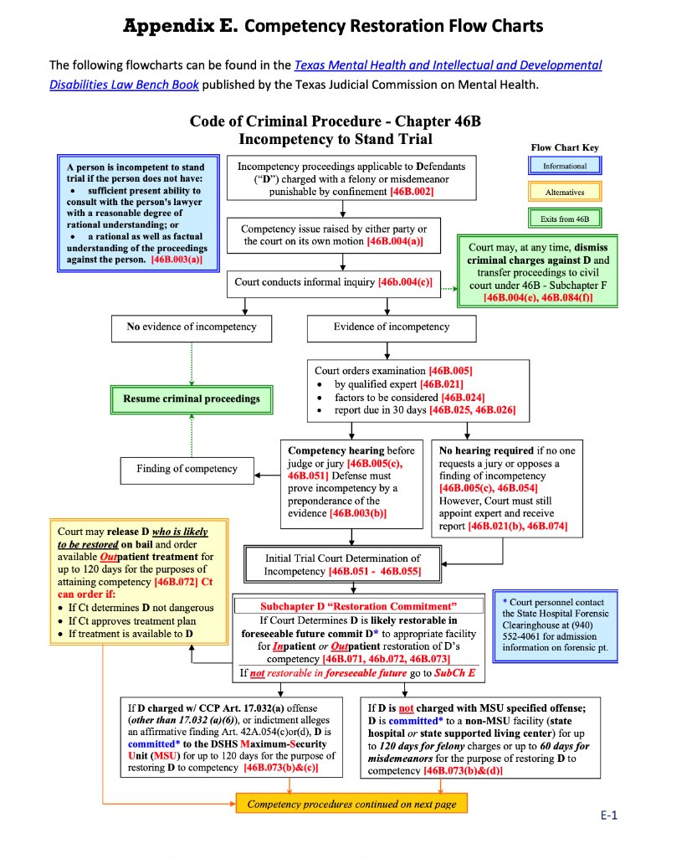
Notes:
https://txbhjustice.org/assets/main/downloads/trial-competency-and-forensic-commitments-101.pdf

Slide 36
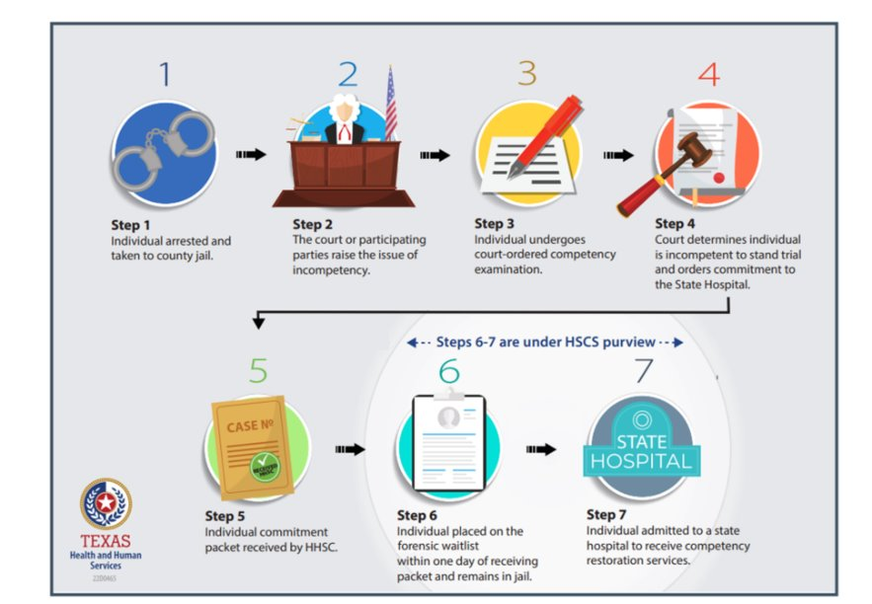
Notes:
https://txbhjustice.org/assets/main/downloads/trial-competency-and-forensic-commitments-101.pdf

Slide 37
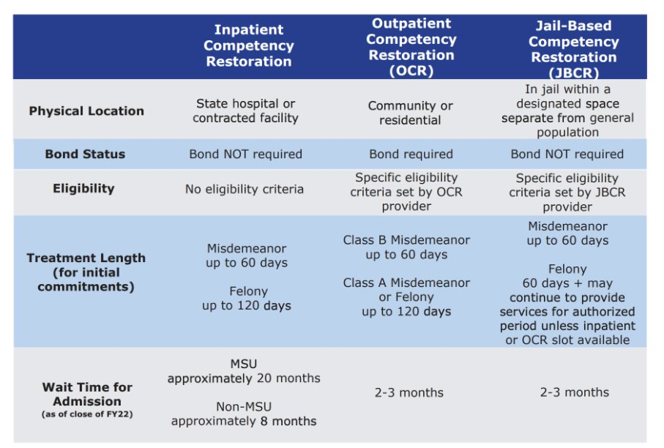
Notes:
https://txbhjustice.org/assets/main/downloads/trial-competency-and-forensic-commitments-101.pdf

Slide 38
Requirements for JBCR
Jail-based competency restoration (JBCR) is provided in jail to people found IST. In Texas, the Local Mental Health Authority (LMHA) or Local Behavioral Health Authority (LBHA) must contract with the county jail to provide CR services (CCP Art. 46B.091(c)).
The JBCR program must:
• Operate in a designated space in the jail to conduct JBCR services;
• Ensure coordination of general health care; supply clinically appropriate psychoactive medications to administer court-order medications to program participants; and
• Provide weekly competency restoration hours commensurate to the hours provided as part of a competency restoration program at an inpatient mental health facility (CCP Art. 46B.091(d)).
Notes:
https://txbhjustice.org/assets/main/downloads/trial-competency-and-forensic-commitments-101.pdf

Slide 39
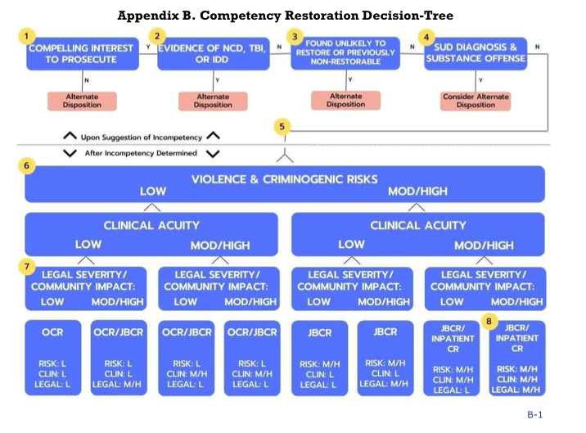
“High Clinical Acuity” likely to need Court ordered Meds
Texas Competency Restoration Guide. Texas Health and Human Services, Mar. 2024.
Notes:
1. The Code of Criminal Procedure (CCP) Articles 46B.0711, 46B.072, and 46B.073 may require certain placements if the person found IST is charged with a Class B misdemeanor. ​
2. Neurocognitive Disorders (NCDs) include a group of conditions previously classified as dementia, which manifests as declines in attention, executive function, learning, memory, language, and social cognition. NCDs are degenerative in nature and the likelihood of restorability declines over time. Traumatic Brain Injuries (TBIs) may impact brain functioning and cognition. Both NCDs and TBIs may be independent of or co-occurring with mental illness. Alternate placements can include nursing homes or assisted living facilities. Restoration may or may not be likely for people with NCD or TBI. ​
3. People who have received CR services in the past and been determined unrestorable may be less likely to restore to competency on subsequent commitments. Alternate dispositions can include a dismissal of charges, consideration of civil commitment, or alternative mental health services. ​
4. People with a primary diagnosis of a substance use disorder (SUD) who are charged with a substance-related offense may be better served in a setting that can provide robust substance use treatment interventions. ​
5. If a person has bonded out of jail, outpatient competency restoration (OCR) may be the most appropriate and least restrictive setting to receive CR. ​
6. Clinicians should use validated and reliable assessment tools to measure violence and criminogenic risks.​
7. Considerations of legal severity and community impact may include violence and criminogenic risks, the nature of the offense, the severity of the offense, and the impact if the person was to return to the community. ​
8. A person committed to inpatient CR may be able to transition to a less restrictive setting if the person is clinically ready and can be safely transferred to outpatient or jail-based CR.​

Slide 40
Court-Ordered/Forced Medications: Overview
“Drugs don’t work in patients who don’t take them”
- General C. Everett Koop, MD, 13th US Surgeon General (1982 – 1989)
Forced medications are typically indicated in patients with anosognosia…
  60%-70% of patients with schizophrenia and other primary psychotic disorders have anosognosia.
  50% of people with bipolar spectrum illness have anosognosia.
• Forced medications typically occur in three contexts in Texas:
  Court Ordered Inpatient Mental Health Services (OPC; Civil Commitment)
  Court Ordered (Civil) Outpatient Treatment (Indirectly; typically modified to inpatient if noncompliant)
  Competency Restoration (Criminal Proceeding)

Slide 41
Jail Diversion Services
Jail Medical/Psychiatric Care
Jail Based Competency Restoration
Notes:
https://txbhjustice.org/assets/main/downloads/trial-competency-and-forensic-commitments-101.pdf

Slide 42

Court-Ordered Medications:
Inpatient
A treating physician may file an application in probate court to administer antidepressants, antipsychotics, anxiolytics/sedatives, hypnotics, and mood stabilizers.
The court must find that the administration of medication is in the patient’s best interest and that this patient lacks capacity to make a decision regarding use of that medication to authorize medication administration without patient’s consent for the full duration of the underlying inpatient commitment order.
Section 574.106(b) of the Health & Safety Code offers a list of considerations for the court in determining the patient’s best interest. The court shall consider:
• the patient’s expressed preferences regarding treatment with psychoactive medication;
• the patient’s religious beliefs;
• the risks and benefits, from the patient’s perspective, of taking psychoactive medication;
• the consequences to the patient if the psychoactive medication is not administered;
• the prognosis for the patient if she’s treated with psychoactive medication;
• alternative, less intrusive treatments that are likely to produce the same results as treatment with psychoactive medication; and
• less intrusive treatments likely to secure the patient’s agreement to take the psychoactive medication.
Notes:
https://txbhjustice.org/assets/main/downloads/trial-competency-and-forensic-commitments-101.pdf

Slide 43
Jail Diversion Services
Jail Medical/Psychiatric Care
Jail Based Competency Restoration

Slide 44
Court-Ordered Medications:
Jail Based Competency Restoration
Article 46B.086 “Court-Ordered Medications” outlines the process by which defendants may be forcibly medicated to restore competence.
Patient who “is in custody awaiting trial in a criminal proceeding” must first have a hearing under Texas Health and Safety Code 574.106
  Probate court must find by clear and convincing evidence that treatment with proposed medication is in the defendant’s best interest, that the patient lacks capacity, and that they present a danger to themselves others.
^If this is rejected the prosecutor has 15 days to file a motion to compel medication that will be heard in criminal court which must find:
  1) the prescribed medication is medically appropriate, is in the defendant’s best medical interest, and does not present side effects that cause harm to the defendant that is greater than the medical benefit;
  2) the State has a clear and compelling interest in the defendant obtaining and maintaining competency to stand trial;
  3) no other, less-invasive means of obtaining and maintaining the defendant’s competency exists; and
  4) the prescribed medication will not unduly prejudice the defendant’s rights or use of defensive theories at trial
Notes:
*A patient can be found incompetent but not meet criteria for involuntary medications. This often happens when someone is higher functioning and has schizophrenia not currently experiencing an exacerbation. There may be no evidence they present a danger to themselves or others.
Two step process from U.S. Supreme Court’s decision in Sell v. United States.

Slide 45
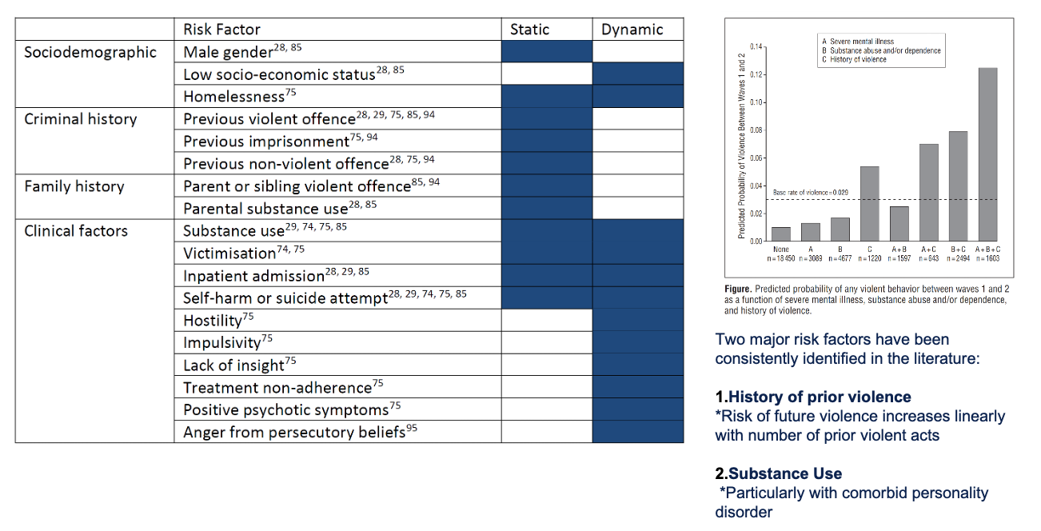
Assessing for Forced Medications
Level of insight into illness and need for treatment.
Relevant examples of impaired judgement.
Risk of harm to others
Risk of harm to self
Deterioration (functional impairment attributable to mental illness that impedes ability to obtain fundamental life necessities)
Whiting D, Lichtenstein P, Fazel S. Violence and mental disorders: a structured review of associations by individual diagnoses, risk factors, and risk assessment. Lancet Psychiatry. 2021 Feb;8(2):150-161. doi: 10.1016/S2215-0366(20)30262-5. Epub 2020 Oct 20. PMID: 33096045.
Notes:
sustenance, shelter, clothing, health, or safety).​

Slide 46


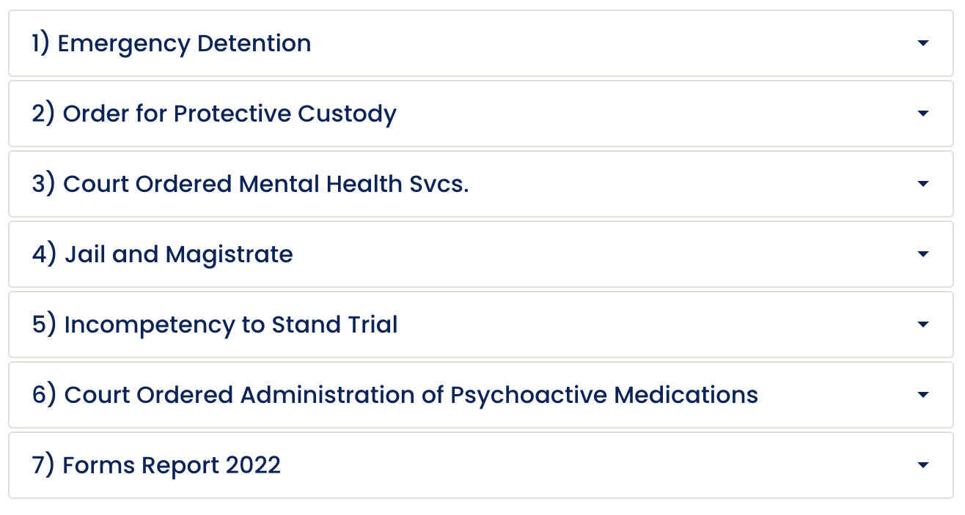
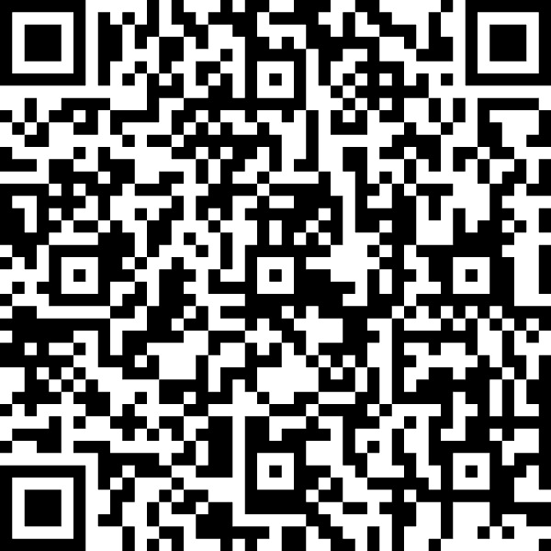
Resources
Texas Behavioral Health Justice Technical Assistance Center
Other Resources
Texas State Auditors Office (Data & Report)
Treatment Advocacy Center (TAC)
Journal of Correctional Health Care
https://txbhjustice.org/resources/downloads
Texas Judicial Commission on Mental Health (Forms)
https://www.texasjcmh.gov/forms/jcmh-committee-forms-database/
Notes:
Journal of Correctional Healthcare- Impact factor of 1.2 up from 0.7 last year but the only national peer reviewed correctional health journal

Slide 47
References
American Psychiatric Association. (2013). Diagnostic and statistical manual of mental disorders (5th ed.). Washington, DC.
Center, Treatment Advocacy. "Anosognosia.” https://www.tac.org/wp-content/uploads/2024/01/Anosognosia-Research-Summary.pdf
Collier, Lisa. Legislative Requirement: A Review of Competency Restoration Services for Inmates in County Jails. The State of Texas State Auditor, Nov. 2024.
Roberson, Alyssa, and Michael J. Vitacco. "Jail-based competency restoration: What's out there and what's missing." Journal of Correctional Health Care 28.4 (2022): 230-235.
Whiting D, Lichtenstein P, Fazel S. Violence and mental disorders: a structured review of associations by individual diagnoses, risk factors, and risk assessment. Lancet Psychiatry. 2021 Feb;8(2):150-161. doi: 10.1016/S2215-0366(20)30262-5. Epub 2020 Oct 20. PMID: 33096045.
Texas Competency Restoration Guide. Texas Health and Human Services, Mar. 2024.
Texas Code of Criminal Procedure, Title 1. Code of Criminal Procedure
Texas Health and Safety Code, Title 7. Mental Health and Intellectual Disability, Subtitle C. Texas Mental Health Code
Texas CCP Ch 46B, 26 TAC ch307 competency restoration; Title 4 HSC Ch 247, Title 7 Ch 574
NTSH Vernon competency program screening assessment
https://www.tdcaa.com/journal/drugs-dont-work-in-patients-who-dont-take-them/
https://www.tac.org/wp-content/uploads/2024/05/TAC-Texas-AOT-Guide.pdf
https://mmhpi.org/topics/policy-research/smart-justice-texas-needs-more-effective-alternatives-than-jail-to-treat-mentally-ill/
https://www.tcjs.state.tx.us/wp-content/uploads/2019/08/TA_Memo_-_LMHAs_and_County_Jails-1.pdf
https://countyprogress.com/mental-health-jail/

Slide 48
Questions?

