Slide 1
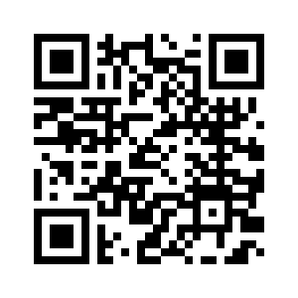
Reigniting Your Workplace & Rediscovering Your Why Through Play
Jeff Harry
Positive Psychology Play Speaker
@jeffharryplays

Slide 2
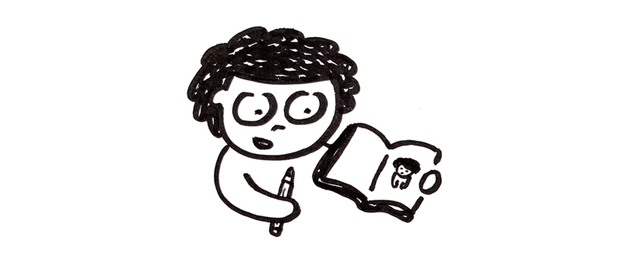
@jeffharryplays

Slide 3
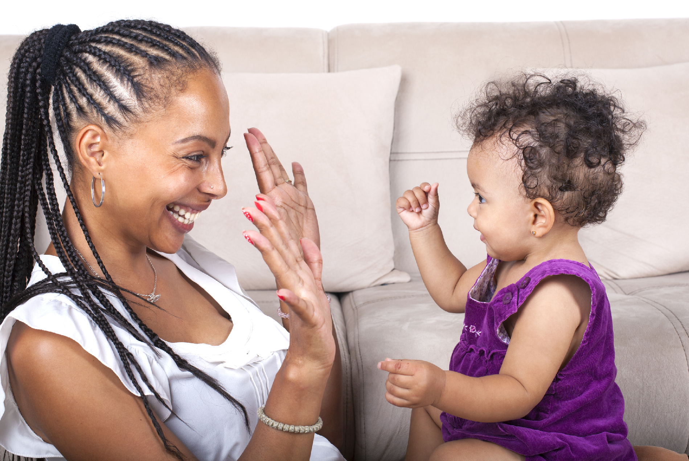
Attunement
@jeffharryplays

Slide 4
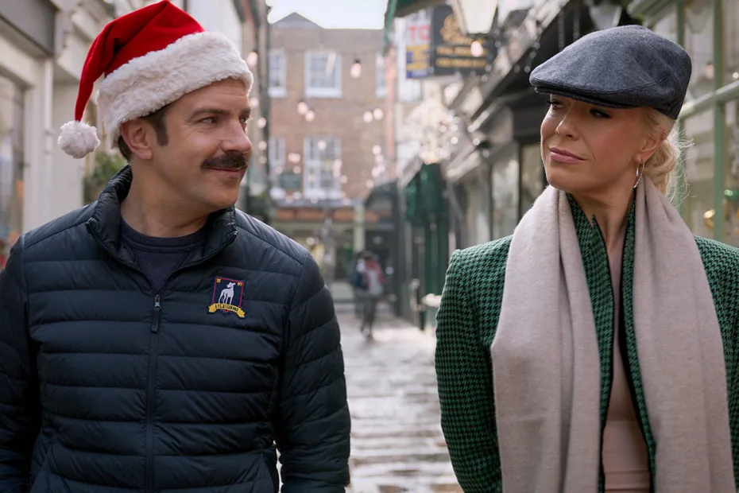
Attunement
@jeffharryplays

Slide 5
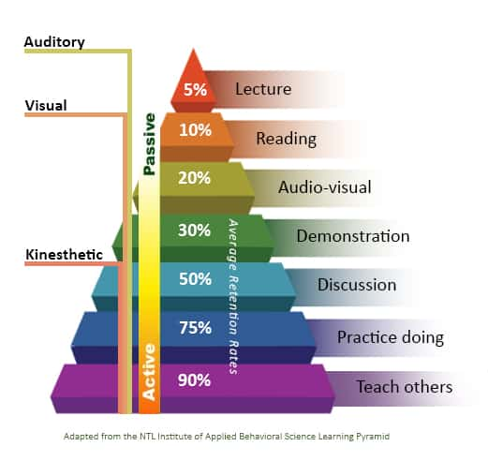
@jeffharryplays

Slide 6
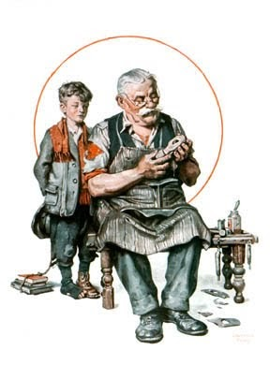
The Cobbler’s Children Have No Shoes
@jeffharryplays

Slide 7
What Do Employees Want Most?
@jeffharryplays

Slide 8
What Do Employees Want Most?
To Feel Seen, Heard,
Appreciated
@jeffharryplays

Slide 9
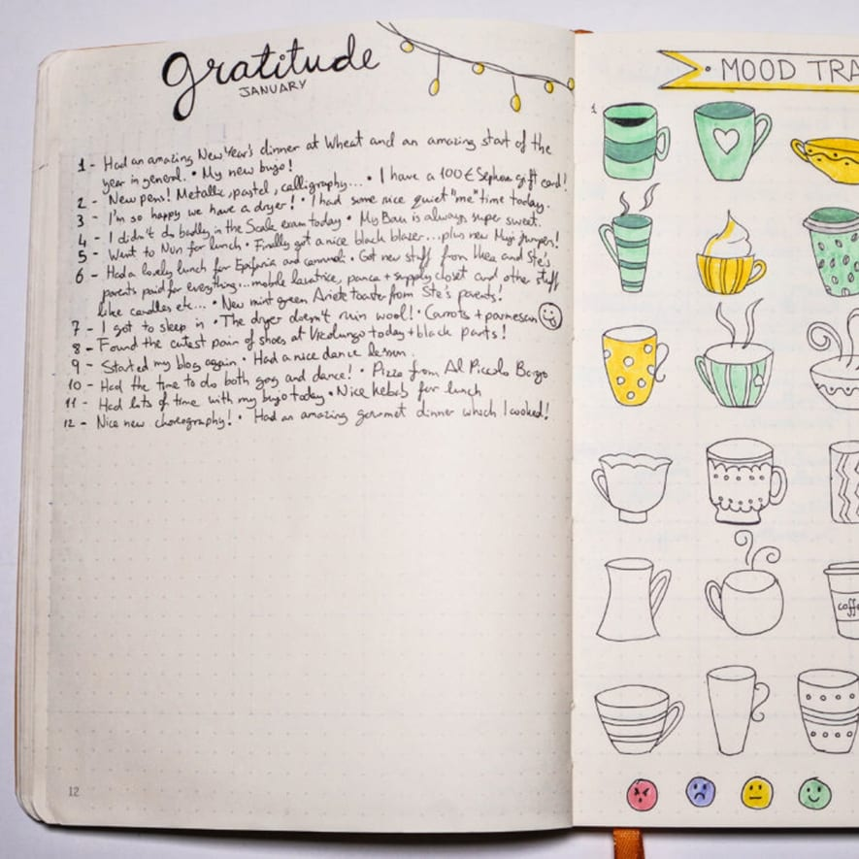
Play Experiment #1
What Work Are You
Truly Proud Of?
@jeffharryplays

Slide 10
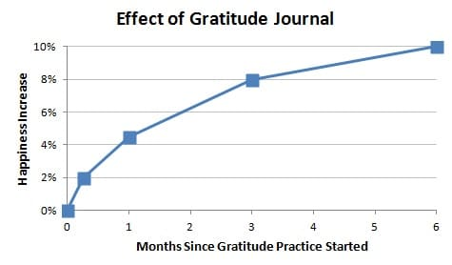
@jeffharryplays

Slide 11
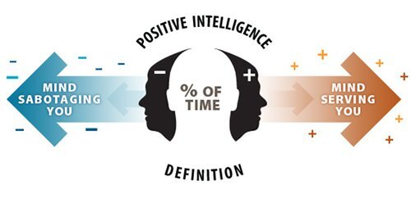
@jeffharryplays
https://www.lukemenziescoaching.com/blog/the-life-changing-positive-intelligence-programme

Slide 12
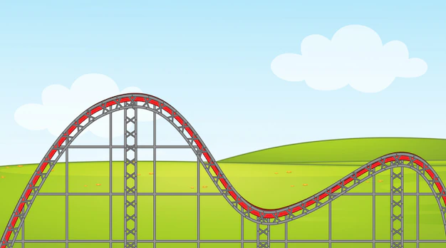
Topics We Are Covering
Learn How Understanding
Our Why Builds Trust
Define Gratitude & Why It Matters In Building Trust
Define Play & How It
Can Help Build Trust
Rediscover Ways To Get
Into Flow Through Play
Identify Your Play Values
RediscoverYourPlay.com @jeffharryplays
@jeffharryplays

Slide 13
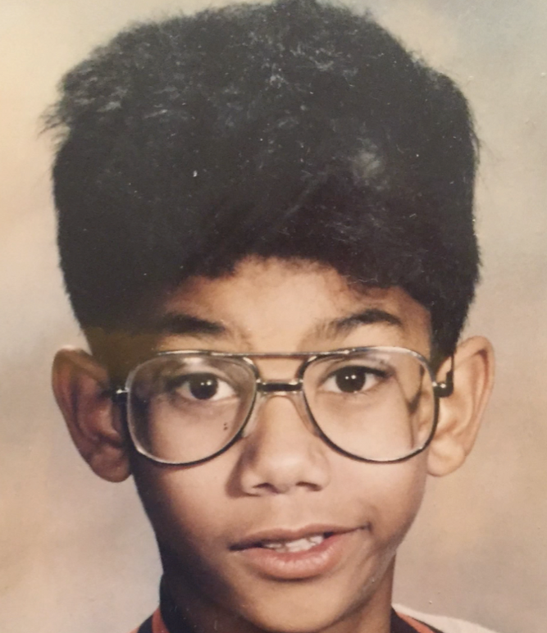
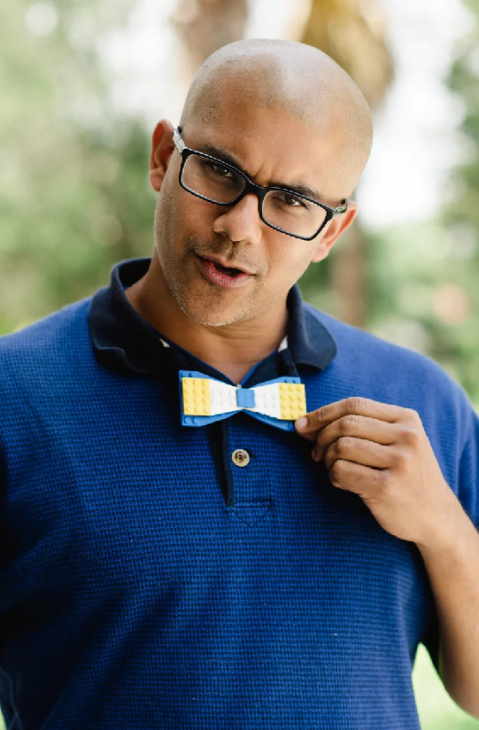
Who Am I?
@jeffharryplays

Slide 14
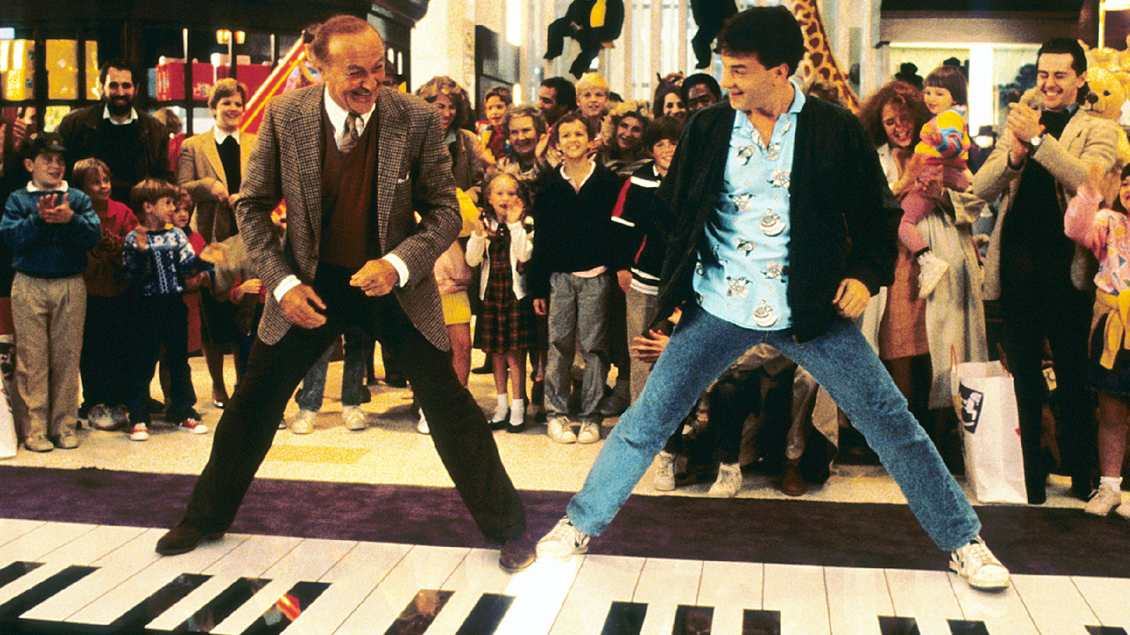

Slide 15
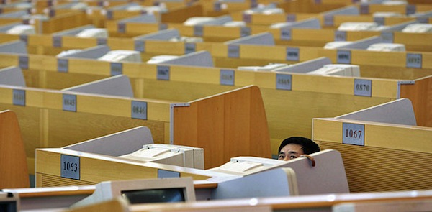

Slide 16
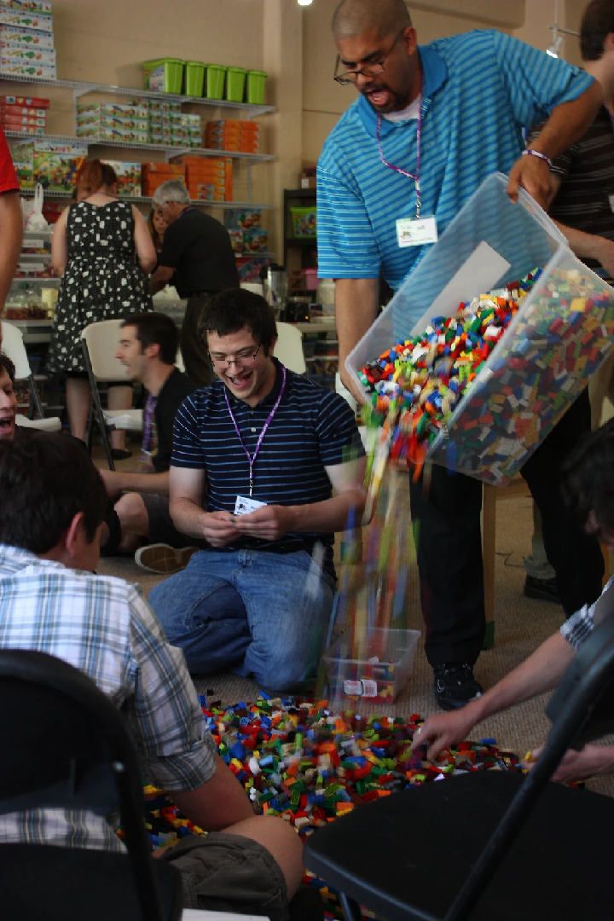

Slide 17
Built The Largest
LEGO-Inspired STEM Organization In The U.S.
Play (No Business Plan)
Intuition (Picked Fun People)
Prioritized people over profit
Followed Our Curiosity
Focused On Celebrating Staff

Slide 18
“If a person could do only one thing to increase their health and happiness, expressing gratitude might be it.”
Kori Miller, PositivePsychology.com
@jeffharryplays

Slide 19
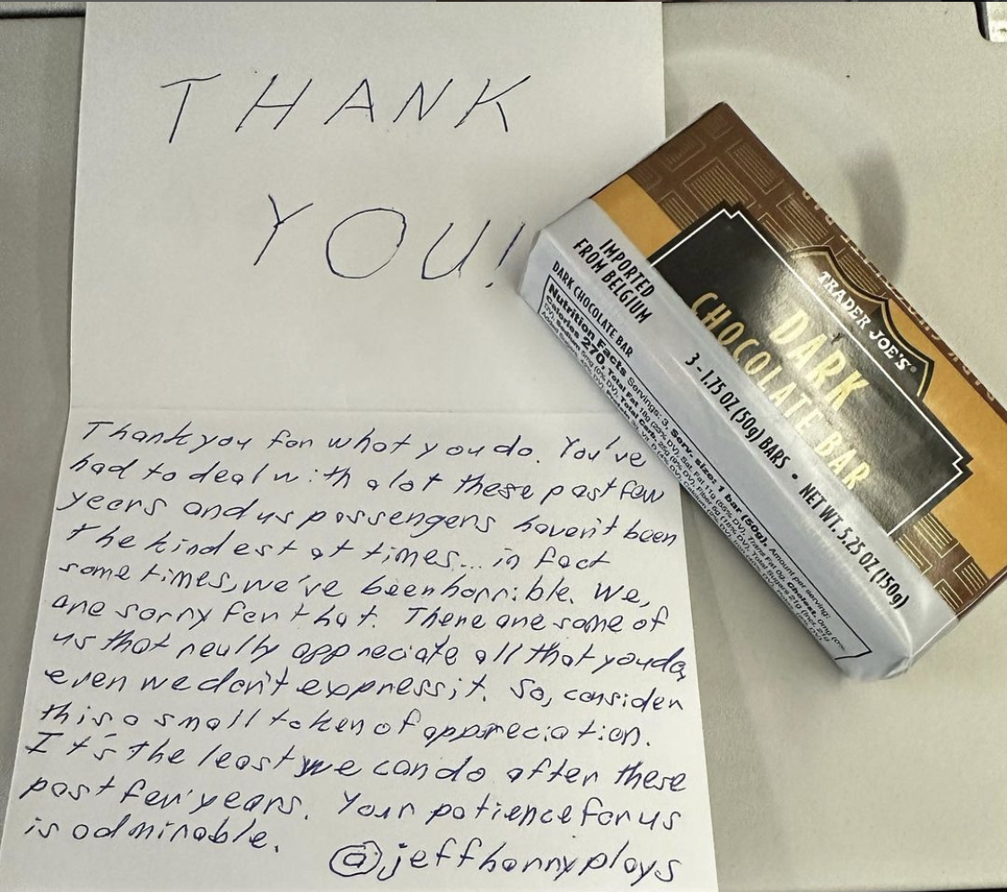
What Is Gratitude?
Selfless
Provides Catharsis
Creates Reciprocity
Two Stages: Goodness in one’s life & Goodness outside of the self
@jeffharryplays

Slide 20
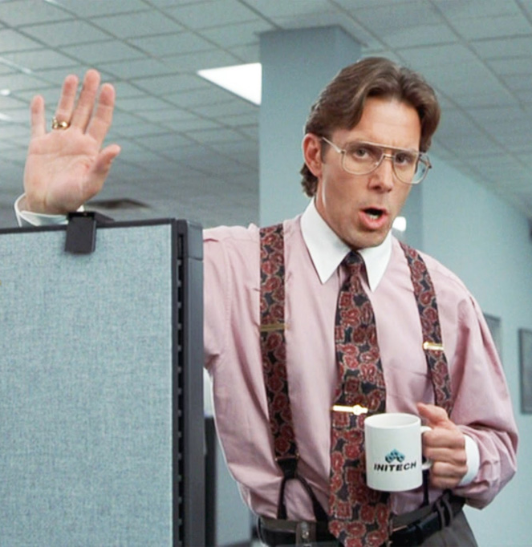
When Does Gratitude Fail?
Excessive sense of self-importance
Arrogance & Vanity
Unquenchable need for admiration and approval
Sense of entitlement
@jeffharryplays

Slide 21
Feeling Seen
@jeffharryplays

Slide 22
Play Experiment #2:
Explore Your Impact
Celebrate The Work
That You Are Truly Proud Of
@jeffharryplays

Slide 23
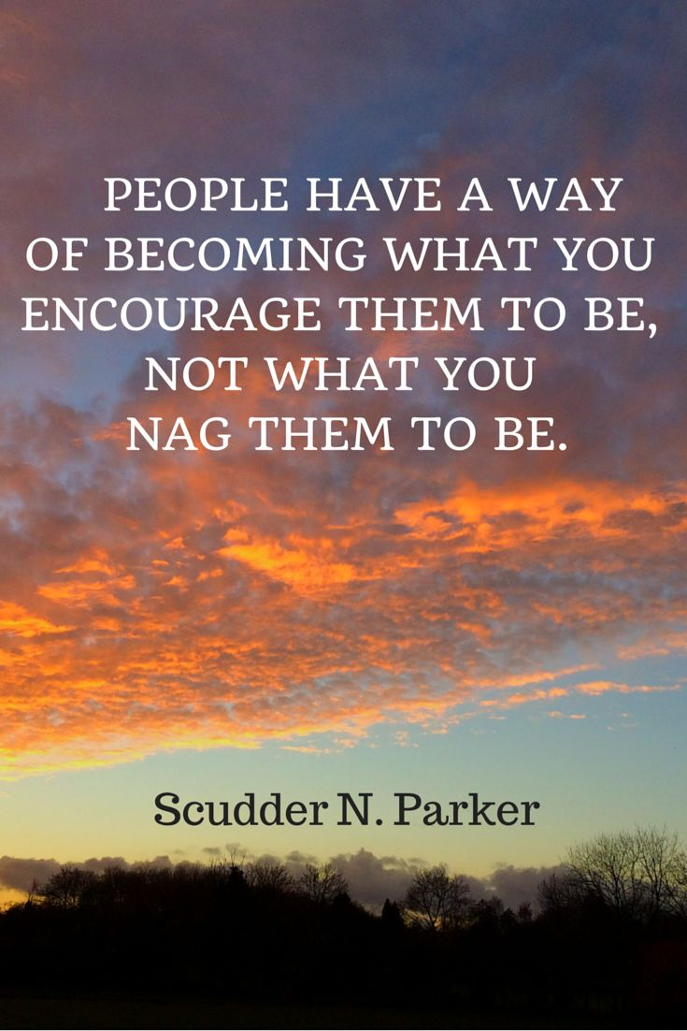
@jeffharryplays

Slide 24
Play Experiment #3:
Explore Your Why
How many people's lives have you impacted this year in positive way?
Directly & Indirectly
@jeffharryplays

Slide 25
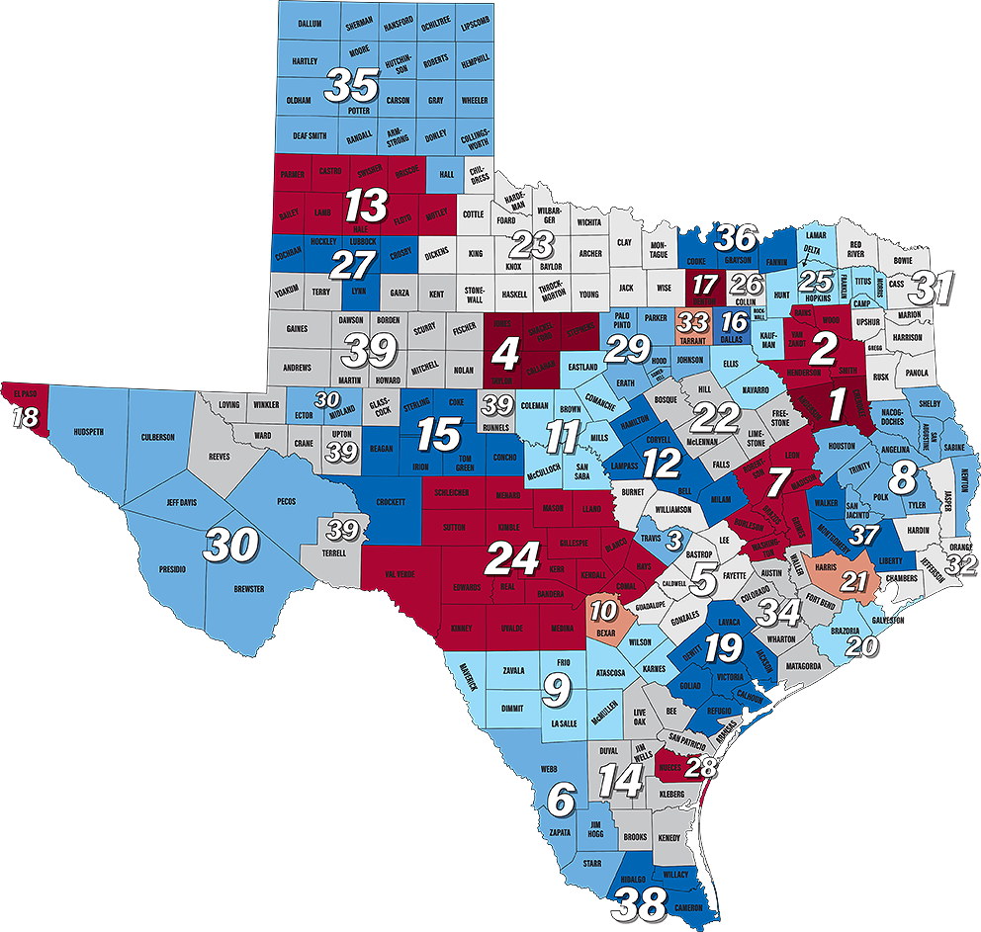
@jeffharryplays

Slide 26
Play Experiment #3:
Explore Your Why
Think of your most memorable & meaningful moment this year where you impacted someone in a positive way
(Felt the most connected to your work)
@jeffharryplays

Slide 27
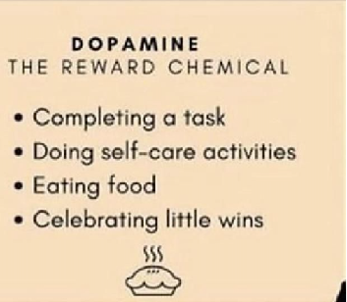
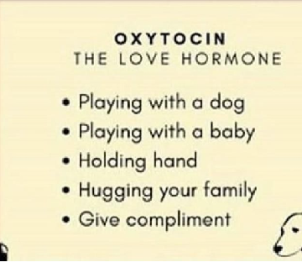
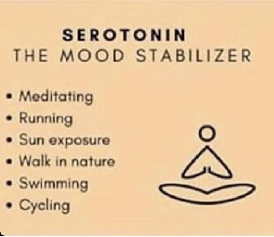
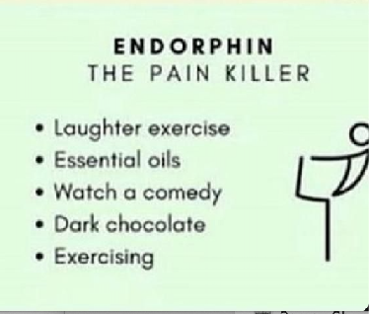
D
O
S
E
@jeffharryplays

Slide 28
Feeling Appreciated
@jeffharryplays

Slide 29
Who Is An Employee Who Hasn’t Been Recognized Enough That You Appreciate?
What Do You Appreciate Most About This Person?
Play Experiment #4:
Communicate Your Appreciation
Tell Them.
@jeffharryplays

Slide 30
Write a message telling this person what you appreciate most about them
Email or text this message to them now…
Check in with yourself about why this might be difficult
Gratitude Is An Action
Feeling gratitude and not expressing it is like
wrapping a gift and not giving it - William Ward
@jeffharryplays

Slide 31
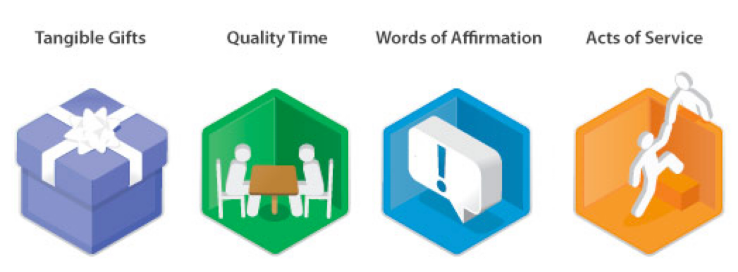
What Is Your Language of Appreciation?
@jeffharryplays

Slide 32
Play Experiment #5:
Ask For What You Want
What Type of Appreciation Do You Need?
@jeffharryplays

Slide 33
Play Experiment #5:
Ask For What You Want
What Type of Appreciation Do You Need?
How Would You Like To Receive It?
@jeffharryplays

Slide 34
Play Experiment #5:
Ask For What You Want
What Type of Appreciation Do You Need?
How Would You Like To Receive It?
Who do you need to tell?
@jeffharryplays

Slide 35
Feeling Heard
@jeffharryplays
@jeffharryplays

Slide 36
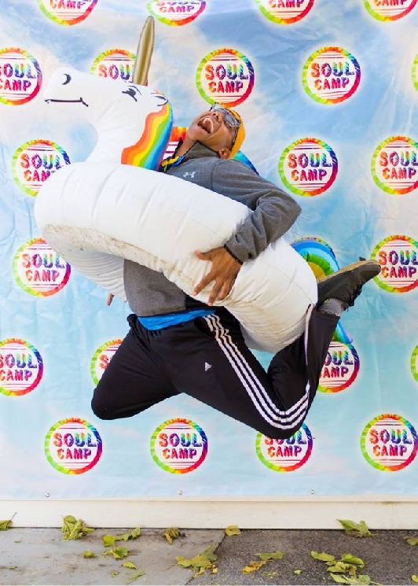
What Is Play?
Play Is Any Joyful Act That Has No Specific Purpose or Result…
Where You Are Fully Immersed In The Moment
@jeffharryplays

Slide 37
What Is Play?
Play Is The Opposite of Perfection.
Play is rooted in curiosity, experimentation, a sense of wonder.
@jeffharryplays

Slide 38
What Is Your Zone of Genius/Flow?
What is the work where you forget
about time?
What is the work you would do even if
you weren’t get paid for it?
@jeffharryplays

Slide 39
Play Experiment #6: Play Values
What Was Your Favorite Way
To Play As A Kid?
Why Did You Love To Play In That Way?
@jeffharryplays

Slide 40
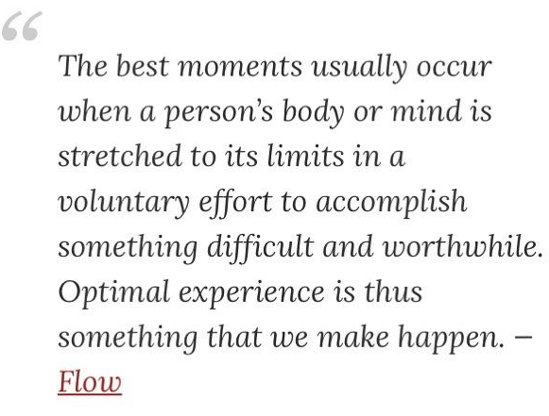
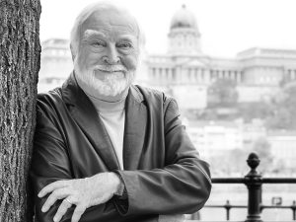
What Is Flow?
Dr. Mihaly Csikszentmihalyi
@jeffharryplays

Slide 41
@jeffharryplays

Slide 42
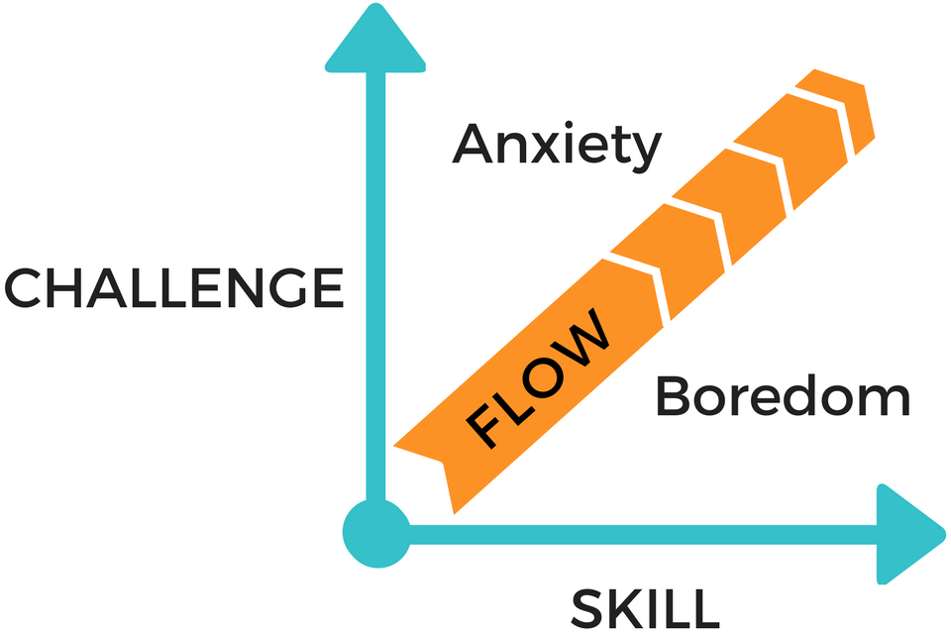
@jeffharryplays

Slide 43
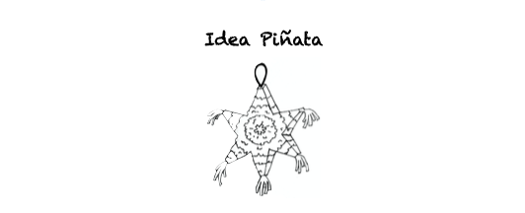
Tap Into Your Flow Play Experiment

Slide 44
Tap Into Your Flow Play Experiment
FILL YOUR IDEA PIÑATA
Share your play values with two other people
Tell them your favorite way to work
Group will brainstorm ideas based on your play values
Give Yourself Permission To Share Silly and Playful Ideas
You will just listen and write down all ideas

Slide 45
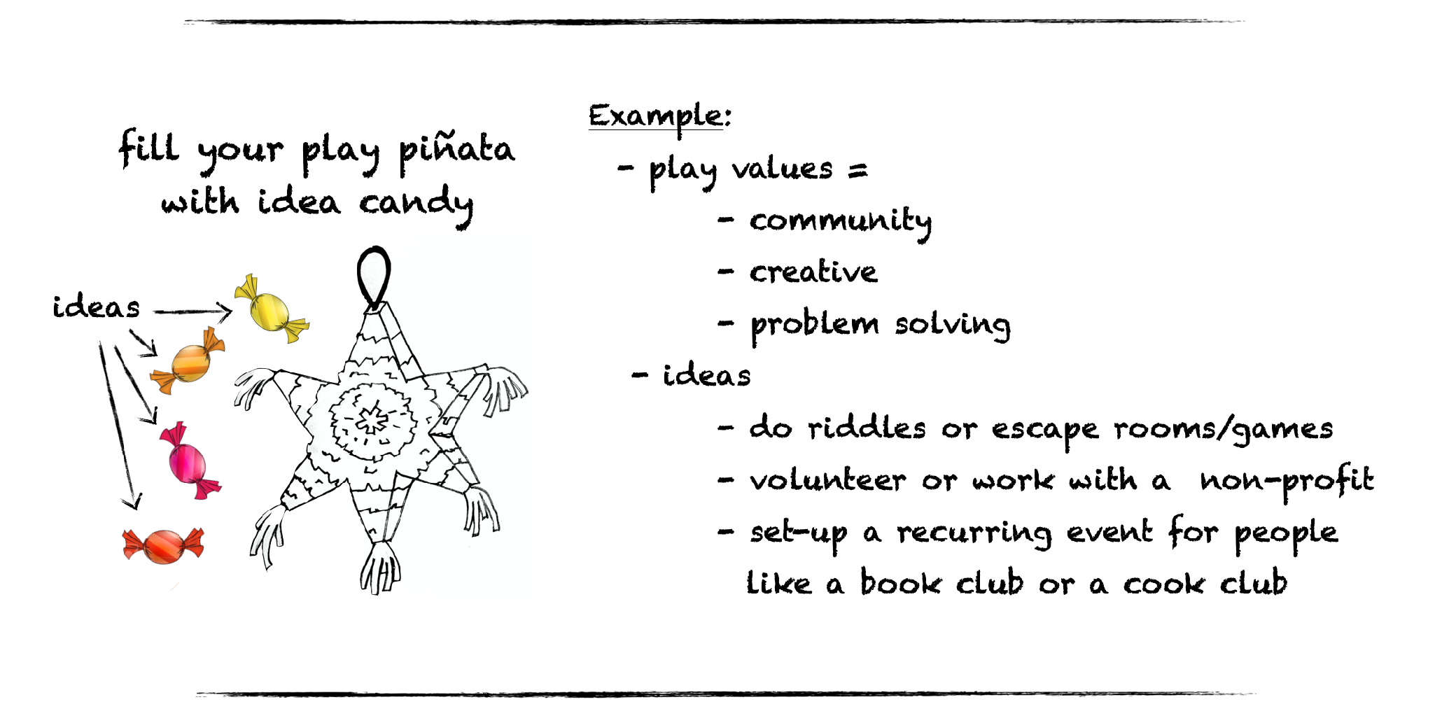
Tap Into Your Flow Play Experiment

Slide 46
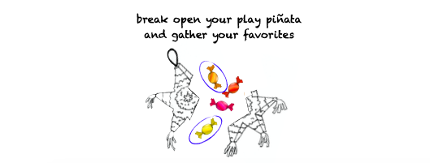
Tap Into Your Flow Play Experiment

Slide 47
Tap Into Your Flow Play Experiment
GATHER YOUR PLAY IDEAS
Choose your favorite idea that is exciting & doable
Pick a play buddy to help you make this a reality
Text/email your play buddy today about your idea

Slide 48
How Are You celebrating You & Your Colleagues Work Daily?
How Do You Feel Seen, Heard, & Appreciated?
What Is Your Current Why & Do You Know Your Staff’s Why?
Who Do You Appreciate & Have You Told Them Lately?
What Is Your Zone of Genius/Flow Work?
What Are Your Play Values & How Are You Infusing Them Into Your Work?
Reigniting Your Workplace Questions
@jeffharryplays

Slide 49
Thanks So Much For Playing!
Access To Studies & Bonus Gift
jeff@rediscoveryourplay.com
@jeffharryplays

