Slide 1
Rescissions, Rancor, and Budget Reconciliation: A Federal Policy Update
Jonah C. Cunningham, President And CEO

Slide 2
About NACBHDD
Founded in 1989
Represents Local Authorities
Dual Focus on I/DD and Behavioral Health
Affiliate of NACo

Slide 3
Ground Rules & Goals

Slide 4
Goals for Presentation
Give Context for Policy Developments
Provide Updates
Share Tools for Education & Outreach

Slide 5
Ground Rules
We are Non-Partisan
Situation is Evolving
Questions are Welcomed

Slide 6
Federal Government Background

Slide 7
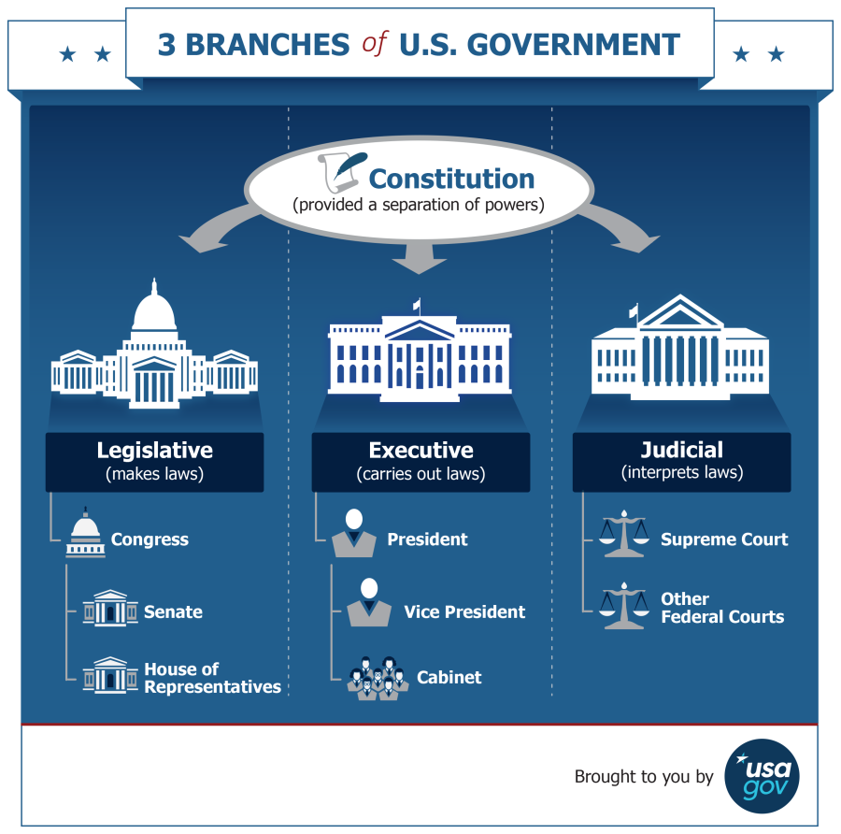
What Are the Rules?
U.S. Constitution
Article I (Legislative)
Article II (Executive)
Article III (Judicial)
Article IV (Relationships Btw States)
Article V (Amending Constitution)
Article VI (Debts, Fed Supremacy, Oaths of Office)
Article VII (Ratification)
Amendments (Bill of Rights)

Slide 8
Federal Budget Overview
Data source: Congressional Budget Office, March 2025

Slide 9
Federal Budget Overview
Data source: Congressional Budget Office, March 2025

Slide 10
Policy Updates

Slide 11
Annual Appropriations
Pass 12 Bills to Fund Government
End of Fiscal Year September 30th
Can Be Combined or Extended
Omnibus/Continuing Resolution
No Funding=Gov Shutdown

Slide 12
President’s Budget
Statement of Policy
Proposed Cuts
$33.3 billion (26.2% decrease) to HHS
Eliminate PRNS
Cuts OCR at Dept. of Ed by $49 Million (35% decrease)
Source: FY2026 Budget Request

Slide 13
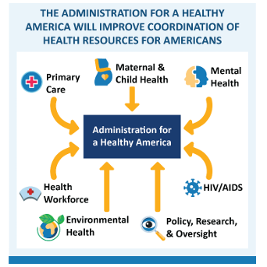
Reorganization of HHS
RIFs of Staff
Merger of SAMHSA/HRSA into AHA
Merger of ACL/ACF
Source: HHS Budget in Brief

Slide 14
Impoundment
Ability of POTUS to “Impound” Funds
Restricted by Impoundment Control Act of 1974
POTUS Must Request Recissions from Congress
Allows for Expedited Process

Slide 15
Budget Reconciliation
OPTIONAL Process
Can Only Focus on Fiscal Matters (Byrd Bath)
Not Subject to Filibuster

Slide 16
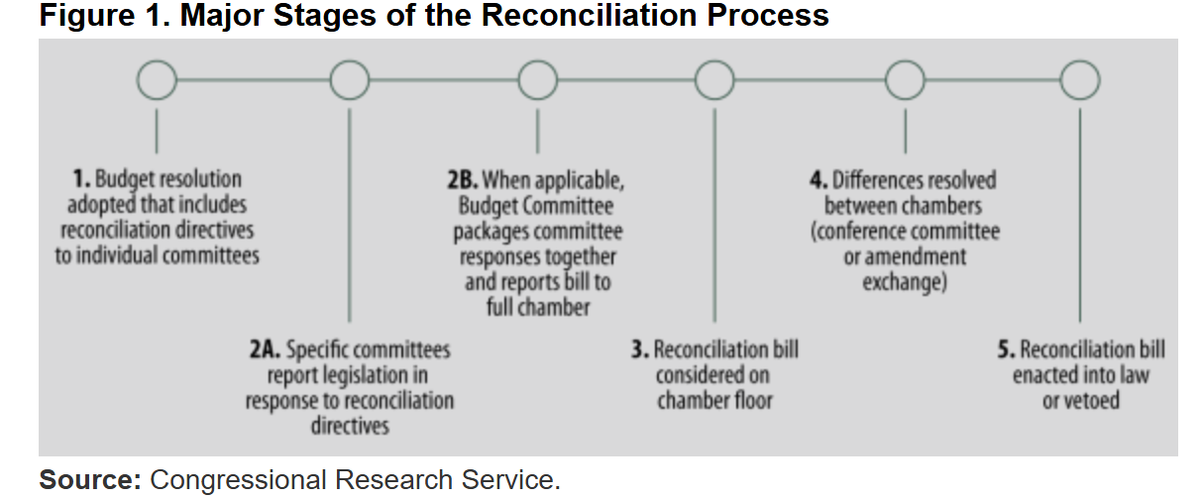
Reconciliation Process

Slide 17
House Passed Bill
Work Requirements
Cost-Sharing of up to $35*
Reduced FMAP for States Covering Undocumented Individuals
Eligibility Redeterminations at Least Every 6 Months
Limits Retroactive Coverage to 1 Month

Slide 18
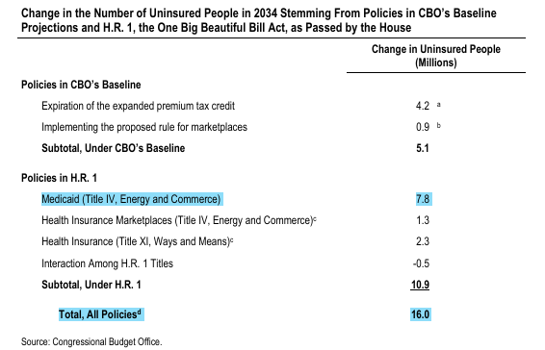
Effects on Medicaid

Slide 19
Debt Limit
More Expenditures Than Revenue ->Issue Bonds
Congressional Oversight of Amount of Bonds Issued
$ Spent w/out Bonds Covering Difference ->DEFAULT

Slide 20
Education & Outreach Resources

Slide 21
Resources for Federal Policy
Congress.Gov
Regulations.Gov
Crsreports.Congress.Gov

Slide 22
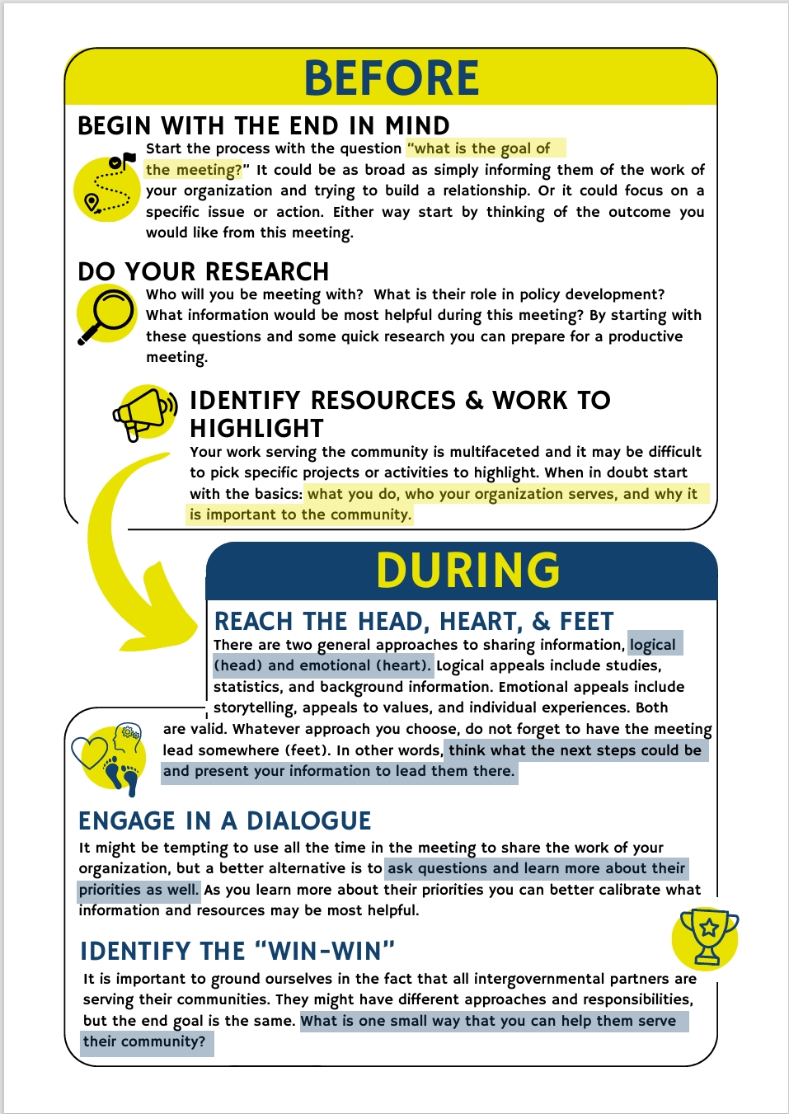
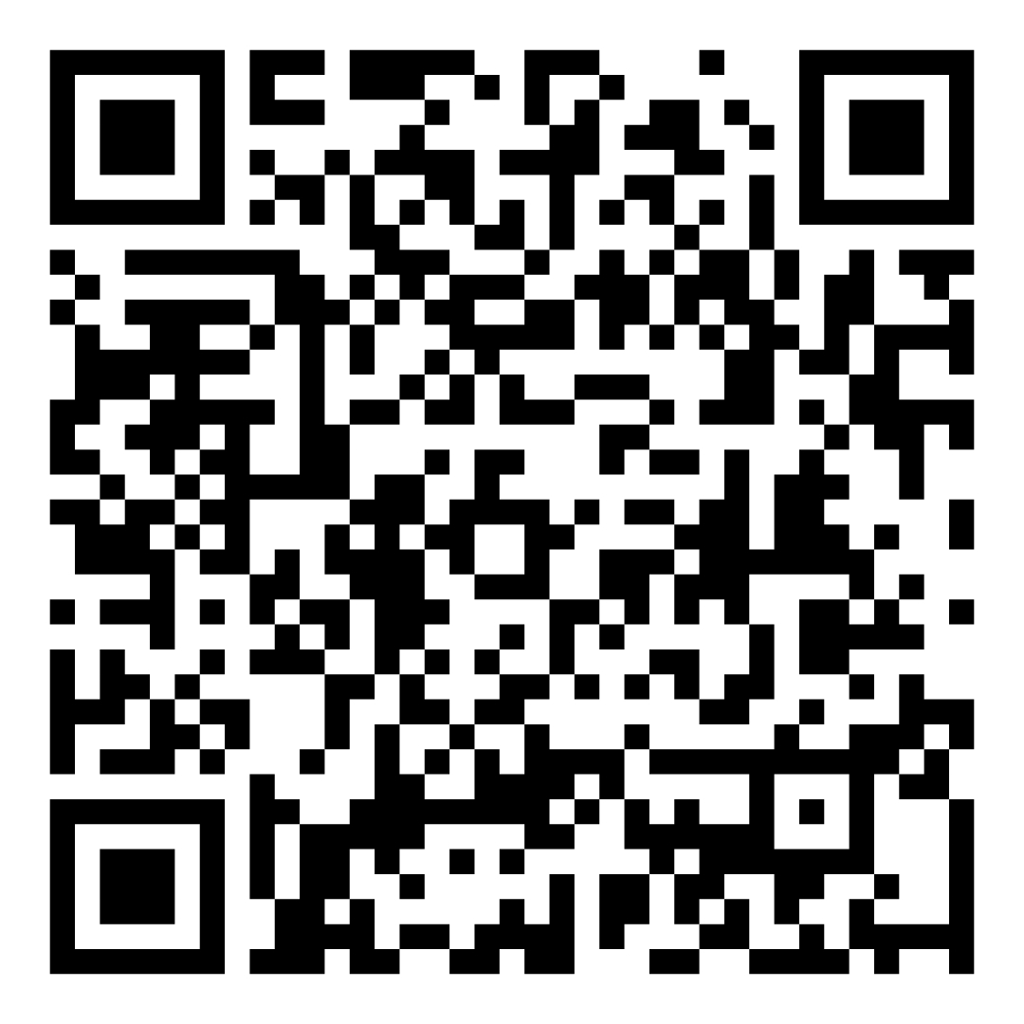
NACBHDD Education Toolkit
An aid for those seeking to connect with policymakers on the state and federal level with the goal of education and engagement.
Scan the QR code to view and download the NACBHDD Education Toolkit

Slide 23
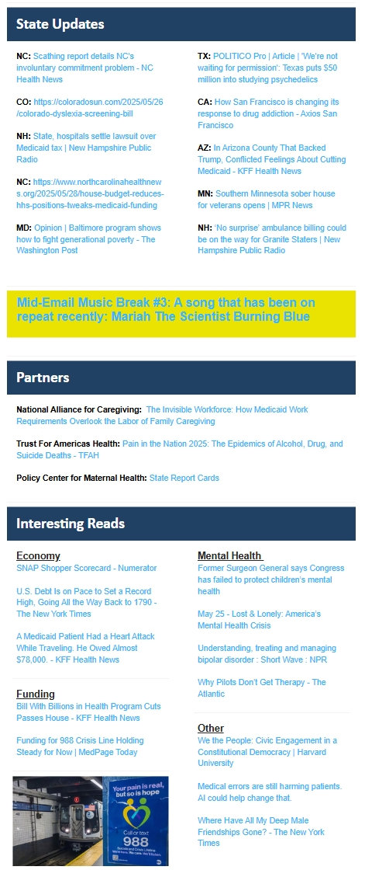
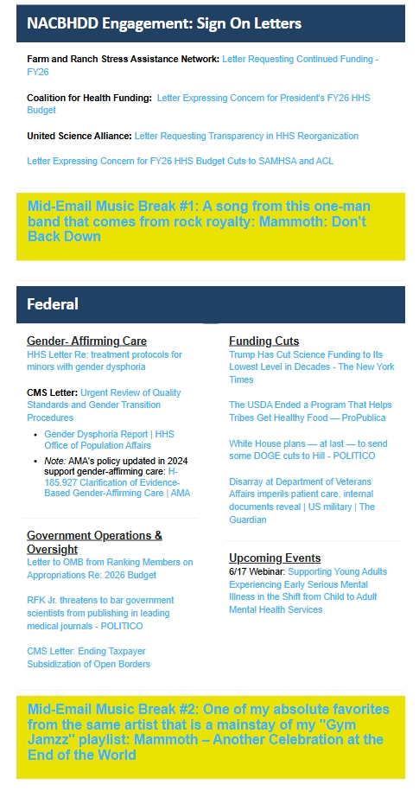
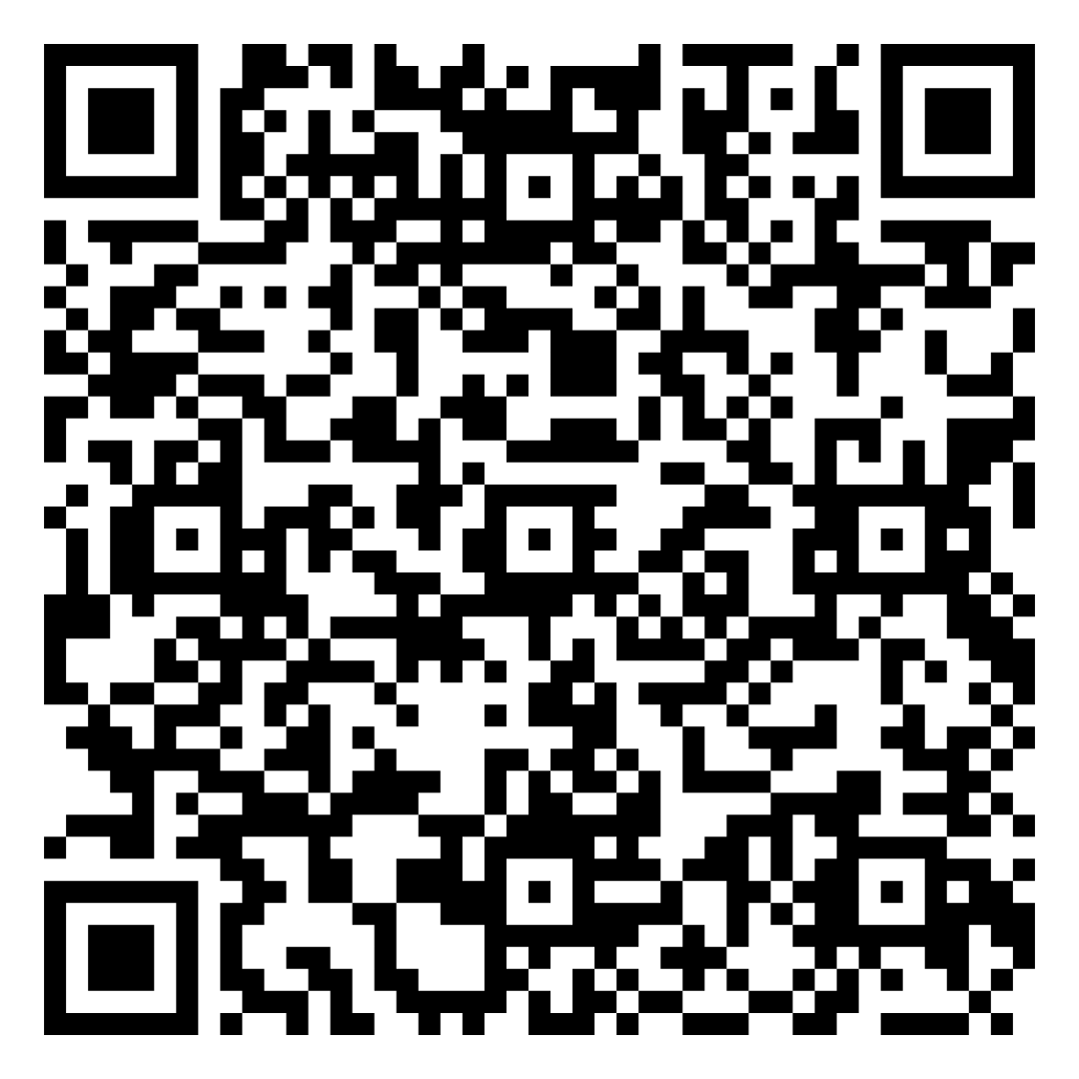
NACBHDD Newsletters
Week in Review
NACBHDD News
Periodic Announcements

Slide 24
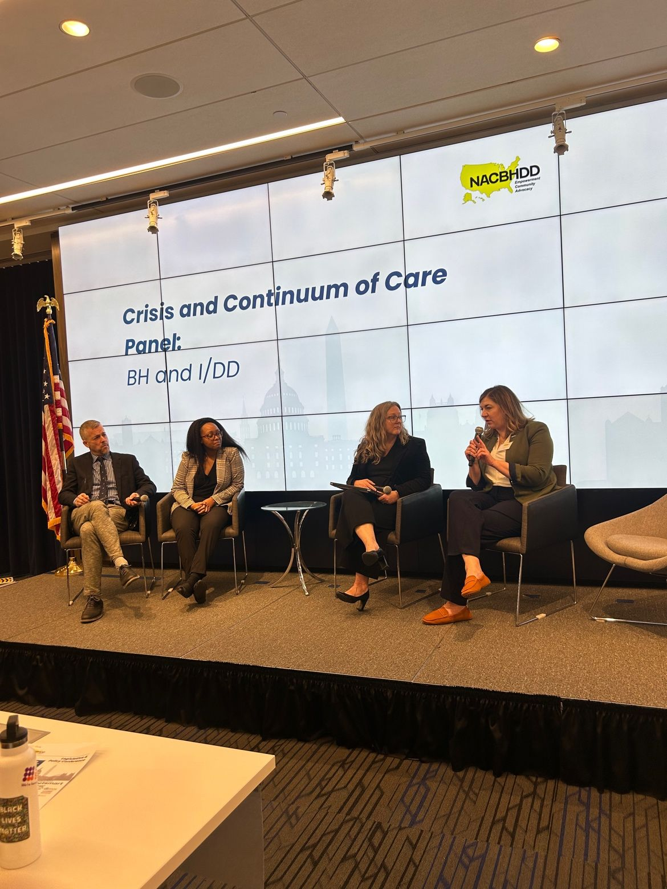
Legislative and Policy Conference
Candid Discussions with Policymakers
“Best Little Meeting in America”
SOLD OUT IN 2025

Slide 25
THANK YOU
jcunningham@nacbhd.org
NACBHDD.org

