Slide 1

Medication-Assisted Treatment and Withdrawal Management Services in Local Mental Health Authorities: The Bluebonnet Trails Experience
Check-in Code: 1006

Slide 2
Disclosure to Learners
38th Annual Texas Council Conference
June 25-27, 2025

Slide 3
Successful Completion
Successful completion of this continuing education activity includes:
Missing no more than 15 minutes of the activity or each session.
Completion and submission of participant evaluation.
Notes:
Summarize: “Here are the instructions to successfully earn CE credit”

Slide 4
Continuing Education
Continuing Medical Education:
This activity has been planned and implemented in accordance with the accreditation requirements and policies of the Texas Medical Association (TMA) through the joint providership of The Texas Department of State Health Services Continuing Education Program and Texas Council of Community Centers.
The Texas Department of State Health Services Continuing Education Program is accredited by the Texas Medical Association to provide continuing medical education for physicians.
The Texas Department of State Health Services Continuing Education Program designates this live activity for a maximum of 6.00 AMA PRA Category 1 Credits™. Physicians should claim only the credit commensurate with the extent of their participation in the activity.
This activity has been designated by the Texas Department of State Health Services Continuing Education Program for 1.50 credits of education in medical ethics and/or professional responsibility.
Notes:
Summarize slides 3-4: “Here are the accreditation statements for continuing medical education, nursing continuing professional development, and licensed psychologists.”

Slide 5
Continuing Education
Nursing Continuing Professional Development:
The Texas Department of State Health Services Continuing Education Program is accredited as a provider of nursing continuing professional development by the American Nurses Credentialing Center’s Commission on Accreditation.
The Texas Department of State Health Services Continuing Education Program has designated a maximum of 6.00 contact hours of Nursing Continuing Professional Development.
Licensed Psychologists:
The Texas Department of State Health Services Continuing Education Program has designated a maximum of 6.00 contact hours for Licensed Psychologists.
This activity has been designated by The Texas Department of State Health Services Continuing Education Program for 1.50 hours in professional ethics.
Notes:
Summarize slides 3-4: “Here are the accreditation statements for continuing medical education, nursing continuing professional development, and licensed psychologists.”

Slide 6
Commercial Support &
Disclosure of Conflict of Interest
This event received no commercial support.
The speakers and Planning Committee for this event have disclosed no financial interests.
Notes:
Summarize: “There are no disclosed financial interests or commercial support.”

Slide 7
Non-Endorsement Statement &
Off Label Use
Accredited status does not imply endorsement of any commercial products or services by the Texas Department of State Health Services, Texas Medical Association, or American Nurse Credentialing Center.
The speakers did not disclose the use of products for a purpose other than what it had been approved for by the Food and Drug Administration.
Notes:
Summarize: “These are statements for non-endorsement and off label use.”

Slide 8
Medication-Assisted Treatment and Withdrawal Management Services in Local Mental Health Authorities: The Bluebonnet Trails Experience
Check-in Code: 1006

Slide 9

Introduction
Carlos F. Tirado MD, MPH, FASAM
Mark Janes MD
Chief Medical Officer
Jordan Adams DSW, LCSW-S, LCDC
Assistant Director of Substance Use Services
Courtney Bearden, PMHNP
Director of Medical Services Administration

Slide 10
Objectives
Define the current standard of care in the management of opioid/fentanyl and alcohol use disorders
01
Identify core competencies for medication assisted treatment (MAT) and ambulatory withdrawal management services
02
Review intake and referral modes for MAT in community mental health centers
03

Slide 11
Program Goals & Process
Goal
Incorporate medication assisted treatment in the course of providing usual outpatient psychiatric treatment
Process
Develop referral models, workflow, infrastructure, funding
Develop expertise for medical and nursing staff
Interdisciplinary team collaboration
Use of telemedicine
Develop ongoing training, education, consultation

Slide 12
Outline
Standard of care for AUD and OUD
Overview of medications for AUD and OUD
  Medication Summary
  Supporting Evidence
Withdrawal Management for AUD
Buprenorphine Induction
Special Considerations – Fentanyl and Kratom
Resources

Slide 13
Standard of Care for
AUD & OUD
Assessment and Pretreatment Services: Comprehensive evaluations, including co-occurring mental health conditions.
Pharmacotherapy: Access to FDA-approved medications.
Counseling and Psychotherapy: Individual, group, and family therapy using evidence-based modalities like CBT, motivational interviewing, 12-step Facilitation.
Recovery Support Services: Peer support, case management, and social service connections.
Transitional Services: Discharge planning and linkage to community-based care.
Medical and Ancillary Services: Including primary care, mental health care, and language access services.

Slide 14

Overview of Medications for
AUD & OUD

Slide 15
Overview of Medications for AUD: Naltrexone
Mechanism: Opioid receptor antagonist; reduces alcohol-induced euphoria and cravings.
Formulations:
  Oral: 50 mg once daily
  Extended-release injectable: 380 mg intramuscularly every 4 weeks
Efficacy:
  Reduces risk of return to heavy drinking (RR: 0.81; 95% CI: 0.72–0.90)
  Number needed to treat (NNT): 11 for heavy drinking reduction
Side Effects:
  Nausea (RR: 1.73), vomiting (RR: 1.53), headache, dizziness
Clinical Trials:
  Supported by 23 RCTs with over 3,000 participants

Slide 16
Overview of Medications for AUD: Acamprosate
Mechanism: Modulates glutamatergic neurotransmission; helps maintain abstinence.
Dosing: 666 mg orally three times daily (adjusted for renal function)
Efficacy:
  Reduces risk of return to any drinking (RR: 0.88; 95% CI: 0.83–0.93)
  NNT: 11 for abstinence
Side Effects:
  Diarrhea (RR: 1.58), flatulence, nausea, insomnia
Clinical Trials:
  Evaluated in 20 RCTs with over 6,000 participants

Slide 17
Overview of Medications for AUD: Disulfiram
Mechanism: Inhibits aldehyde dehydrogenase; causes unpleasant reaction when alcohol is consumed.
Dosing: 250 mg orally once daily (range: 125–500 mg)
Efficacy:
  Mixed results; not significantly better than placebo in reducing drinking (RR: 1.03; 95% CI: 0.90–1.17)
  Best used in highly motivated patients under supervision
Side Effects:
  Hepatotoxicity, metallic taste, drowsiness, neuropathy
  Severe reactions if alcohol is consumed (flushing, tachycardia, nausea)
Clinical Trials:
  Evaluated in 3 RCTs with 622 participants

Slide 18
Overview of Medications for OUD: Methadone
Mechanism: Full opioid agonist; suppresses withdrawal and cravings.
Dosing:
  Initial: 20–30 mg orally once daily
  Maintenance: 60–120 mg/day
Formulations: Liquid, tablet, or diskette; dispensed only through certified Opioid Treatment Programs (OTPs)
Efficacy:
  Proven to reduce opioid use, improve retention, and lower mortality
  Long-term studies show superior retention compared to other treatments
Side Effects:
  Sedation, constipation, sweating, QT prolongation, respiratory depression
Risks: High overdose potential if not carefully titrated; requires daily observed dosing initially

Slide 19
Overview of Medications for OUD: Buprenorphine
Mechanism: Partial opioid agonist; ceiling effect reduces overdose risk
Dosing:
  Induction: 2–4 mg sublingual, titrated to 8–16 mg/day
  Maintenance: 8–24 mg/day
Formulations: Sublingual tablets/films (often combined with naloxone), extended-release injection (weekly/monthly)
Efficacy:
  Reduces opioid use, cravings, and overdose risk by up to 60%
  NNT to prevent one fatal overdose: 52.6
Side Effects:
  Headache, nausea, constipation, insomnia, precipitated withdrawal if started too early
Advantages: Can be prescribed in office-based settings; lower misuse potential

Slide 20
Overview of Medications for OUD: Naltrexone (Extended-Release Injectable)
Mechanism: Opioid antagonist; blocks euphoric effects of opioids
Dosing:
  380 mg intramuscular injection every 4 weeks
Formulations: Extended-release injectable (Vivitrol)
Efficacy:
  Effective in highly motivated individuals; reduces relapse risk
  Less effective than methadone or buprenorphine for retention
Side Effects:
  Injection site reactions, nausea, headache, hepatotoxicity
Limitations: Requires full detox (7–10 days opioid-free) before initiation to avoid precipitated withdrawal

Slide 21
Evidence of Benefits (OUD)
Methadone and Buprenorphine Reduce Overdose and Acute Care Use
A large comparative effectiveness study of over 40,000 adults with OUD found that only methadone and buprenorphine were significantly associated with reduced risk of:
Opioid overdose (Adjusted Hazard Ratio [AHR] at 12 months: 0.41, 95% CI: 0.31–0.55)
Serious opioid-related acute care use (AHR at 12 months: 0.74, 95% CI: 0.58–0.95)
Other treatment pathways, including inpatient detox and behavioral therapy alone, did not show similar protective effects

Slide 22
Evidence of Benefits (OUD)
Methadone and Buprenorphine Reduce Overdose and Acute Care Use
A large comparative effectiveness study of over 40,000 adults with OUD found that only methadone and buprenorphine were significantly associated with reduced risk of:
Opioid overdose (Adjusted Hazard Ratio [AHR] at 12 months: 0.41, 95% CI: 0.31–0.55)
Serious opioid-related acute care use (AHR at 12 months: 0.74, 95% CI: 0.58–0.95)
Other treatment pathways, including inpatient detox and behavioral therapy alone, did not show similar protective effects

Slide 23
Evidence of Benefits (OUD)
Buprenorphine Lowers Mortality and Improves Retention
Buprenorphine is associated with:
60% reduction in all-cause and opioid-related mortality
Improved treatment retention
Reduced risk of HIV and hepatitis C transmission
The Number Needed to Treat (NNT) to prevent one fatal opioid overdose is 52.6, which is significantly better than many standard preventive therapies in medicine

Slide 24
Evidence of Benefits (OUD)
Methadone’s Long-Term Effectiveness
Methadone has been used for over 50 years and is shown to:
Reduce illicit opioid use
Improve treatment retention
Decrease HIV and hepatitis C seroconversion
Lower all-cause mortality
However, it requires daily observed dosing (early in treatment) in federally licensed opioid treatment programs (OTPs), which can limit access .

Slide 25

Withdrawal Management in
AUD & OUD

Slide 26
Ambulatory Withdrawal Management in AUD
Important service for patients with limited resources and/or inability/unwillingness to go to inpatient facility
Can be conducted in context of primary care
Requires adequate staff support
Can be done by telehealth
Applicable H Codes

Slide 27

Alcohol Withdrawal:
Complications Timeline
Alcohol Withdrawal
seizures
Delirium Tremens
Severity
0
1
2
3
4
5
6
7
Days

Slide 28
Timeline of Alcohol
Withdrawal Treatment
Early
(0-6 hrs)
Middle
(6-12 hrs)
Late
(12-36 hrs)
Mild anxiety
Borderline Tachycardia at rest (90-100 bpm)
Possibly intoxicated
Drinking within last 4-8 hours
Mod to severe anxiety
Tachycardia at rest
BAC approaching or at zero
Appreciable tremor, diaphoresis, clouding
Redirectably agitated
Disoriented
Visual/tactile hallucinations
Non-redirectable agitation
Seizure
Autonomically unstable
Restraint-ICU

Slide 29
Ambulatory Withdrawal Management - Alcohol
Selection Criteria
  Mild to moderate withdrawal symptoms (CIWA-Ar score < 15)
  No history of severe withdrawal complications (e.g., seizures, delirium tremens)
  Stable medical and psychiatric status
  Supportive home environment with reliable supervision
  No concurrent substance use requiring inpatient care
  Ability to adhere to frequent follow-up and medication regimen

Slide 30
Ambulatory Withdrawal Management - Alcohol
Monitoring and Follow-Up
Daily or twice-daily in-person or telehealth check-ins
Use of CIWA-Ar scale to monitor symptom progression
Clear emergency plan if symptoms worsen
Transition to long-term AUD treatment (e.g., naltrexone, acamprosate) after stabilization

Slide 31
Sample Medication Protocols
Benzodiazepines (first-line)
  Chlordiazepoxide: 25–100 mg every 6–8 hours, taper over 3–5 days
  Diazepam: 10–20 mg every 6–8 hours, taper as tolerated
  Lorazepam: Preferred in liver disease; 1–2 mg every 6–8 hours
Gabapentin (off-label)
  300–600 mg TID; useful for mild withdrawal and craving reduction
Carbamazepine (off-label)
  200 mg TID–QID; alternative to benzodiazepines in some cases
Adjuncts:
  Thiamine (100 mg daily) to prevent Wernicke’s encephalopathy
  Folic acid, multivitamins, and hydration support

Slide 32
Ambulatory Induction for OUD
Buprenorphine
Safe and effective
Can be conducted in context of primary care or behavioral health clinics
Can be done by telehealth
Applicable H and G Codes
Can be more challenging with fentanyl use
X-Waiver eliminated in 2023 – no patient limits and can be rx’d as a standard S-III drug

Slide 33
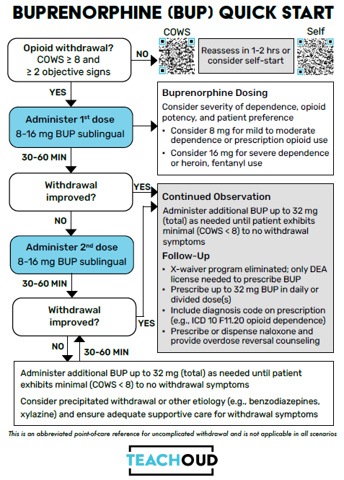
Ambulatory Induction - Opioids

Slide 34
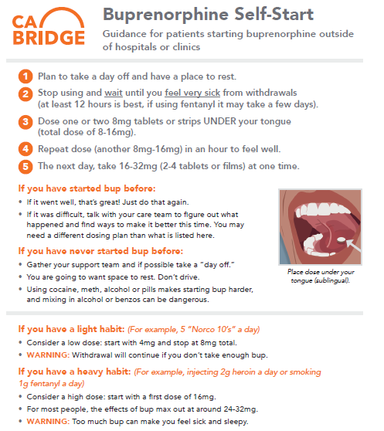
Ambulatory Induction - Opioids

Slide 35
Special Consideration –
Fentanyl & Kratom
Buprenorphine
Safe and effective
Can be conducted in context of primary care or behavioral health clinics
Can be done by telehealth
Applicable H and G Codes
Can be more challenging with fentanyl use
X-Waiver eliminated in 2023 – no patient limits and can be rx’d as a standard S-III drug

Slide 36
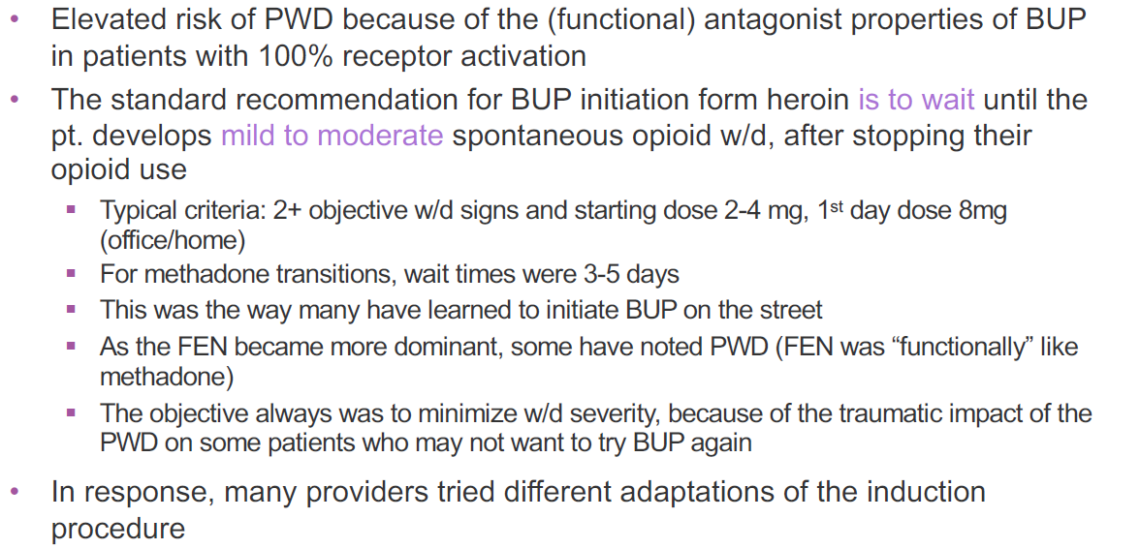
Buprenorphine Initiation & Precipitated Withdrawal

Slide 37
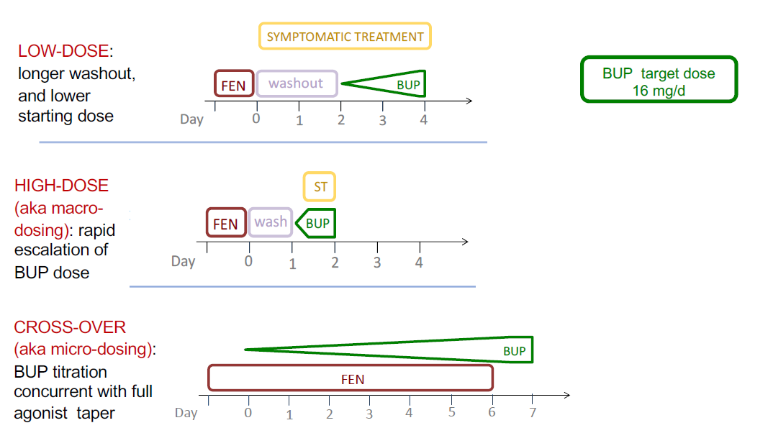
Buprenorphine Initiation:
Protocol Variations

Slide 38
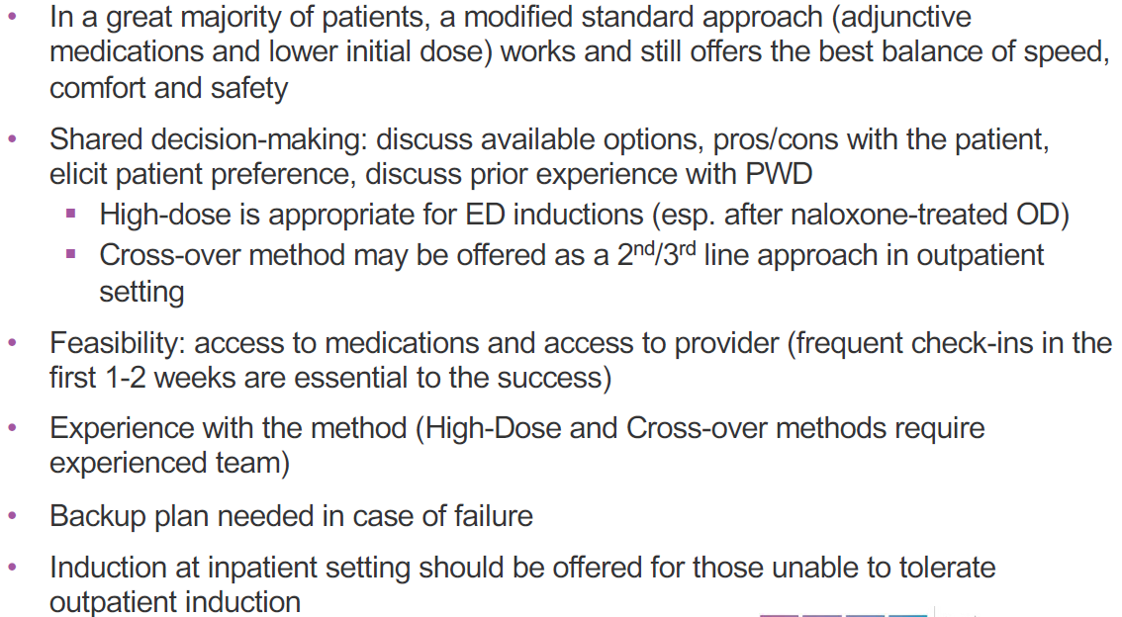
Choosing the “RIGHT”
BUP Induction Protocol

Slide 39
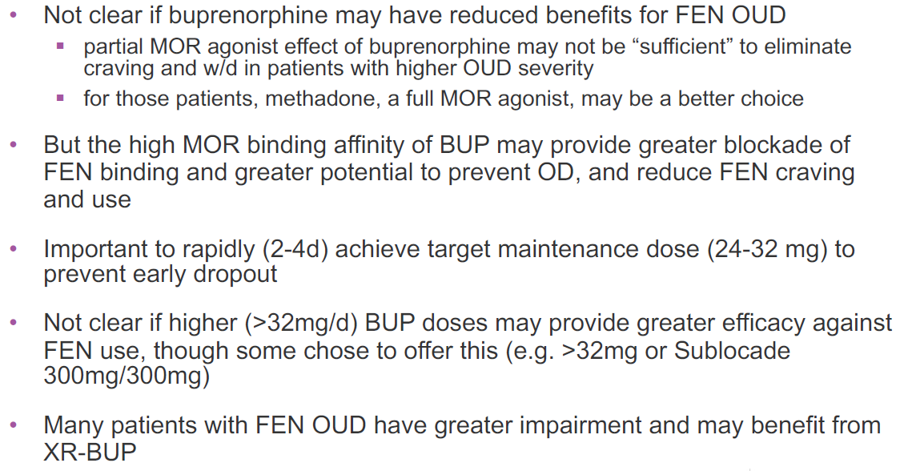
Buprenorphine Maintenance in Fentanyl Users

Slide 40
Special Consideration –
Kratom
Kratom
Readily available online and at smoke/vape shops
Prior DEA effort to schedule kratom in 2016 met heavy resistance and was withdrawn
A 2023 JAMA Network Open study found that many kratom users report instrumental use (e.g., for pain, mood, productivity), but frequent users showed signs of tolerance, withdrawal, and craving, suggesting potential for dependence
SAMHSA data indicate that kratom use often co-occurs with other substance use and mental health symptoms, reinforcing the need for integrated care models
.7-Hydroxymitragynine (7-OH) is a high-potency metabolite of mitragynine
  Associated with more rapid development of tolerance, stronger opioid effects, more severe withdrawal
  Much shorter half-life – possibly associated with more rapid onset of withdrawal and drive for repeat dosing
Responds well to buprenorphine

Slide 41
Resources
TEACH – OUD: UT School of Pharmacy
  Provider Resources | TeachOUD
Be Well, Texas – safety net buprenorphine treatment
  Home - Be Well Texas
TxCOPE – statewide overdose prevention and tracking app
  TxCOPE - Addiction Research Institute
Public Health Institute CA Bridge Program
  Bridge - Public Health Institute

Slide 42
References
National Guidance on Essential Specialty Substance Use Disorder (SUD) Care
Pharmacotherapy for Alcohol Use Disorder: A Systematic Review and Meta-Analysis | Psychiatry and Behavioral Health | JAMA | JAMA Network
Medication for Opioid Use Disorder in Federally Qualified Health Centers | Health Policy | JAMA Network Open | JAMA Network
meds_for_oud.pdf
Buprenorphine for Opioid Use Disorder—An Essential Medical Treatment | Substance Use and Addiction Medicine | JAMA Internal Medicine | JAMA Network
Behavioral Health Providers: Service and Claim Billing Guidelines for Withdrawal Management and Withdrawal Treatment Services
Comparative Effectiveness of Different Treatment Pathways for Opioid Use Disorder | Psychiatry and Behavioral Health | JAMA Network Open | JAMA Network
Billing & Payment | CMS
ASAM Billing & Coding
Quick-Guide-CMS-SUD-2022_0.pdf

Slide 43
Case Example 1
32-year-old male who resides with his mother and sister. Treated for schizophrenia and has been prescribed Invega Sustenna 156 mg monthly for management.
Psychiatric history: two hospitalizations, the most recent occurring four years ago.
Medical history: hypertension; valsartan 60 mg daily.
Substance use history: daily consumption of 6-8 alcoholic beverages per day x 1 year. He previously attempted residential rehabilitation but did not complete the program two years ago.
Urine drug screen positive for THC

Slide 44
Case Example 2
26-year-old female who lives alone and presents with a diagnosis of bipolar I disorder, most recent episode depressed.
Psychiatric history: Outpatient psychiatric care, through a private psychiatrist, before transferring to this clinic two months ago. Her current medication regimen includes quetiapine 600 mg at night and lamotrigine 100 mg twice a day.
Substance use history: daily use of opiates obtained off the street for at least 2 years, with uncertainty regarding fentanyl exposure. She reports initially using opiates for back pain following a motor vehicle accident four years ago, which resulted in ongoing pain but no head injury or other significant physical trauma.
She describes being unable to stop opiate use without experiencing withdrawal symptoms. In addition to opiates, she also reports daily use of THC and occasional alcohol consumption. A recent drug screen was positive for THC, opiates, and methamphetamine.

Slide 45

Questions?

Slide 46
Thank you!

