Slide 1
Supporting our Veterans’ Families: A Trauma Informed Approach

Slide 2
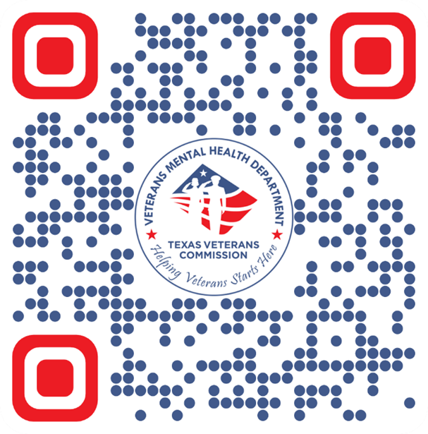
Veterans Mental Health
Gary Medina
Veteran Homeless Program Manager

Slide 3
Recognize Unique
Challenges
Understand Military
Training Objectives
Culture
Identify Distress
Signals
Apply Trauma-Informed
Practices

Slide 4
Understanding Military Culture
ACTIVITY!
Structured Environment
Frequent Relocations
Values and Identity
Resilient Community

Slide 5
The Deployment Cycle
Pre-Deployment
Deployment
Anxiety, training intensifies, family prepares for separation
Family adjusts to absence, new roles established, communication challenges, constant worry
Post-Deployment
Reintegration
Family stabilizes in new normal, adjusting period
Joy of reunion mixed with adjustment struggles, renegotiation of roles, processing of experiences

Slide 6
Impact on Military Children
Early Childhood (0-5)
Attachment disruptions, regression in milestones, sleep disturbances
School Age (6-12)
Academic impacts, somatic complaints, emotional regulation difficulties
Adolescence (13-18)
Identity challenges, increased responsibility, risk-taking behaviors
Young Adult (19+)
Career/education choices influenced, caretaking roles, relationship patterns

Slide 7
Military Spouses: The Force Behind the Force
Family Stability
Maintaining the emotional core of the family
Career Sacrifices
Frequent relocations disrupting professional advancements
Community Building
Creating support networks from scratch with each move
Home Management
Solo parenting and household responsibilities during deployments
Military spouse face an average of 8-12 moves during a 20-year military career.

Slide 8
Reintegration Challenges
Role Renegotiation
During deployments, family members adapt to new roles and responsibilities.
Communication Gaps
Veterans may struggle to discuss experiences while families may not know how to ask or listen.
Different Time Perceptions
Life continued for both the service member and family during separation, creating disconnects in shared experience. Children grew, relationships evolved, and priorities shifted.
Intimacy Rebuilding
Physical and emotional intimacy requires patience to rebuild. Trauma, medication side effects, and emotional numbing can complicate this essential reconnection process.
Notes:
Reintegration isn’t a single event but a process that can take months or even years.

Slide 9
Invisible Wounds: PTSD in the Family Context
Veteran & Service Member Experience Intrusive memories and nightmares
Hypervigilance in public settings
Emotional numbing to protect self and others
Crying children make me angry
PTSD affects the entire family system, not just the veteran
ACTIVITY!

Slide 10
Invisible Wounds: PTSD in the Family Context Continued
Family Experience Walking on eggshells to avoid triggers
Confusion about personality changes
Loss of emotional connection and intimacy
Taking on protective and caretaking roles
These wounds begin to appear and inflict others

Slide 11
Invisible Wounds: PTSD in the Family Context Continued
Signs of Family Adaptation Children taking on parenting roles
Communications patterns become restricted
Social isolation as a family unit
Hypervigilance becomes normalized
Without early intervention, families are forced carry a significant role

Slide 12
Traumatic Brain Injury (TBI) and Family Dynamics
Cognitive Challenges
Personality Changes
Caregiver Burden
Child Adjustment
Memory problems, difficulty concentrating, and slowed processing speed can frustrate both the veteran and family members
Family members may feel they’re living with a different person than the one they knew before injury
Spouses often become care coordinators and daily support providers, managing medical appointments, and medication
Children may struggle to understand why their parents forgets things, gets angry unexpectedly, or can’t participate in noisy activities

Slide 13
Substance Use Concerns
Pain Management
Prescription medications for combat injuries can lead to dependence
Self-Medication
To manage pain trauma symptoms
Recovery Support
Families need guidance on supporting recovery without enabling, setting boundaries, and accessing their own support resources
Family Impact
Substance use creates unpredictability

Slide 14
Financial and Housing Insecurity
Transition Challenges
What kinds of civilian jobs do you think align best with military training?
Housing Instability
True or False:
Veterans always have strong credit and savings due to steady military income.
Benefit Navigation
Fact or Fiction:
Most veterans receive VA disability claim decisions within a few weeks of applying, with little to no financial impact during the waiting period.

Slide 15
Financial and Housing Insecurity
Definition | The distress that results from actions, or lack of actions, that violate one's moral or ethical code
Common Causes | Having to make impossible choices
Manifestations | Shame, guilt, self-condemnation, loss of religious faith
Family Impact | Emotional withdrawal
Support Approaches | Meaning-making opportunities, connection with spiritual leaders trained in military issues

Slide 16
Two Truths and a Lie
Veterans often use substances to cope with physical pain or emotional regulation.
Families of veterans experiencing substance use challenges always receive adequate support from systems and services.
In many cases, families act as the first responders to substance

Slide 17
Moral Injury vs. PTSD
A lasting psychological, spiritual, behavioral, or social impact that can result from witnessing, failing to prevent, or engaging in acts that violate one’s moral beliefs or values.
PTSD is primarily a fear-based, high alert, witnessing a traumatic experience or being part of the traumatic experience (combat, sexual assault, witnessing death)

Slide 18
Signs of Distress in Veterans
Voice and a Choice
Environmental Awareness
Provide choices throughout interactions to restore sense of control
Consider how physical spaces might trigger veterans (crowded waiting rooms, loud areas, confined spaces without clear exits).
Language Sensitivity
Whole-Family Approach
Avoid military jargon unless you truly understand it, as misused terms can damage credibility and trust.
Recognize that trauma affects the entire family system. Avoid focusing exclusively on the veteran while inadvertently sidelining family members' experiences

Slide 19
Signs of Distress in Veterans
68%
Isolation
Of veterans experiencing distress withdraw from family activities and social connections before seeking help
75%
Sleep Disruption
Report significant sleep problems including insomnia, nightmares, and hypervigilance at night
63%
Anger
Experience anger outburst that seem disproportionate to the triggering situation
58%
Risk-Taking
Engage in dangerous behaviors including reckless driving, substance use, or thrill-seeking actives

Slide 20
Recognizing Distress in Military Children
Adolescents (13-18)
Risk-taking behaviors
Substance experimentation
Depression or anxiety symptoms
School Age (6-12)
Declining academic performance
Social withdrawal from peers
Excessive worry about family safety
Acting out or unusual compliance
Preschool (0-5)
Increased separation anxiety
Sleep disturbances and nightmares
Somatic complaints (stomachaches)

Slide 21
Trauma-Informed Care Framework
Safety First
Trustworthiness
Collaboration
Empowerment
Create physical and emotional safety through predictable environments, clear communication, and trauma-sensitive practices.
Build trust through transparency, consistency, and following through on commitments.
Partner with families rather than directing them.
Give Veterans a voice and a choice

Slide 22
Trauma-Informed Care Framework
VA Healthcare System
Vet Centers
Benefits Administrations
State & Local Resources

Slide 23
Avoiding Re-Traumatization
Physical Space Awareness
Inclusive Language
Supportive Environment
Practicing Grounding Techniques
Open Communication

Slide 24
Community Support Beyond Government Programs
While government programs provide essential services, community resources often fill critical gaps with mere flexibility and personal touch. Faith communities, veterans service organizations and military – focused nonprofits create vital safety nets for veteran families.

Slide 25
Cultural Humility in Practice
Curiosity
Self-Awareness
Open Dialogue
Adaptation
Approach each family with genuine interest in their unique experience of military service and culture
Reflect on your own assumptions about military service and veterans
Invite families to educate you about their specific military experiences and cultural background
Modify approaches based on family feedback and cultural considerations

Slide 26
Let’s test our assumptions about military culture and how it intersects with identity. Read the statement below—tell me if you think it’s Fact or Fiction.”
Imagine you’re at a community outreach event, trying to connect veterans with local resources. A colleague casually says, 'Well, you know all veterans are tough guys who don’t like to talk about their feelings.' You nod along, but then pause and wonder—Is that true for all veteran's?"

Slide 27
Thank you
Help build a community for those the desperately need it. Connect with our veterans and their families. Having a support system helps ease stress and certain contemplations.

