Slide 1

Stop Dreading Productivity Management
How to Achieve a 93% Compliance Rate
Check-in Code 3004
June 2025

Slide 2

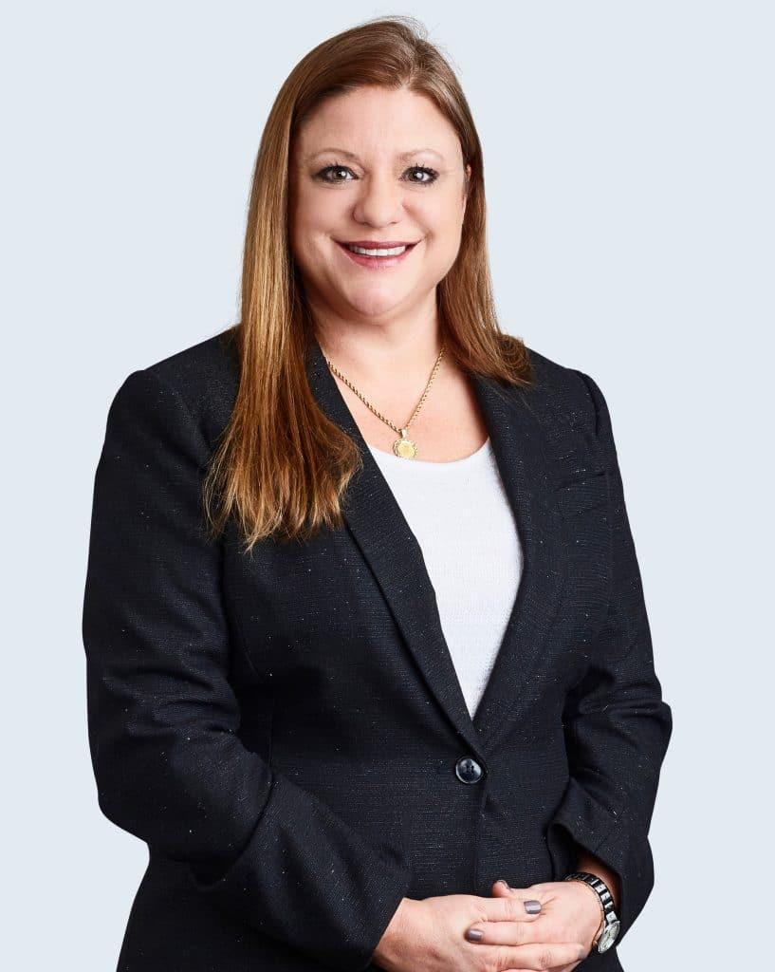

Who Are We and Why Should You Care What We Have to Say?
Metrocare generates a $172M in revenue with $135M coming from Mental Health Services.
Of that $135M, $86M is generated from FFS, DPP and CCP
While we ARE the LIDDA, we are NOT the LMHA and have learned to THRIVE through initiative, mistakes, analysis and just plain GRIT!
Take our lessons learned home and make them your own!
Kelli Laos, LCSW
Chief Operating Officer
Jennifer Wadsworth, LPC-S, MBA
Chief Clinical Officer

Slide 3
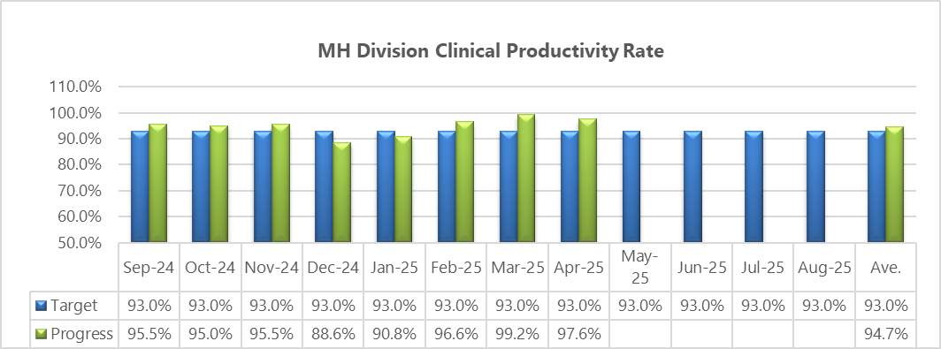
Board Key Performance Indicator

Slide 4
Metrocare’s Taxing History with Productivity
How to Measure it?
How to Monitor it?
How to Communicate it?
How to Performance it?
No
  By Direct Service Hours
  By % of Caseload Seen
No
Monthly
Quarterly
Annually
No
  Strictly by Dollar Amount (to employee)
  Strictly by Service Hours (to manager)
No
  Delayed Intervention
  Reactionary Management
Yes
  Staff driven approach
  Blended Rate based on Medicaid
  With tools to monitor LOC and Caseload
Yes
Daily (by Employee)
Weekly (by Manager)
Weekly (by Director)
Monthly (by Chief)
Calculator/Dashboards
Yes
  Begin in NEO
  Patient Care Focus to Employee
  Patient Care and Budget Focus to Manager
  Normalize the Conversation
Yes
  Allow monitored “ramp up”
  Time Limited PIPs combined with Support and Resources

Slide 5

Standard Productivity Calculations
Staff spend a certain amount of time daily engaged in billable services.
  Account for positions that must travel
  Account for positions that have more non billable services than others
2. Clinic Based Positions
  APN – 7 hours of service per day
  LPHA – 5.5 hours of counseling service per day
3. Field Based Positions - Outpatient
  QMHP – 5 hours of service per day (62.5%)
  Peer – 5 hours of service per day (62.5%)
4. Field Based Positions – Intensive
  QMHP – 4 hours of service per day (50%)
  Peer – 4 hours of service per day (50%)
  Care Coordinator – 4 hours of service per day (50%)

Slide 6
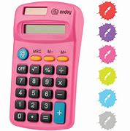

Creating a Benchmark - Bench Calculators
QMHP – Adult Outpatient
Service Code | Description | Unit | Rate | Weekly Units | Weekly Dollars | Svc Hours | Svc Percent
3700 | Psychosocial Rehab - Ind. | 15 | $ 27.00 | 72 | $1,944.00 | 18.00 | 45.00%
0460 | Case Management | 15 | $ 20.00 | 12 | $ 240.00 | 3.00 | 7.50%
3800 | Skills Development - Ind. | 15 | $ 25.00 | 16 | $ 400.00 | 4.00 | 10.00%
TOTALS |  |  |  | 100 | $2,584.00 | 25.00 | 62.50%

Slide 7

Changing the Narrative
Peer Led workgroup
  Normalize the conversation about benchmarks
  Ramp Up Planning
  Staff Training on Benchmarks
  Manager Training on Benchmarks
  Mentorship

Slide 8
Training
Staff Training
Manager Training
Why We have Benchmarks
Productivity and the Mission
Productivity Conversations
Example Schedules
Strategies for Success
Structure of Session
How to track Progress
Efficient Documentation
Signs that You Need Help
Budget Implications
How Productivity is Created

Slide 9

Resources and Support for Staff and Manager
Staff
Structure
One-on-Ones
  Set SMART Goals
Analytical Tools
Manager
Scheduling Calendar
One-On-Ones
On Site Assistance
Start the Conversation sooner rather than Later
Analytical Tools

Slide 10
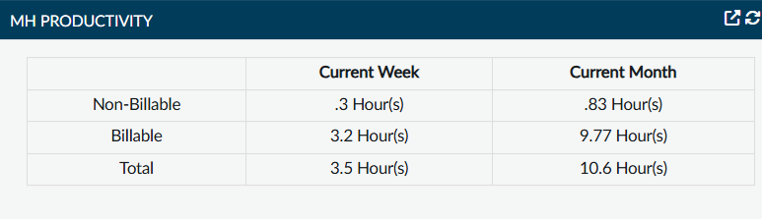
Tools and What to Do Next
Analytical Tools:
Caseload Reports
Productivity Report
Productivity Widget
Next Steps:
Strategic Scheduling by Location
Non-Billable to Billable Services
Scheduling Enough Individuals per Day
Performance Improvement Plans

Slide 11

Mentorship/Ramp Up Plan
Clinic based Mentors
Field based Mentors
Quarterly Mentor Workgroup
Ramp Up for New Staff
Timeframe | Week 3 | Week 4 | Week 5 | Week 6 | Week 7
Activity | Clinic Based Observation | Clinic Based Practice | Clinical Academy | Field Based Observation | Field Based Practice
Training Expectations | 20 hrs. | 20 hrs. | 7 hrs. | 20 hrs. | 10 hrs.
Timeframe | Week 8 | Week 9 | Week 10 | Week 11 | Week 12
Function/Mentor for Shadowing | Full Role | Full Role | Full Role | Full Role | Full Role
Scheduling of Clients per day | 2+ | 3+ | 4+ | 5+ | 5-6+
Clinical Hours Expectation | 25% | 50% | 70% | 90% | 100%

Slide 12
Productivity Incentive Program
Bonus Eligibility
Staff averaging above 105% of their productivity benchmarks for the quarter are eligible to receive a 20% bonus of the amount collected in excess of 105% of benchmark.
Bonuses are calculated and paid based on the following criteria:
  For individual bonuses – no minimum % of program net income for eligibility
  Paid quarterly based on the 3 months prior
  Revenue generating, direct-care positions only (i.e., clinical/medical)
  Full time and part time employees are eligible, plan excludes PRN and contracted staff
  Employees must be on the payroll and in the same reporting unit at start and end of bonus period to be eligible
  Individual bonus payments will be capped at $750/individual/quarter
23% of QMHPs Bonus!

Slide 13
Agency Incentive Programs
Agency Bonus Program
Achievement of Agency Incentive Metrics established by Board
Paid annually with % of payout based on % of achievement to metric, with max payout of 10% of employee’s base salary
Example metrics:
>87% of survey question “Your overall satisfaction with Metrocare Services.”
Increase number of unique individuals served by 1.5% YOY
Don’t leave out Non-Clinical Staff!
Metrocare also offers an Agency Bonus Program

Slide 14

Questions?

