Slide 1

The Intersection between Mental Health and the Housing Crisis
June 2025

Slide 2
Learning Objectives
Understanding the impact of Housing instability on Mental Health and how the Local Mental Health Authorities can support clients experiencing a housing crisis.
Explore different housing intervention types and how to assess clients on their housing stability needs and goals.
Lessons Learned in Development from the LMHA

Slide 3
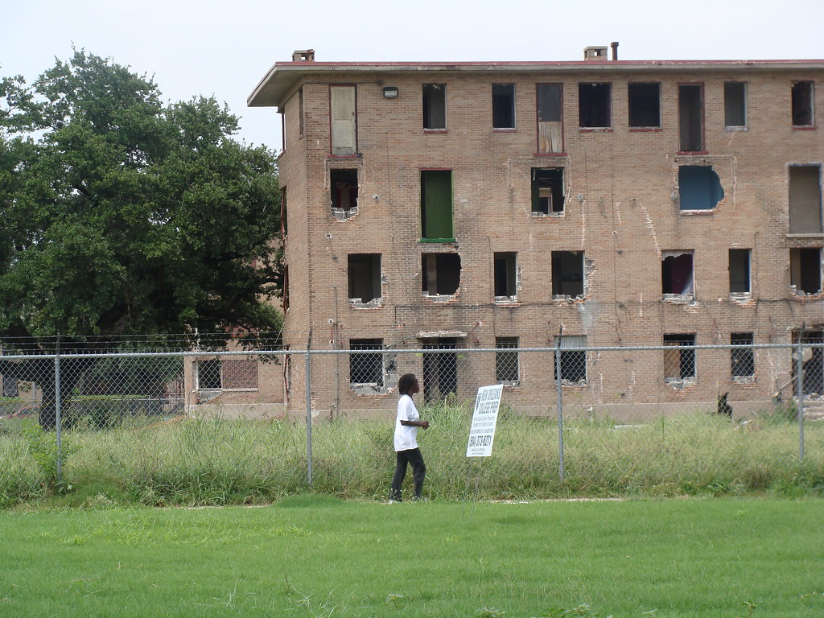
What Causes Housing Instability?
Lack of affordable housing
Lack of income
  Unemployed or underemployed due to a number of factors, such as a challenging labor market; limited education; a gap in work history; a criminal record; unreliable transportation or unstable housing; poor health or a disability.
Health problems- can cause or be exacerbated by
Domestic Violence
Racial Inequality
  Especially for black/AA and Indigenous people
This Photo by Unknown Author is licensed under CC BY-SA

Slide 4
Impacts on Health…
Ability to afford other necessities including food, medication, and transportation.
Affordable housing is often in neighborhoods with higher crime rates, thus exposing residents to a greater risk of injury.
Living in an unsafe neighborhood and/or struggling to pay rent contributes to high levels of stress, which can have lasting impacts on health.
Affordable housing is often in areas that lack grocery stores and access to healthy food options. This contributes to health conditions like obesity and diabetes.
Affordable housing is often in neighborhoods with underfunded schools. This impacts children’s ability to access a quality education.

Slide 5
Transinstitutionalization
A term used to describe a major unintended consequence of deinstitutionalization — where individuals with serious mental illnesses are moved not into community care as intended, but instead into other types of institutions like:
Jails and prisons
Homeless shelters
Nursing homes
Emergency departments
Rather than achieving true community integration, transinstitutionalization simply shifted people from one institution to another, often without appropriate psychiatric care.

Slide 6
Why LMHAs/LIDDA…
They are crucial points of access to publicly funded mental health services.
Serve uninsured, underinsured, and low-income individuals.
Help prevent hospitalization, homelessness, and incarceration through community-based interventions.
Higher acuity meaning more client assistance needed

Slide 7

Continuum of Housing
Homeless Diversion/Prevention
Supported Employment/SOAR
Temporary Financial Assistance
Intensive Problem Solving
Budgeting
Landlord Mediation
Permanent Supportive Housing
HUD
City/County
State
Foundations
Federal Home Loan Bank
Affordable Housing/Subsidy
Local Housing Authority
Public Housing
Tax Credit Properties
811 Project Rental Assistance
HUD 811

Slide 8
Homeless Diversion and Prevention
Housing Stability Plans
Landlord Outreach Services
SOAR
Supported Employment
Temporary Rental Assistance***

Slide 9
Affordable Housing/Subsidy
Low Income Housing Programs
811 PRA
HUD 811
HUD 202
Foundations
Accessible Spaces
Public Housing
Local Housing Authorities

Slide 10

Permanent Supportive Housing Development
Capital
On-Going Services
Operations

Slide 11

How to fund it…

Slide 12
Federal
State
Local Governments
Foundations
Philanthropy

Slide 13
Getting to Know Funders…
Funder | Funding Opportunities
HUD, HUD CoC, CDBG, HOME | Subsidies, Services and Capital
Texas Department of Housing and Community Affairs | Capital, 811 Project Based Rental Assistance
Local Government | Services, Capital, Subsidies
Local Housing Authorities | Subsidy
Federal Home Loan Bank | Capital
Corporation for Supported Housing | Capital
Texas State Affordable Housing Corporation | Capital, Services

Slide 14
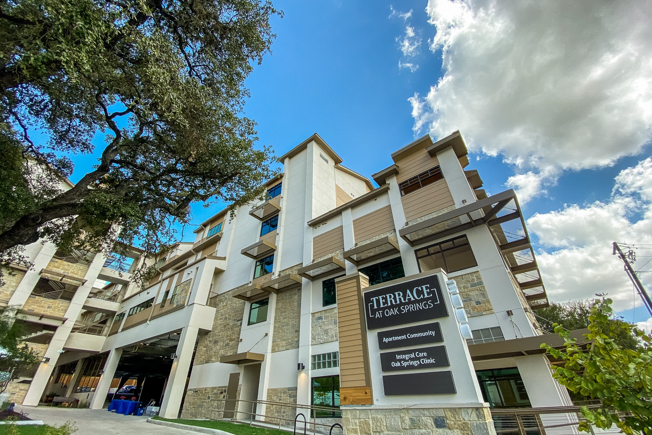
Terrace at Oak Springs
Landowner/Developer: Integral Care
Sources:
Capital One Bank
City of Austin
Mobile Loaves & Fishes
National Equity Fund
Rathgeber Foundation
St. David’s Foundation
Texas Dept. of Housing and Community Affairs
Texas Health and Human Services Commission
Integral Care
Services: City of Austin
Operations: Housing Authority of the City of Austin-Vouchers
Type: New Construction: $19,393,304

Slide 15
The Nellie
Landowner: Integral Care
Developer: Elizabeth Property Group Sources:
  HUD Loan
  Home ARP
  Historic Tax Credit
  Tax Credit
  Solar Credits
Services: HUD CoC/Developer
Rental Assistance: HACA
Costs: $14+million Rehab

Slide 16
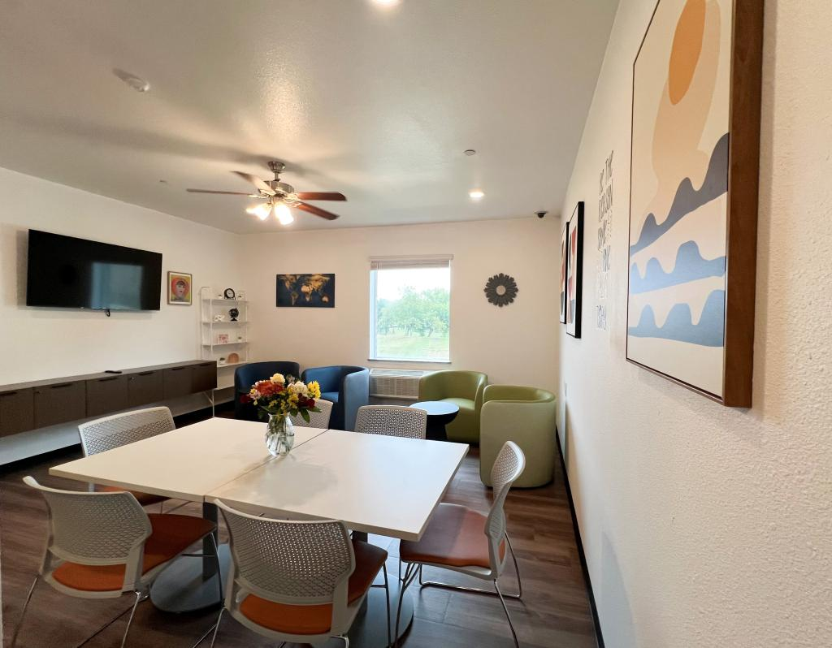
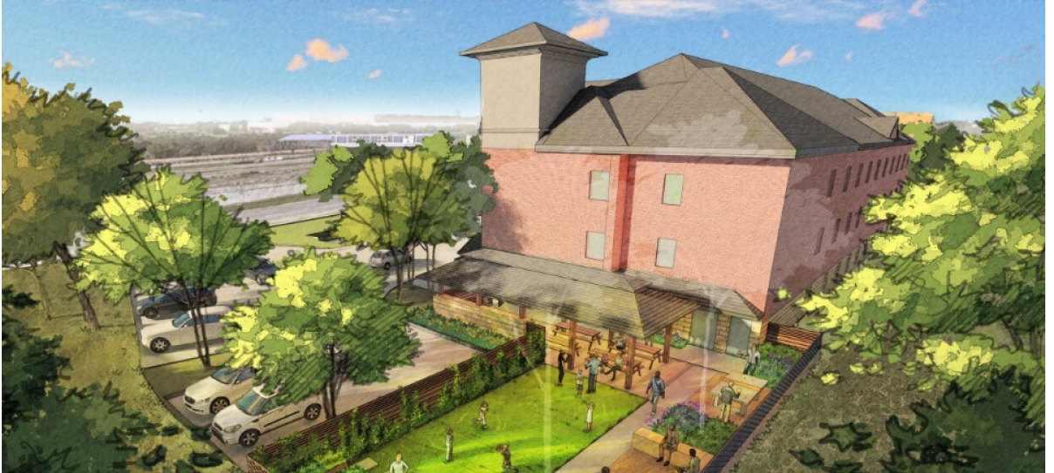
The Bungalows at Century Park
Costs: $6.7million (purchase)+ $4 million (rehab)

Slide 17
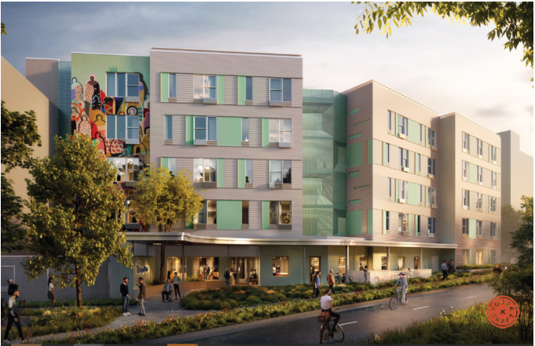
Seabrook Square II Apartments
Land: City Owned
Developer: Integral Care/Capital A
Capital Funders:
  Owner Equity
  State and Local Fiscal Recovery Funds
  City Rental Housing Development Assistances (federal/local funds, housing trust funds, GO bonds)
  Federal Home Loan Banks
  Philanthropic
Services: City
Vouchers: City
Cost: $21,000,000

Slide 18
Scattered Site
Capital: Open Market Apartments
Support Services: HHSC, City of Austin
Vouchers: Housing Authority of Travis County, Housing Authority of the City of Austin, HUD CoC

Slide 19
Development Lessons Learned
Create a Subsidiary
Trauma Informed Design
Stay faithful to the Single Site PSH model
Cameras
Controlled access/Single Point of Entry
Several places for residents to gather
Bus line
Back up plans electrical outages
Have more than one elevator
Intercom System
Get Resident Feedback
NOTHING CAN BE CUSTOM!

