Slide 1
AutISM
AND LAW ENFORCEMENT

Slide 2
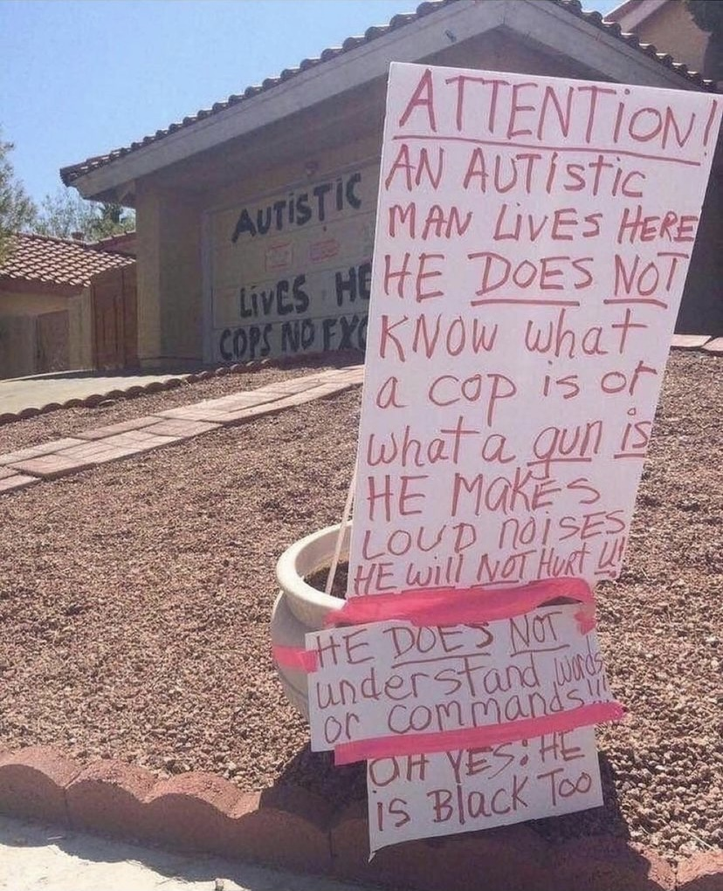
Autism and Law enforcement

Slide 3
Tres Jackson
Born in 2000 Employee
Oldest son and Big Brother Gamer
Military Brat Licensed Driver
High School Graduate Autism Ambassador
Rusty Awards – Bell County Person of the Year
Variety of Texas - IMPACT Award 2024
Registered Behavioral Technician

Slide 4
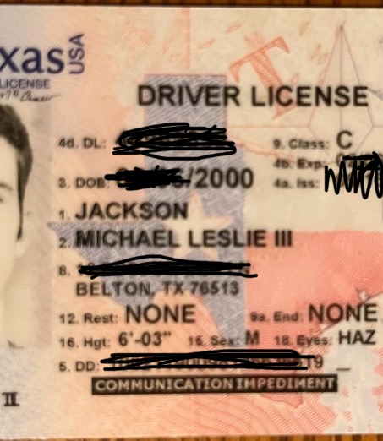

Slide 5
I work for:
Jim Nichols
Elected Bell County Attorney
Richard Lazott
  First Assistant

Slide 6
Anne Jackson
Prosecutor for 20 years
Specialized in Family Violence Misdemeanors
Felonies for 9 years
Saw IDD in Crimes Against Children
Military Spouse
Deployment Survivor (3 times)
Mother of 3 boys
What do I know about girls?!?!?!?

Slide 7
Kristin Tindell
Elementary School Teacher
Special Educator
Board Certified Behavior Analyst
  Tres’ Therapist and most trusted human!!!!!!!
Licensed Professional Counselor
Owner of
  Central Texas Behavioral Solutions
  Hoofbeats Therapeutics
PhD student in Applied Behavior Analysis
Mother and wife

Slide 8
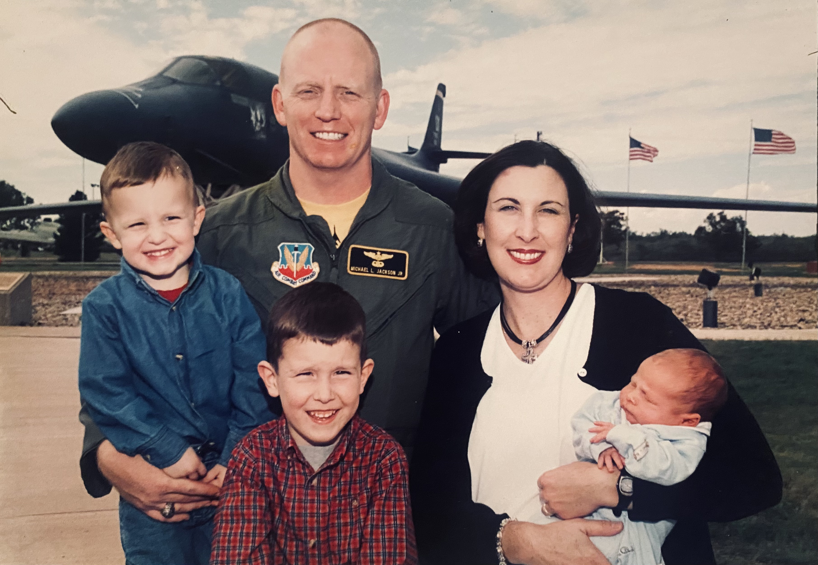
Our Family 2004

Slide 9
Ten things we wish you knew
https://youtu.be/x5mhttps://youtu.be/x

Slide 10
5 Things to know
We look normal but are different.
We are not disabled.
We often react inappropriately . . . especially in social situations.
We don’t understand EMOTION, but we “care”.
We are not BROKEN. We want and need to be understood.

Slide 11
5 ways to care
Be patient. It takes us longer.
We need a certain level of GRACE.
LISTEN.
Avoid sudden, unexpected change.
Ask detailed questions about things we understand.
Do not become frustrated with how we attend/make eye contact

Slide 12
If you have met one person
with autism, you have met
ONE PERSON
with autism.

Slide 13
3 levels
Level 1
Level 2
Level 3
Requires Support
May have a hard time communicating with neurotypical peers
Difficulty with Social Cues and Body Language
ASPERGERS
Requires Substantial Support
May find it hard to communicate in a socially acceptable way
Behaviors are a mismatch with time and place
* Stimming
* Repeated behaviors
Requires VERY Substantial Support
May be entirely unable to mask and care for them selves
Challenges with Daily Living Tasks
Unable to mask

Slide 14
Texas Rules of Prof. Conduct
Rule 1.01 Competent and Diligent Representation
    Do you have the legal knowledge, skill and training reasonably necessary to represent someone with autism?
Rule 1.16 Clients with Diminished Capacity
    How do you tell whether someone on a SPECTRUM, is at risk of substantial physical or financial harm, or cannot act in her/his own interest?

Slide 15
Commonalities
Communication challenges
Sensory integration/overload
STIMS
Needs routine/Transitions are DIFFICULT
Flat affect/no emotion
Repeated behaviors
Restricted Interests
Hyper-attending
Lack of eye contact/parallel play
Task Avoidance/Learned Helplessness

Slide 16
Metaphors
Double edge sword * He’s a night owl
Get outta your hair * She is the apple of my eye
As the crow flies * Plenty of fish in the sea
She has cold feet * Cold hearted/heart of stone
Beating a dead horse * Time is money
Raining cats and dogs * Laugher is the best medicine
Roller coaster of emotions * Start a new chapter
Early bird gets the worm * The curtain fell
Fish out of water * He wears different hats
Wipe the slate clean * They are like oil and water
They went to bat for you * It’s game time
Fit as a fiddle * Happy as a clam

Slide 17
Concrete or LITERAL thinking – we are NOT FLEXIBLE thinkers.
People say “you’re autistic?”
Does that mean you take everything literally?
And I’m like “nah, that’s kleptomaniacs”
    Definitely Craig @Bedo76 via B_alexa-autism (Twitter)

Slide 18
Life Span of Autism
Not meeting developmental milestones
  Speech
  Fine Motor Skills
  Eye contact and laughter
  Parallel play
  Restricted Interests
  Thomas the Tank Engine/ Trains/Hot Wheels/Dinosaurs/Shoes/Weapons
  Comicon
  Marvel Universe/ DC?
  Video Games

Slide 19
How it looks ….
Elementary School
  Pervasive Developmental Disorder–Not otherwise specified (PDD-NOS)
  Trouble learning and meltdowns. A few friends.
Middle School
  ASPERGERS/Autism Spectrum Disorder (ASD)
  Trouble Learning. Headaches. Anxiety. One friend.
High School
  Intellectual Developmental Disorder (IDD)
  Failing Tests (STAAR). Self Isolation. Running Away. Violence.

Slide 20
Special Education
Least Restrictive Environment -- Mainstream
  Special Education Teachers
    High turnover rate so - frequent loss of relationships and routine.
    Talk to me -- How do I find out what Tres is NOT doing?
  General Education Teachers
    Middle School & High School
      7- 8 teachers per year
        ALWAYS a few who do not/will not understand modifications necessary for Tres to learn

Slide 21
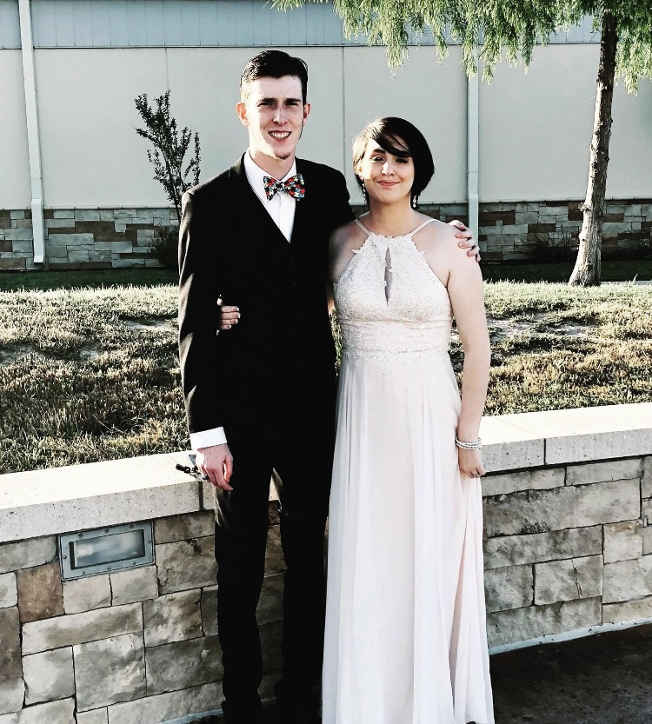
Tres and Olivia – Prom 2018

Slide 22
What helped Tres
Applied Behavioral Analysis (ABA)
  Tindell (Central Texas Behavioral Solutions)
One Friend
  Olivia
Standing up to Dad
  I’m your son . . . Not a soldier
Explorers at the Belton Police Department
  Sgt. Richard Kusak
A boss who takes time to understand
  FireStreet Pizza

Slide 23
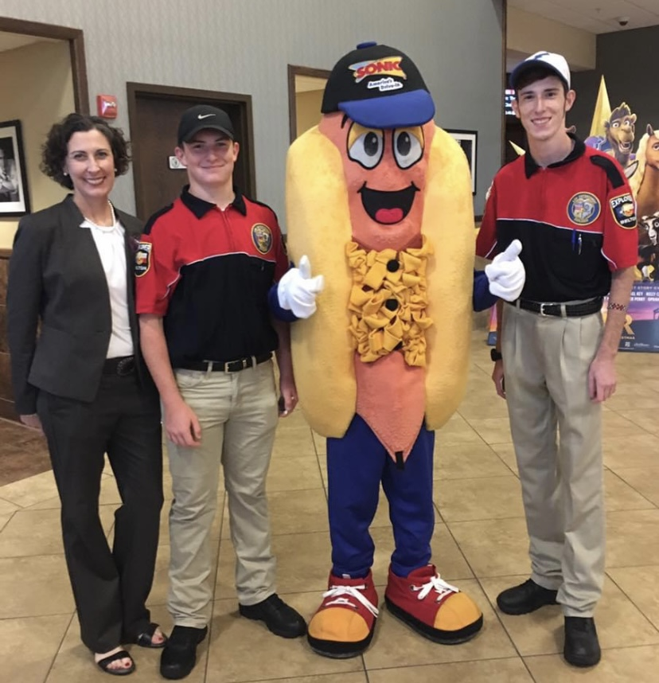
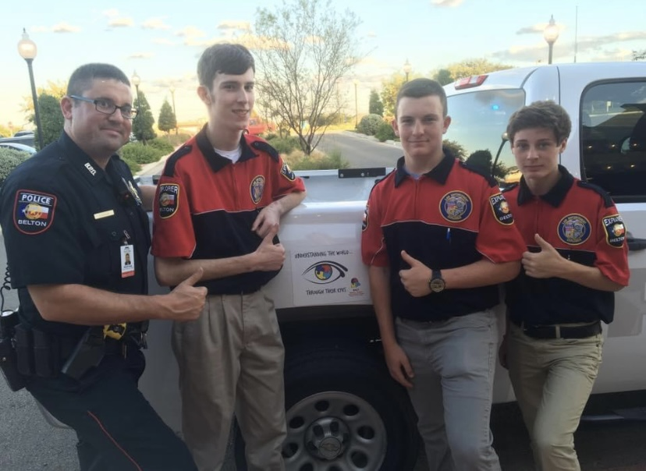
Tres on Duty

Slide 24
Our family’s crises/911 calls
X-Box and the Credit Card
Football game, grandparents & broken glass
Homework and self-harm
  Decision tree
The fight with dad, the knife and the POLICE

Slide 25
Labels
Handicapped
  Handi – capable
Retard
  Fast or High Speed
Normal
  Neurotypical
Normal is Boring

Slide 26


Slide 27
B a I t
Bell County Autism Intervention Team
  Juvenile Probation
  Patrol Officers
    Liability
      Hands On? Hands Off?
    Clarity of Speech
      Command Presence
      Do what I say!!!

Slide 28
Witnesses, victims & suspects
INTENTIONALLY Choose your words
What happened to you?
What did you see?
What did you do?

Slide 29
A.S.K. BAG
Autism Sensory Kit
  Headphones
  Ball Cap/Beanie
  Sunglasses
  Weighted Blanket/Soft Towel
  Dry Erase Board
  Picture Stories
  Fidgets
    Spinners
    Bubble Wrap
    Oral

Slide 30
I’m autistic, which means
Everyone around me has a disorder that makes them:
  Say things they don’t mean
  Not care about structure
  Fail to hyper-focus on singular important topics
  Have unreliable memories
  Drop weird hints
  Creepily stare into my eyeballs

Slide 31
So why do people say YOU’RE the weird one?
    Because there’s more of them
        than me.
        Autisticnotweird.com

Slide 32
Custodial setting
What do these phrases convey?
  ‘I am going to pat you down” or “search you”.
  “Do you have anything on you?”
  “I am going to check you for lice.”
  “Face the wall.”
  “Do you waive these rights?”
What can the listener expect?
  Touch or grab, to escort, etc.
Tell the suspect/inmate:
  When and for how long …
  What part of your body will touch his/hers.

Slide 33
Panic Points
Sensory Overwhelm
Locked in the car/No escape
Driving into building/Sally Port
Wearing someone else’s clothes
  UNDERWEAR
Alone in Cell
  “They will forget about you here”

Slide 34
Things Tres noticed
Are you diagnosed with anything?
  A very general question.
  A strong desire for precision and accuracy.
  “Was that from a private doctor?”
A desire to smile when picture taken.
  This is what they have been told their entire lives.
  That’s a rule!
Extreme anxiety about BOREDOM

Slide 35
Cases with ASD Victims

Slide 36
Adam Lanza
Diagnosed with Sensory Processing Disorder in Elementary
  Became angry when touched
  “The noise and the chaos disrupted him.”
Diagnosed with Aspergers in Middle School
High School
  Robotics Club until mother changed schools.
Played violent video games
Mom took him to gun range and had firearms in house
Planning to move Washington State for college

Slide 37
December 14, 2012
Shot mother 4 times with her gun as she lay in bed
Shot and killed 26 people at Sandy Hook Elementary School in Newtown, Connecticutt
  20 children between 6-7 years old
  6 adult staff members.
  No evidence that he was mistreated by or had hard feelings about elementary school.

Slide 38
Office of Child Advocate in November 2014
Lanza had Asperger's syndrome and, as a teenager, suffered from depression, anxiety, and obsessive-compulsive disorder, but concluded that these factors
"neither caused nor led to his murderous acts".
The report went on to say,
  "his severe and deteriorating internalized mental health problems …
    combined with an atypical preoccupation with violence … (and) access to deadly weapons …
    proved a recipe for mass murder.

Slide 39
Dylan Roof
Killed 9 African Americas in Charleston, SC at
Emanuel African Methodist Episcopal Church
In his Manifesto he says:
  Curiosity piqued by trial of George Zimmerman, who shot Trayvon Martin
  Googled “black on White crime”.
  Found Council of Conservative Citizens which offered
pages of “brutal black on White murders”.
  “I’ve never been the same since that day”

Slide 40
roof
After murders, defense attys have him evaluated:
  As a child he
    Exhibited “disturbingly introverted behavior”
    Played alone, never started conversations
    Visited mental health provider in 2009 after threatening suicide
    Reported persistent anxiety when around others
    Refused to take prescription for anti-depressants
  Described Roof as “a geyser of autistic symptoms”
  Opinion: “People are a language that he neither understands nor speaks”

Slide 41
Testimony to judge
“If they say I have autism, it’s like they are trying to discredit me.” Emphasized to his attorneys that an autism/mental health diagnosis
diluted his purpose for gunning down 9 parishioners at the church.
Roof believed being labeled Autistic is worse than death penalty.
  “because once you’ve got that label, there is no point in living anyway”.
Defense argued that Roof was incapable of cooperating with counsel,
  his decision were affected by delusions,
  he has fixed false beliefs that are a product of mental illness, and
  the fact he has figured out how to sabotage his defense . . .
    Illustrates why it is “so terrible to try an incompetent defendant”

Slide 42
Judge watched and listened and deemed Roof competent
Convicted and sentenced to DEATH on January 10, 2017

Slide 43
April of 2016 in Bell County
14 month-old admitted to hospital with seizures and bruising around anus and genital area, bleeding in diaper.
People in home are mother, mother’s boyfriend and parents and PAUL.
All interviewed.
Boyfriend and PAUL polygraphed.
Boyfriend “passed”. Paul “failed”.
After failing the polygraph, detectives obtain a “written confession”.
  Inserted pen into baby’s vagina
PAUL arrested for AGGRAVATED SEXUAL ASSAULT OF A CHILD
Defense attorney is appointed for PAUL.
PAUL sits in jail for months

Slide 44
Writes letters from jail
I have psychological problems.
I am depressed and have been in a mental hospital.
When I went to the jail to take the polygraph I was still traumatized by the incident.
I was telling the truth and I still failed the test.
I was trying very hard to not punch myself in the head.
When I cannot punch myself in the head I have an anxiety attack.
I assumed the sheriff would not let me go home until I told her what happened.

Slide 45
Video of “confession”
PAUL was questioned for 3 hours 17 minutes
During the interview Paul denied sexual contact 20 different times
PAUL was very tearful and repeatedly maintained his innocence
during the interview before writing 1 sentence statement
After reading this one sentence statement, the law enforcement officers told the defendant what to write about the time and place these alleged acts were committed.

Slide 46
Paul
  IDD Evaluation determined:
  Spoke in a monotone and overly formal manner
  Social nuances were missed
  Expressive and receptive language abilities lacking
  Symptoms of Autism Spectrum Disorder observed
  Total standard score on Intelligence Test: 70 IQ
  Overall age equivalence of 8 yrs,10 mos
  (although had job, car, DL, and lived independently)
  Detective testified: I do not administer polygraphs to
  anyone under 10 years of age
  Judge Jezek: Paul was overwhelmed by the circumstances
  surrounding his confession such that he did not
  make a decision to confess of his own free will

Slide 47
February 20, 2020
Same girl, now 6y, has broken arm and injured genital area
Guess who still lives in that house?
Girl says mom’s boyfriend “tried to put a dick in my mouth”
Boyfriend is arrested and charged with Injury to a Child
Pled guilty to this felony in April of 2023
Is now on 7 years probation

Slide 48
The 911 call
An Autistic Meltdown
A brick
Blood
                “He’s gonna kill me”
WHY ARE YOU CRYING?”
‘I wanna go to jail”
“I hurt Mom”
“I love my life with you”

Slide 49

A mother’s 911 call

Slide 50
What caregivers need
Respite. Rest. A Break.
Understanding

Slide 51
A Texas Case
Graham PD

Slide 52
Elijah McLain and Aurora PD
Karim Jovian - Elijah McClain's Final Words to the Police were Heart Breaking | Facebook

Slide 53
Words spoken by police
You are acting suspicious
Cooperate
Stop tensing up dude
Relax or I’ll have to change this situation
It’s not going to be good for you – I’m telling you right now.
If you keep messing around … I’m going to have to bring my dog out

Slide 54
Elijah’s last words/acts
I’m an introvert.
I’m different.
I’m just trying to go home.
I intend to take my power back.
Respect the boundaries I am speaking to you.
I don’t fight. I don’t do that stuff. I have no gun.
I can’t breathe correctly.
I’m sorry.

Slide 55
fear
Why so strong?
  Freeze? Flee? Fight?
Did Elijah try to grab the gun?
Ketamine

Slide 56
When our nervous systems
are over-activated from emotional triggers,
we cannot just CHOOSE to calm down.

Slide 57
Excited Delirium
  Acute Distress
  Bizarre and/or aggressive behavior
    Shouting
    Paranoia
    Panic
    Violence toward others
    Unexpected physical strength
    Hyperthermia (gets hot)

Slide 58
From What?
That is a list of symptoms, not a DIAGNOSIS
More accurate phrase:
Altered mental status

Slide 59
Excited Delirium
2020: American Medical Association
      Opposes Excited Delirium as a medical diagnosis
      American Psychiatric Association:
      Diagnosis is “non-specific” and “lacks clear diagnostic criteria”.
      Is used “retrospectively”
  2023: American College of Medical Toxicology
          Multiple distinct contexts with various underlying causes
          “it is time to discontinue the use of this term”
      National Association of Medical Examiners
          Asked members to stop listing “excited delirium as a cause of death”

Slide 60
“Google City of Graham, Autism and Tazer”
    It is our opinion that our officer made a judgment call based on the limited information available, as the job forces them to do every day.
    Based on the situation and presentation of Mr. Moore, the responding officer believed him to be under the influence of controlled substances.
    A reasonable officer could have made this determination.

Slide 61
Graham PD, July of 2018
He then appropriately initiated procedures to determine intoxication.
After the struggle began, the techniques used were consistent with law and department policy for use of force.
We currently meet all stated mandated requirements for mental health training.
Chief Tony Widmer
r

Slide 62
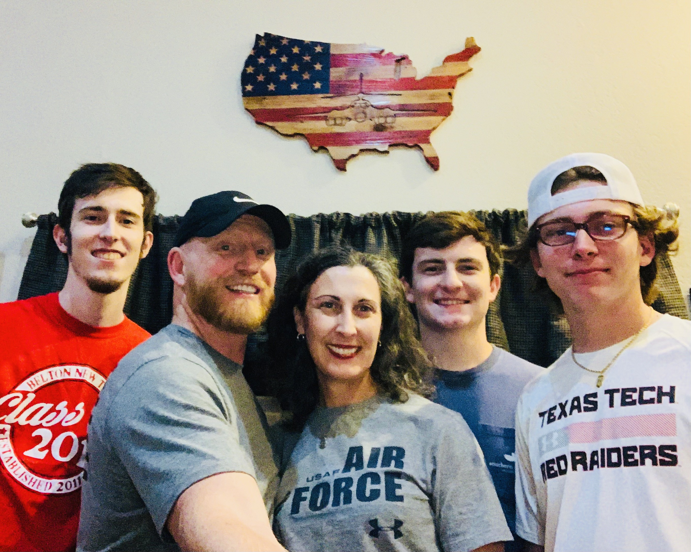
2020

Slide 63
Why does Tres teach?
Transparent
Vulnerable
  HURT ME
  AWARE

Slide 64




Movie & Books about autism

Slide 65



A book and some comedy

Slide 66
Questions?
Tres Jackson
Tres.jax90@gmail.com
(254)624-4243
Anne Potts Jackson
Anne.Jackson@bellcounty.Texas.gov
(254)913-4114

