Slide 1

Bridging Gaps: Advancing Community Services Using the Sequential Intercept Model
Keisha Morris, BA,LCDC.QCC
Andrews Center
Chief SIM Officer- Andrews Center

Slide 2
WHAT IS THE SIM?
A Framework for Community Change
The Sequential Intercept Model maps how people with behavioral health needs move through the criminal justice system — and identifies every point where communities can intervene, divert, and connect them to care instead.
1
Maps the System
A shared picture of how people flow through crisis, courts, jail, and reentry — right now.
2
Identifies the Gaps
Where are we losing people? Where do tools exist but go unused?
Developed by Mark R. Munetz, M.D. and Patricia A. Griffin, Ph.D.
in conjunction with SAMHSA's GAINS Center. Used nationwide to assess resources, identify gaps, and plan change.
3
Builds Shared Ownership
Decision-makers commit together to 3–4 priorities the community can actually move on.

Slide 3
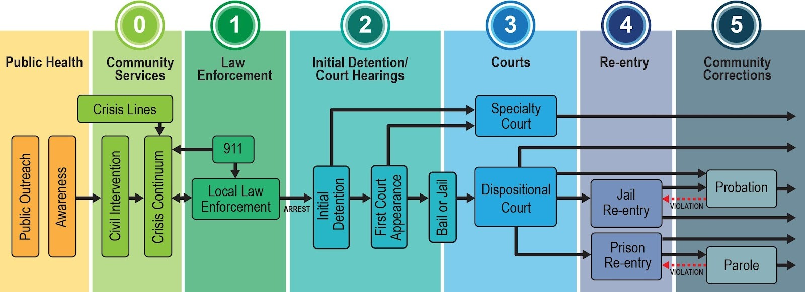
THE MODEL
Adult Sequential Intercept Model
Six intercepts — from community services to corrections — each an opportunity to divert people into care.
0 Community Services · 1 Law Enforcement · 2 Initial Detention · 3 Courts · 4 Reentry · 5 Community Corrections
Each intercept is a decision point where the community can reshape outcomes.

Slide 4
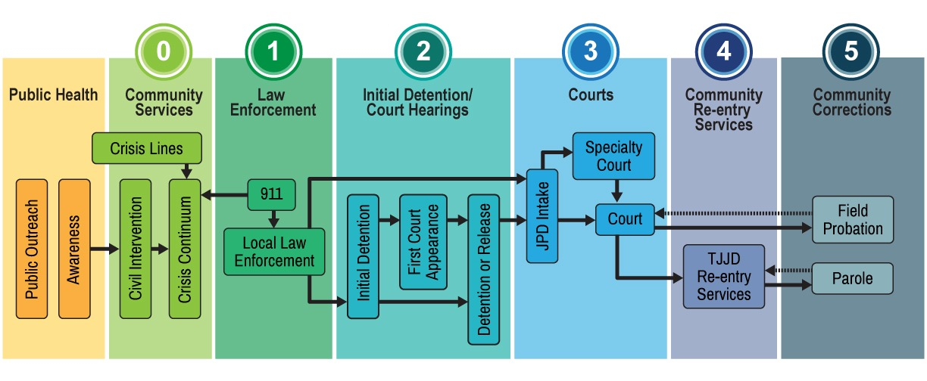
THE MODEL
Youth Sequential Intercept Model
A parallel framework for youth — adding schools, child welfare, and juvenile justice to the continuum.
Why it matters: youth system gaps — particularly adolescent psychiatric beds — have lasting impact on the adult system.

Slide 5








WHO LEADS A SIM
A Small Team of Committed Leaders
You don't need a huge task force. You need the right people at the table.
Judges & Magistrates
Law Enforcement Leadership
What It Takes
Local Mental Health Authority
Prosecutors & Defense
10–15
core leaders across the continuum
Jail Leadership
Probation / Community Supervision
Hospitals & Crisis Providers
People with Lived Experience & Families
2
workshop sessions (one virtual, one in-person)
3–4
community priorities to drive action
90 days
to early wins after the workshop
What they share: authority to act, time to commit, and willingness to lead.

Slide 6
HOW IT WORKS
How a SIM Mapping Works
Three phases. A few months. Lasting community change.
01
02
03
Virtual Session
In-Person Session
Final Report
~3 hours · Remote
1–2 days · On-site
~4–6 weeks later
Facilitators convene the community to inventory existing resources, surface gaps, and identify opportunities across the continuum.
The community gathers to map intercepts in detail, then selects 3–4 priorities with immediate implementation potential.
Facilitators document resources, gaps, priorities, and recommendations — evidence for funding and implementation.
What your community brings: 10–15 core leaders across justice, behavioral health, and community services. JCMH handles the rest.

Slide 7

FUNDING
What It Cost Your Community
$0
Fully Funded by the Judicial Commission on Mental Health ed by the Judicial Commission on Mental Health
Workshop planning and coordination planning and coordination
Facilitator time (expert-led)
System analysis and synthesis and synthesis
No registration. No tuition. No material fees.
Final report development
What your community brings: committed leaders, two workshop sessions, and the will to act on priorities.
Rural communities are specifically prioritized for 2025–2026.

Slide 8

A COMMUNITY IN MOTION
Smith County: What SIM Made Possible
Adult SIM (2022) · Youth SIM (2024) · Refresh (2026)
23-Hour Diversion Center
Article 16.22 Formalized
Under construction — a true alternative to jail and ER for people in crisis, including people with IDD.
Magistrate-level process expanded to identify behavioral health needs earlier in the legal process.
Psychiatric Capacity Expanded
Cross-System Coordination
UT Health at Tyler grew psychiatric staffing in response to rising community demand.
Ongoing groups across behavioral health, juvenile justice, and community services tackle complex cases together.
The common thread: sustained leadership, clear ownership, and alignment between identified needs and the resources committed to meet them.

Slide 9
Why This Work Matters
Behavioral health demand continues to increase
Improves mental health outcomes
Lowers cost and strains on jails
Speeds up the legal process

Slide 10

Smith County's History
Limited mental health resources and unstable nonprofit funding
Community frustration with LMHA capacity limitations
Strained relationships between hospitals, law enforcement, and crisis services
Behavioral health challenges impacting public safety and healthcare systems

Slide 11
The SIM Initiative
On September 22-23, 2022, 75 stakeholders, in the Smith County community, gathered to invest time and passion into identifying barriers between mental health and the legal system. Participants included hospital staff, law enforcement, commissioners, judges, attorneys, justice of the peace, as well as peer, mental health and recovery supports. Over a day and a half, the four topics of most concern arose to become the priorities of our county.
Jail Diversion (Deflection) Center
16.22 Process- Mental Illness Identification at Earliest Stage of Criminal Proceeding
Collaboration between Mental Health and Law Enforcement
Secure funding for Children/Youth/Adult inpatient beds

Slide 12
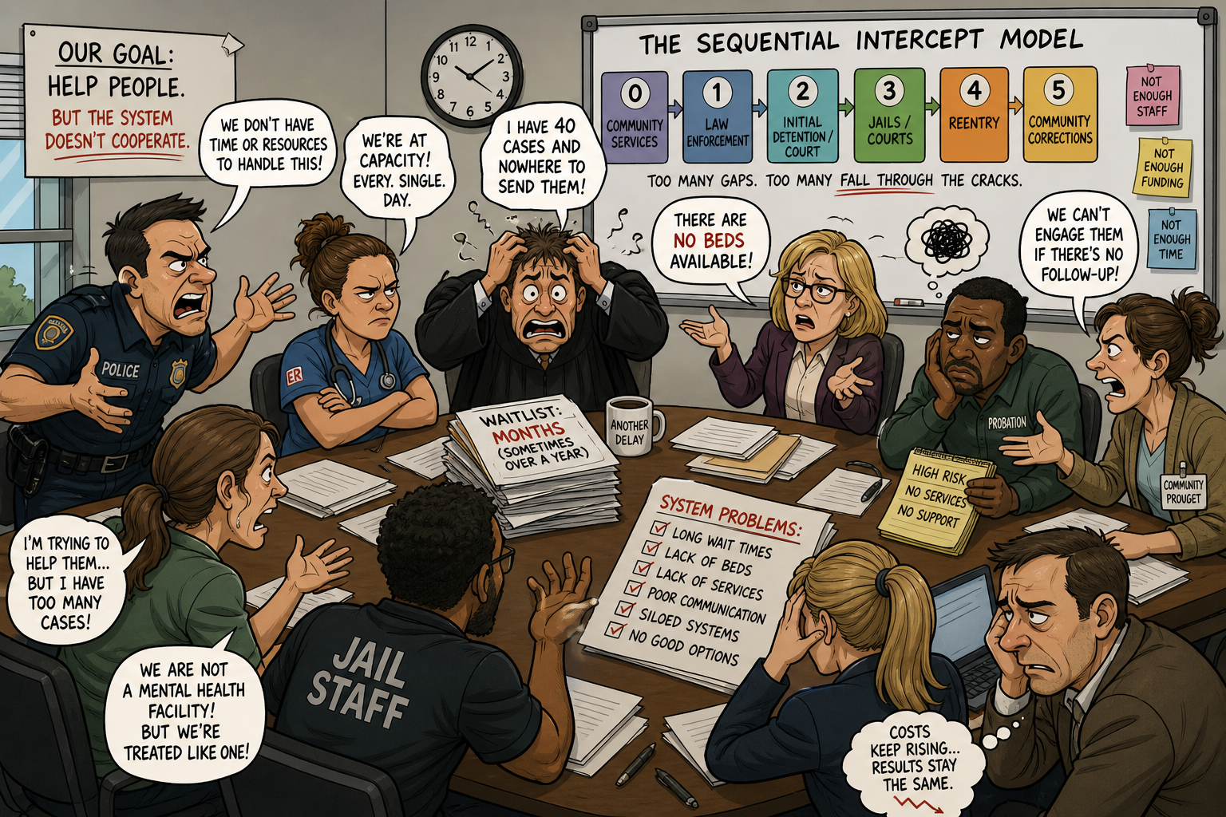
How the Meeting Looked

Slide 13
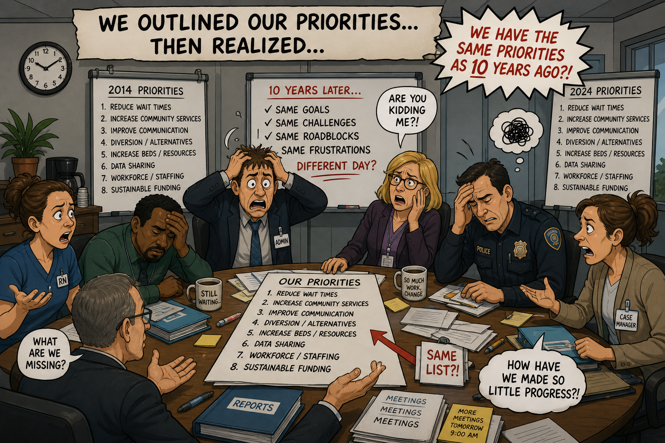
Meeting Takeaways……

Slide 14
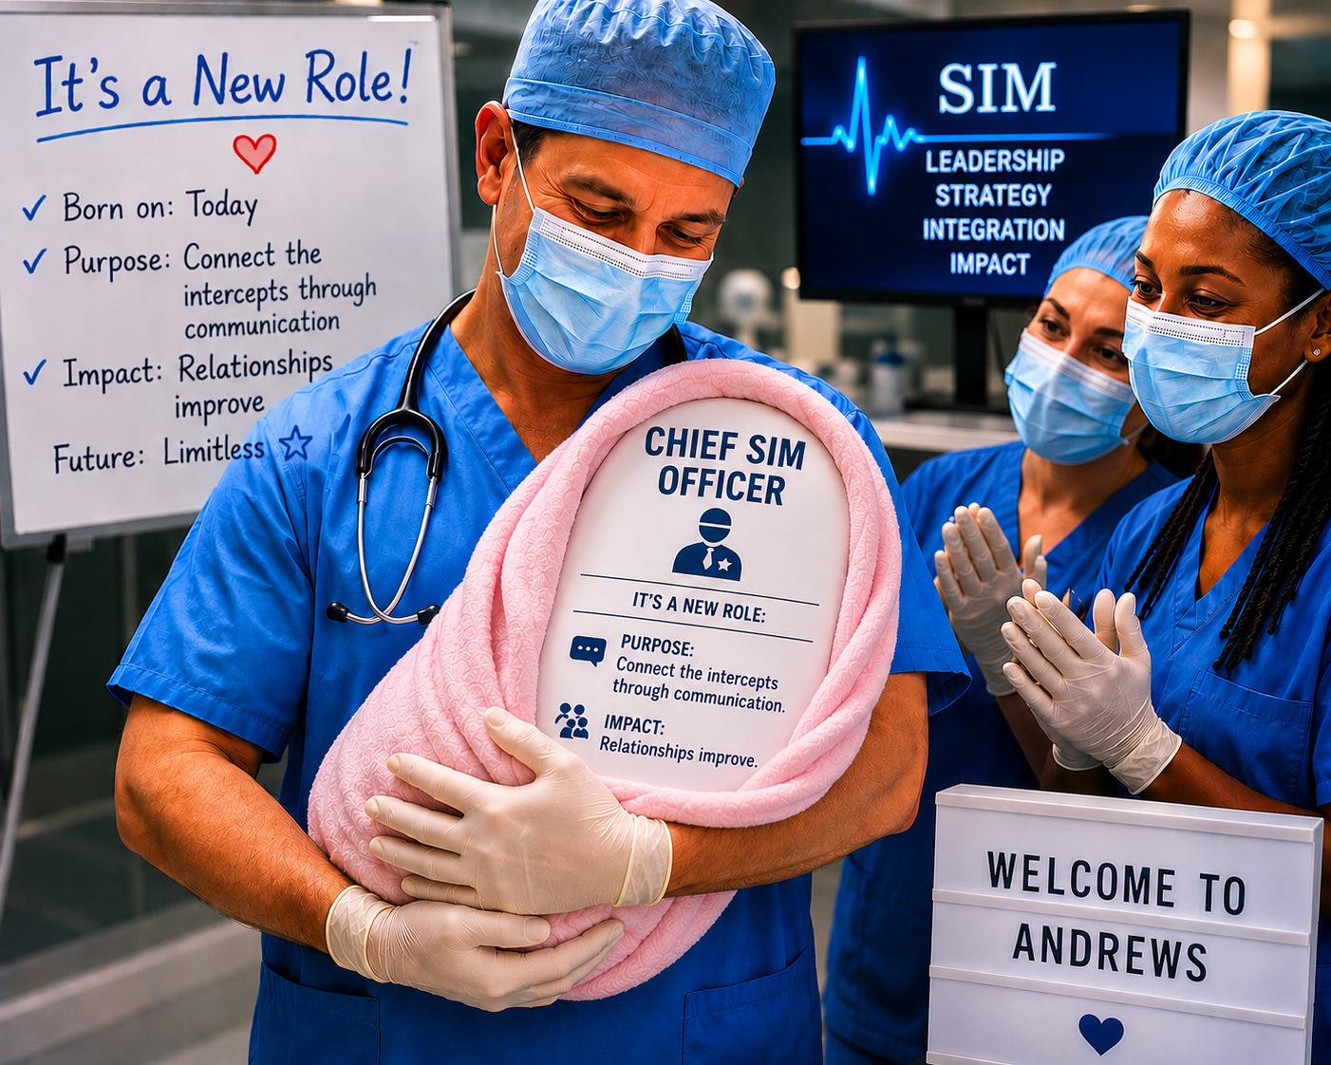

Slide 15
Chief SIM Officer Role
Leads cross-system coordination
Aligns agencies across all intercepts
System improvement strategies

Slide 16
Oversight Includes
Mobil Crisis Outreach (MCOT) & Crisis Respite
Substance Use (IOP, MAT, OSAR)
Forensic Programs -JBCR, OCR, Jail Continuity of Care, (Jail Navigators)
Texas Correctional Office on Offenders with Medical or Mental Impairments (TCOOMMI)

Slide 17
Crisis Response (MCOT/Respite)
24/7 crisis response and field-based intervention
Assist w/ de-escalation & safety planning
Rapid assessment and diversion to appropriate care

Slide 18
Respite
Respite Services
Short-term, voluntary residential support that provides stabilization and serves as an alternative or step-down from hospitalization.

Slide 19
Intensive Outpatient SUD
Intensive Outpatient Program (IOP) for Substance Use Disorder
A structured treatment program that provides therapy and recovery support several times per week while allowing individuals to live at home and continue daily responsibilities.

Slide 20
Region 4 OSAR
Region 4 OSAR (Outreach, Screening, Assessment, and Referral) is a state-funded program that provides outreach, screening, assessment, and referral services to connect individuals to appropriate substance use treatment and support.

Slide 21
Forensics
OCR community-based treatment that restores a person’s ability to participate in their legal case while remaining in a less restrictive setting.
JBCR - Provides timely competency restoration services in jail, reducing waitlists and improving access to appropriate care.
Jail Continuity of Care- Early identification & engagement, discharge & re-entry planning, care coordination across jails, courts and community, warm handoffs
TCOOMMI (Texas Correctional Office on Offenders with Medical or Mental Impairments) Provides case management and treatment support for individuals on probation or parole to support re-entry

Slide 22

Building Buy In Across the Intercepts

Slide 23
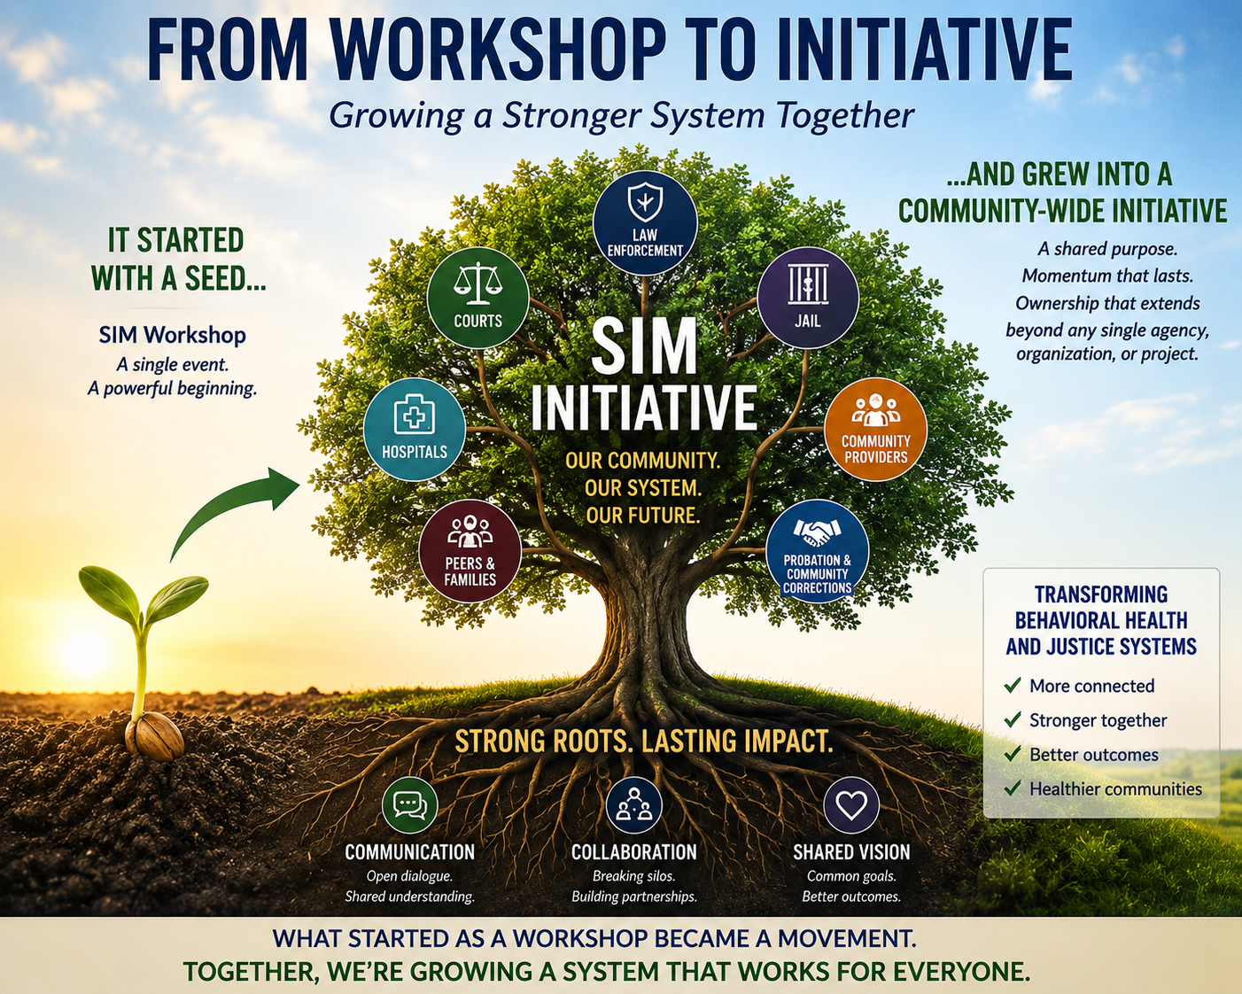
The Approach
Rather than presenting the Sequential Intercept Model (SIM) as a one-time workshop, we framed it as a community-wide initiative.
The word initiative created a sense of purpose, momentum, and ownership that extended beyond any single agency, organization, or project. It transformed SIM from an event into an ongoing effort to improve the behavioral health and justice systems.

Slide 24
Why It Worked
Created a Shared Vision
Established common goals that stakeholders could support and work toward together.
Changed the Narrative
Shifted conversations from "their problem" to "our system."
Made Participation Meaningful
Connected individual efforts to a larger community impact.
Built Inclusive Engagement
Gave stakeholders a seat at the table regardless of their intercept, role, or organization.
Generated Momentum
Sparked curiosity, encouraged collaboration, and motivated agencies to become part of the solution.

Slide 25
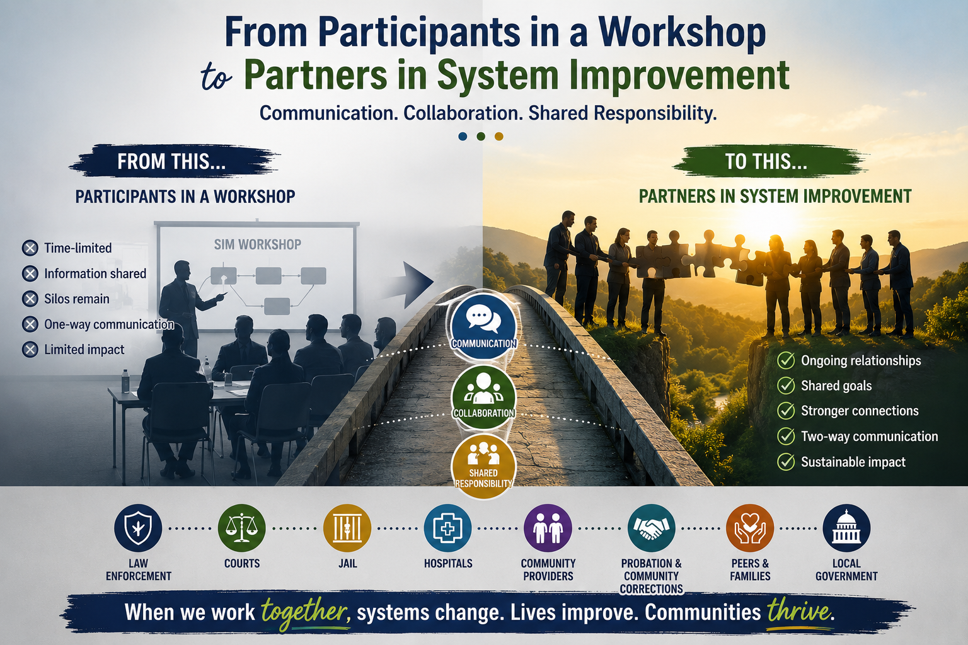
Key Outcome-The initiative became bigger than any one organization.

Slide 26
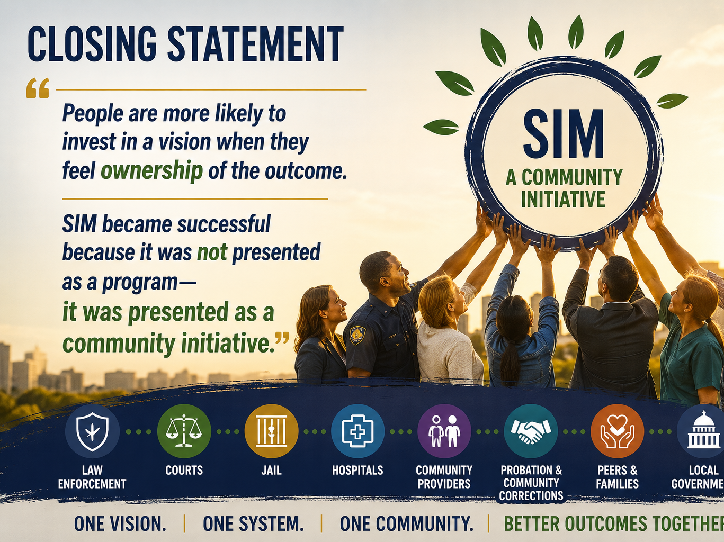

Slide 27


Slide 28
Established Funding
FY2025
(MHG-JII) (NCA) to support JBCR $200,000.00 x 2yrs $400,000.00
Jail (CoC) $250,000.00 x 2yrs $500,000.00
HHSC Respite 694,574 x 2 yrs $1,389,148.00
Governors Grant for Equipment $198,716.07
HHSC Construction Grant $991,450.00
FY25 Subtotal: $3,479,314.07
FY2026
HHSC Operations Diversion Center $780,178.00
HHSC FY26-28 $1,560,356.00
HHSC Specialized Female Funding HHSC $50,477.00
Smith County Opioid Funds $110,000.00
FY27-29
Jail Co Extension $250.000.00 x3 yrs $750,00.00
FY26–FY29 Total: $3,251011.00
Grand Total $6,730,325.07

Slide 29
What’s Next: The Diversion Center

Slide 30

Andrews Center
Through strong partnerships and over $6.7 million in leveraged funding, we are reducing recidivism, lowering jail and ER utilization, and strengthening community-based solutions. These efforts represent both smart fiscal stewardship and improved public safety.
Yet despite these measurable outcomes, much of this work remains one of the county’s best-kept secrets. The impact is real—and we look forward to continuing to build visibility, partnership, and results for Smith County.
Keisha Morris, BA, LCDC, QCC
Chief SIM
kmorris@andrewscenter.com

Slide 31
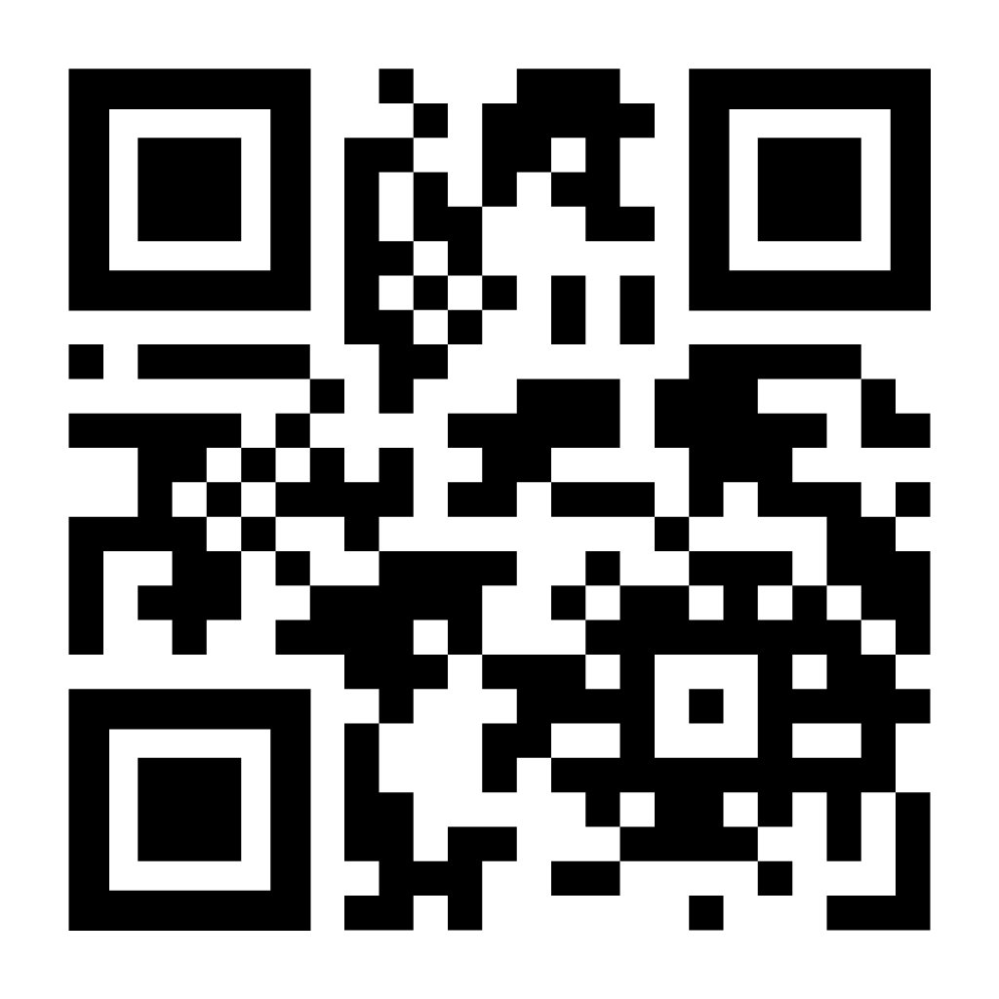
YOUR NEXT STEP
Apply for a SIM Mapping in Your County
The JCMH is accepting rural community applications now.
1
Identify your core team
10–15 leaders across justice, behavioral health, and community services.
2
Submit the application
Complete JCMH's online request — goals, stakeholders, mapping history.
3
Schedule your workshop
JCMH facilitators work with you on timing, logistics, and pre-work.
SCAN TO APPLY
Learn more: texasjcmh.gov/programs-initiatives/sim-mapping-workshop
Contact JCMH@txcourts.gov.gov

