Slide 1

Silos to Synergy:
Advancing Patient-
Centered Systems of Care
Laura Golden, OTR, OTD
System Director of Transition and Teaming
Elizabeth Stasey, LPC-S, LCDC
System Director of Provider Training and Support
Martha Sanderford-Smith, DNP, RN
Healthcare System of Care Network Administrator
Room
Code
2005

Slide 2



TAKING FLIGHT
FROM SILOS
TO SYNERGY

Slide 3
COURSE CORRECTION
Welcome to Services
•Creating one front door at every center for consistent, coordinated access
•Prevent patients/families from having to “jump through hoops”
•Tell me your story, and you only have to tell it once
•Assess for services and supports without restrictions of diagnosis

Slide 4
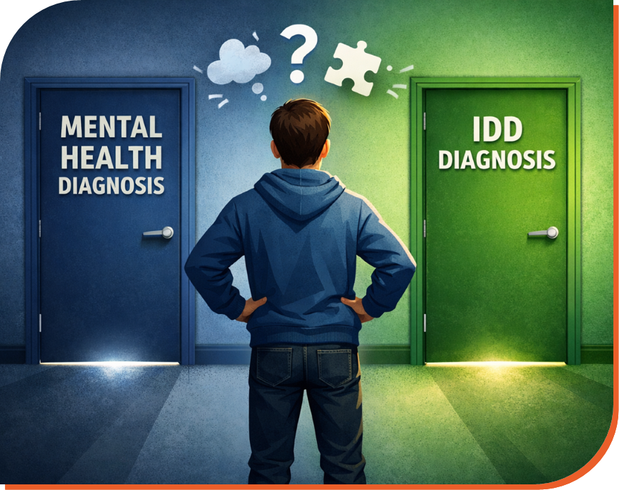

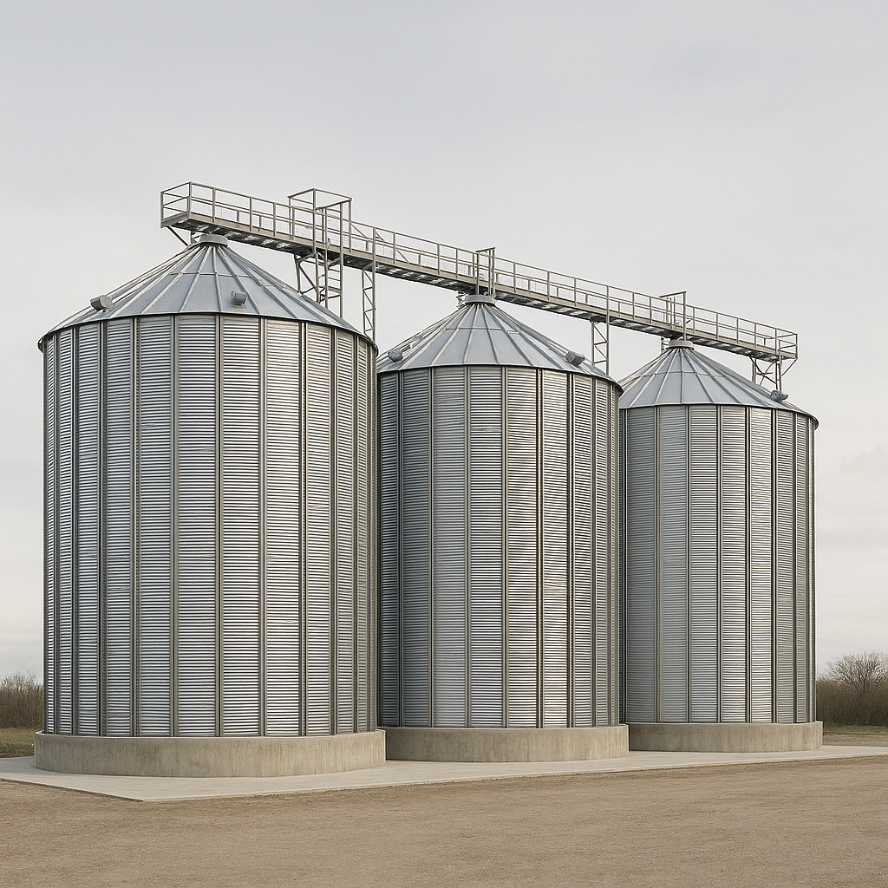
Siloed Programs
  Separate intake
  Separate eligibility
  Separate funding streams
  Separate staff expertise
Historically services were organized around diagnostic categories.

Slide 5

People Don’t Experience Their Life in Silos
People come with:
  mental health needs
  cognitive differences
  trauma histories
  housing needs
  family dynamics
  community barriers
  children/dependents

Slide 6

What if we organized around the
person instead of the diagnosis?
Shifting From:
Diagnosis --> Determines Services/Supports
to
Person --> Needs --> Supports

Slide 7

THE FLIGHT PLAN
Welcome to Services
•No matter what “door” a patient/family walks through, we serve them
•Prevent patients/families from having to “jump through hoops”
•Tell me your story, and you only have to tell it once
•Assess for services and supports without restrictions of diagnosis

Slide 8

Emerging Approach
The focus shifts from diagnosis to identifying individual needs and supports

Slide 9
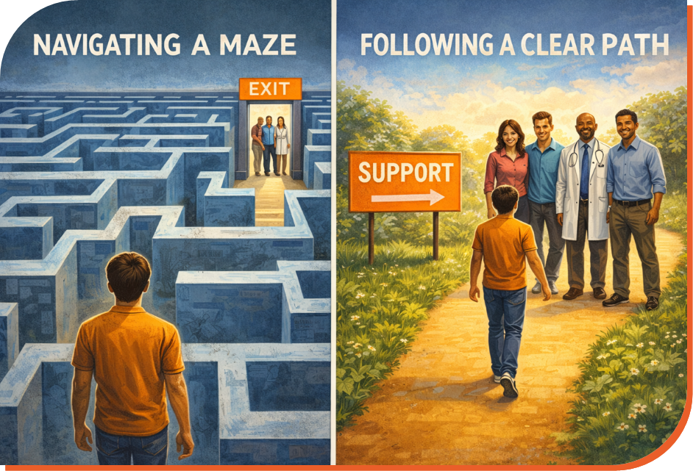
•Person-centered approach
•Support needs drive services
•Diagnosis informs care but does not define support

Slide 10
Looking Beyond Diagnosis:
Understanding the Person
  We look at the whole person, not just their diagnosis — because a label never tells the full story of someone’s strengths, preferences, and experiences.
  We focus on needs, asking what supports, environments, and strategies will help the person thrive, not just what category they “fit” into.
  We prioritize understanding, taking time to learn what matters most to the person, what challenges they face, and what helps them feel safe and successful.

Slide 11
Looking Beyond Diagnosis:
Understanding the Person
  We work together on solutions, partnering with the individual, their family, and their support network to find the right tools, services, and strategies.
  We use diagnosis as one piece of information, but our real goal is helping each person live well, feel supported, and reach their goals — regardless of their diagnosis.

Slide 12

The Old Model
If they say IDD ⟶ Send to DS
If they say MH ⟶ Send to BH
The New Model
Assess the whole person ⟶ Serve them now ⟶
Connect them to the right long-term supports

Slide 13
A Simple Saying
“We serve the person in front of us today, regardless of diagnosis.”
“We don’t send people away — we support them now and connect them to the right services over time.”

Slide 14
A Clear Why
•People were falling through the cracks.
•People waited months for IDD assessments with no support.
•People with MH needs were being missed because they said “I’m here for IDD.”
•People with IDD were being missed because they said “I’m here for MH.”
•Now we stabilize, support, and coordinate immediately, not after diagnosis.

Slide 15
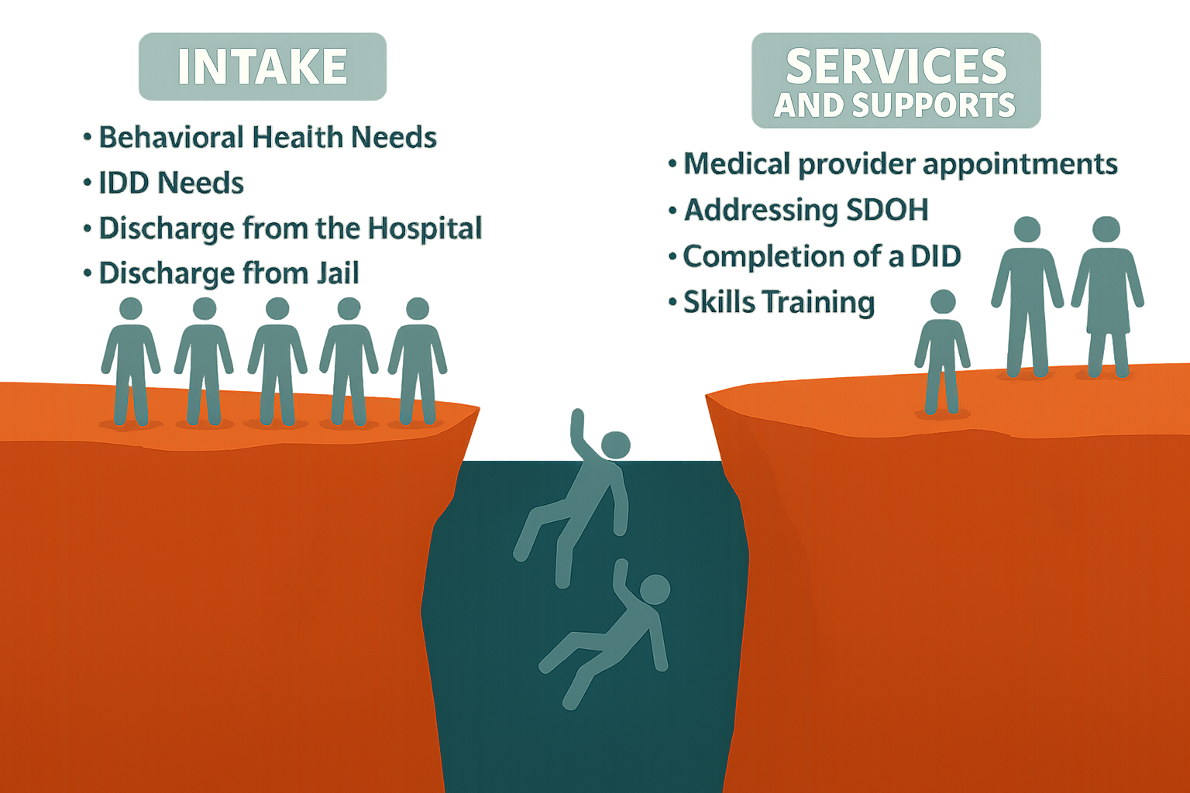

Slide 16
A Simple Rule of Thumb
“If they’re here, they get assessed.
If they’re assessed, they get served.
If they get served, they stay connected.”

Slide 17
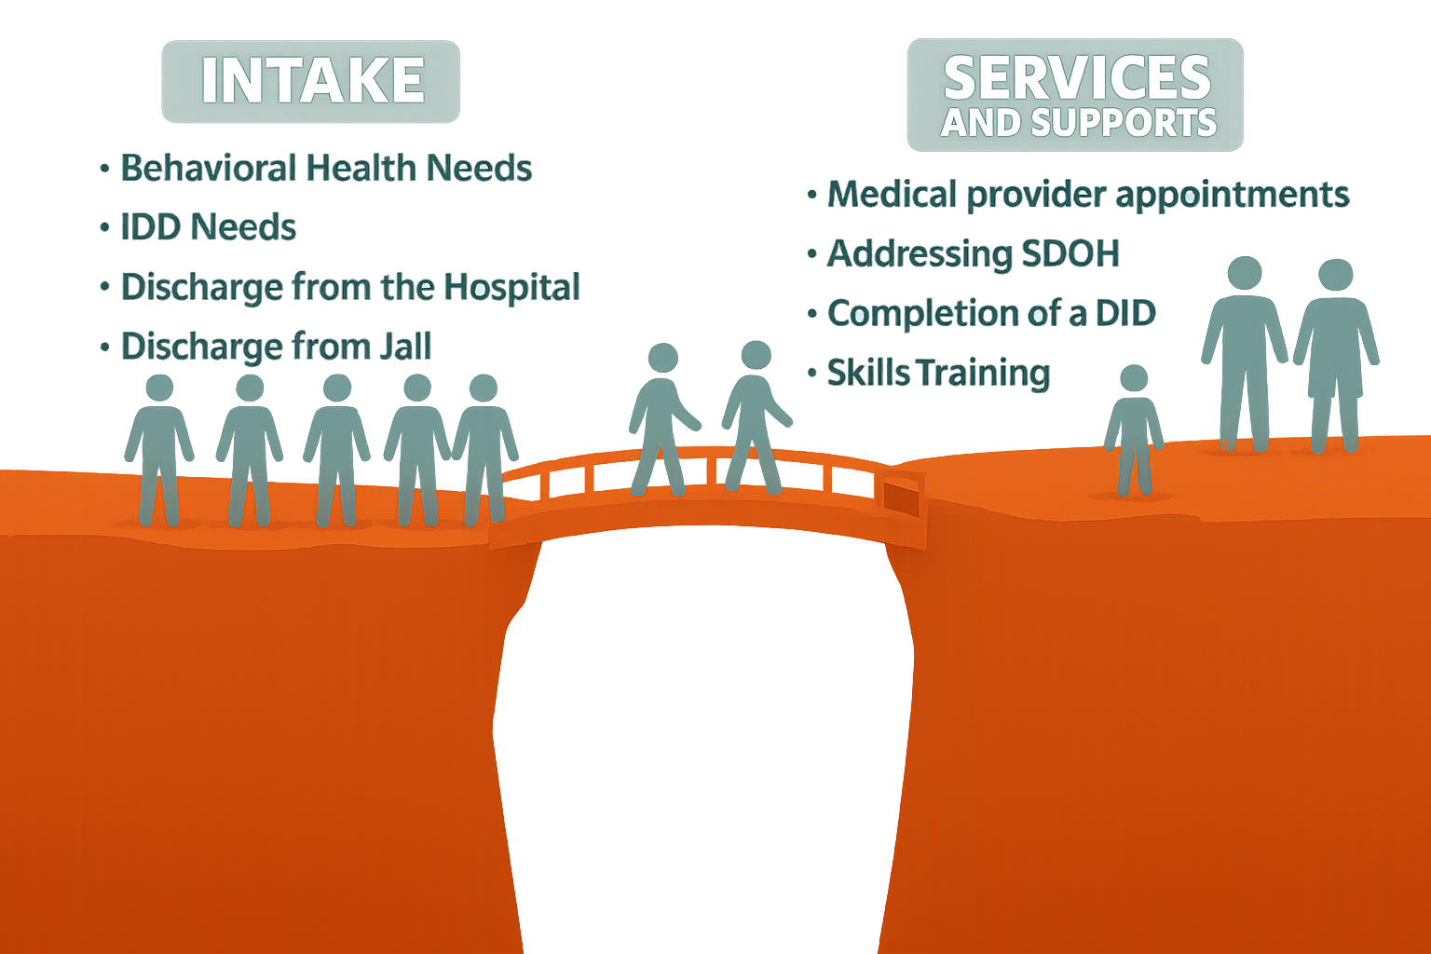
Notes:
Share story of transferring patient from Tyler to Ft Worth to be with her boyfriend.

Slide 18
THE UNIFIED BOARDING GATE
ECI Collaborative Intake
ECI has a well‑established “boarding gate” where the crew works together from the start.

Slide 19
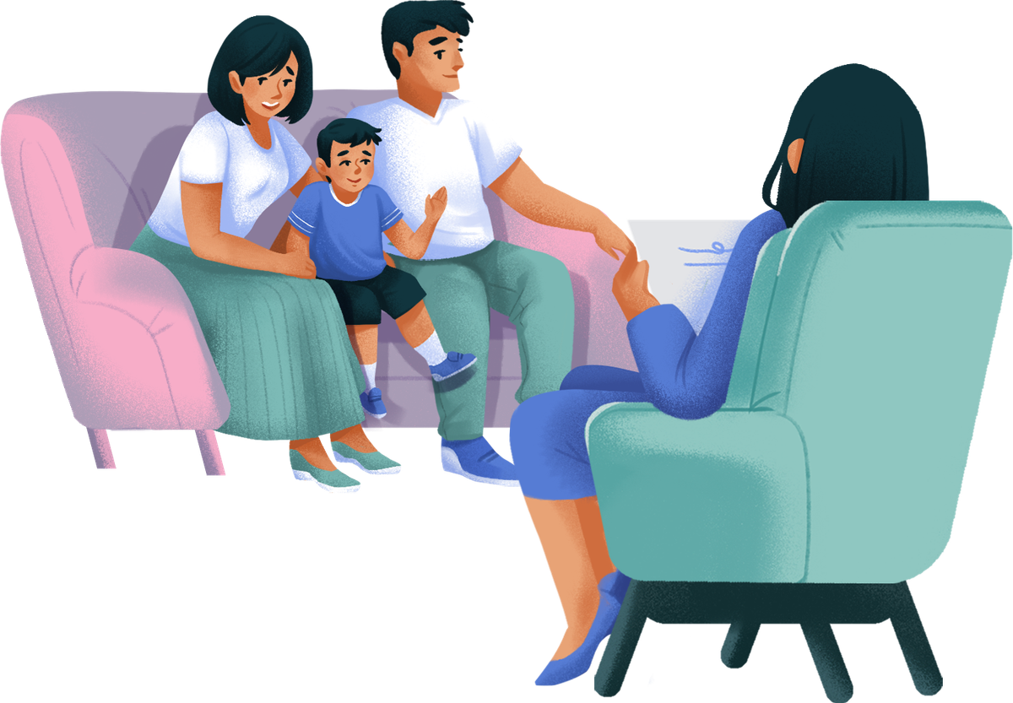
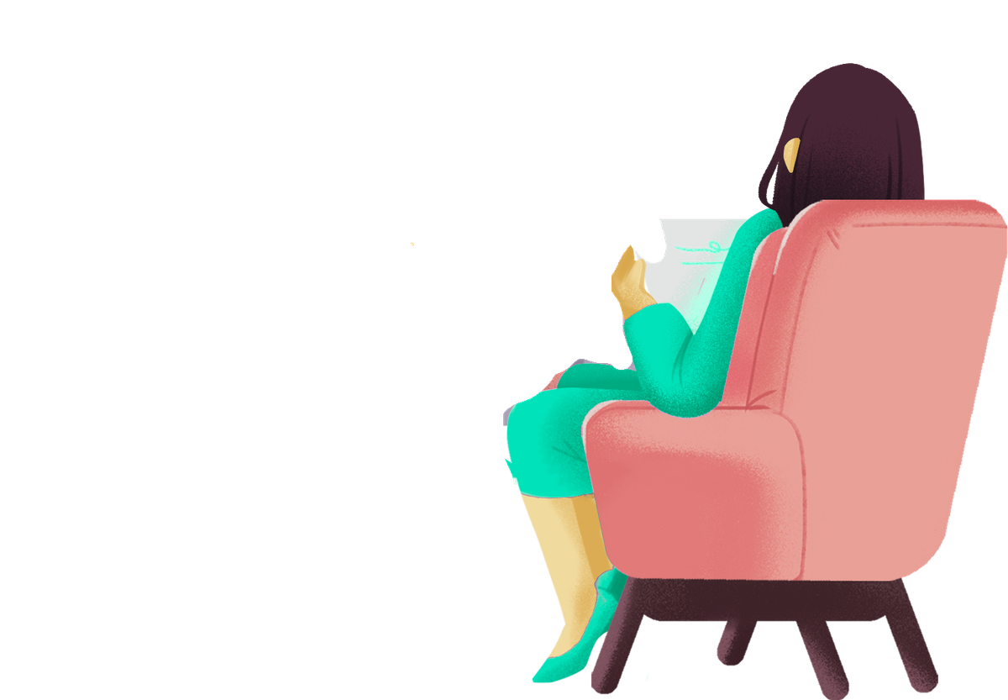
THE UNIFIED BOARDING GATE
ECI Collaborative Intake
We are telling our story once
OT/PT/SLP
Early Intervention Specialist

Slide 20
THE UNIFIED BOARDING GATE
LMHA/LIDDA Intake
LPHA
I’m telling my story once.
Diagnostic Assessment
Back office logistics
DID Referral
QMHP
ANSA/CANS
Screenings
Treatment Plan
Safety Plan

Slide 21
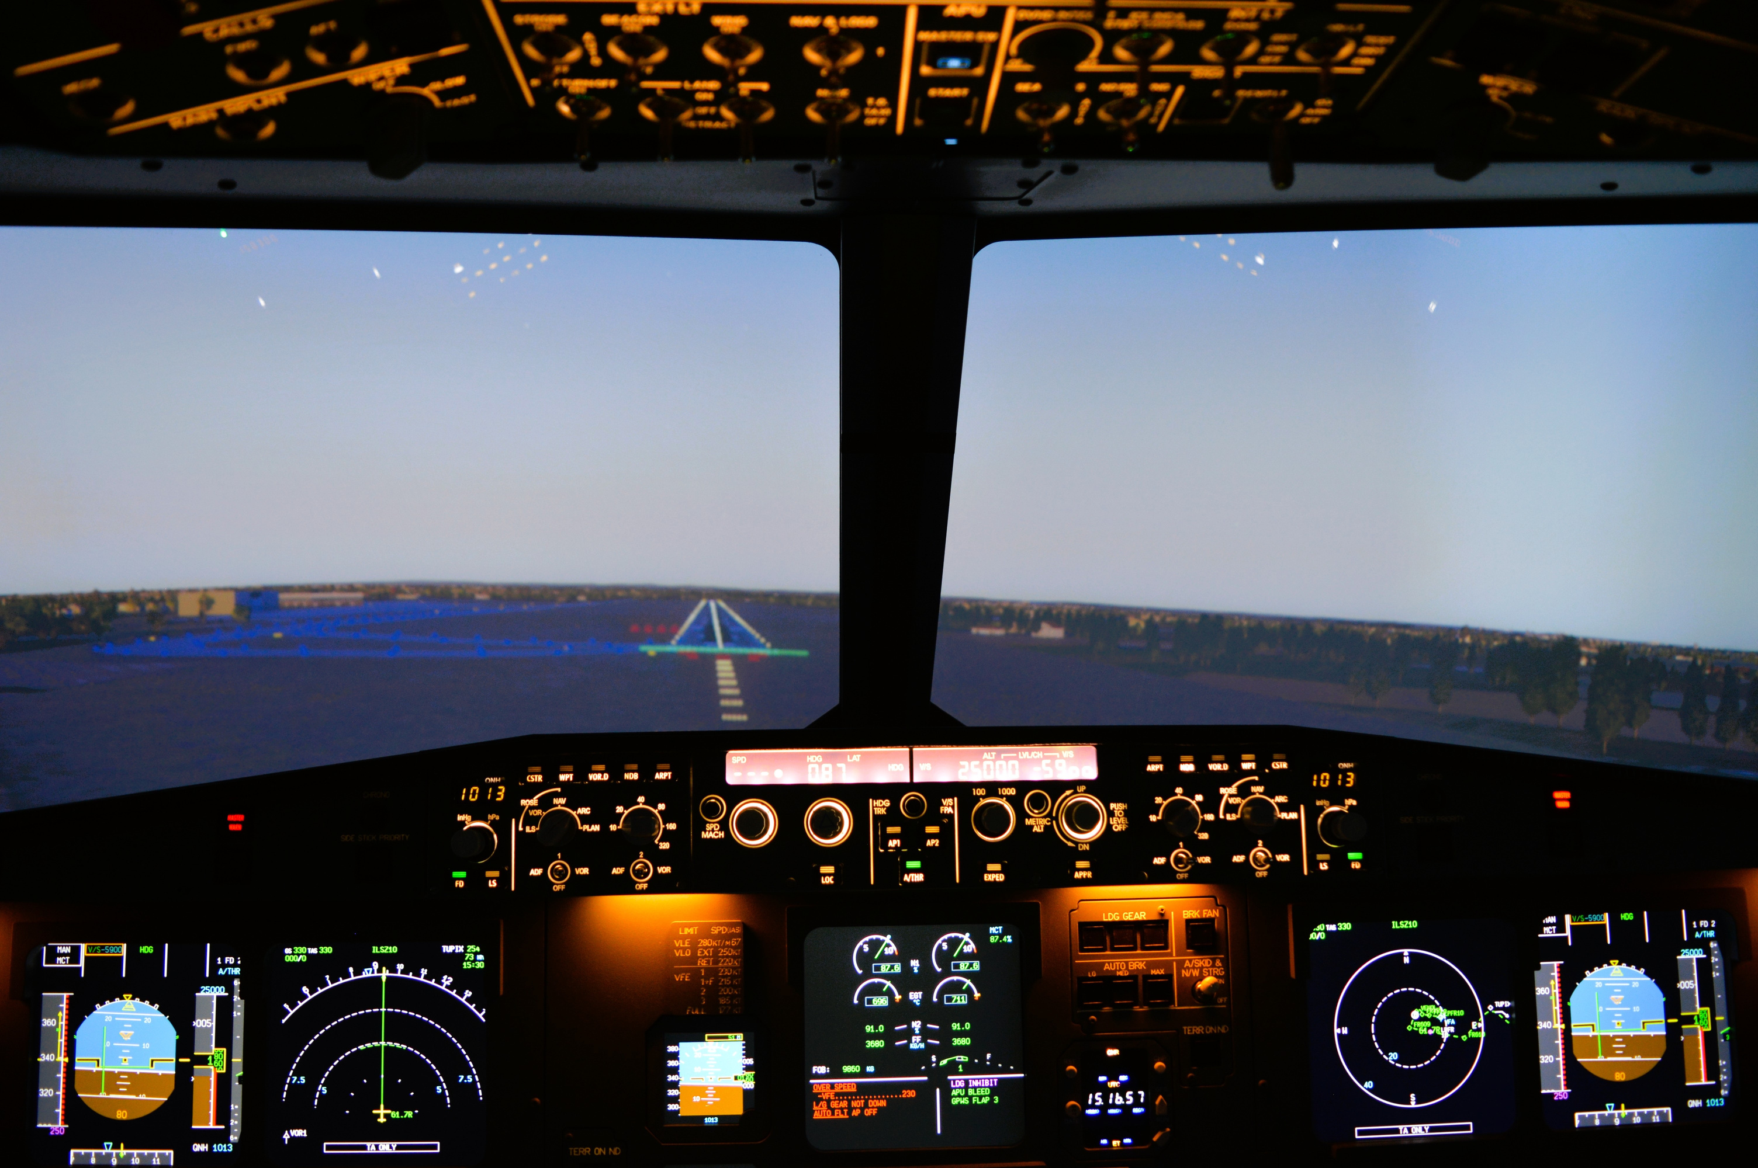

COPILOTS
Primary Provider
Rethinking Treatment Approaches
Notes:
Our treatment team is like a flight crew—each role is different, but we work together to safely guide the patient through their journey to recovery

Slide 22
WHO SHOULD BE THE PRIMARY PROVIDER?
  Personality
  Interests
  Availability of the Patient/Family in conjunction with the Service Provider
  Service Needs
  Strengths
    Knowledge
    Experience
    Expertise
Notes:
Our treatment team is like a flight crew—each role is different, but we work together to safely guide the patient through their journey to recovery

Slide 23
WHAT IS PRIMARY PROVIDER?
  “Homeroom Teacher”
  Provide, arrange, and coordinate services
  A part of a larger team supporting the patient
Notes:
we can note that this is already in place with our LIDDA individuals and a work in progress in LMHA

Slide 24
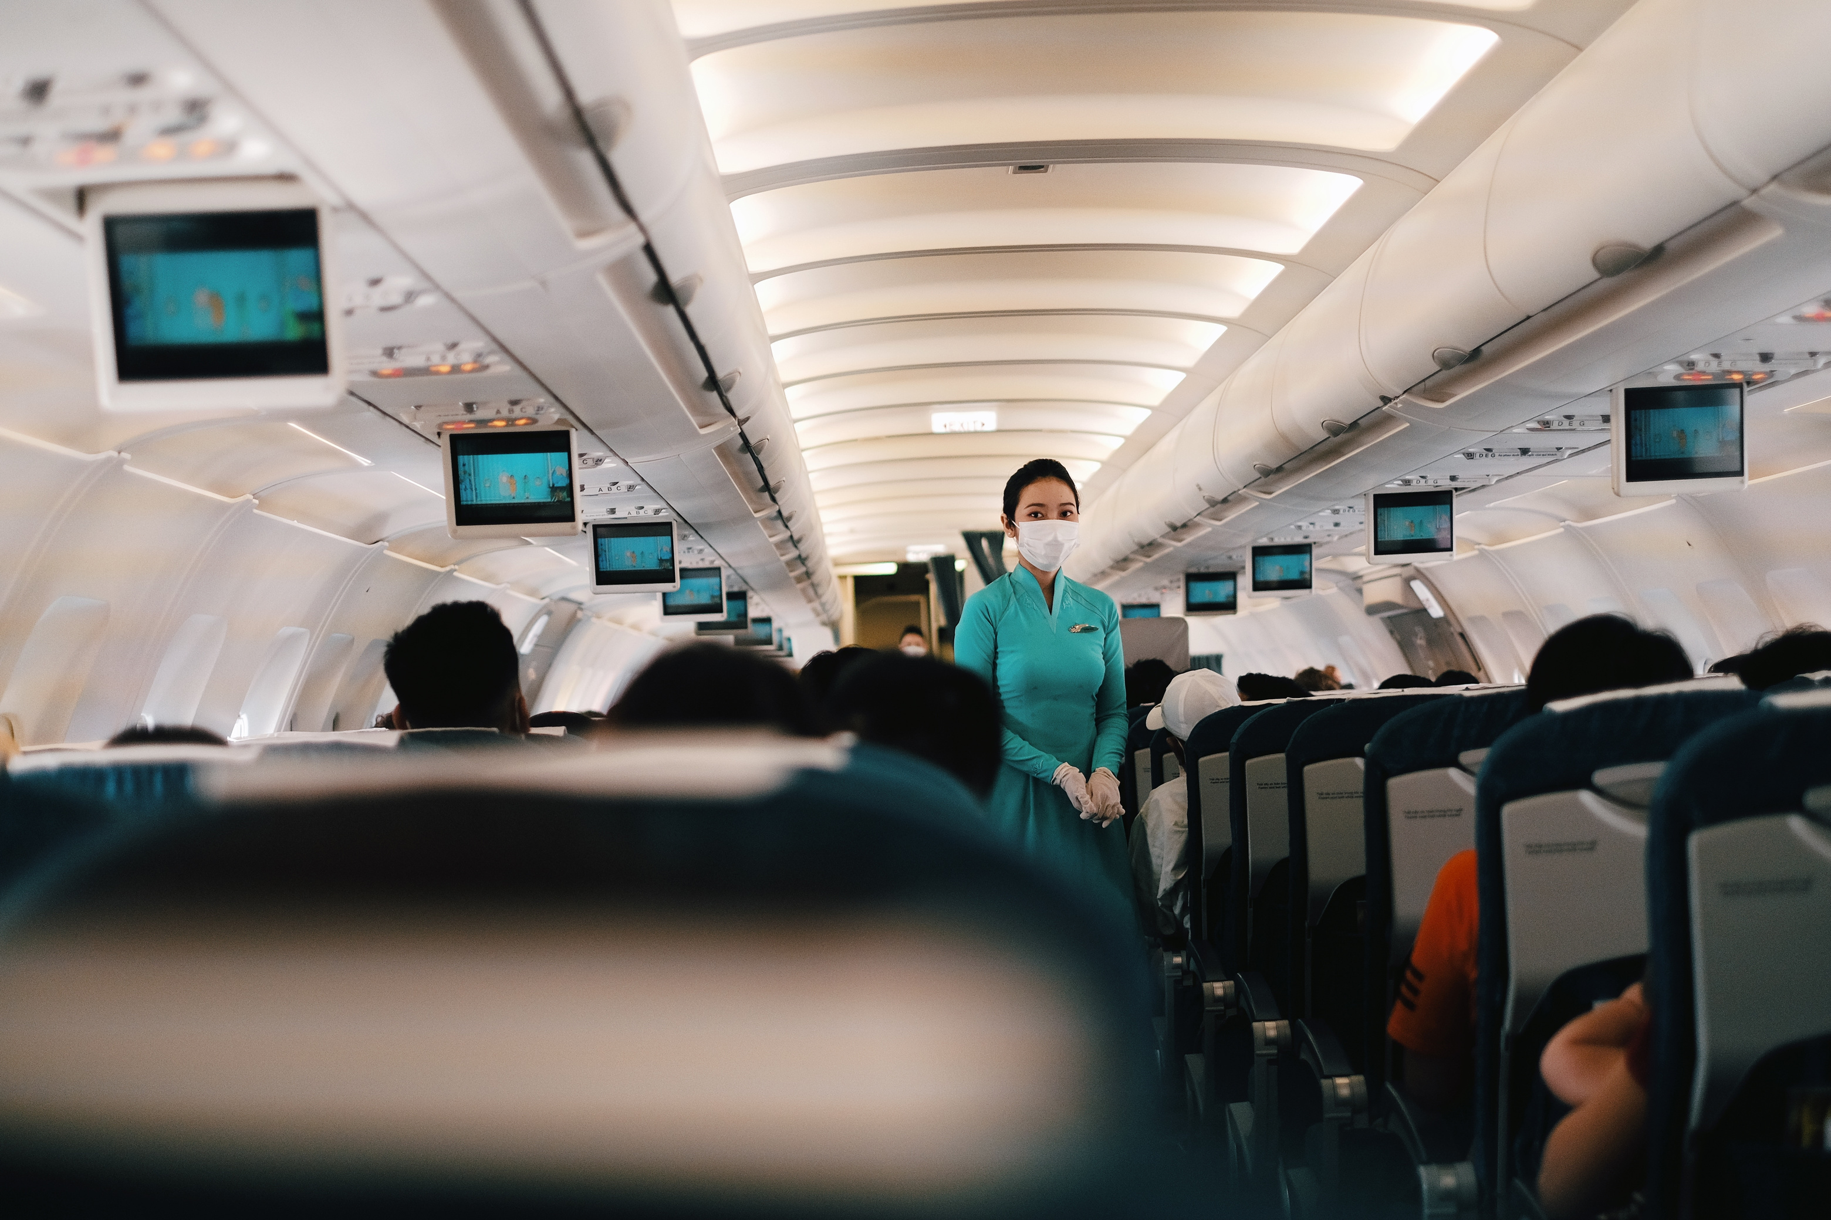
THE FLIGHT CREW
Teaming
Rethinking Treatment Team and Staff Meetings
Notes:
Our treatment team is like a flight crew—each role is different, but we work together to safely guide the patient through their journey to recovery

Slide 25
TEAMING
  Minds coming together to find the right services for new and existing patients
  Figuring out who the right person is to service the patient and their support system
  Helping teammates work through a case when they have done all they know how to do
  Developing an action plan to move forward with the patient and their support system
Notes:
Our treatment team is like a flight crew—each role is different, but we work together to safely guide the patient through their journey to recovery

Slide 26

WHAT YOU BRING TO THE TEAM
  Questions you have about a particular family-if challenging behavior, describe (i.e. support needed around strategies, alternatives, and/or resources
  What you and the parent/caregiver have already tried
  Any pertinent context
Be mindful of what you are bringing to the interaction/situation with a family
i.e. feelings, thoughts, beliefts, experiences, etc.
Notes:
Our treatment team is like a flight crew—each role is different, but we work together to safely guide the patient through their journey to recovery

Slide 27

TEAM’S RESPONSE (USE TEAMING MAP)
  Count to 3: ask at least 3 open-ended questions before providing feedback
  Provide Feedback: team shares where they link family is on the teaming map and other strategies, alternatives, resources
  Determine if a joint visit is apropriate and by whom: schedule and plan
  Re-cap what you will try (new strategies) and/or seek (alternatives, resources, joint visit support) and if family needs to be teamed again to see how new ideas are working or if further teaming is required
Notes:
Our treatment team is like a flight crew—each role is different, but we work together to safely guide the patient through their journey to recovery

Slide 28
Formal Multidisciplinary Case Consultations
Specialty Open Office Hour
Meet with Subject-Matter Expert
Center Team Meeting
Team Lead
Meeting

Slide 29
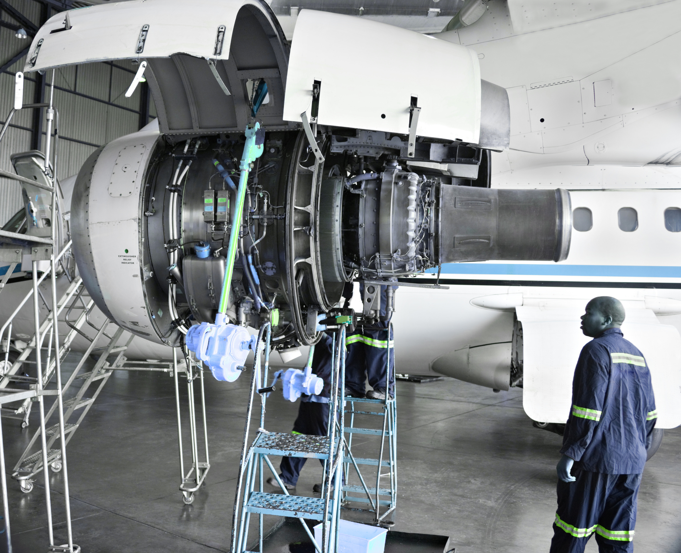
MAINTENANCE CREW
Build for the Future
Rethinking How We Support Staff
Notes:
Our treatment team is like a flight crew—each role is different, but we work together to safely guide the patient through their journey to recovery

Slide 30
MAINTENANCE CREW
  Training
  Mentor Program
  Reflective Supervision
  Coaching
  TBRI
Notes:
Our treatment team is like a flight crew—each role is different, but we work together to safely guide the patient through their journey to recovery

Slide 31

FLIGHT DEBRIEF
What We Learned
The Good, The Bad, and The Ugly of an
Agency Transformation
Notes:
Our treatment team is like a flight crew—each role is different, but we work together to safely guide the patient through their journey to recovery

Slide 32
What Transformation Actually Looked Like
  Organizational disruption with intention.
  Things we did:
    Broke down siloed divisions
    Reorganized teams around population needs instead of diagnoses
    Redesigned intake to start with the person’s story
    Shifted conversations from “Do they qualify?” to “What supports do they need?
    Built cross-disciplinary team
    Centered trauma-informed and person-centered practices
Notes:
Our treatment team is like a flight crew—each role is different, but we work together to safely guide the patient through their journey to recovery

Slide 33

Lessons Learned
  Broken Pieces and Gaps
    Missed reimbursement opportunities
    Mutual work unknown
      Revenue
      EHR usage
      Approaches to training
  Trauma-wise language
  Teaming-cross teaming
  Fear of working with a different populations
Notes:
Our treatment team is like a flight crew—each role is different, but we work together to safely guide the patient through their journey to recovery

Slide 34

Transformation requires:
  Leadership courage
  Staff collaboration
  Willingness to challenge old structures
  Commitment to the people we serve
This required culture change, not just structural change.
Notes:
Our treatment team is like a flight crew—each role is different, but we work together to safely guide the patient through their journey to recovery

Slide 35

3 Responses to
Organizational Transformation
Notes:
Our treatment team is like a flight crew—each role is different, but we work together to safely guide the patient through their journey to recovery

Slide 36

Jumping Ship
Some people chose to leave.
Reasons often included:
  discomfort with uncertainty
  strong identification with old roles
  fear of losing expertise/status
  resistance to changing long-standing systems
This is normal in major transformation.
Notes:
Our treatment team is like a flight crew—each role is different, but we work together to safely guide the patient through their journey to recovery

Slide 37
On the Sidelines
Some people stayed but watched.
They were:
  cautious
  unsure if the change would stick
  waiting to see outcomes
  protecting themselves from risk
These individuals were not resistant —
they were uncertain.
Notes:
Our treatment team is like a flight crew—each role is different, but we work together to safely guide the patient through their journey to recovery

Slide 38
Actively Involved
  People who leaned into the transformation
  Helped shape the new culture and systems
  Helped build the new system
  Became champions of the change
These people were critical to success.
Notes:
Our treatment team is like a flight crew—each role is different, but we work together to safely guide the patient through their journey to recovery

Slide 39

Collaborators
  They focused on the mission
  They kept asking:
    “How does this help the people we serve?”
  They embraced learning
  They said things like:
    “I don’t know yet.”
    “Let’s figure it out.”
    “What can we try?”
Notes:
Our treatment team is like a flight crew—each role is different, but we work together to safely guide the patient through their journey to recovery

Slide 40
Collaborators
  They worked across silos
  They collaborated with:
    mental health staff
    IDD specialists
    case managers
    clinicians
    community partners
Notes:
Our treatment team is like a flight crew—each role is different, but we work together to safely guide the patient through their journey to recovery

Slide 41
Collaborators
  They redesigned processes
  They helped rethink:
    intake
    service planning
    care coordination
    eligibility conversations
    referrals
  They listened to people served
  They brought voices of patients and families into decisions.
Notes:
Our treatment team is like a flight crew—each role is different, but we work together to safely guide the patient through their journey to recovery

Slide 42
Collaborators
  They tolerated ambiguity
  Transformation means:
    unclear paths
    iteration
    experimentation
  Collaborators stayed engaged even when things weren't perfect.
Notes:
Our treatment team is like a flight crew—each role is different, but we work together to safely guide the patient through their journey to recovery

Slide 43
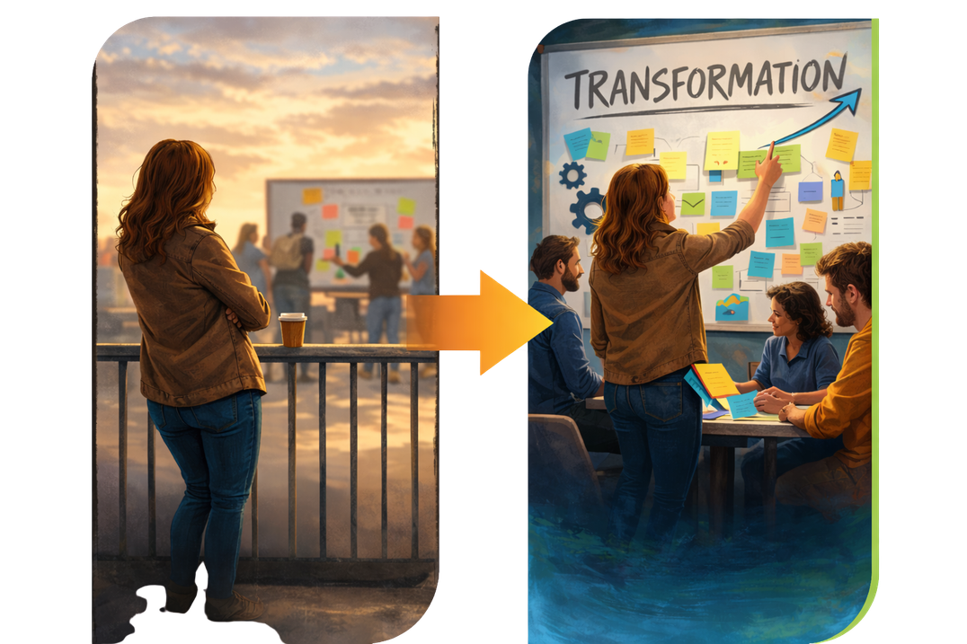
How to Move People Off the Sidelines
People move from the sidelines when they feel:
Safe
  Psychological safety matters.
  Leaders should communicate:
    change is happening
    mistakes are part of learning
    voices are valued
Notes:
Our treatment team is like a flight crew—each role is different, but we work together to safely guide the patient through their journey to recovery

Slide 44
How to Move People Off the Sidelines
People move from the sidelines when they feel:
Included
  Invite people into the process.
  Examples:
    workgroups
    design sessions
    feedback loops
    pilot teams
Heard
  When people see their input reflected in decisions, engagement increases.
Notes:
Our treatment team is like a flight crew—each role is different, but we work together to safely guide the patient through their journey to recovery

Slide 45
How to Move People Off the Sidelines
People move from the sidelines when they feel:
Supported
  Provide:
    training
    mentorship
    clear expectations
    transition support
Connected to Purpose
  People engage when they see how transformation helps the people served.
Notes:
Our treatment team is like a flight crew—each role is different, but we work together to safely guide the patient through their journey to recovery

Slide 46

How to Prevent People From Jumping Ship
Helpful Strategies Include
Clear communication
Explain:
    why change is happening
    what the vision is
    what success looks like
Acknowledge grief
Major change means people lose:
    familiar roles
    identity
    expertise structures
Not everyone will stay, but leadership can reduce unnecessary loss.
Notes:
Our treatment team is like a flight crew—each role is different, but we work together to safely guide the patient through their journey to recovery

Slide 47
How to Prevent People From Jumping Ship
Helpful Strategies Include
Provide pathways
Help staff understand:
    where they fit in the new model
    how their expertise still matters
Celebrate progress
Highlight:
    small wins
    staff contributions
    patient impact
Not everyone will stay, but leadership can reduce unnecessary loss.
Notes:
Our treatment team is like a flight crew—each role is different, but we work together to safely guide the patient through their journey to recovery

Slide 48

Person-Centered, Trauma-Informed Transformation
Transformation should mirror the values we want in services.
Meaning:
Person-centered leadership
  Leadership listens and collaborates.
Notes:
Our treatment team is like a flight crew—each role is different, but we work together to safely guide the patient through their journey to recovery

Slide 49
Person-Centered, Trauma-Informed Transformation
Transformation should mirror the values we want in services.
Meaning:
Trauma-informed culture
  Recognize that:
    Change can trigger:
    uncertainty
    loss of control
    stress
  So we prioritize:
    transparency
    predictability
    compassion
Notes:
Our treatment team is like a flight crew—each role is different, but we work together to safely guide the patient through their journey to recovery

Slide 50

Transformation Isn’t Just Structural-
It’s Cultural
The shift is from:
Programs built around diagnosis
to
systems built around people, needs, and supports.
Notes:
Our treatment team is like a flight crew—each role is different, but we work together to safely guide the patient through their journey to recovery

Slide 51
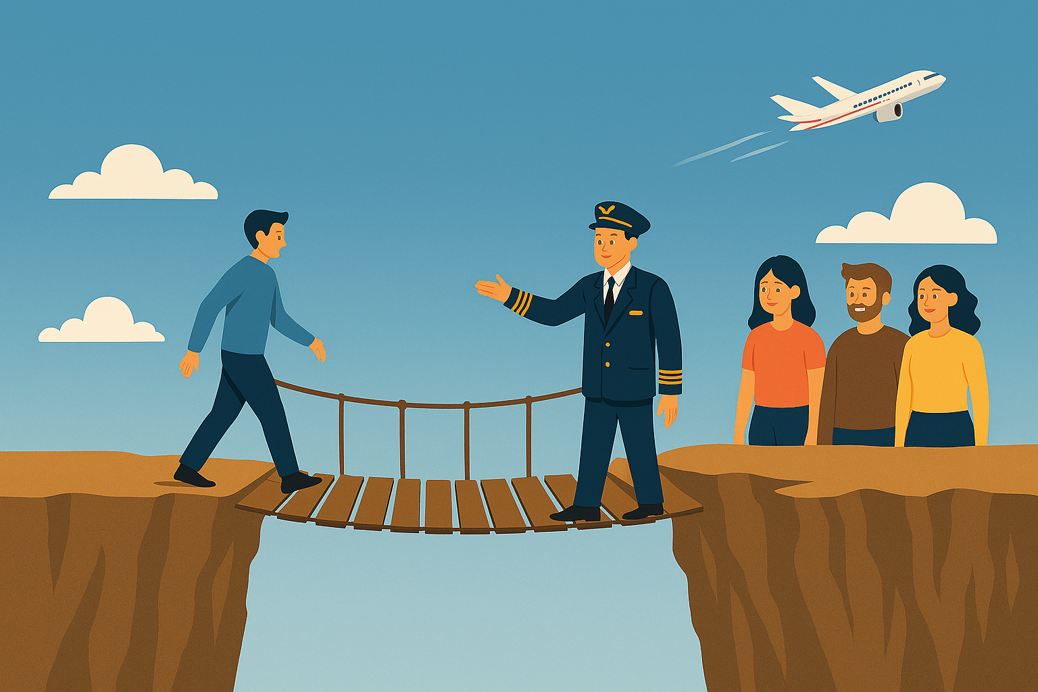
The goal was never to change departments...
it was to change lives.

Slide 52
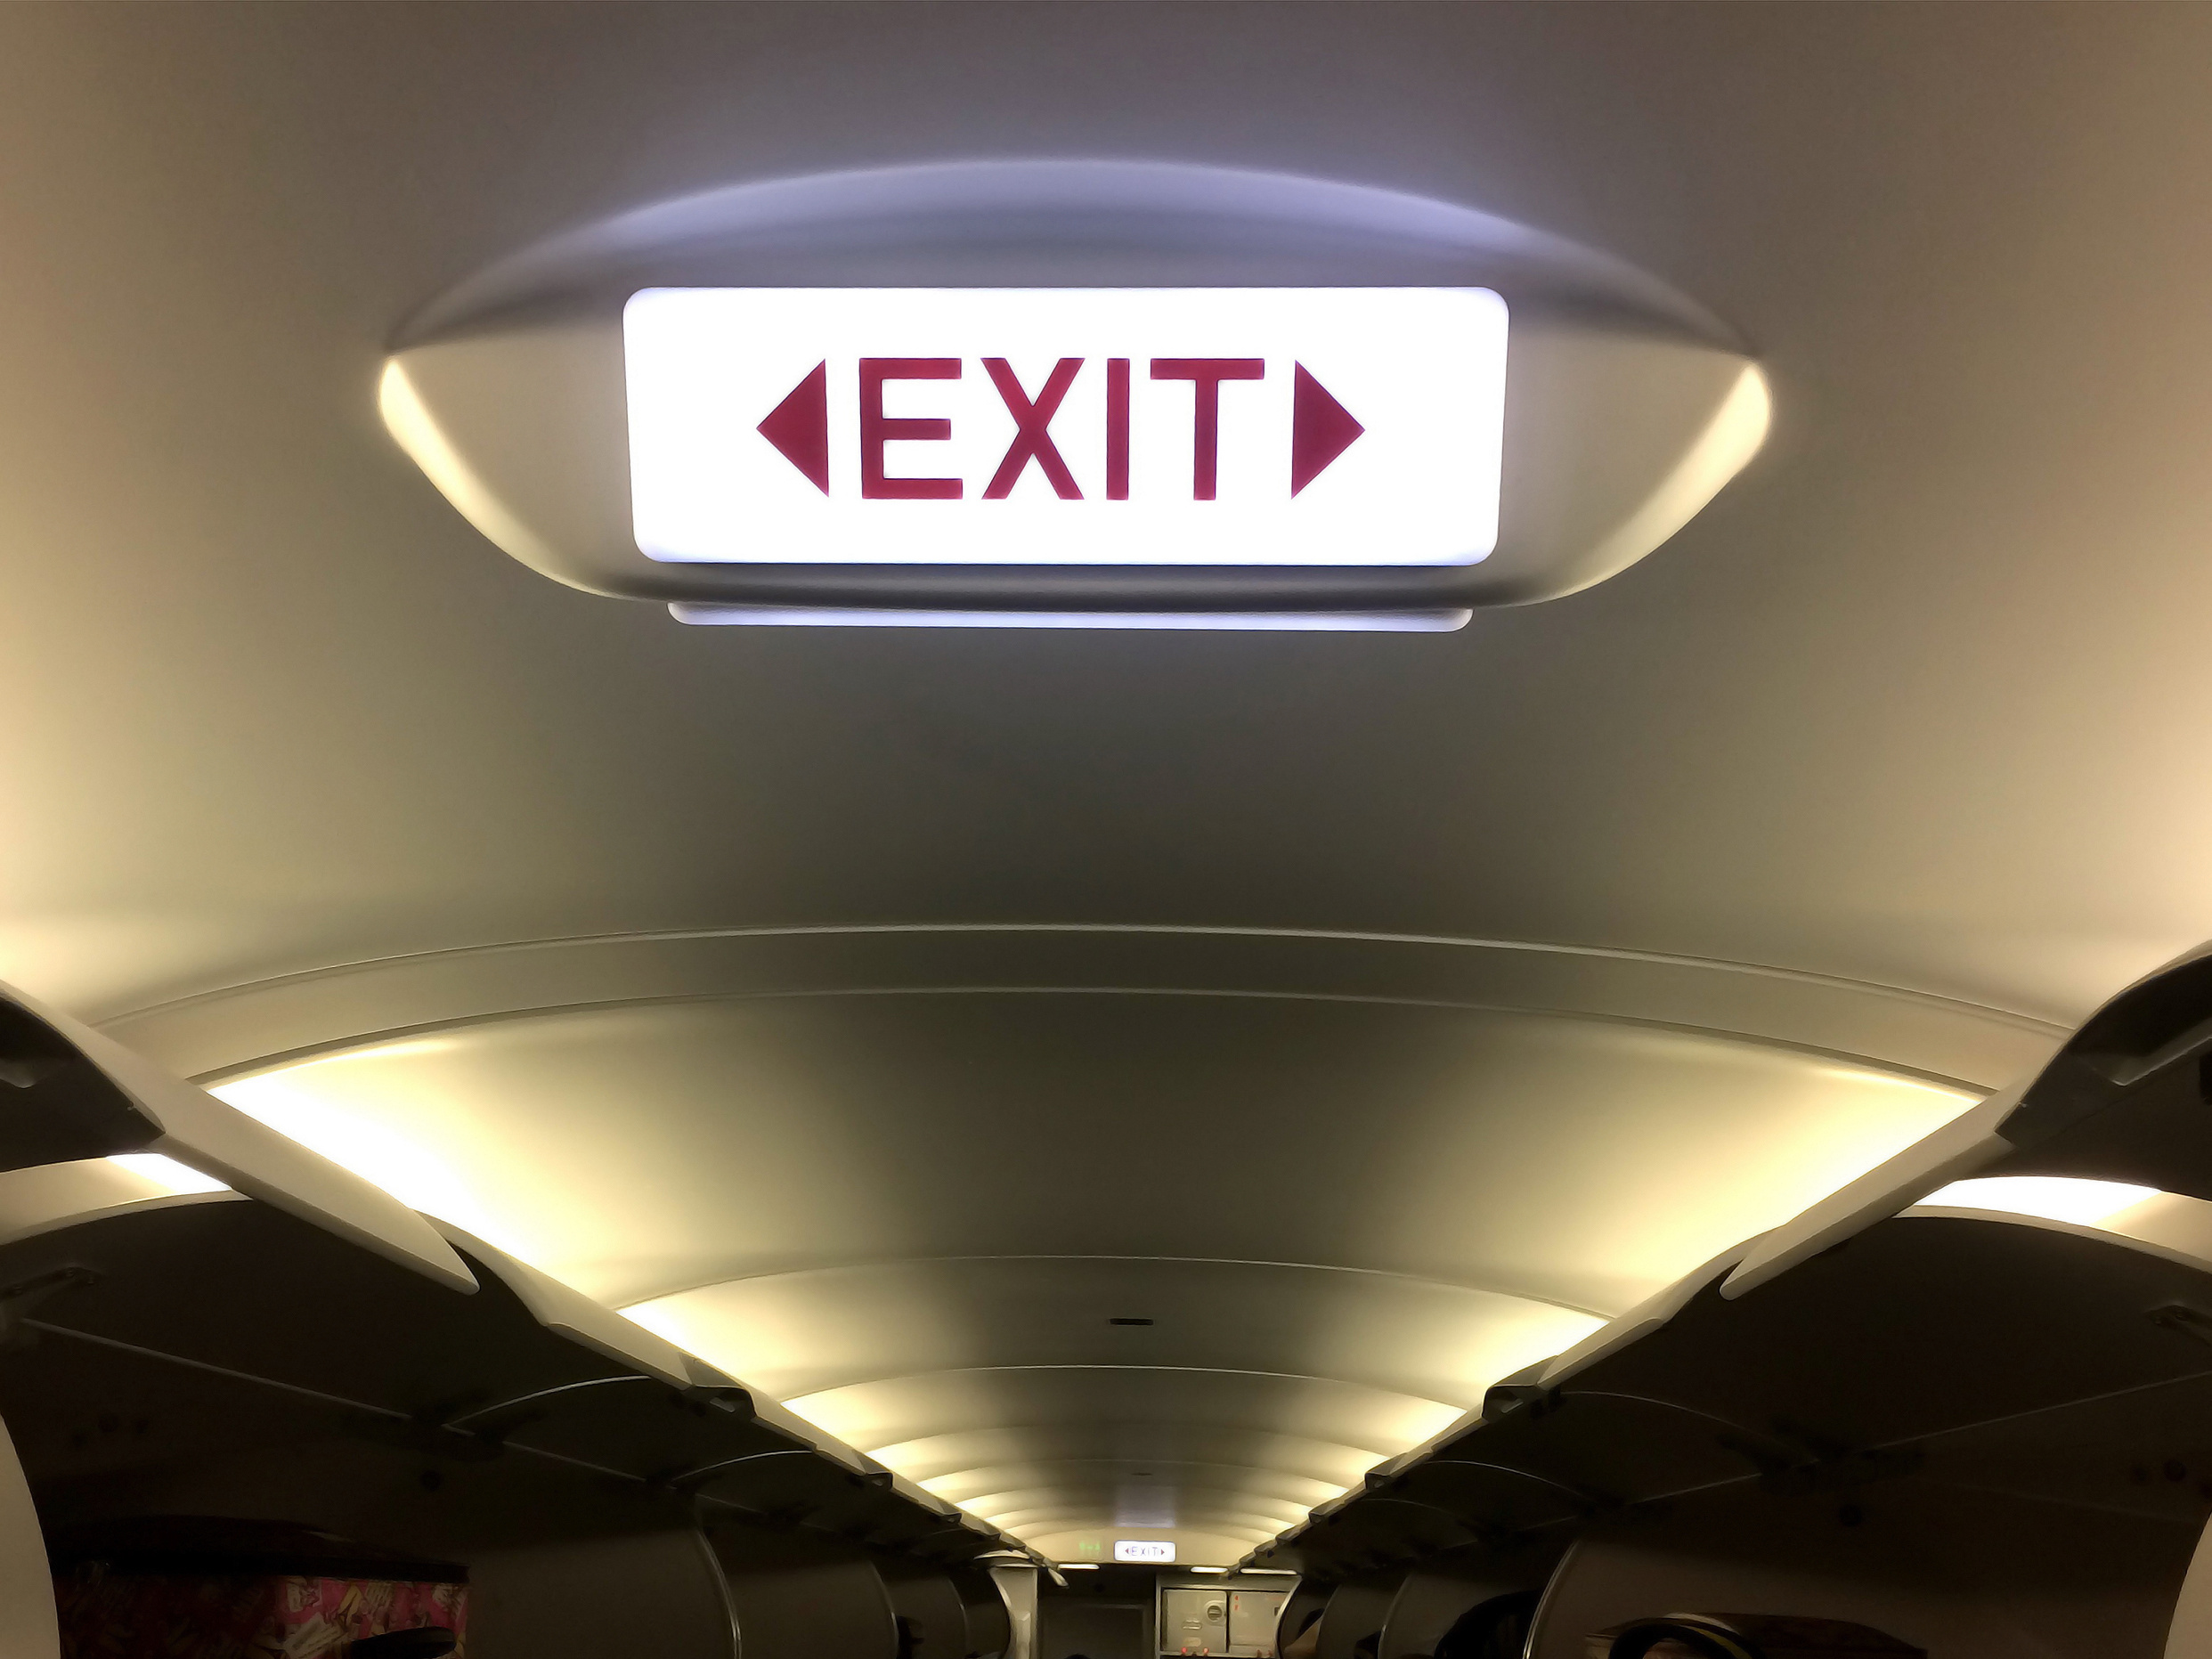

Slide 53



Questions?
For more information on any of our services, visit:
www.MHMRtarrant.org
Facebook.com/MHMRtarrant

